Slide 1
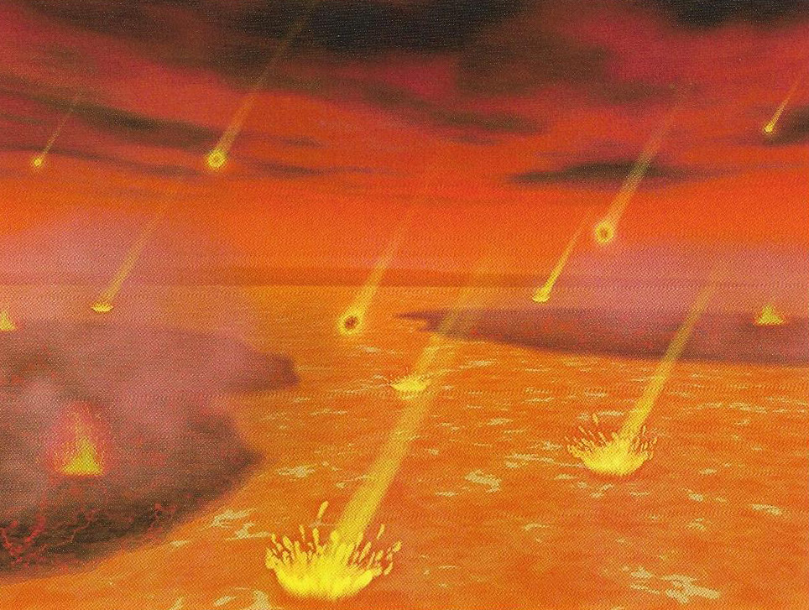
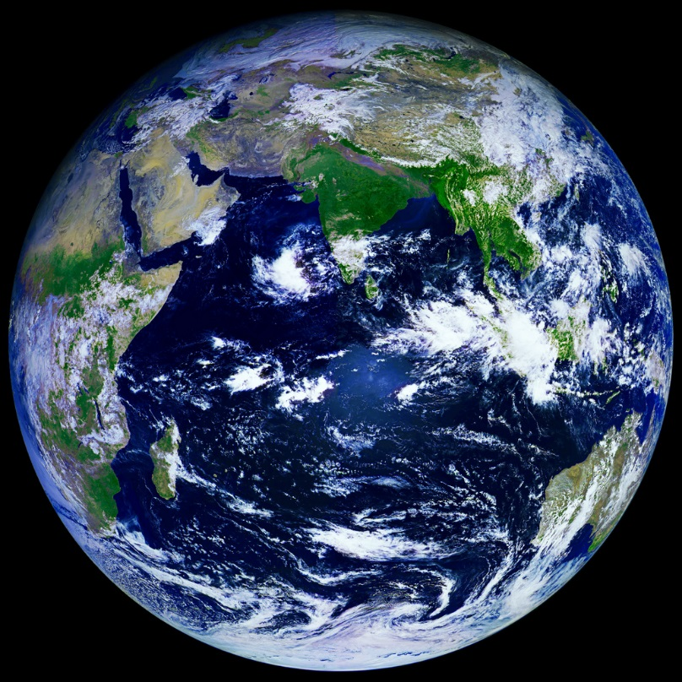
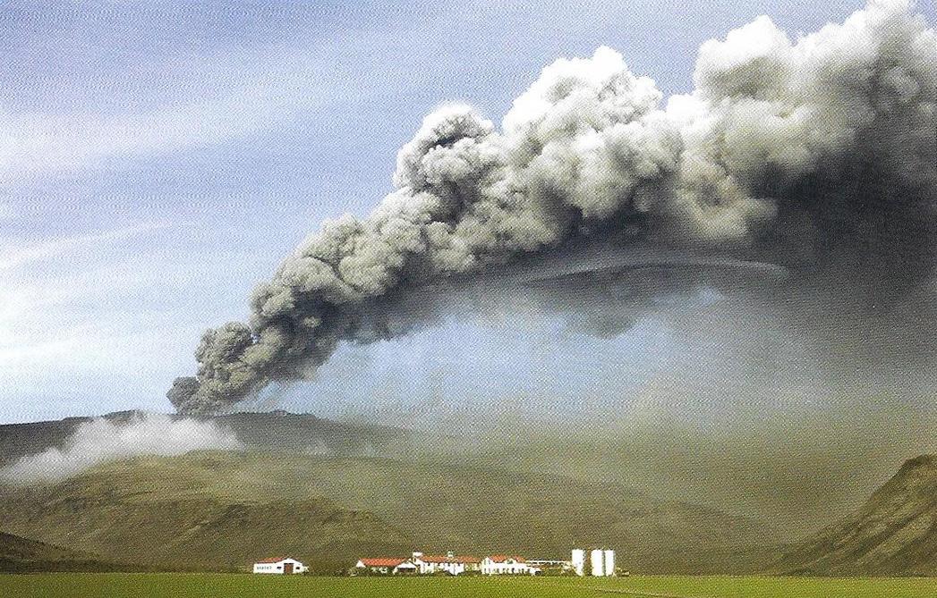
Evolution of the Earth 13.7 Billion Years in the Making
PART 2: Hadian Era and Archean Era
Dr. Gregg Wilkerson
Earth Science
Bakersfield City College

Slide 3
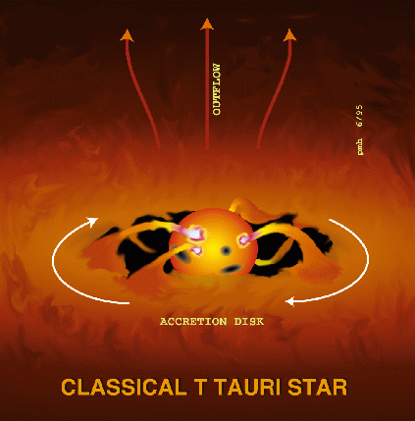
4.6 Billion years ago (9.1 billion years after the Big Bang)
Solar Nebula condenses
Protosun forms
“T Tauri” phase
Planitesimals form

Slide 4
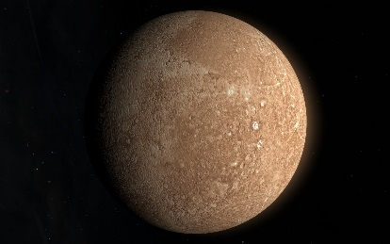
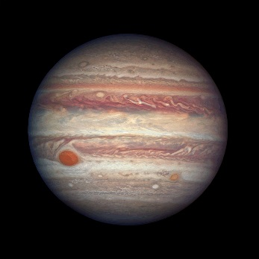
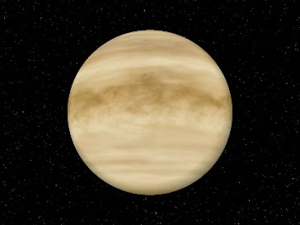
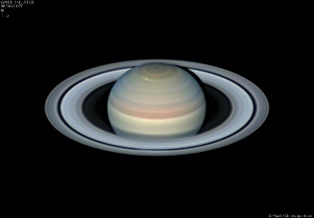
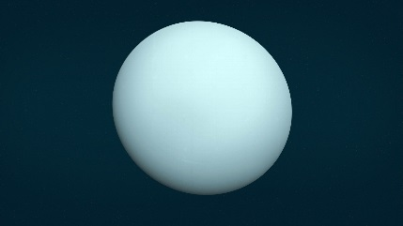
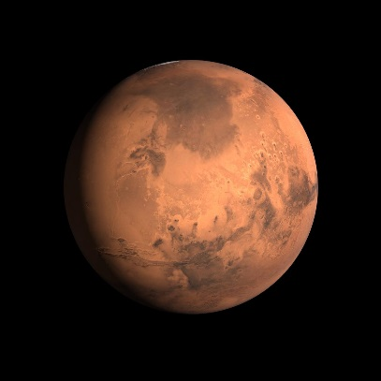
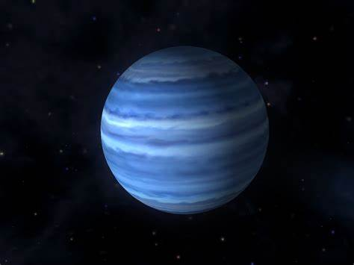
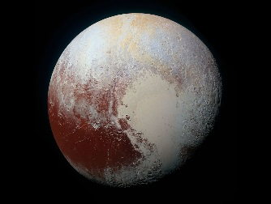
Planetesimals
Rocky Inner Planets
Rocky outer Planets
-Mercury
-Venus
-Earth
-Mars
Jupiter
Saturn
Uranus
Neptune
(Pluto)

Slide 5
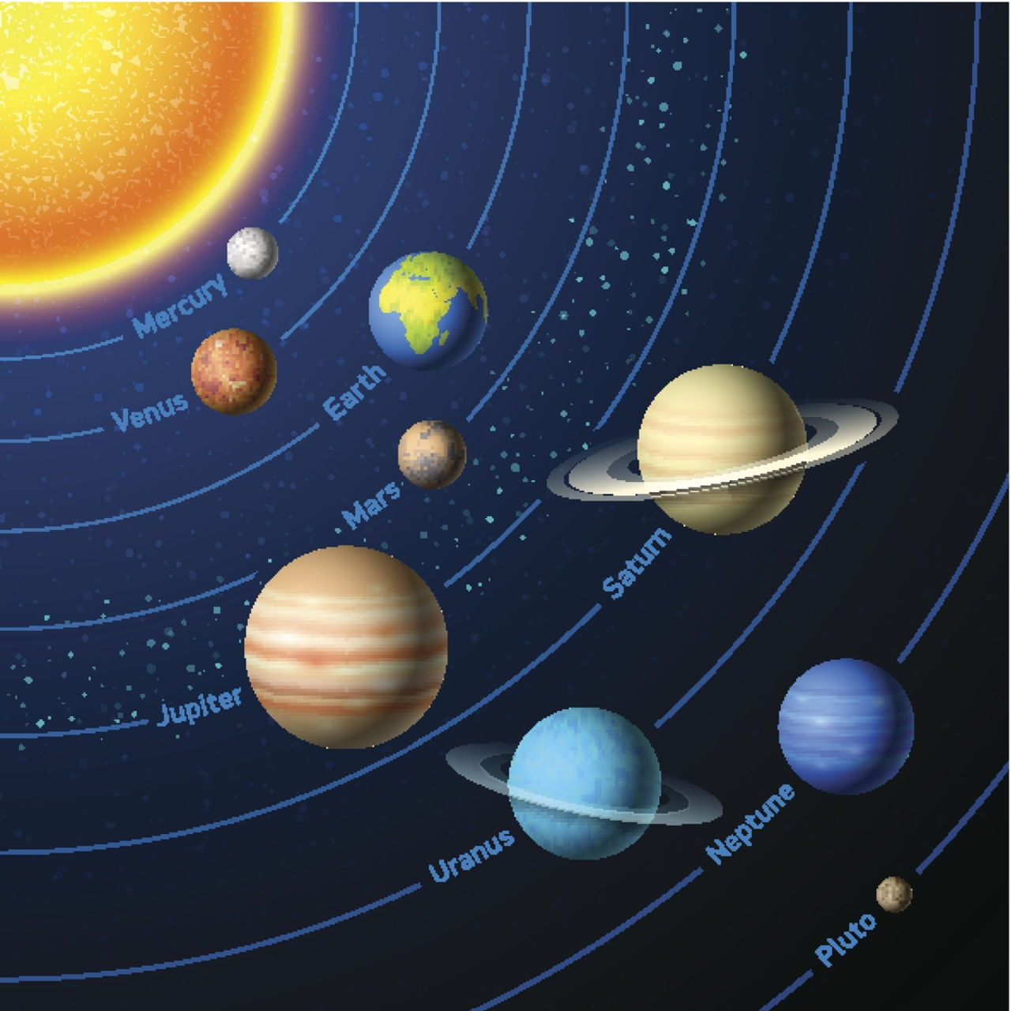

Slide 6
From Protoplanets to Planets
Growth by accretion
8 protoplanets and moons
Asteroid belt is remnant of failed protoplanet
Asteroid belt Video

Slide 8
Goldilocks Planet
Not to hot, not to cold
Gravity just right:
--Not to not big to retain ammonia, methane and other poisonous gases
--Not to small to loose water and other volatiles needed for life would escape
Ridgid Geologic Plates: Permits creation of land masses: Not all ocean

Slide 9
Goldilocks Planet
If 10% closer to the Sun, too hot like Venus, no life
If 10% further away from Son, to cold like Mars, frozen over oceans, and no life
Near a modest size stare: long lifespan
Position in the Milky Way: on periphery, not too much cosmic radiation to kill off all life,
Just the right atmosphere
Meteorite Impact and Age of Mammals

Slide 10
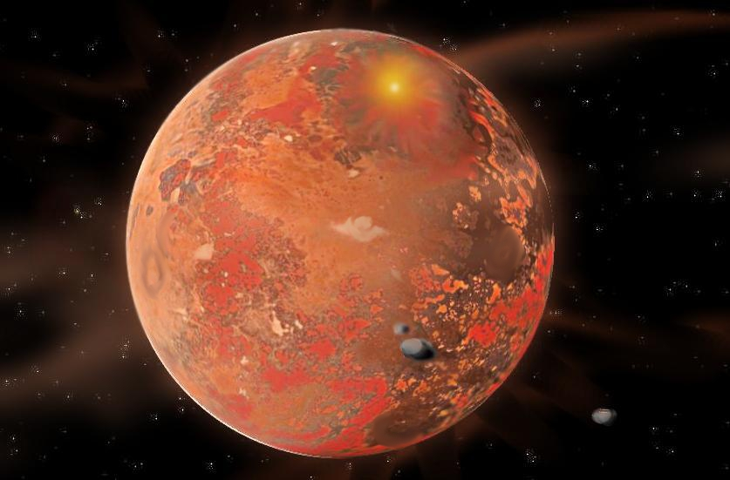
Accretion Period: Hadean Era, molten earth

Slide 11
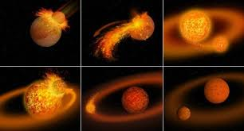
Creation of the Moon
Impact from Mars-Size proto-planet
Video

Slide 13
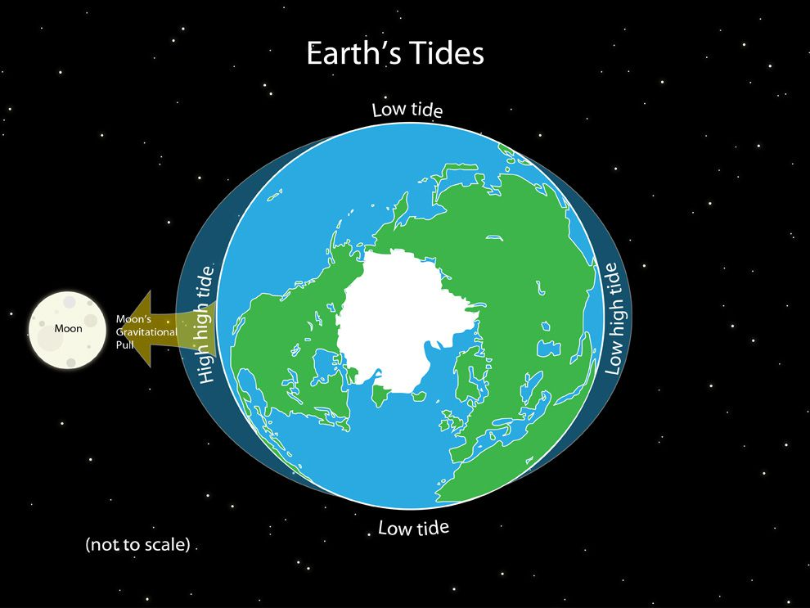
Because of the Moon we have
Tides
Ocean circulation
Aren’t we lucky!

Slide 14
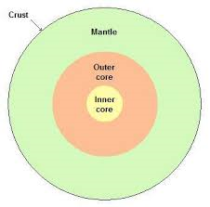
Planetary Differentiation: 4.5 Billion Years
Iron-Nickle Core
Mantle
Primitive Crust

Slide 15
Formation of Continents

Slide 16
Formation of Continents: Accretion

Slide 17
Outgassing and formation of the Atmosphere
No atmosphere: No greenhouse
No greenhouse = frozen oceans
Frozen oceans = no life
Hydrogen
Helium
Methane
Ammonia, Sulfur Dioxide
Carbon Dioxide, Water

Slide 18
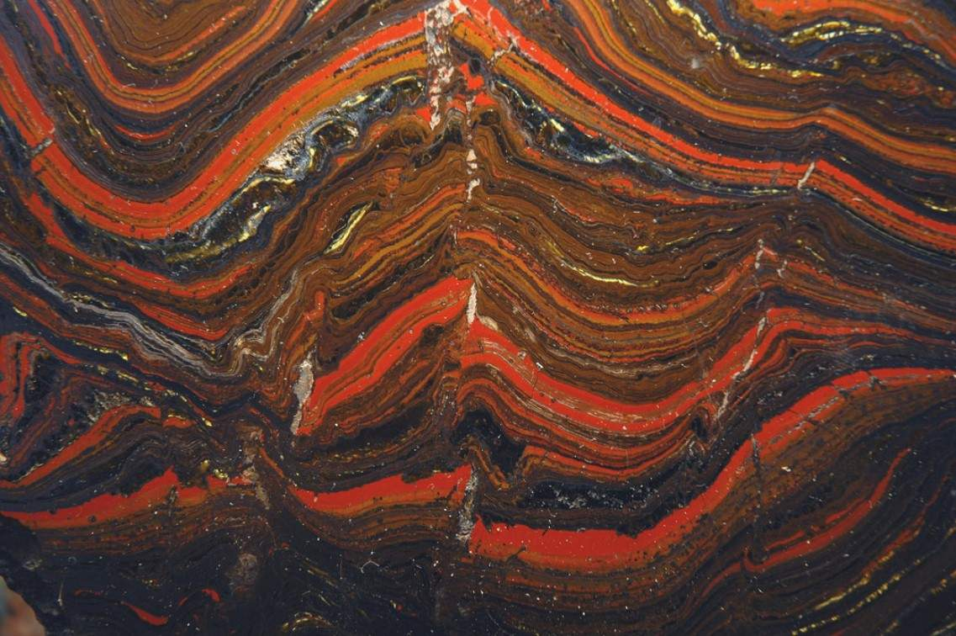
Original Atmosphere was Poisonous and Reducing: 4.5 to 3.5 Billion Years
Banded Iron Formations

Slide 19
BIF: Only in old PreCambrian Rocks

Slide 20
Precambrian Clastic Uranium in Place Gold Deposits: Whitwaterstrand

Slide 21
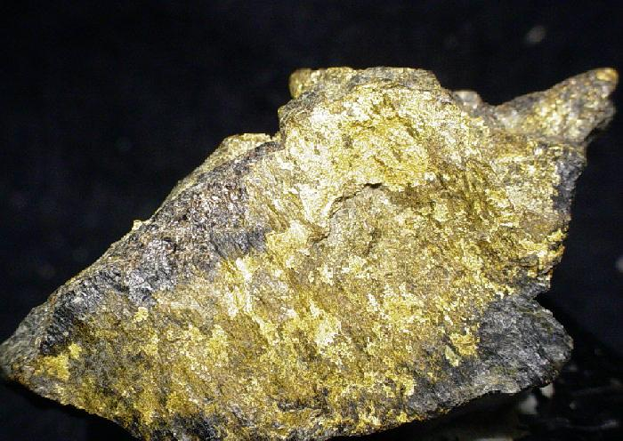

Slide 22
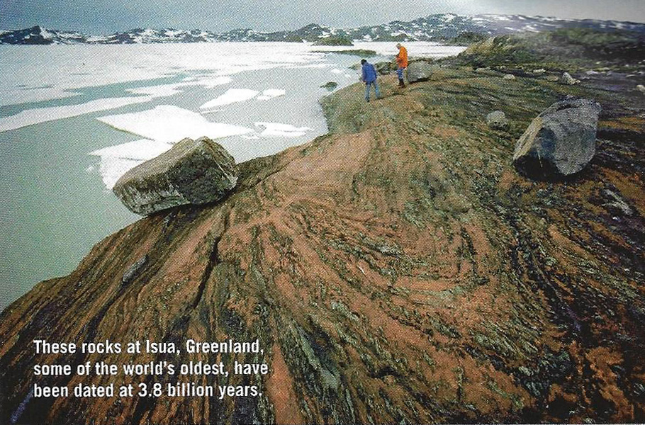
Evolution of Oceans: 4.0 Billion years ago
90% of current ocean volume in Precambrian basins
Rain was acidic (H₂SO₄)
Rapid chemical erosion
Sediments and Sedimentary Rocks
Isua Volcanics: 3.8 b.y.

Slide 23
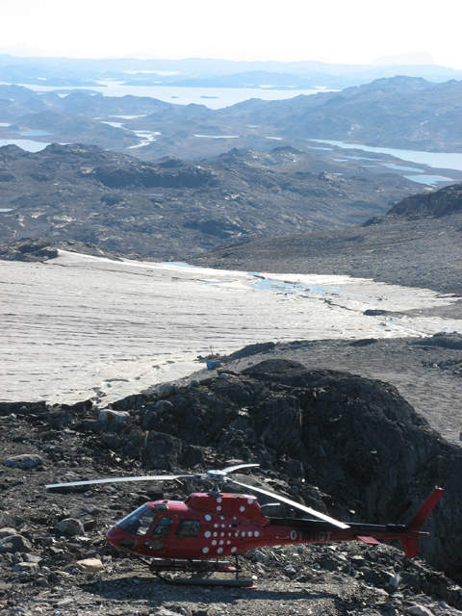
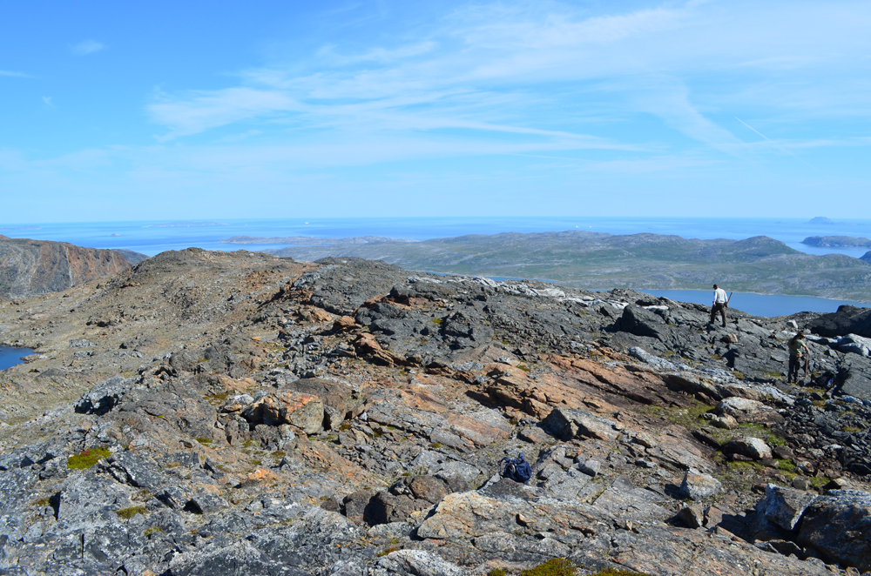

Slide 24
Isua Volcanics Geology

Slide 26
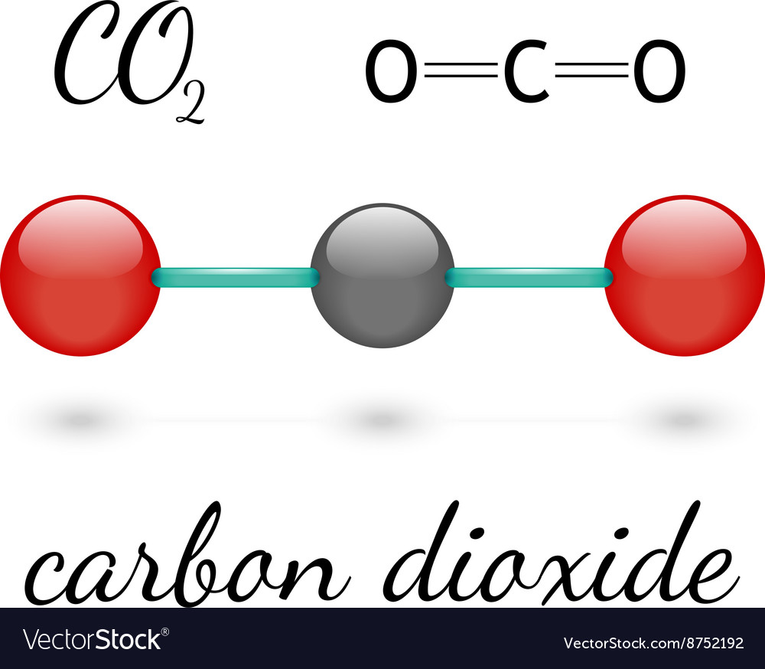
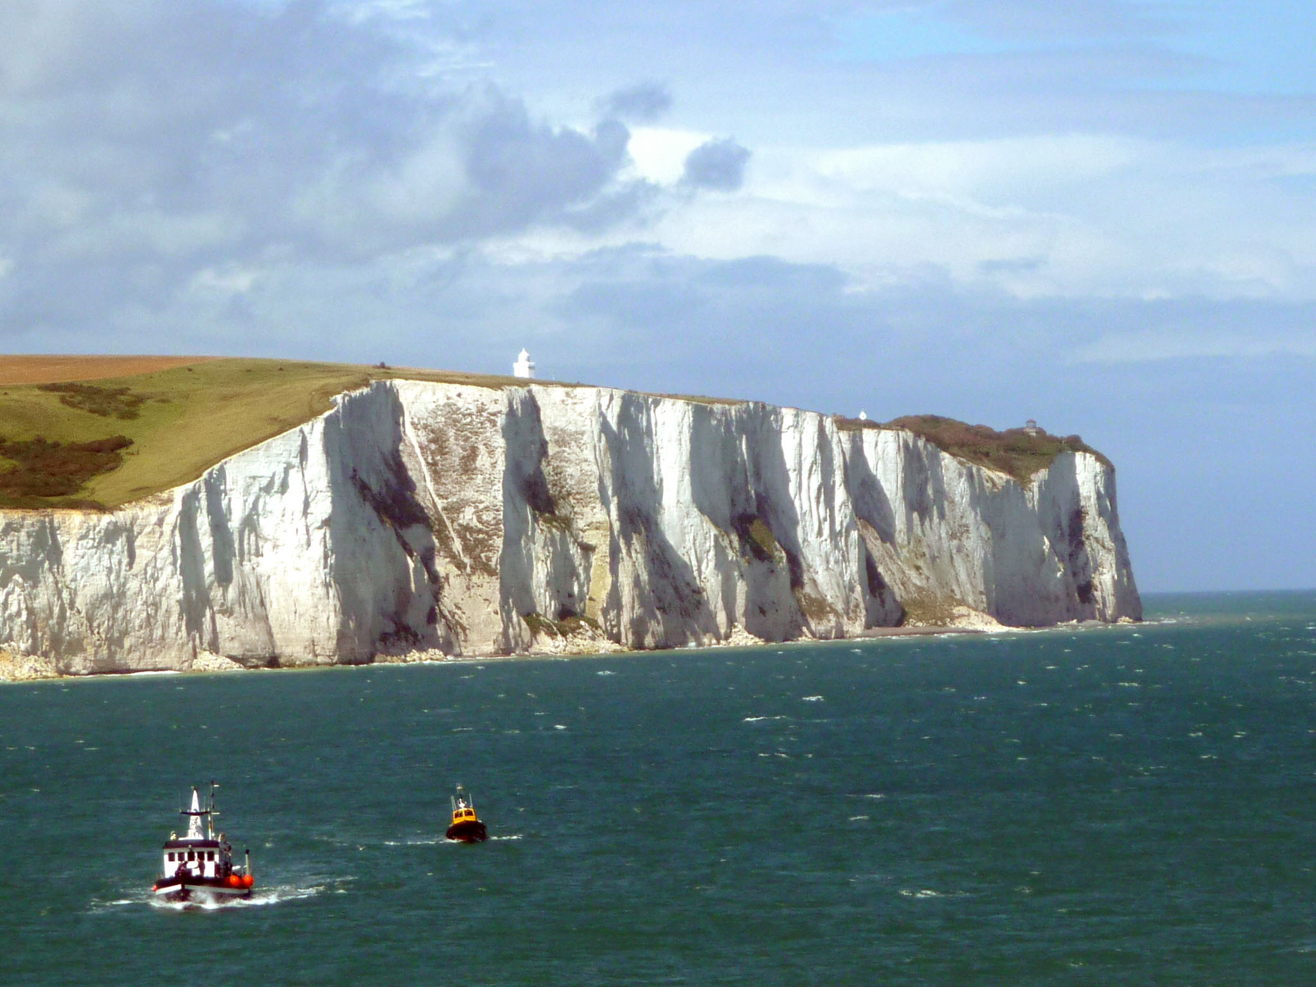
Carbon Dioxide in the Oceans
CaC0₃ = Limestone
Sink for CO₂
White Chalk Cliffs of Dover, England

Slide 27
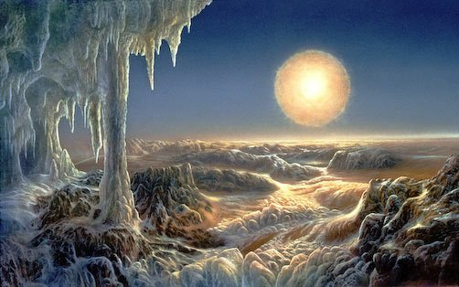
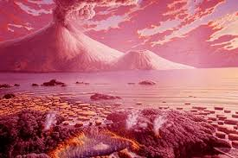
Rock Subdivisions of the Pre-Cambrian
Archean “Ancient Age”

Slide 28
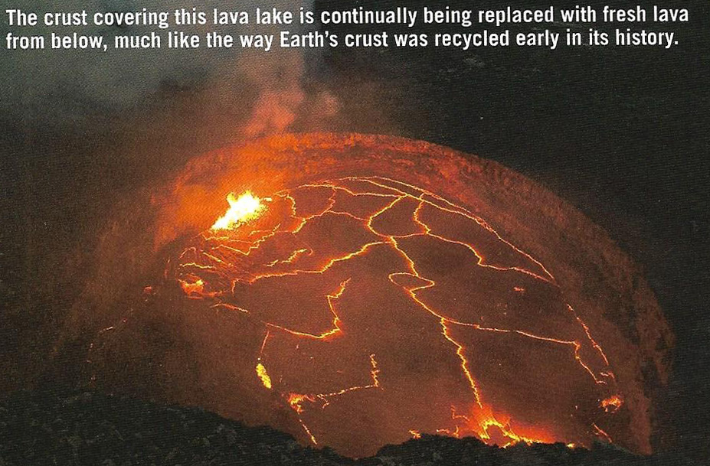
Archean Igneous Rocks
Hot Spots
Some early plate tectonic subduction and divergence

Slide 29
Continued Formation of Continents from Continental Crust

Slide 30
Formation of Continents: Accretion

Slide 31
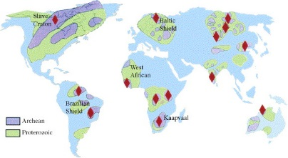
Proto-Cratons: 3 billion years Ago
Cratons are large enough to escape subduction and subsequent destruction

Slide 32
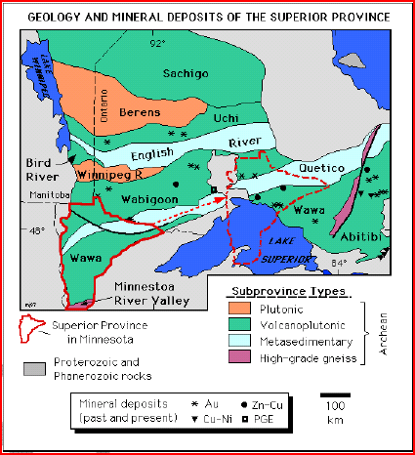
Algoman (Kenoran) Orogeny: Late Archean 2700-2500 M.Y. ago
North America, Superior province, South Dakota to Lake Huron

Slide 33
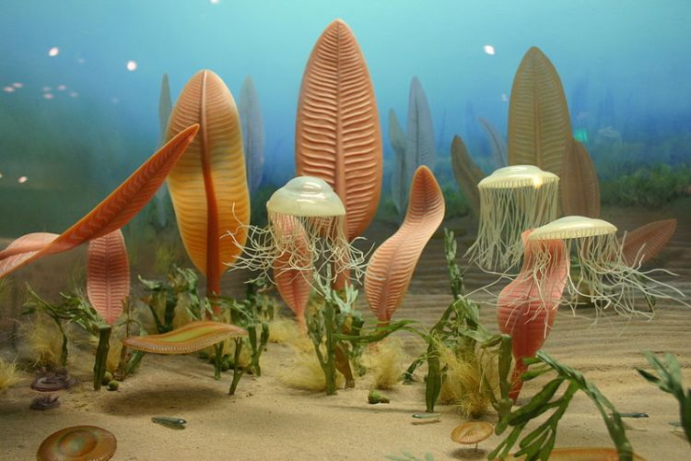
Subdivisions of the Precambrian
Hadian
Archean
Proterozoic “Early Life”

Slide 34
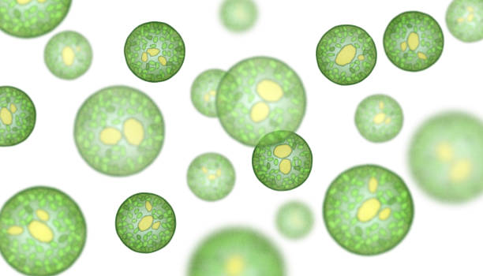
Evolution of Life; 3.5 Billion Years Ago
Cyano-bacteria
Algae (stromatolites)
Oxygen

Slide 35
Bacteria fossils in rocks (speleothem)

Slide 36
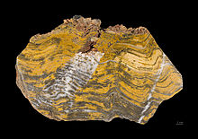
Algae: Stromatolites

Slide 37
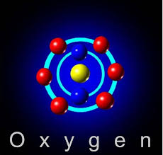
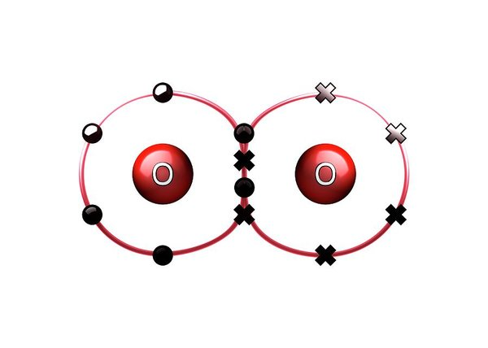
The Great Oxidization Event: 2.5 Billion years ago
No more Banded Iron Formations
Atmosphere not poisonous: 10-25% 0xygen
Ozone (0₃), protects early life from ultraviolet light

Slide 39
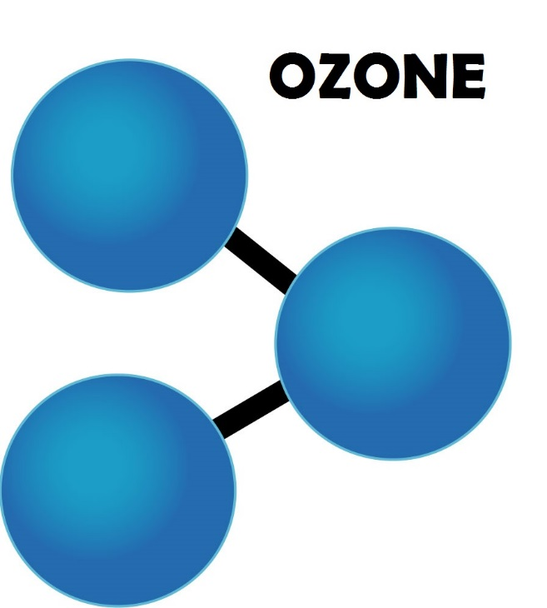

Slide 40
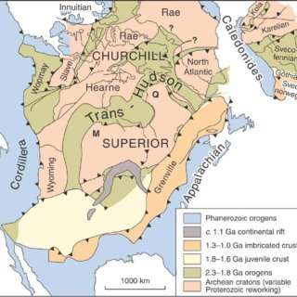
Trans-Hudson (Hudsonian) Orogeny: 2.0 to 1.8 Billion Years Ago
From Hudson Bay west into Saskatchewan then south through the western Dakotas and Nebraska. Result of the collision of the Superior craton with the Hearne craton and the Wyoming craton during the Proterozoic.

Slide 41
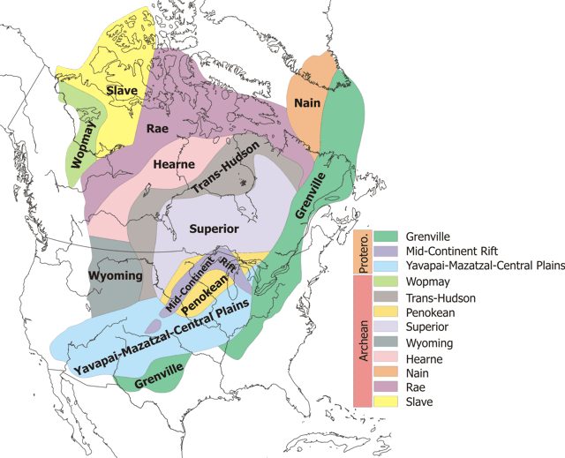

Slide 42
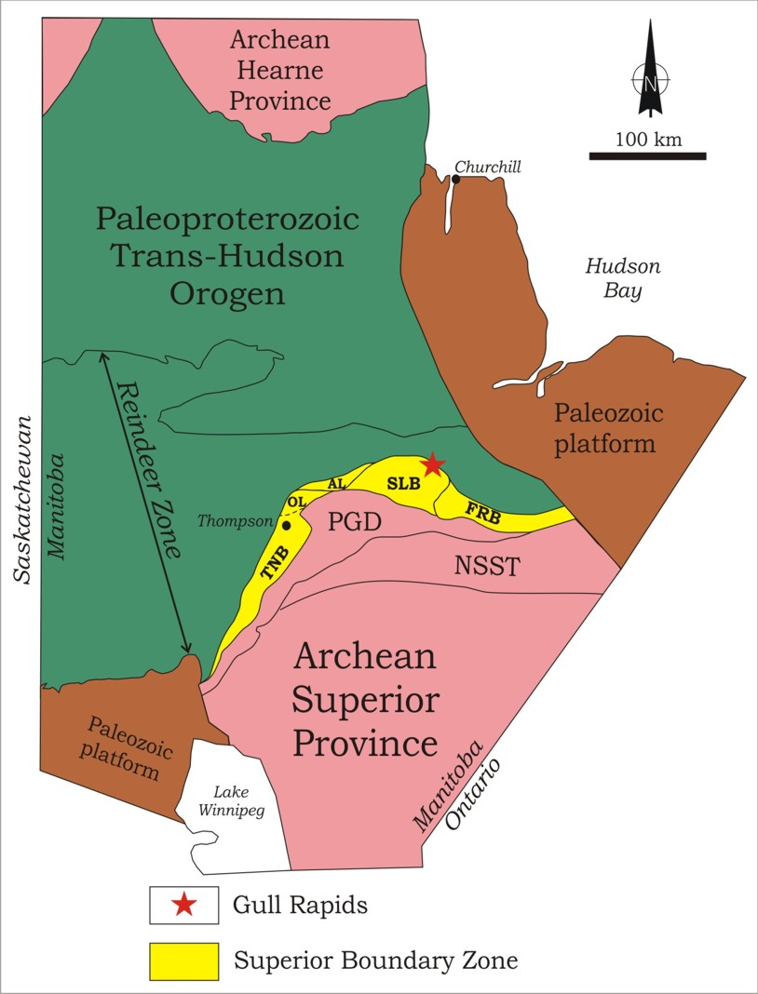
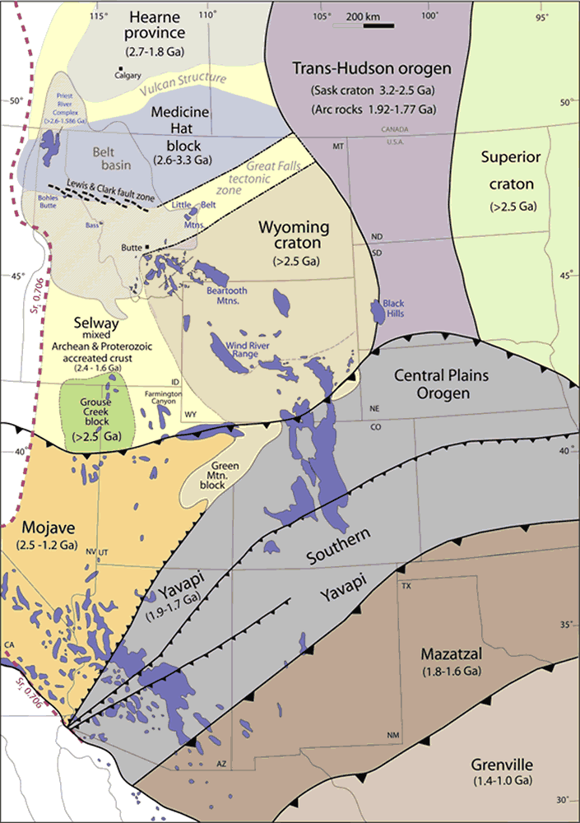

Slide 43
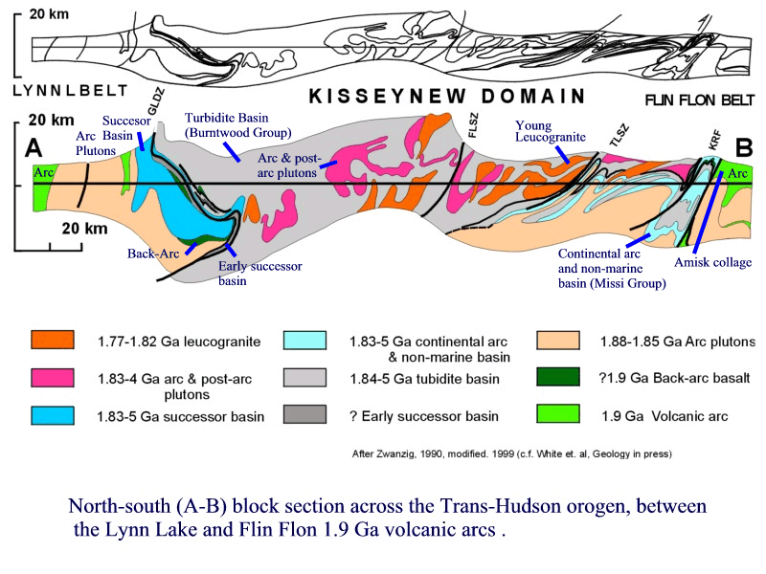

Slide 44
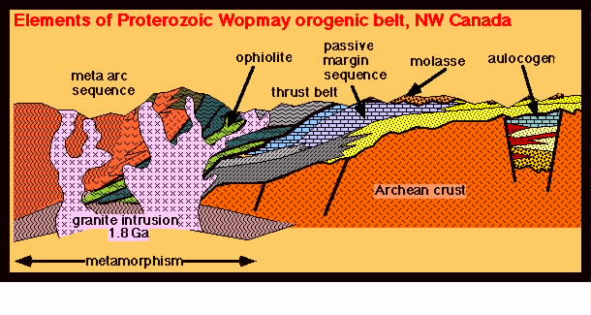
Wopmay Orogeny: 2.1 to 1.9 Billion Years Ago
Canadian Shield
Collision between the Hottah terrane (north of the Hottah Lake), a continental magmatic arc, and the Archean Slave Craton at about 1.88 Ga (billion years).

Slide 46
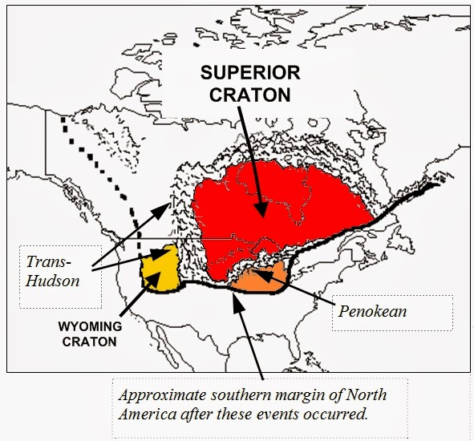
Penokean Orogeny: 1.8 to 1.5 Billion Years Ago
Wisconsin, Minnesota, and Michigan, U. S. A. and southern Ontario, Canada

Slide 47
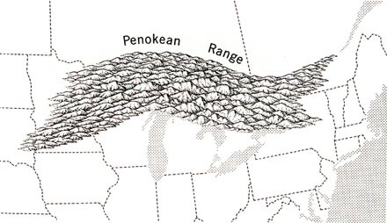

Slide 48
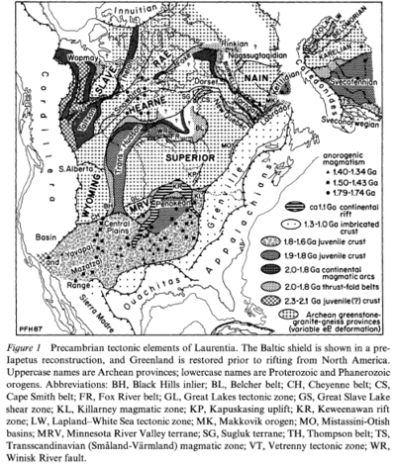

Slide 49
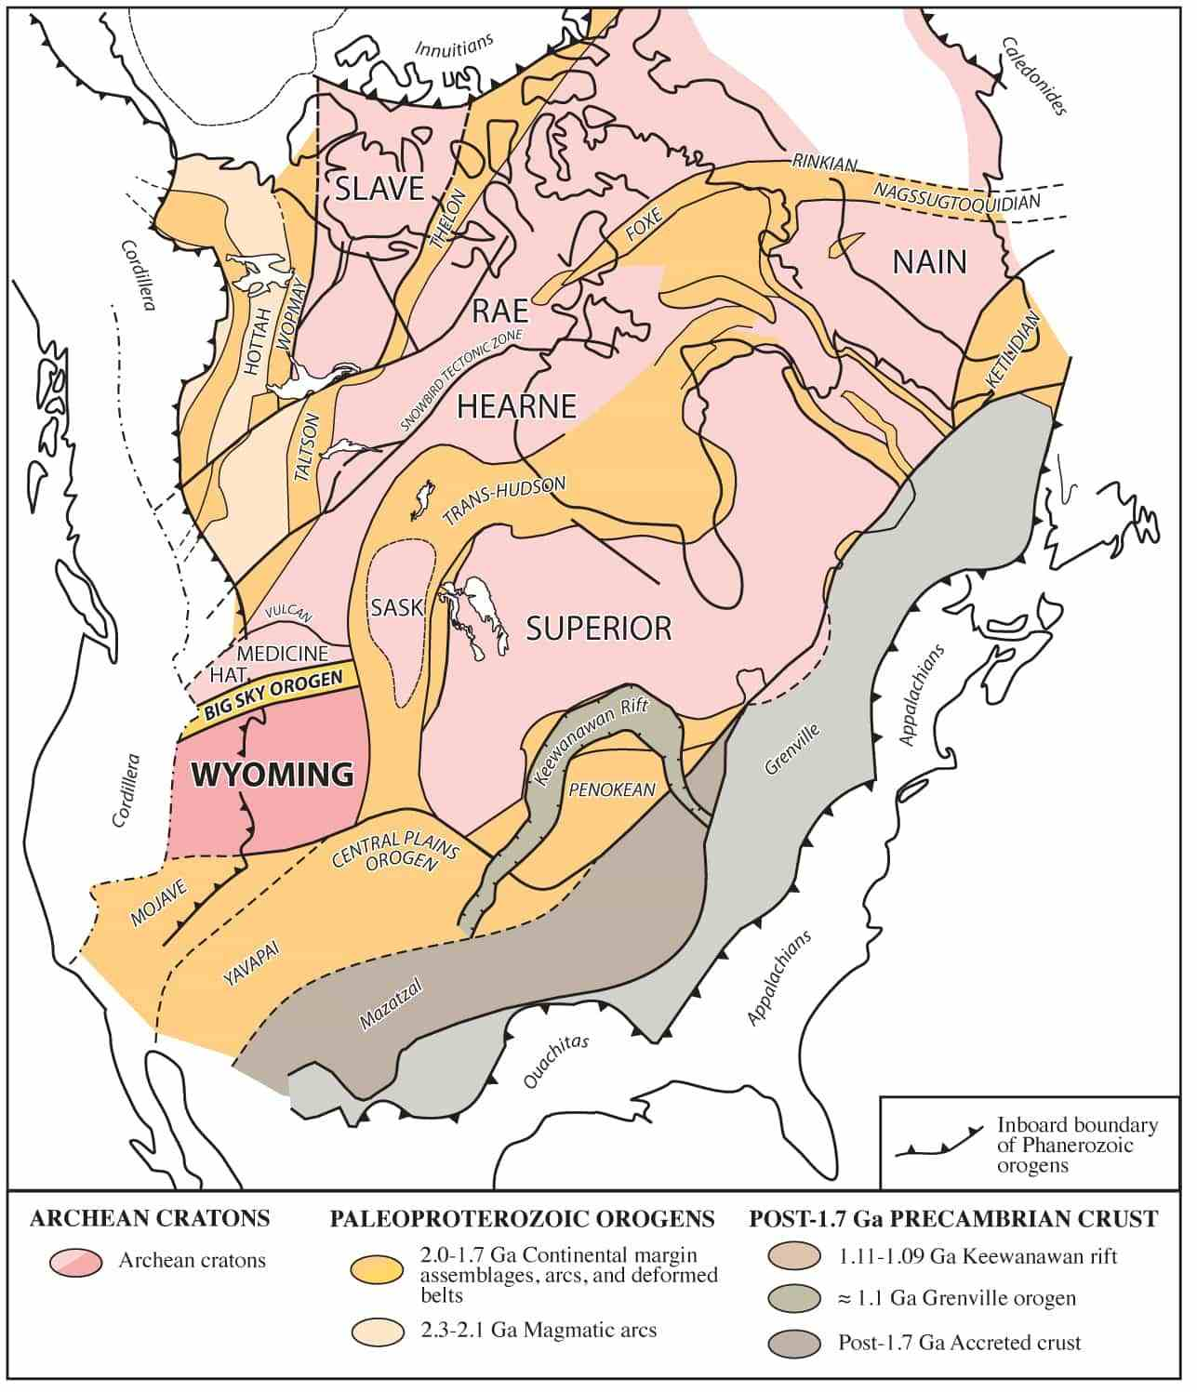
Big Sky Orogeny: 1.7 Billion Years Ago
Proterozoic collision between the Hearne craton and the Wyoming craton in southwest Montana

Slide 51
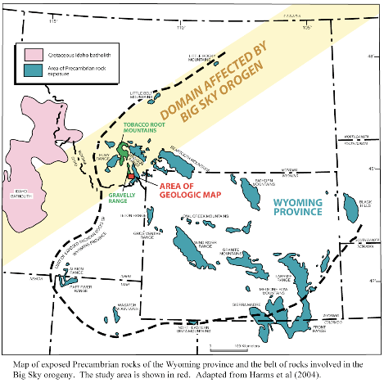
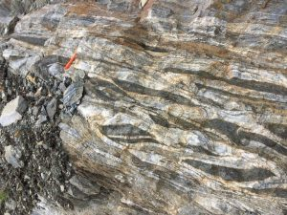

Slide 52
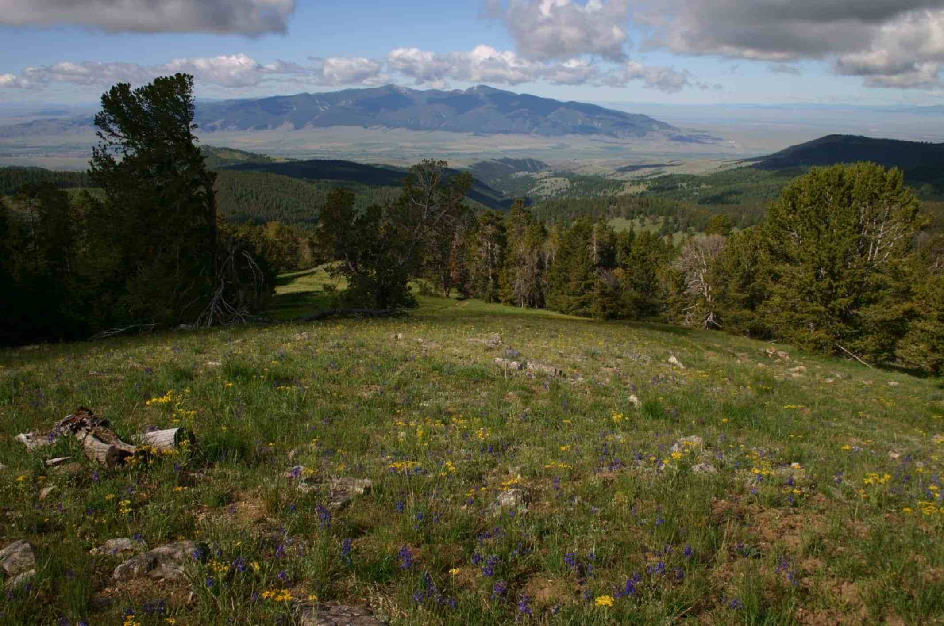

Slide 53
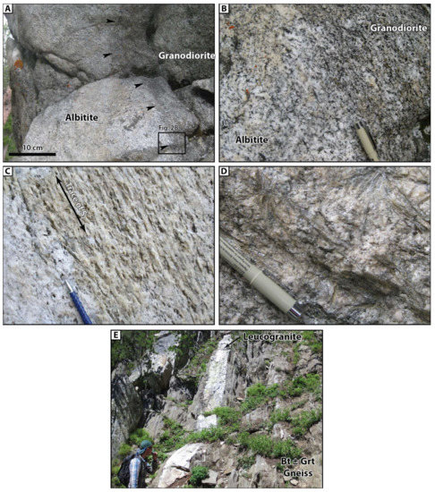

Slide 54
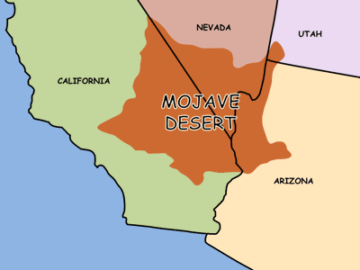
Ivanpah Orogeny: 1.7 Billion Years Ago
Mojave province, south western USA

Slide 55
Yavapai –Mazatzal Orogeny: 1.71 and 1.65 Billion Years ago
Mid to south western USA

Slide 60
Grenville Orogeny: 1.2 to 1.0 Billion Years Ago
Associated with the assembly of the supercontinent Rodinia. Formed folded mountains in Eastern North America from Newfoundland to North Carolina.

Slide 67
Development of Cratons: 1 Billion years Ago

Slide 69
Cratons of North America

Slide 70
Supercontinent of Rodinea: 1.1 Billion years ago
Laurentia = North America

Slide 71
Supercontinent of Rodinia

Slide 72
Rodinia broke up into Lauritania and Gondwanaland: 600 to 800 Million Years Ago

Slide 73
Proterozoic to Cambrian Transition
Microscopic Life
To
Megascopic Life

Slide 74
Life and Calcium Carbonate: 540 million years ago
Biogentic Limestones

