Slide 1
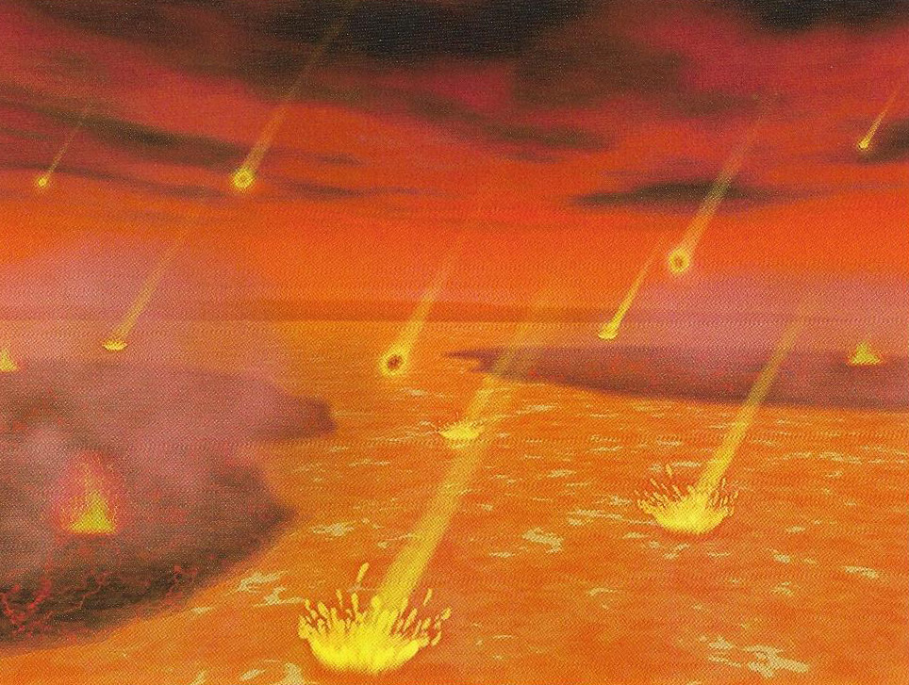
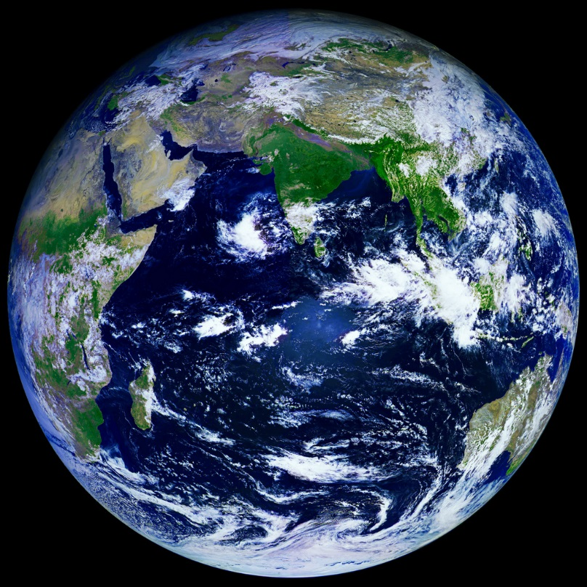
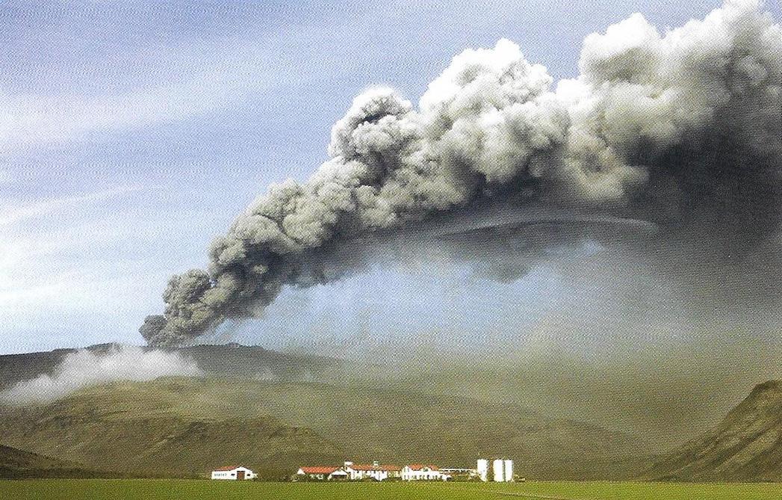
Evolution of the Earth 13.7 Billion Years in the Making
PART 5: Silurian
Dr. Gregg Wilkerson
Earth Science
Bakersfield City College

Slide 2
Silurian: 430 Million Years Ago

Slide 3
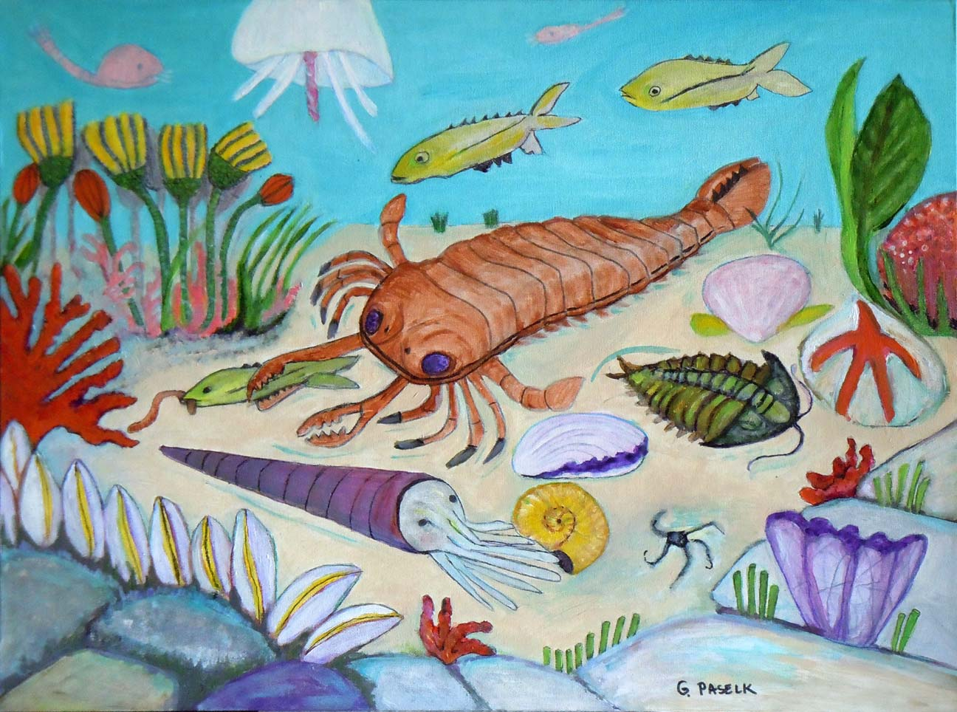
Silurian Life: 423 to 416 M.Y. age
Trilobites
Nautiloids
Early fish
Early ammonites
Sea Scorpions

Slide 4
Plants invade the land

