Slide 1
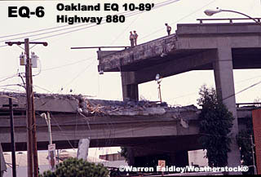
INTRODUCTION TO EARTH SCIENCE
LAB 06: Part B
Dr. Gregg Wilkerson and Jack Pierce
3
Earthquakes
and
Earth’s Interior

Slide 2
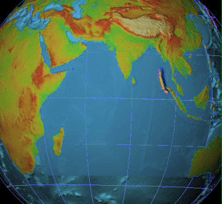
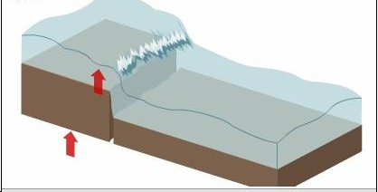
What is a tsunami?
an enormous ocean wave created from an earthquake
or an undersea volcanic eruption
1.0
2.0
3.0
Sea floor shifts,
displacing water and
creating tsunami.
4.0
5.0
6.0
7.0
35

Slide 3
Tsuname Video
Watch it!
https://video.search.yahoo.com/yhs/search?fr=yhs-sz-001&hsimp=yhs-001&hspart=sz&p=tsunami+videos#id=2&vid=9fc6e056cb9f8bc5682a3e2a3cc20543&action=click

Slide 4
Can earthquakes be predicted???????????
At this time – EQ’s cannot successfully be
predicted.
In order to predict an EQ – science folks must
predict a small range of uncertainty
as to the location and timing.
Predictions must be able to produce few failures
and no false alarms.
38

Slide 5
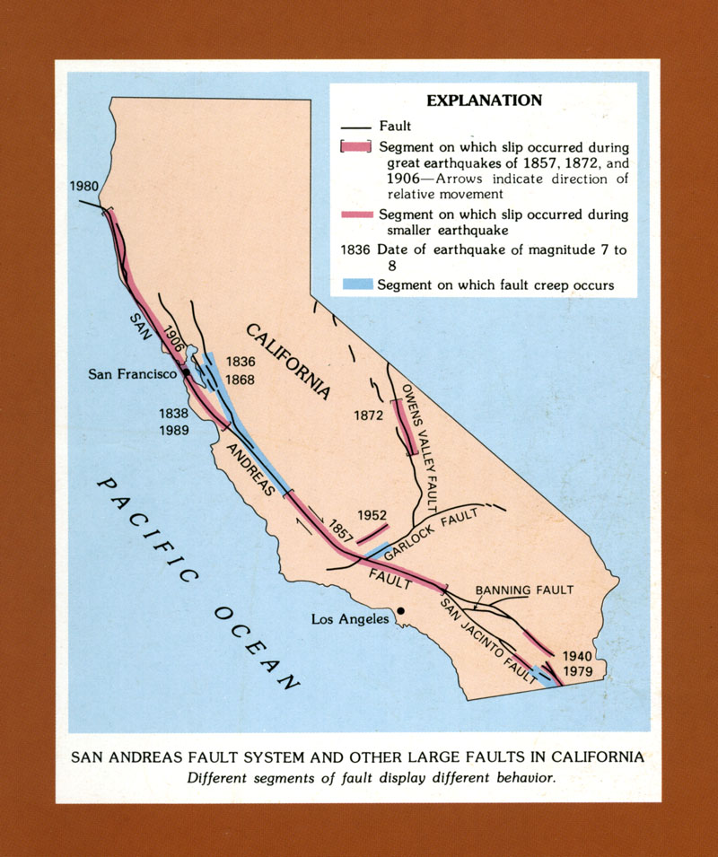
Can earthquakes be predicted along the SAF??
Seismologists warn that an EQ larger than 6.5 will occur along the San Andreas Fault.
How do seismologists
predict this warning?
Bakersfield
39

Slide 6
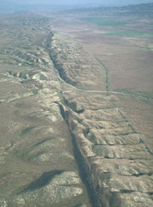
How geologists predict EQ’s
Long Range EQ-Prediction – Seismic gap method
Prediction of an EQ is based on probability – What is the probability
of an EQ?
Statistical estimation when EQ’s take place over a given time
span (the frequency of EQ’s)
Assumption that EQ’s are cyclic -- repetitive
Seismic gap method - SAF
Based on studies of the San Andreas Fault,
the probability of an EQ is:
Less than 10% in Northern CA
Parkfield (central CA) = 90%
Southern CA = 30%
40

Slide 7
Use of the seismic gap
method along the SAF
Cyclic EQ’s in Parkfield,CA
1857
1881
1901
1922
1934
1966
1 EQ about
every 22 years
Cyclic EQ M6 or greater
rupturing in the same
area of the fault zone
Parkfield
90%
Bakersfield
The next predicted EQ
before 1993
DID NOT HAPPEN!
90% chance of a major EQ
41

Slide 8
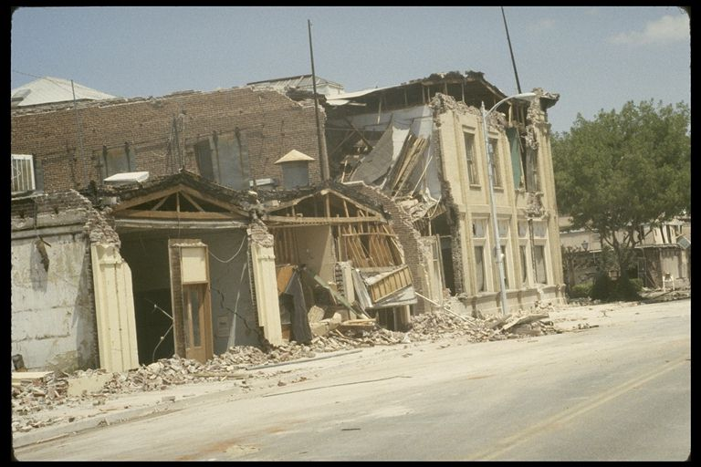
But that may have been do to the Coalinga Earthquake, 1983

Slide 9
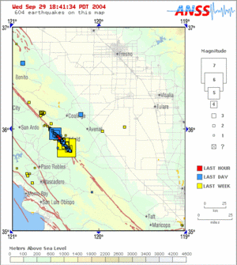
EC – Did the EQ on 9/28 reduce the
probability of 90%?
www.quake.usgs.gov/recenteqs/
September 28, 2004
M6 at Parkfield
42

Slide 10
Short Term Earthquake Prediction
1. Animal Behavior
2. Water Levels in Wells
3. Technology: My Shake: https://myshake.berkeley.edu/

Slide 11
I
a good earthquake
Discuss with a friend:
Can EQ’s be predicted? – Why or Why not?
2. Draw a picture of CA and show where
the San Andreas fault is located.
3. Explain how the seismic-gap method
works when predicting earthquakes.
I will get an A on my exams and quizzes
43

Slide 12
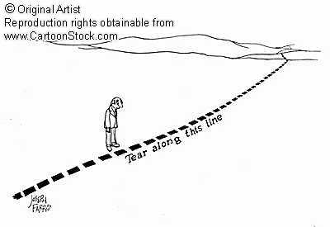
Structural Geology
Faults
44

Slide 13
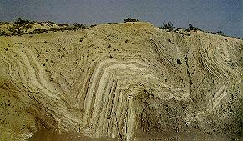
Structural Geology – Earth Deformation
Fault
Folds
45

Slide 14
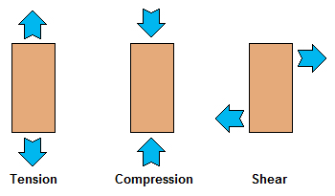

Slide 15
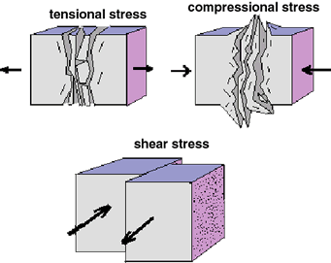

Slide 16
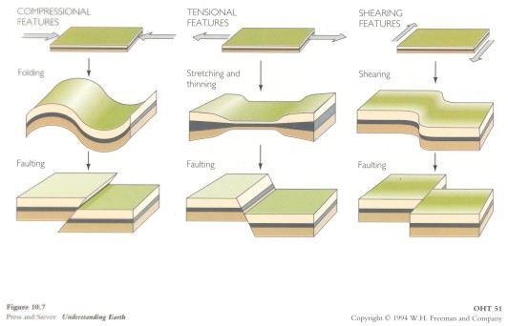

Slide 17
How is rock deformed?
(stress and strain relationships)
Stress
force (pressure) acting on the rock surface
Strain
a change in the shape (deformation) to the
response of stress
Compression
Tensional
undisturbed
cube
Shear

Slide 18
Faults
Joint – fracture within a rock body
Fault – movement along a fracture or joint
B
fault
Joint
B
A
A
47

Slide 19
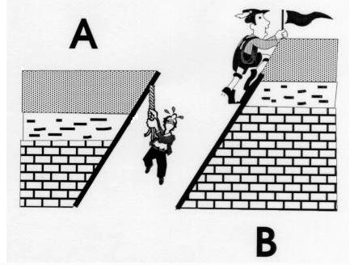

Slide 20
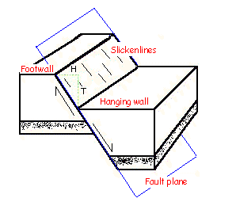
Displacement

Slide 21
Normal and Revers Fault Animation
Animation
https://www.quia.com/jg/1302155list.html

Slide 22
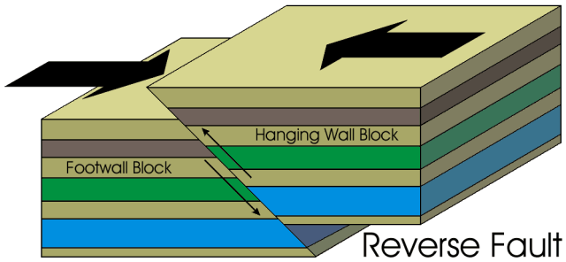

Slide 23
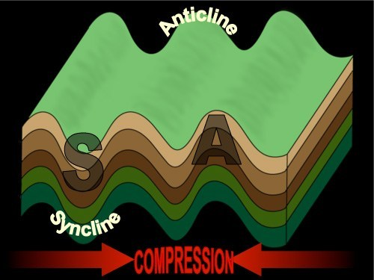

Slide 24
I
A good earthquake
Describe the differences between stress
and strain
2. Describe the stress types compression
tensional, and shear
Draw a fault block and label:
hanging/footwalls
fault plane
Discuss with a friend
I will get an A on my exams and quizzes
50

Slide 25
Normal Fault
HW down relative to FW
Tensional stress
Extension of crust
HW
FW
FW
HW
Reverse Fault
HW up relative to FW
HW
Compression stress
Shorting of crust
FW
52

Slide 26
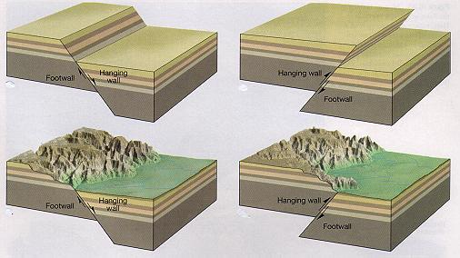
Vertical type faults
FW
HW
HW
FW
Normal faulting
(extension of crust)
Reverse faulting
(compression of crust)
FW
HW
FW
HW
53

Slide 27
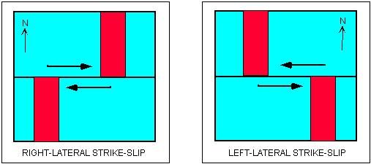
Strike-slip faulting: two blocks sliding past one another
Map View
Turned to Right
Turned to Left

Slide 28
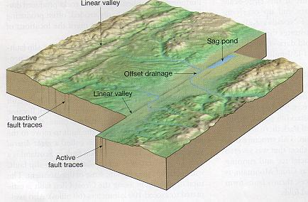
What is the type of strike-slip fault?
Right-Lateral – strike slip

Slide 29
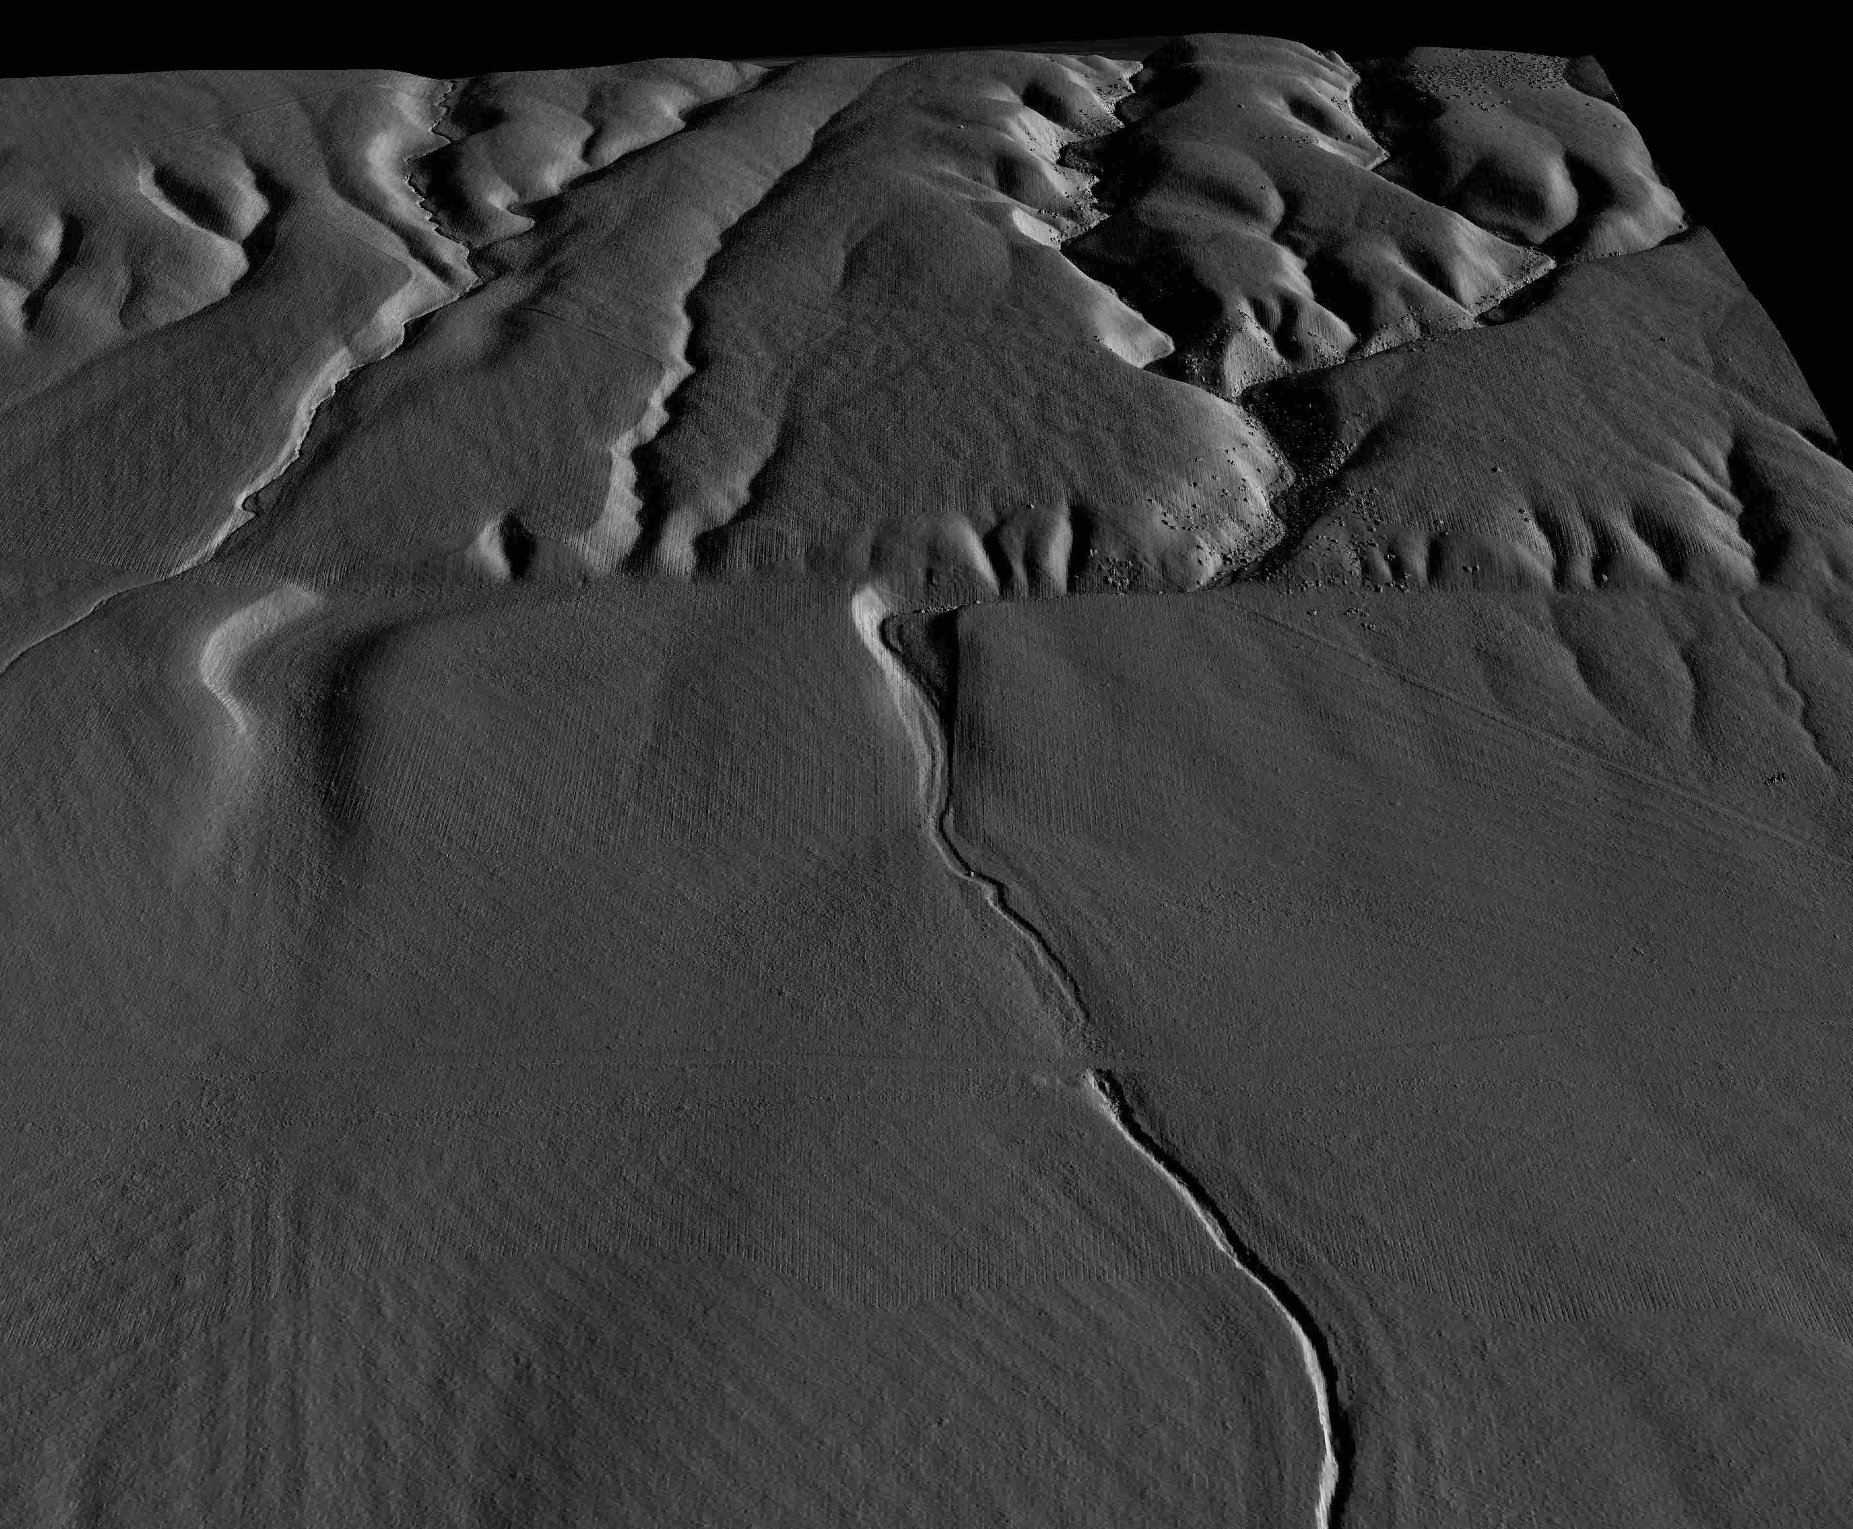
Wallace Creek
Right-Lateral
Strike slip
San Andreas Fault – Wallace Creek,
Carrizo Plane
56

Slide 30
I
a good earthquake
Discuss with a friend:
Draw a diagram showing the differences
between a normal and reverse fault.
2. Explain the differences between the
cross-sectional fault views of a normal,
reverse, and strike-slip fault
Describe the type of stresses that produce
both normal and reverse faults.
I will get an A on my exams and quizzes
58

