Slide 1
Planetary, Solar and Intergalactic Probes: PART 2
Dr. Gregg wilkerson

Slide 2
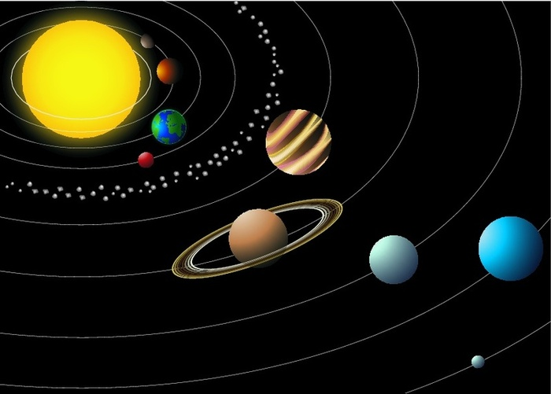

Slide 3
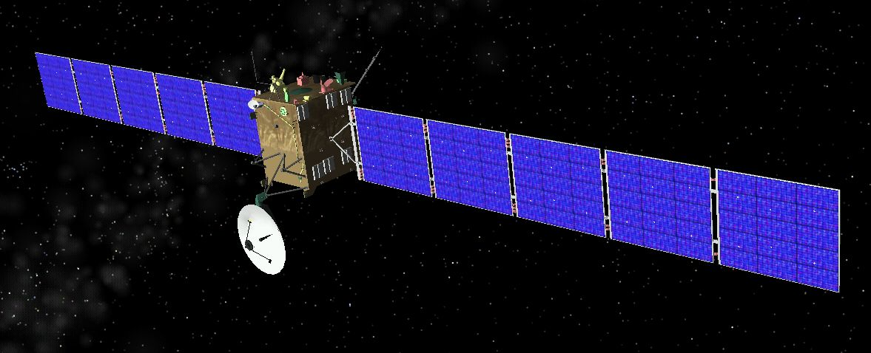
A STEROID BELT PROBES, 1991-2018: 14 MISSIONS
Galileo (951 Gaspra, 243 Ida)
Clementine (1620 Geographos)
NEAR Shoemaker (253 Mathilde, 433 Eros)
Deep Space 1 (9969 Braille)
Cassini (2685 Masursky)
Stardust (5535 Annefrank)
Hayasusa (25143 Itokawa)
New Horizons (132524 APL)
Rosetta (2867 Steins, 21 Lutetiia)
Dawn (Vesta)
Chang’e 2 (4179 Toutaitis)
PROCYON (200 DP107)
162173 Ryugu (Minerva 11-1A, Minerva 11-1B, MASCOT, Minerva 11-2, SCI, SCAM-3)
Osiris-Rex (101955 Bennu)

Slide 4
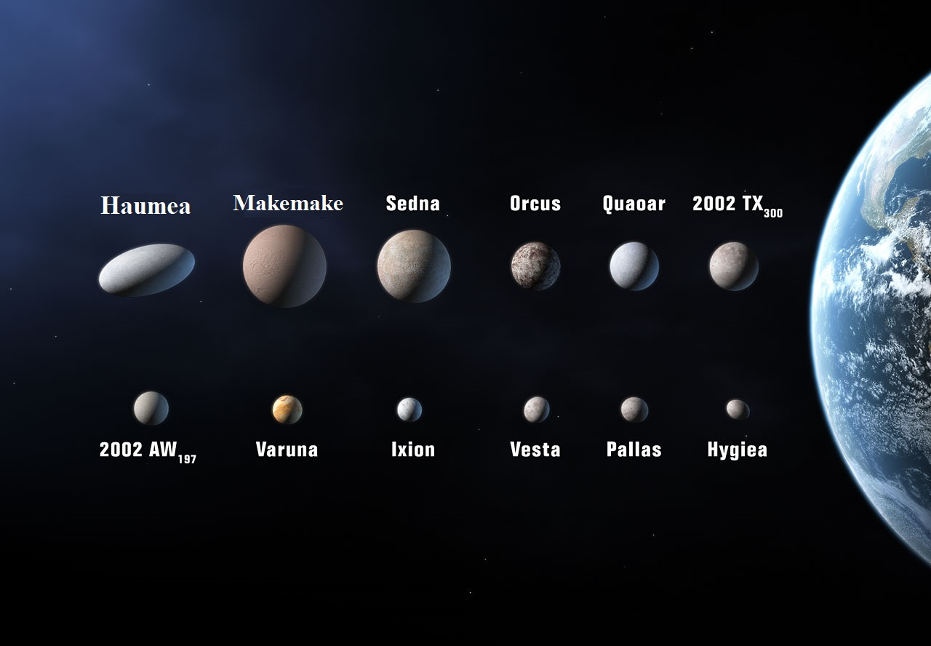
Largest Asteroids

Slide 5
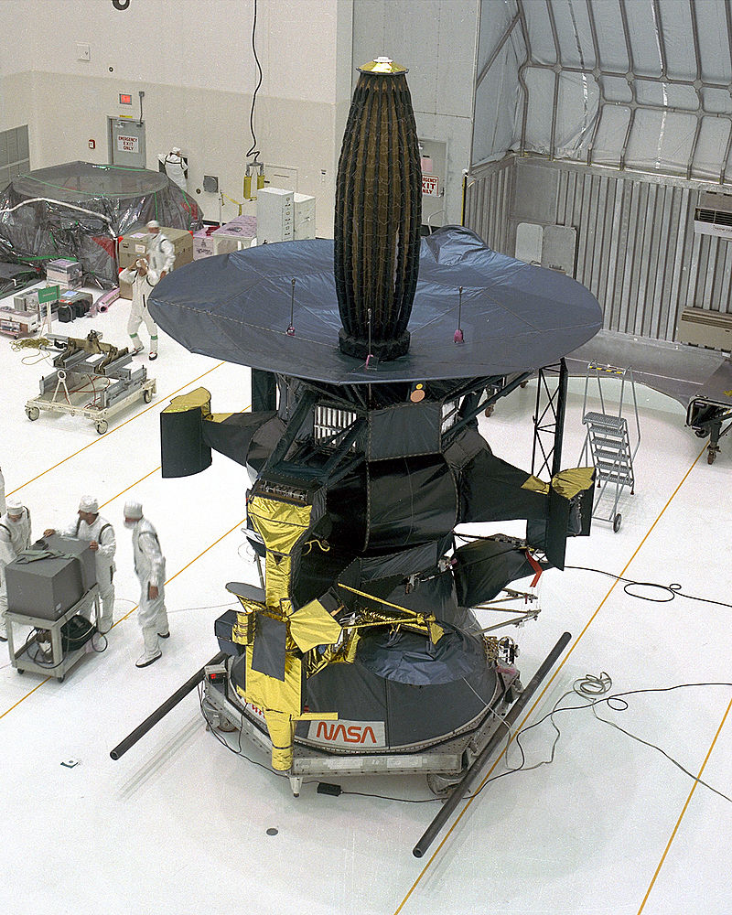
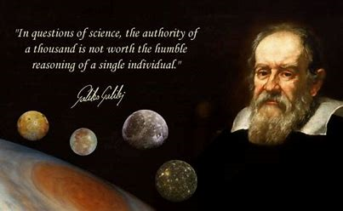
Galileo, 1991, 1993
Flyby of Venus and asteroid belt
gravity assist en route to Jupiter; minimum distance 16,000 km

Slide 6
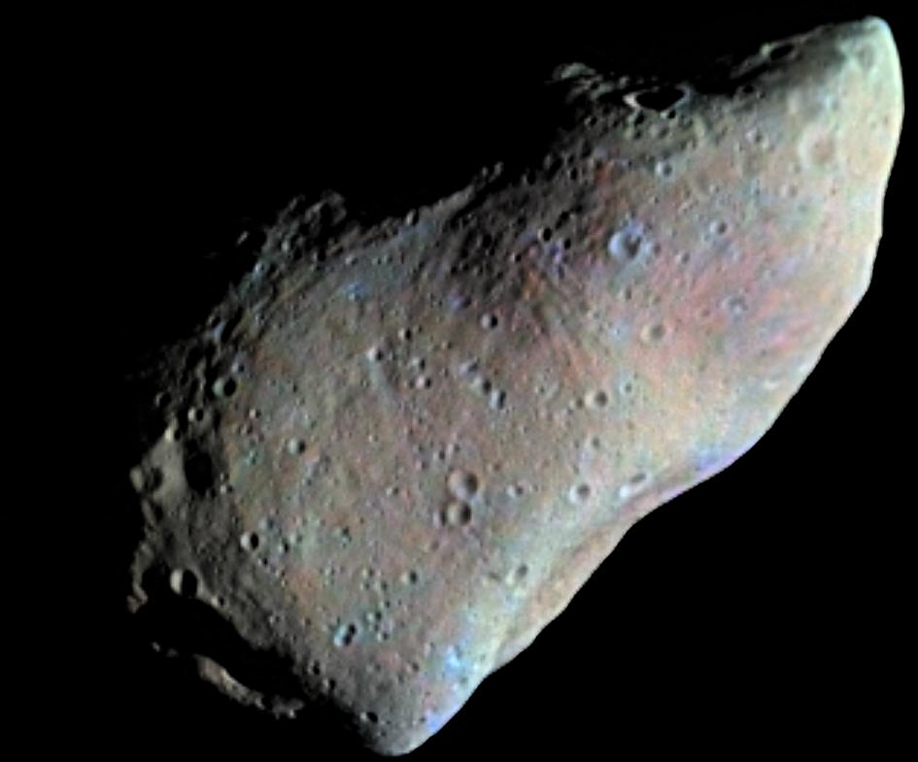
951 Gaspara asteroid

Slide 7
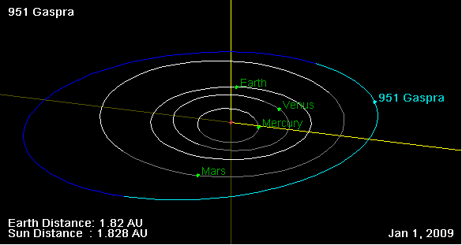

Slide 8
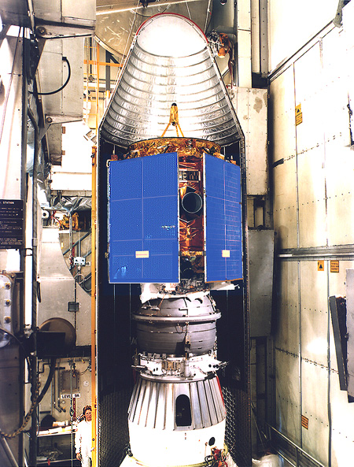
NEAR SHOEMAKER, 1997, 2000-2001
253 Mathilde, 1997
433 Eros, 2000-2001

Slide 9
243 Ida asteroid

Slide 10
433 Eros asteroid

Slide 11
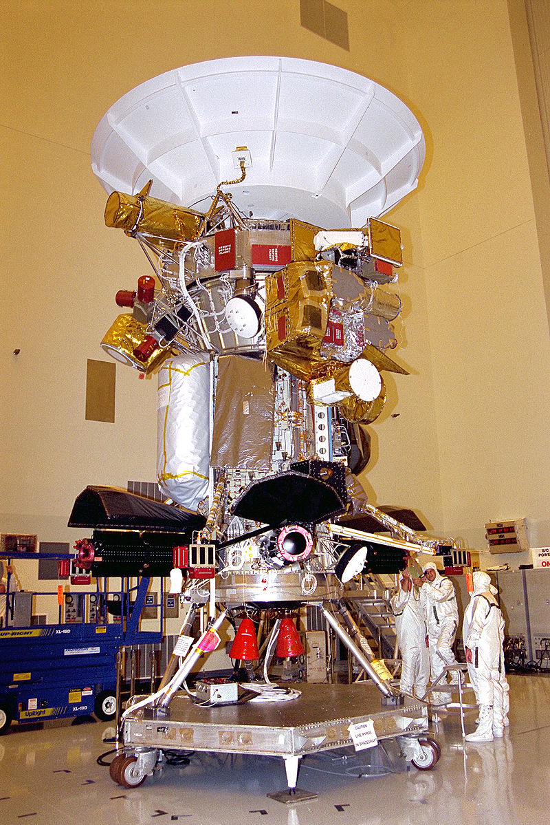
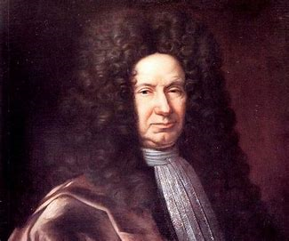
Cassini, 2000
Flyby of Venus and 2685 Masursky
gravity assist en route to Saturn
Giovanni Cassini

Slide 12
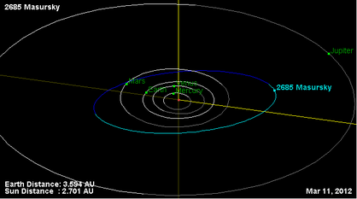
2685 Masursky asteroid

Slide 13
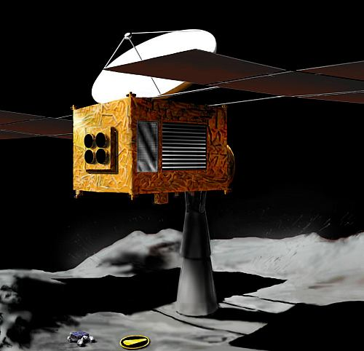
Hayabusa, 2005-2007 (write it down!)
25143 Itokawa asteroid
Sample and return
Landed on Itokawa in 2005, initially failed as sampling device failed to operate, but second landing resulted in a success. It returned to Earth in 2010

Slide 14
25143 Itokawa asteroid

Slide 16
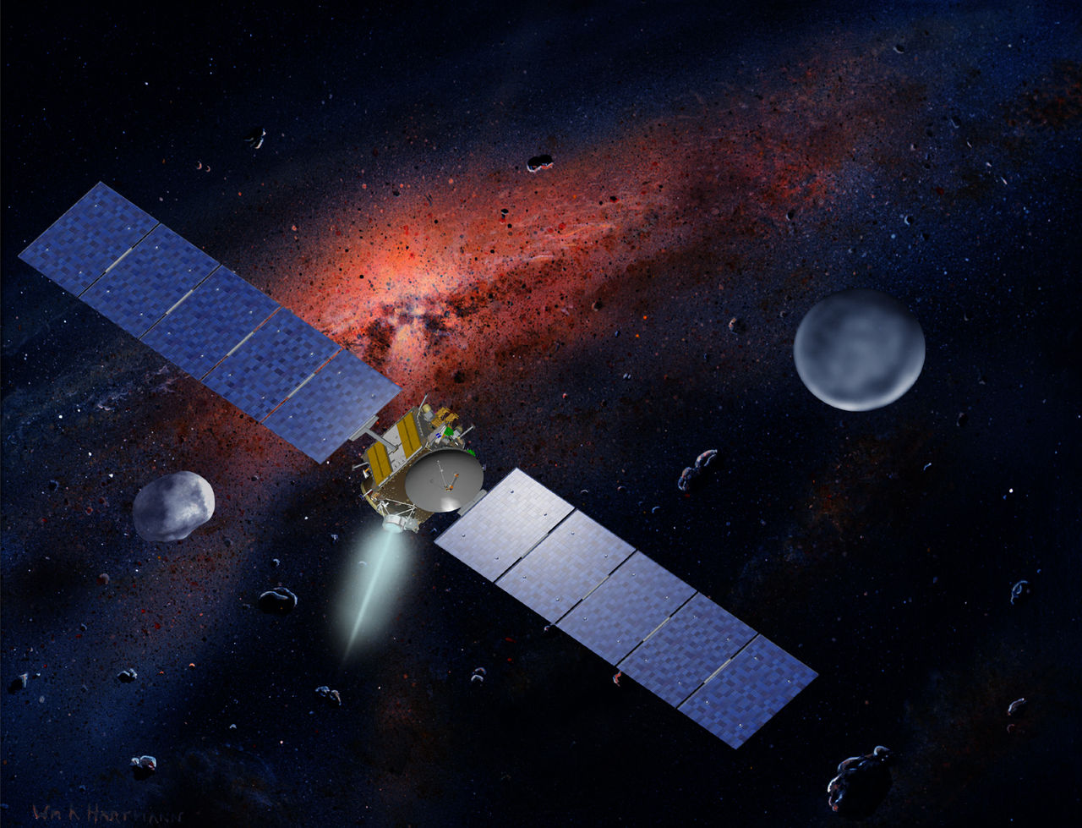
DAWN, 2011-2012
4 Vesta asteroid
First spacecraft to orbit two different celestial bodies; now orbiting Ceres

Slide 17
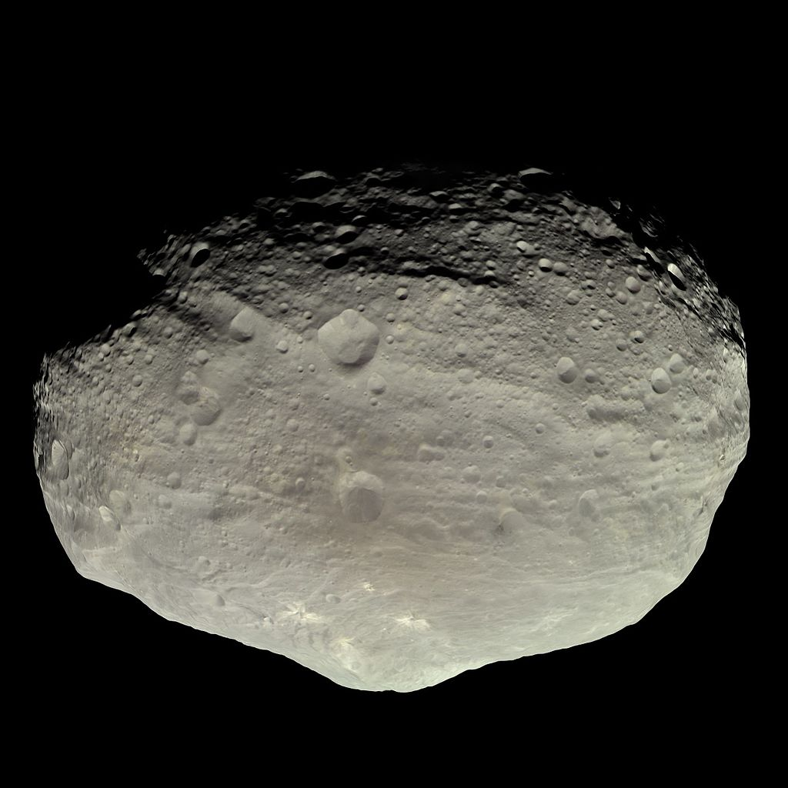
Vesta Asteroid
One of the largest objects in the asteroid belt
Mean diameter of 525 kilometres (326 mi)
Impact Craters, like a moon

Slide 18
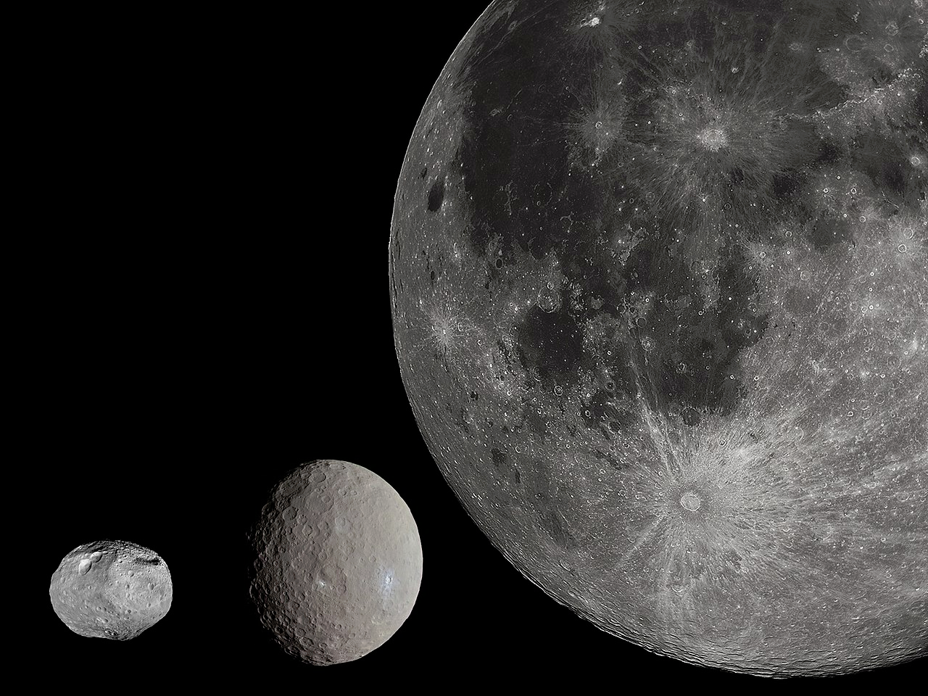

Slide 19
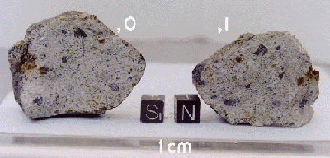
Vesta on Earth!
Numerous fragments of Vesta were ejected by collisions one and two billion years ago that left two enormous craters occupying much of Vesta's southern hemisphere.
Debris from these events has fallen to Earth as howardite–eucrite–diogenite (HED) meteorites

Slide 20
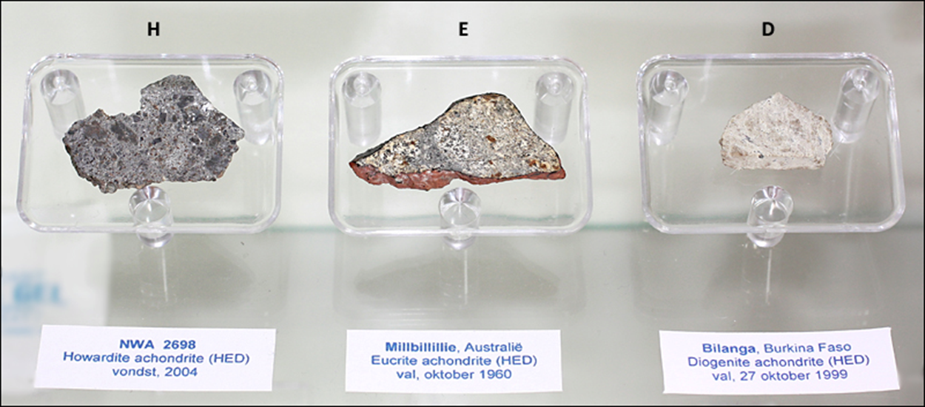

Slide 21
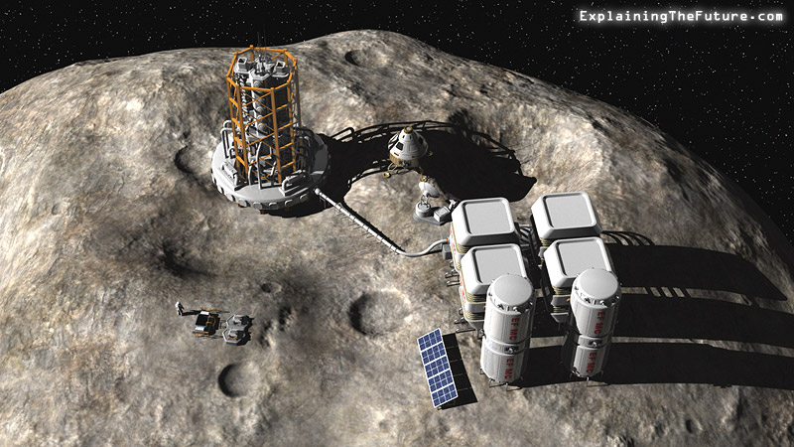
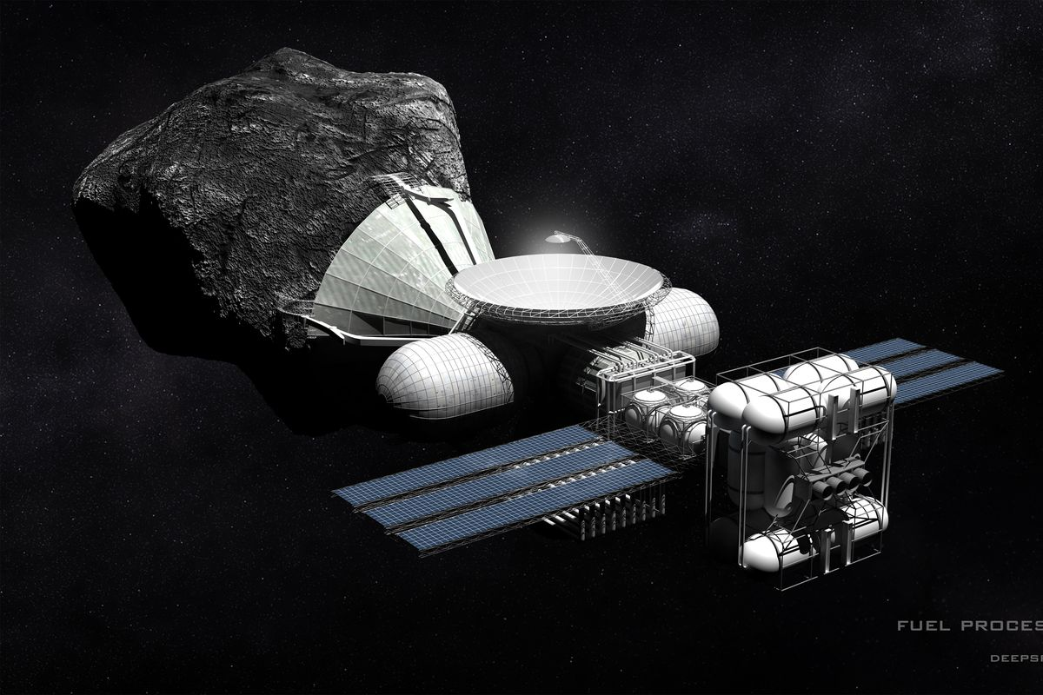
ASTEROID MINING
VIDEO
VIDEO 2

Slide 23
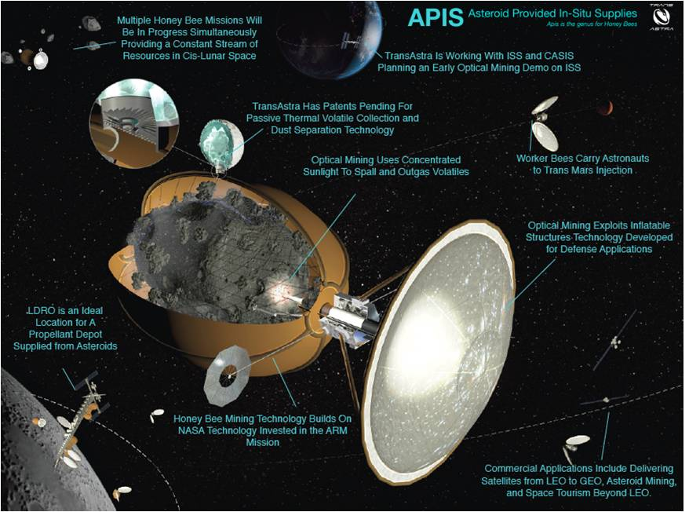

Slide 24
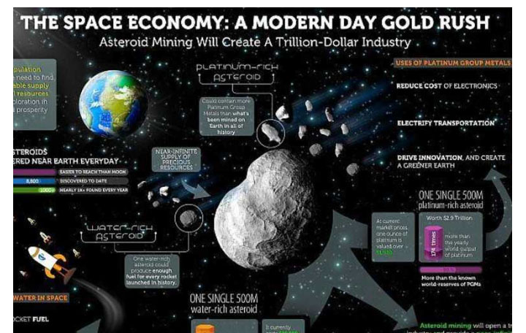

Slide 25
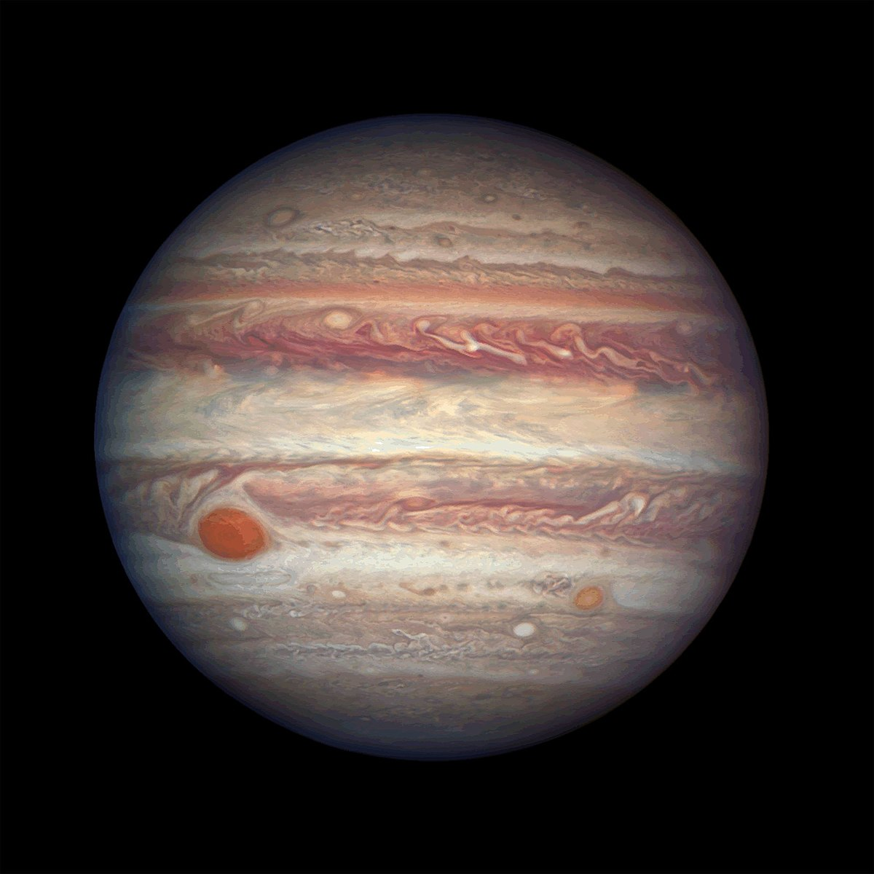
JUPITER PROBES: 8 MISSIONS
Pioneer 10
Pioneer 11
Voyager 1
Voyager 2
Ulysses
Galileo Orbiter and Probe
Cassini
New Horizons

Slide 26
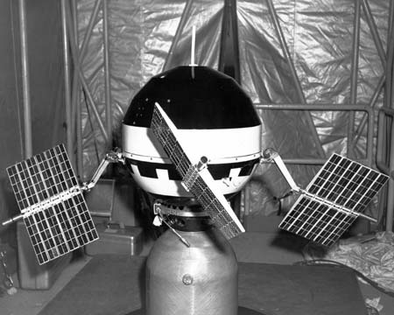
PIONEER 10, 1973
Flyby
first probe to cross the asteroid belt
first Jupiter probe
first man-made object on an interstellar trajectory;
now in the outer regions of the Solar System but no longer contactable

Slide 27
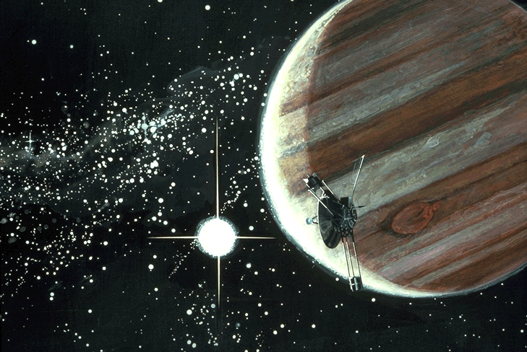

Slide 28
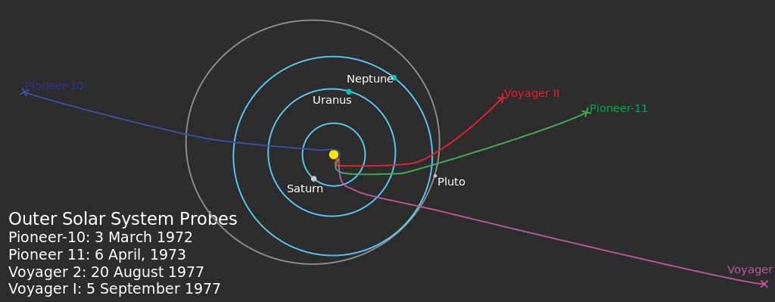

Slide 29
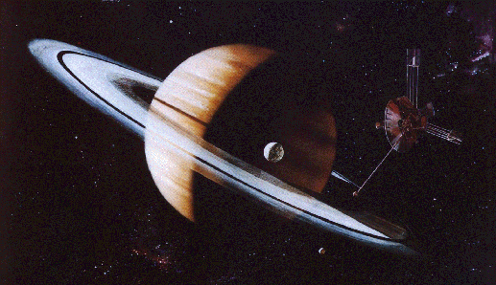
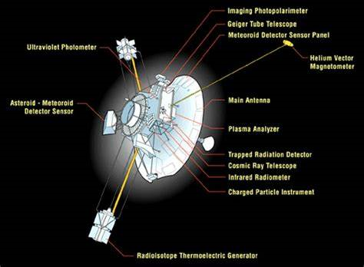
Pioneer 11, 1974
Flyby of Jupiter
Went on to visit Saturn

Slide 30
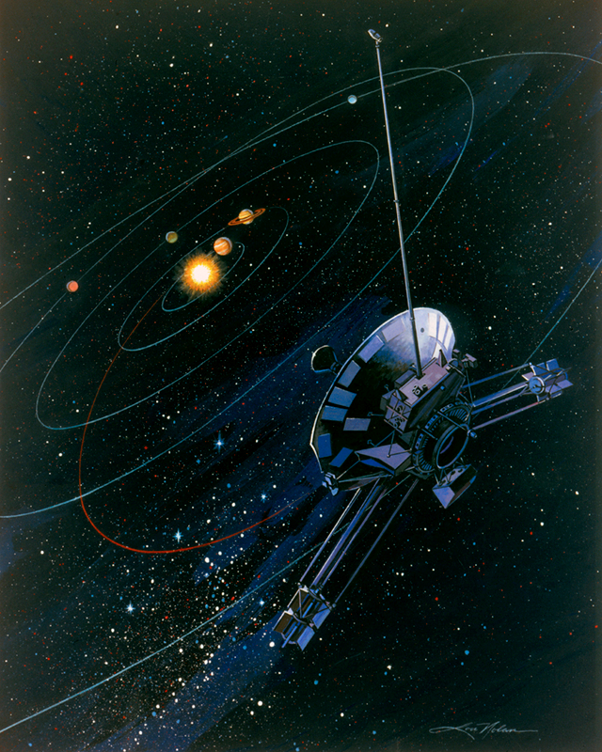
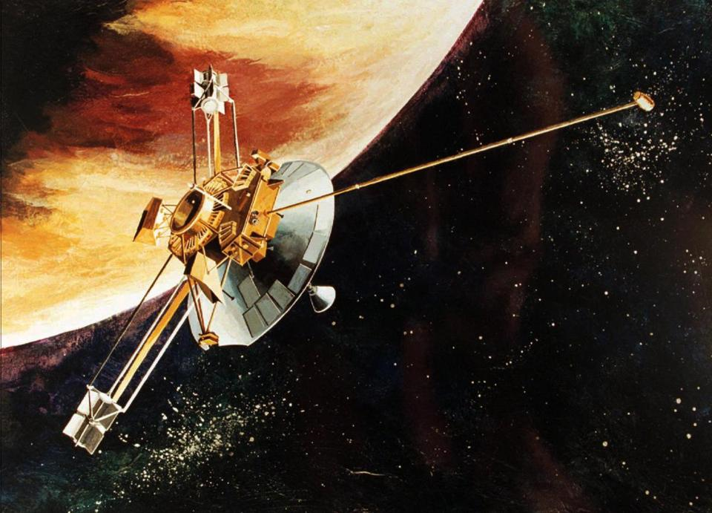

Slide 31
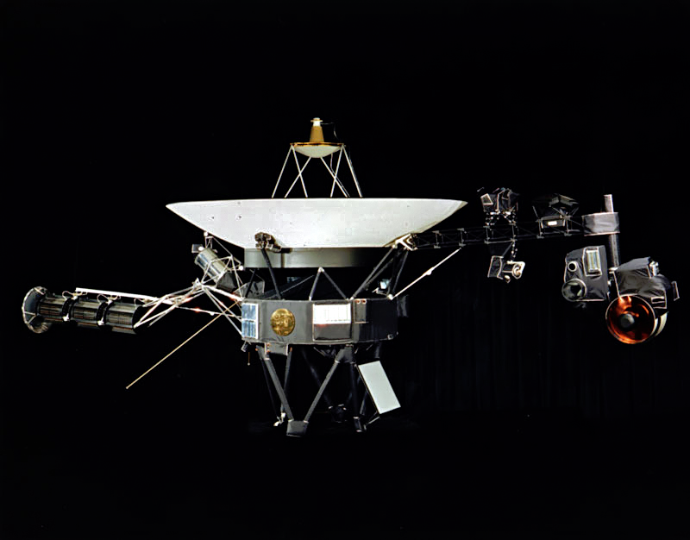
Voyager 1, March of 1979
Flyby of Jupiter
Went on to visit Saturn

Slide 34
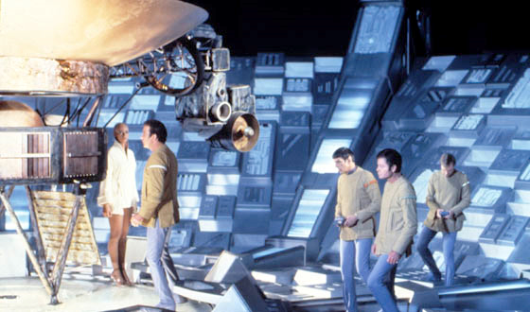
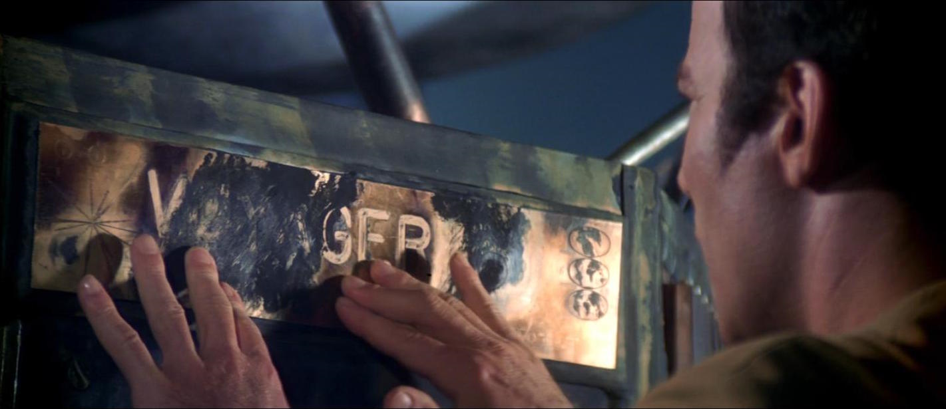
Star Trek and Voyager 1 “VGER”

Slide 35
VOYAGER 2, JULY of 1979
Flyby of Jupiter
went on to visit Saturn, Uranus and Neptune
Identical to Voyager 1

Slide 37
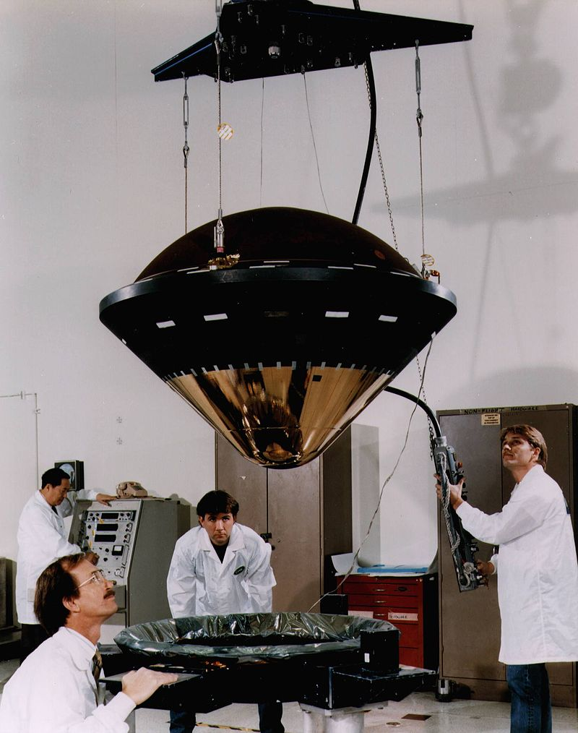
Galileo Orbiter and Probe, 1995-2003
Orbiter: also flew by various of Jupiter's moons; intentionally flown into Jupiter at end of mission; first spacecraft to orbit Jupiter; first spacecraft to flyby an asteroid
Atmospheric Probe: first probe to enter Jupiter's atmosphere

Slide 38
Galileo Orbiter Namesake

Slide 39
Cassini, 2000
Flyby of Jupiter
gravity assist en route to Saturn
Giovanni Cassini

Slide 40
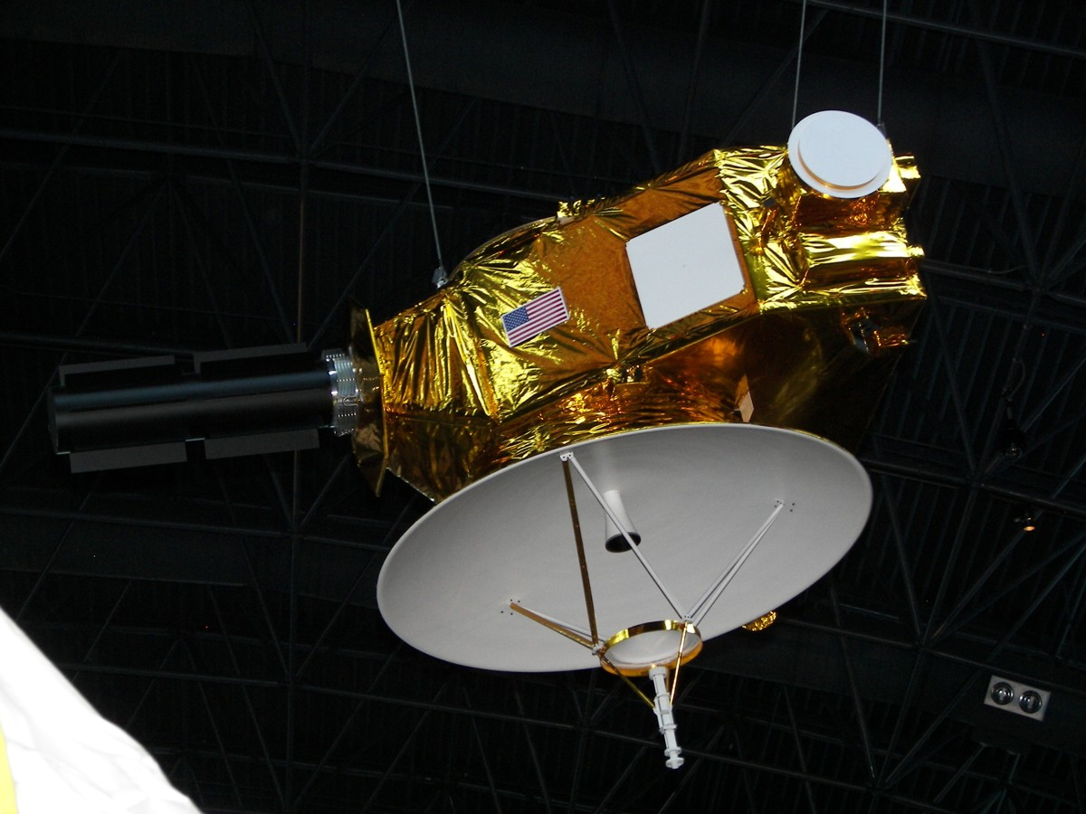
New Horizons, 2007
Flyby
gravity assist en route to Pluto

Slide 41
New Horizons, 2007
Flyby
gravity assist en route to Pluto

Slide 42
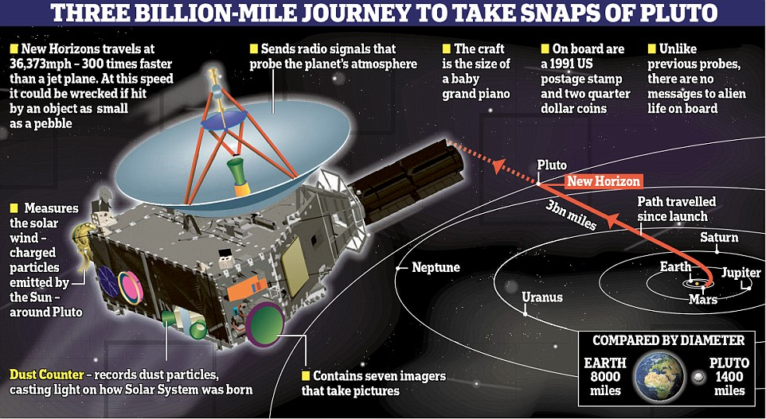

Slide 43
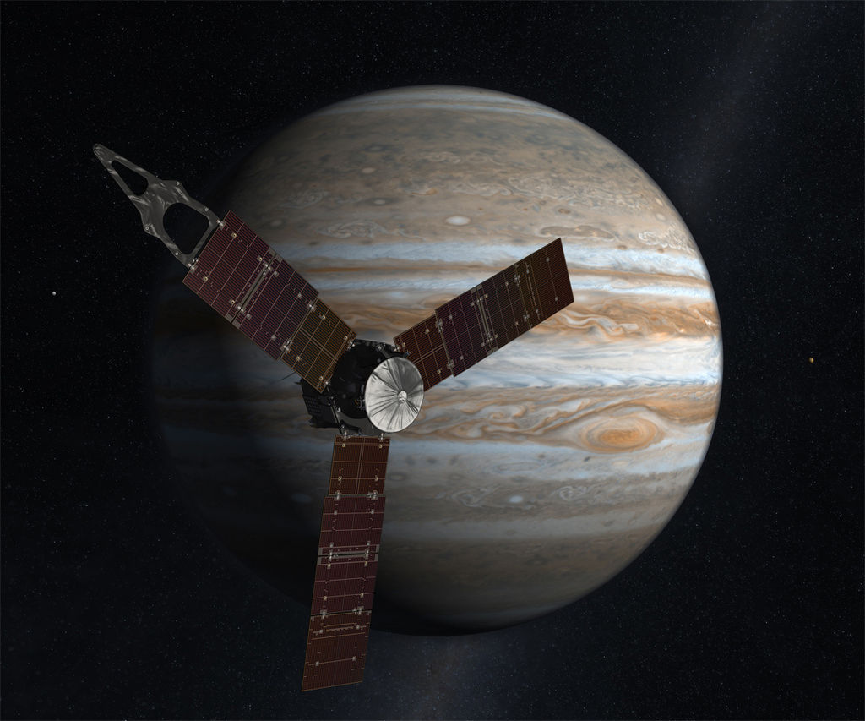
Juno, 2018
Orbiter
First solar-powered Jupiter orbiter, first mission to achieve a polar orbit of Jupiter.

Slide 44
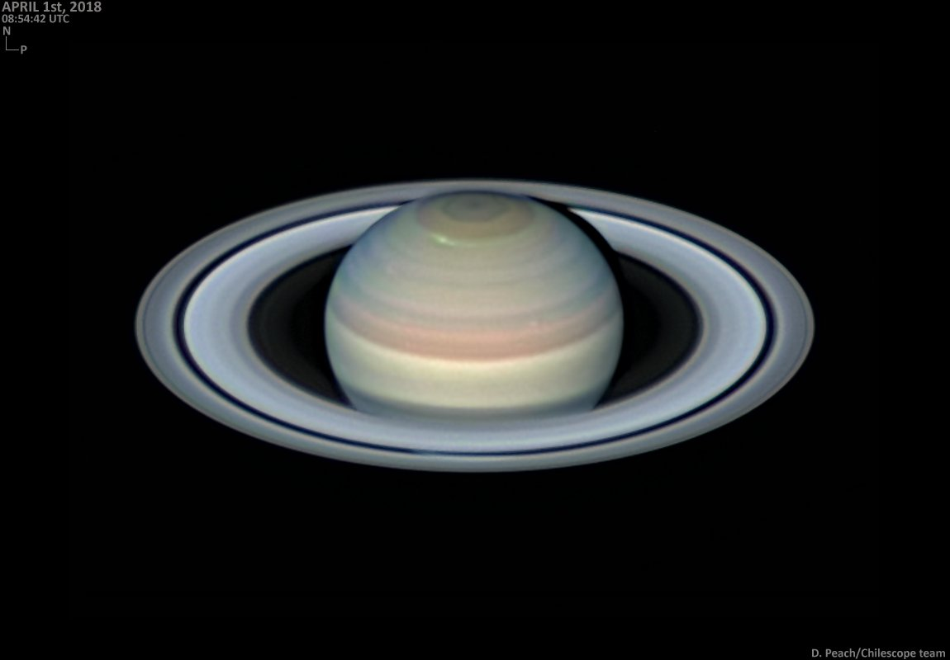
SATURN AND TITAN PROBES
Pioneer 11
Voyager 1
Voyager 2
Cassini
Huygens
Dragonfly (2025)

Slide 45
Pioneer 11, 1979
Flyby of Saturn
Previously flew by Jupiter

Slide 47
Voyager 1, March, 1980
Flyby of Jupiter
Went on to visit Saturn, then Uranus and Neptune

Slide 50
VOYAGER 2, 1981
Flyby of Saturn
Previously flew by Jupiter
Went on to Uranus and Neptune
Identical to Voyager 1

Slide 52
Cassini, 2004-2017
Orbiter
Previously flew by Jupiter for gravity assist en route to Saturn
Also performed flybys of a number of Saturn's moons, and deployed the Huygens Titan lander; first spacecraft to orbit Saturn

Slide 53
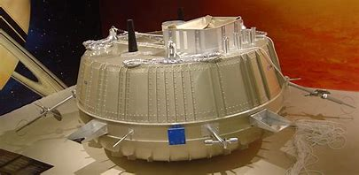
HUYGENS PROBE FOR TITAN, 2005
Deployed by the Cassini Probe
first probe to land on a satellite of another planet
VIDEO

Slide 54
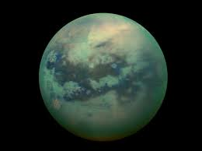
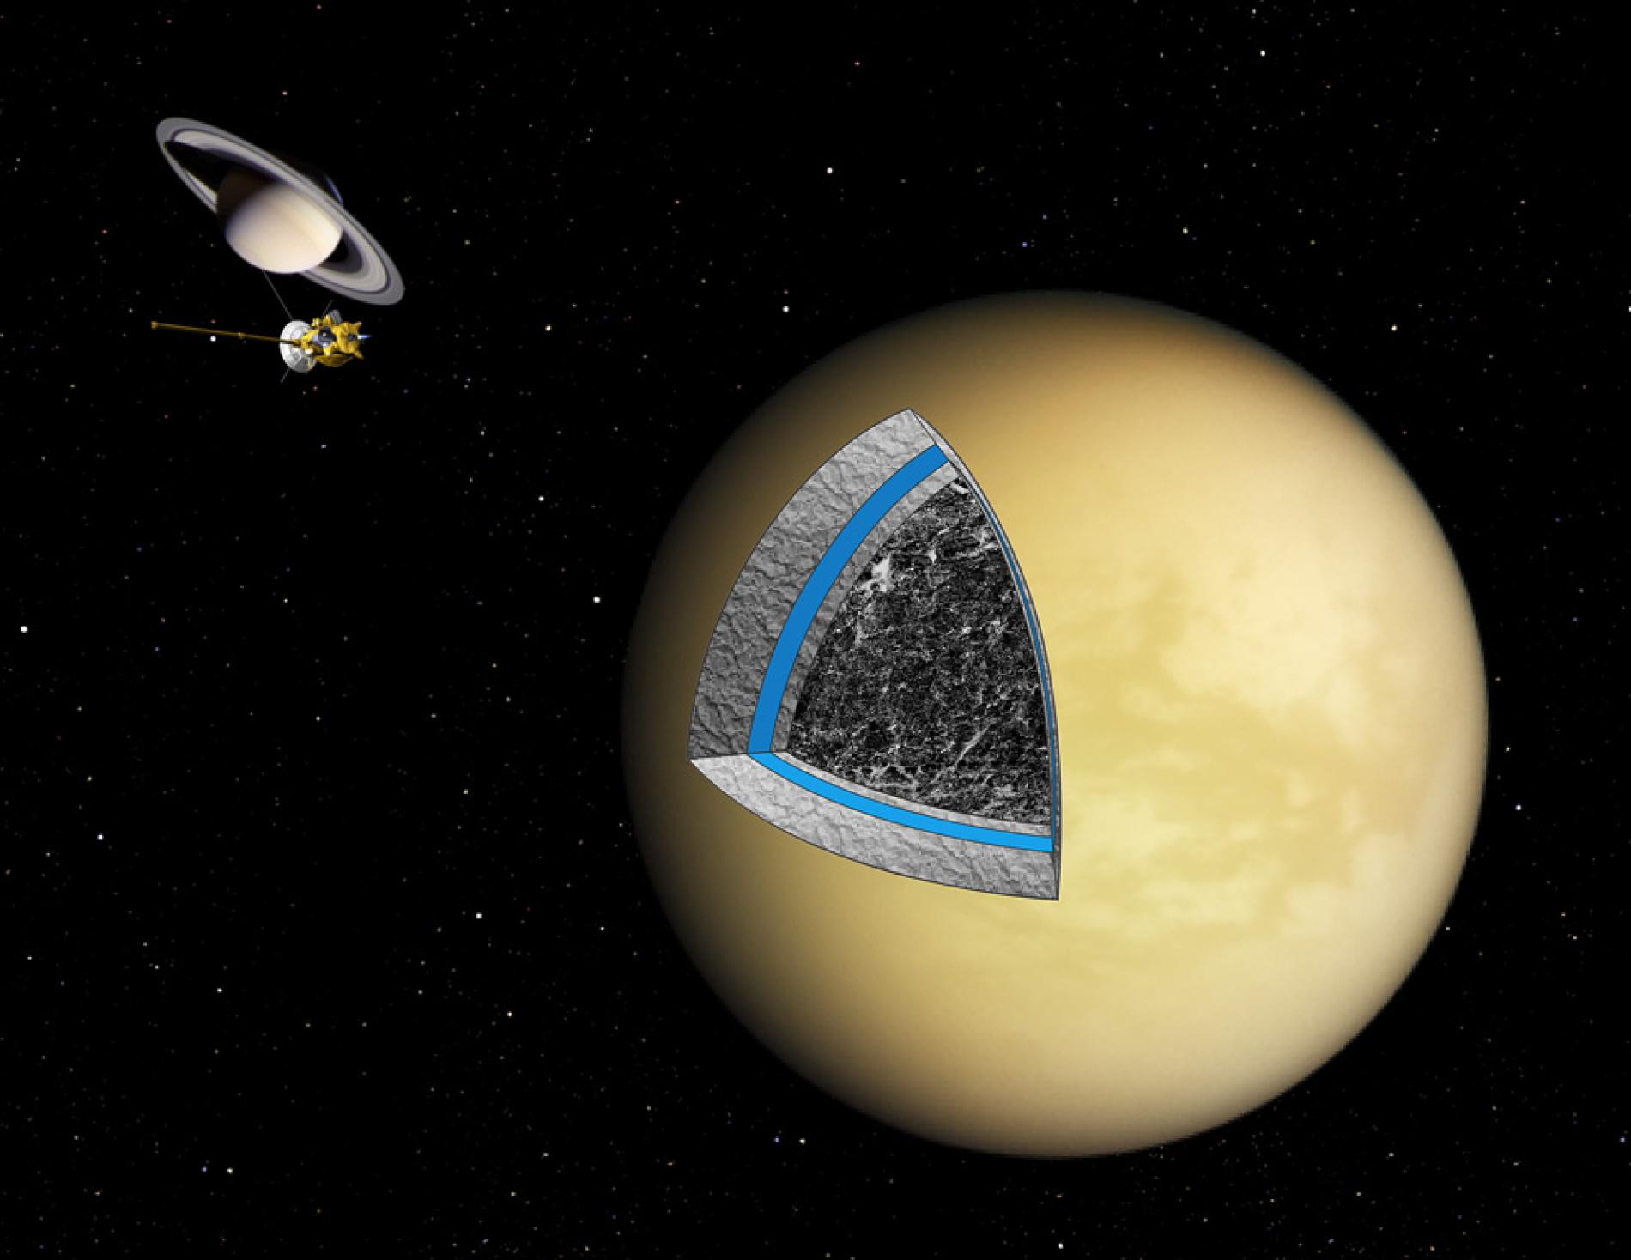
Titan
VIDEO
Slushy Interior

Slide 55
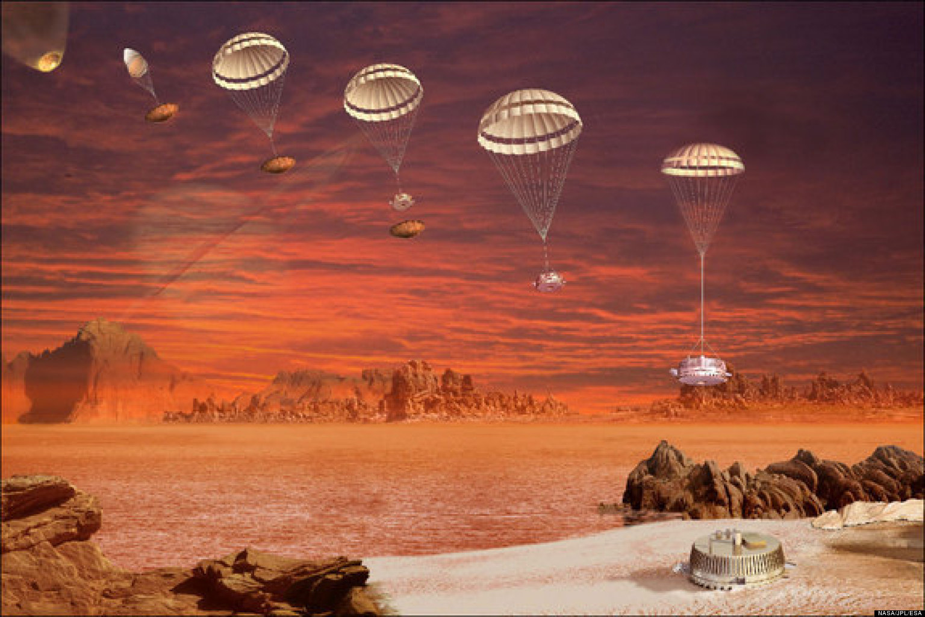

Slide 56
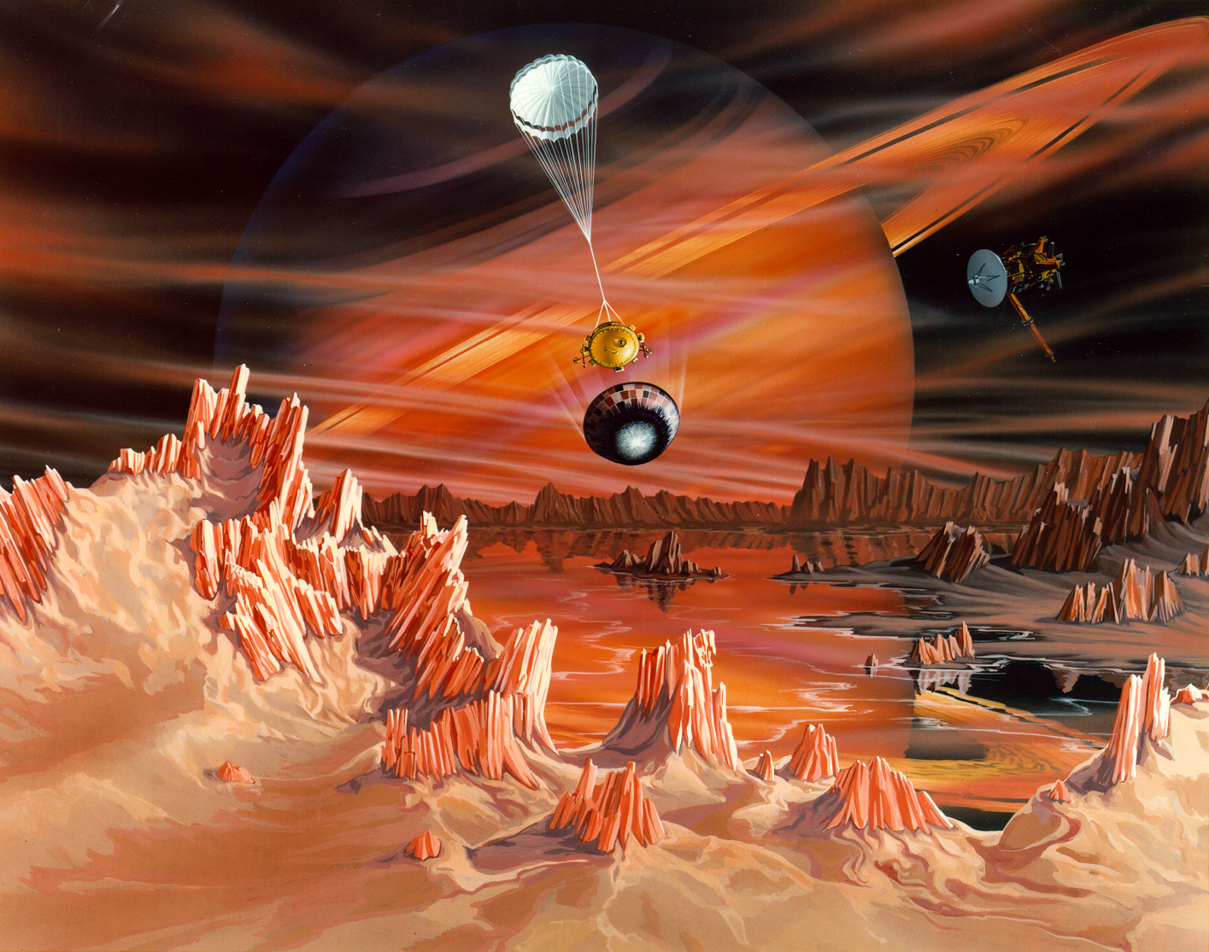

Slide 57
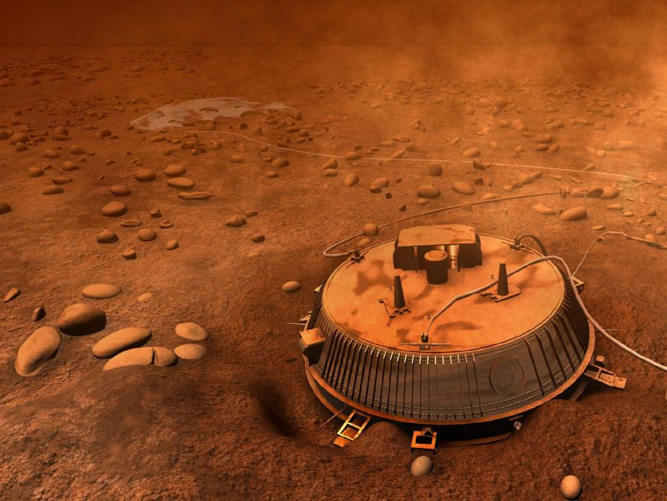

Slide 58
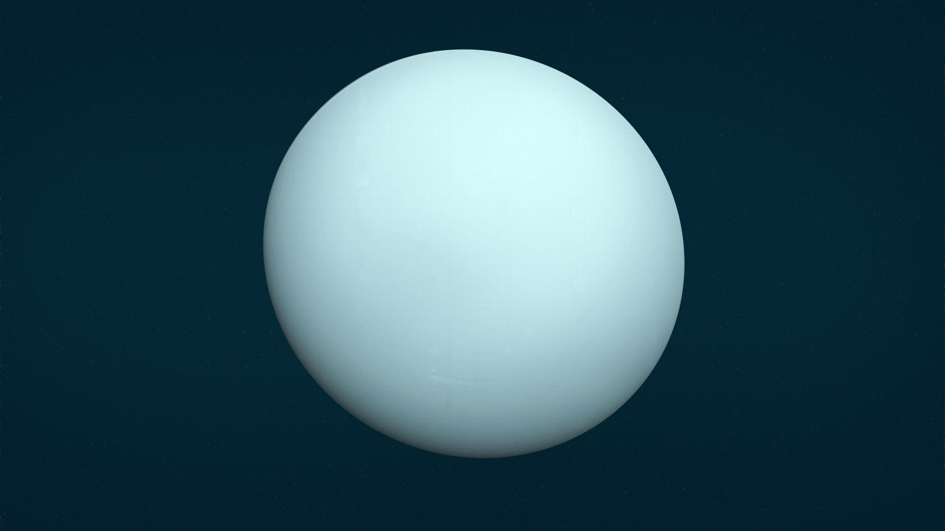
URANUS PROBES: 1 MISSION
Voyager 2

Slide 59
VOYAGER 2, 1986
Flyby of Uranus
Previously flew by Jupiter and Saturn
Went on to Neptune
Identical to Voyager 1

Slide 61
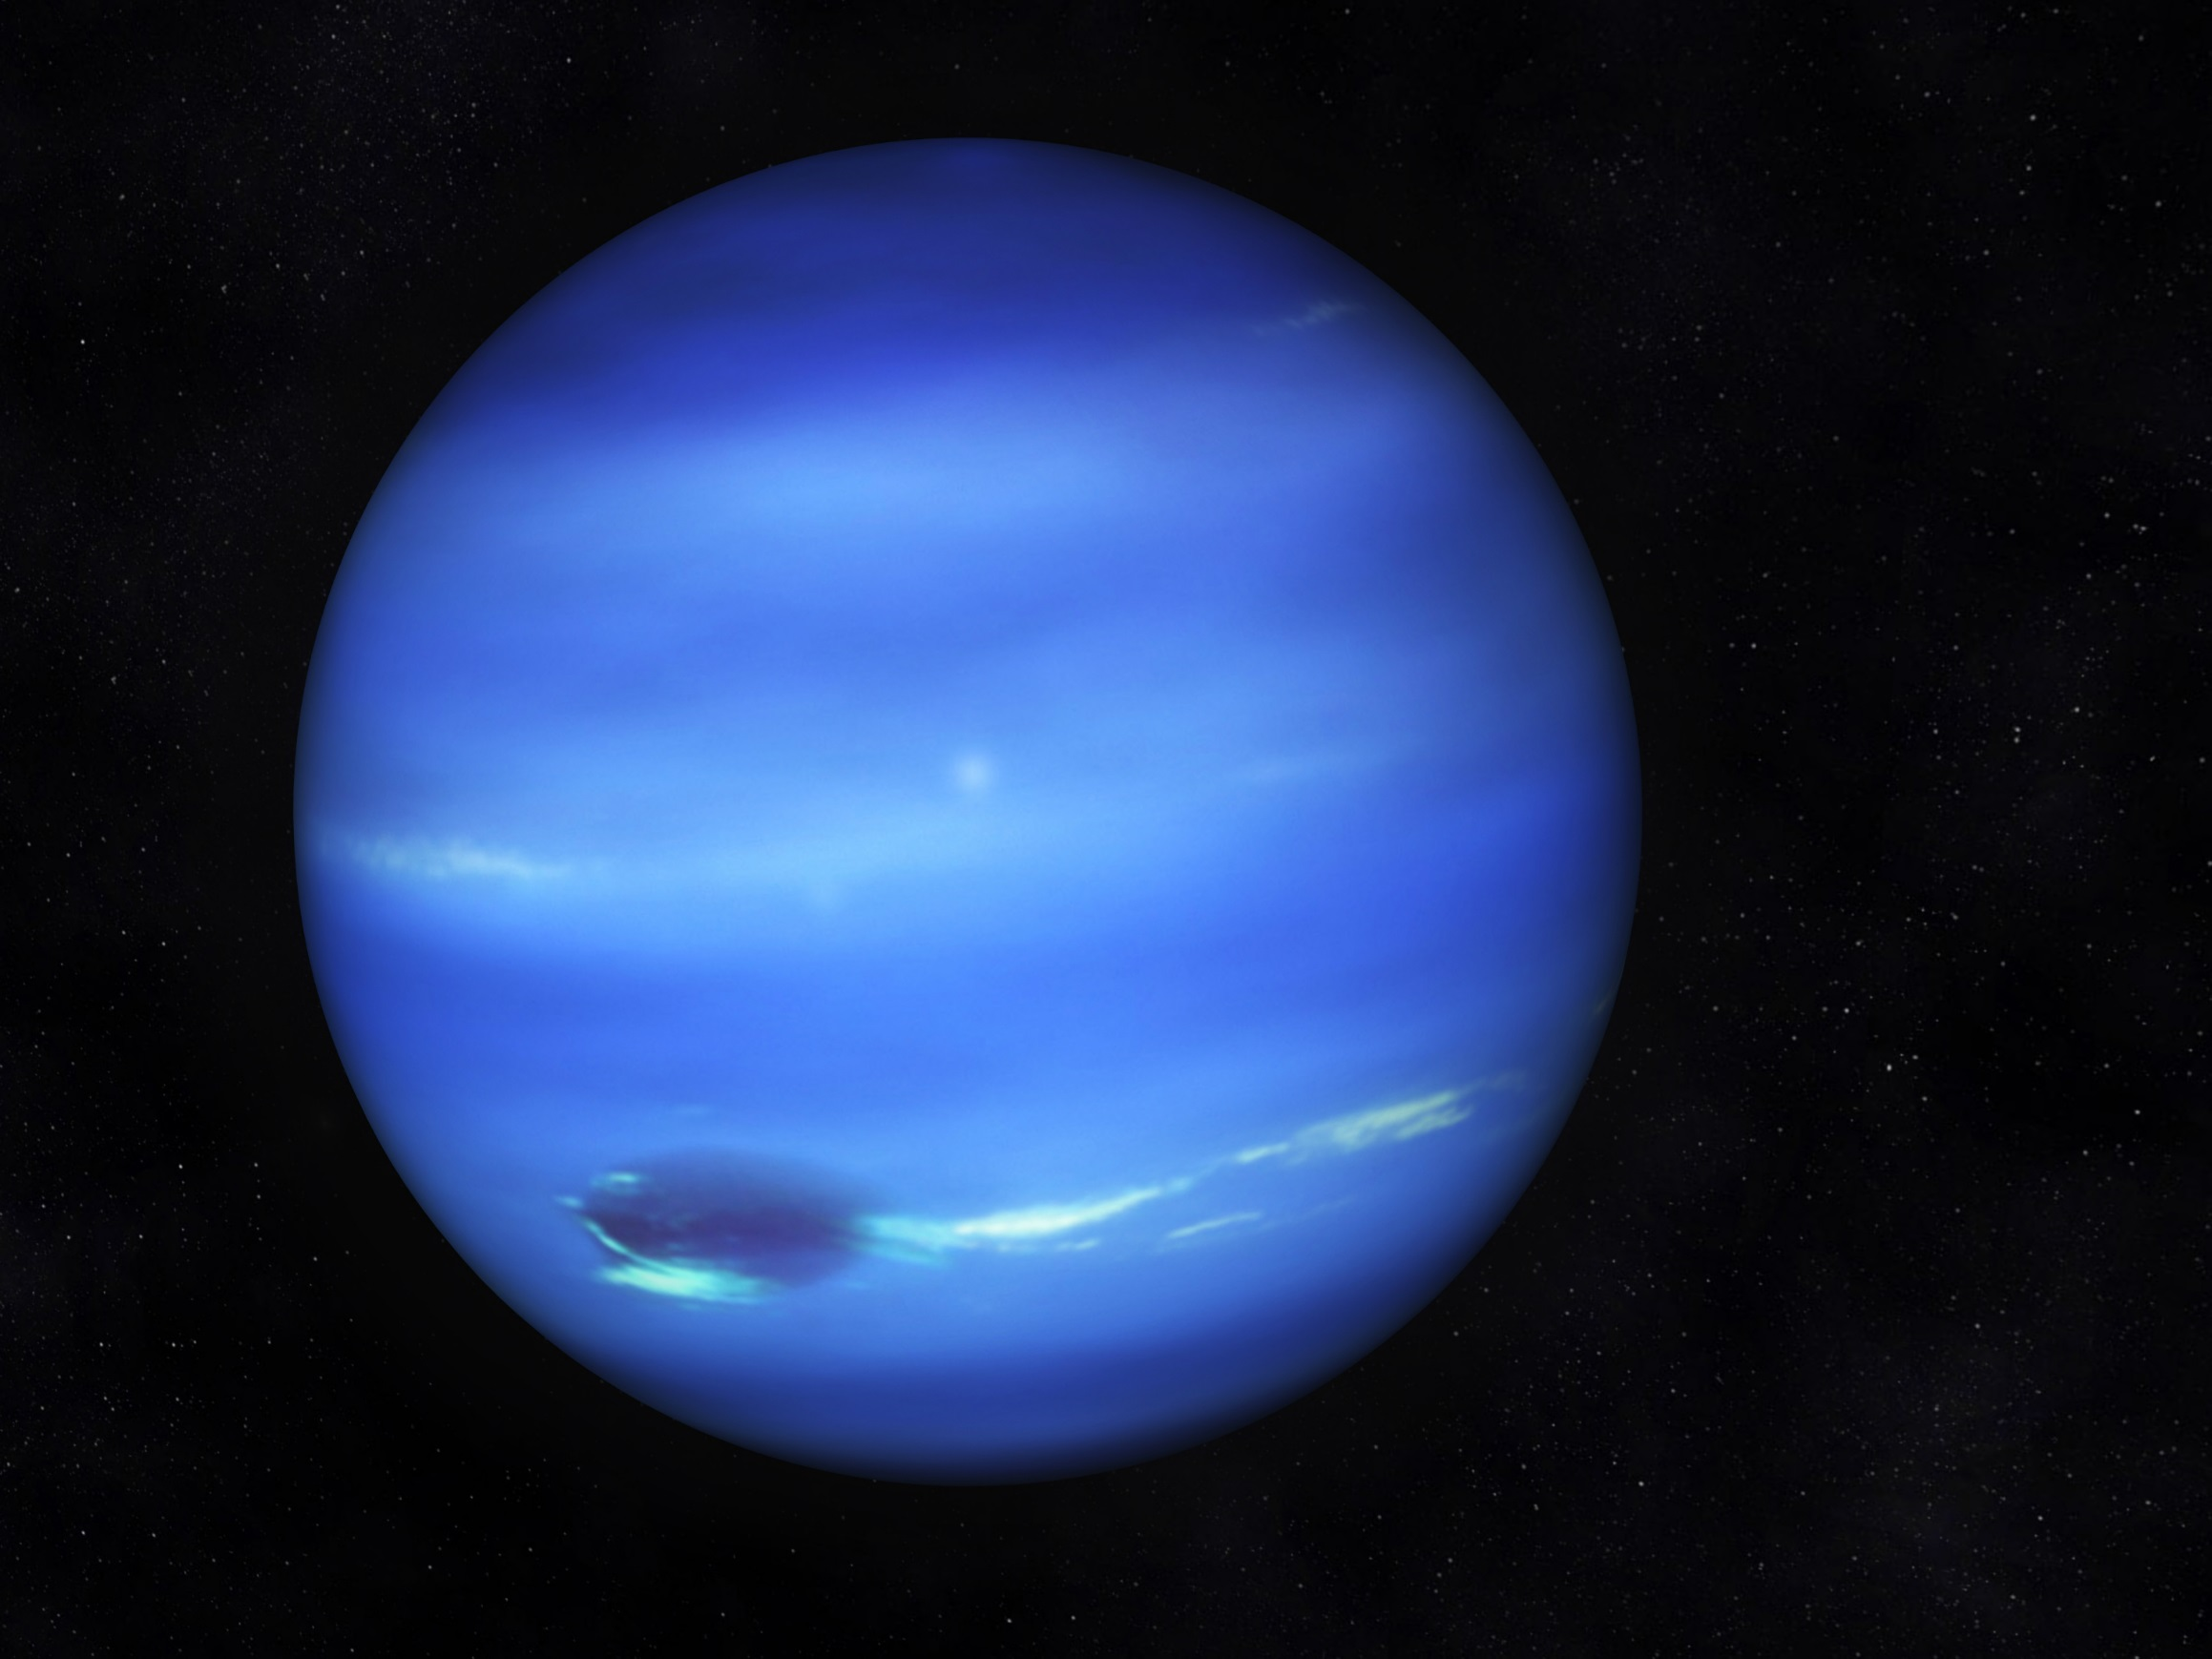
NEPTUNE PROBES:: 1 MISSION
Voyager 2

Slide 62
VOYAGER 2, 1986
Flyby of Neptune
Previously flew by Jupiter and Saturn and Uranus
Identical to Voyager 1

Slide 64
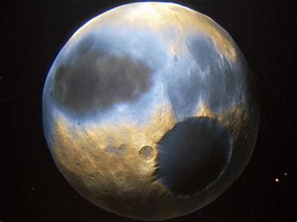
PLUTO PROBES: 1 MISSION
New Horizons
VIDEO

Slide 65
New Horizons, 2007
Flyby of Pluto
Previously flew by Jupiter as gravity assist en route to Pluto

Slide 67
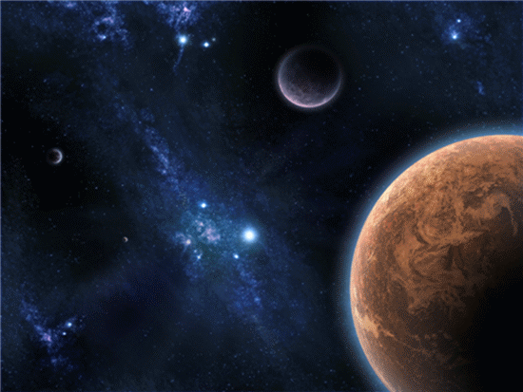
I
Space Probes 2.
Discuss with a friend:
What is the difference between a flyby, orbiter, lander and sampler type probes?
2. How is gravity and timing used to direct a probes flightpath??
I will get an A on my exams and quizzes.

Slide 68
COMET PROBES – 18 Missions
ICE (21P/Giacobini-Zinner)
Vega 1(1P/Halley)
Suisei (1P/Halley)
Vega 2 (1P/Halley)
Sakigake (1P/Halley)
Giotto (1P/Halley)
ICE (1P/Halley)
Grotto (26P/Grigg-Skjellerup)
Sakigake (45P/Honda-Mrkos-Pajduskova)
Sakigake (21P/Giacobini-Zinner)
Suisei (55Tempel-Tuttle)
Suisei (21P/Giacobini-Zinner)
Deep Space 1 (19P/Borrelly)
CONOTOUR (73/Churyumov-Gerasimeko)
CONTOUR (6P/d’Arrest)
Deep Impact-EPOX (103/Hartley)
Stardust – NExT (9P/Temple)
Rosetta-Philae (67P/Churyumov-Gerasimenko)

Slide 69
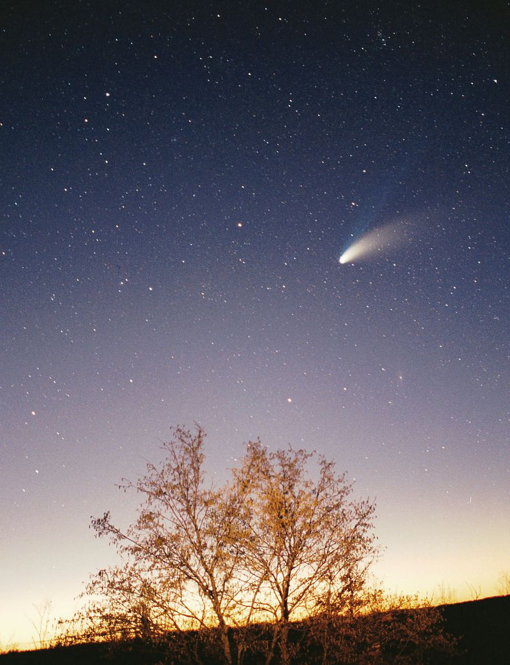
What is a Comet?
Icy
Small Solar System body
When passing close to the Sun, warms and begins to release gases, a process called outgassing.
This produces a visible atmosphere or coma, and sometimes also a tail

Slide 70
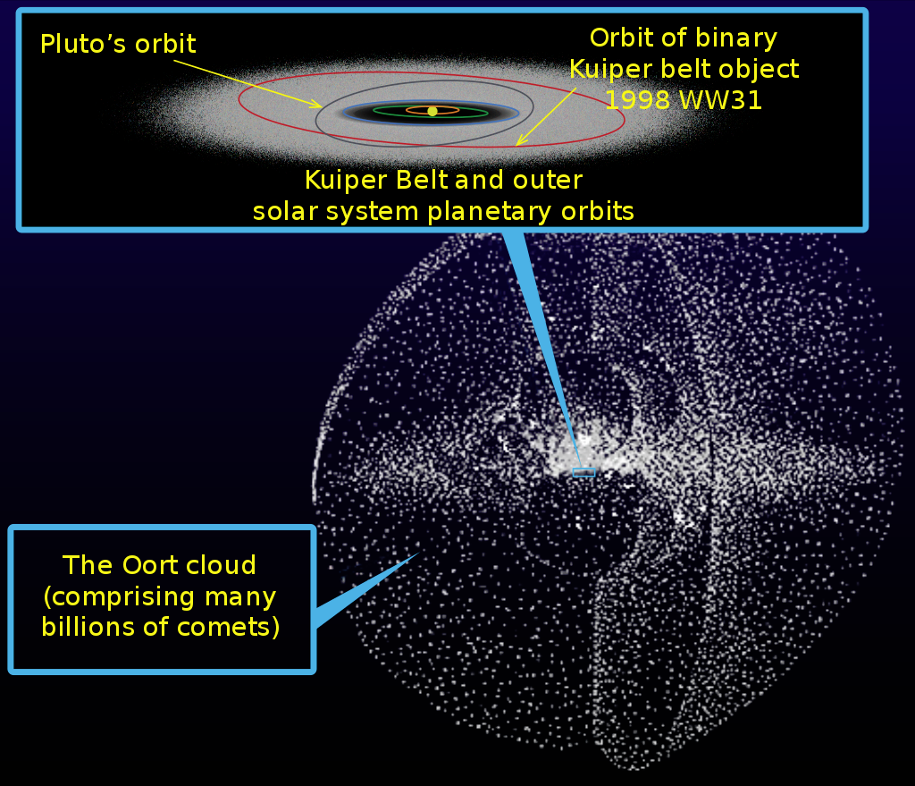
Where do Comets come from?
Ort Cloud
Remnant of Solar System formation, but not flattened

Slide 71
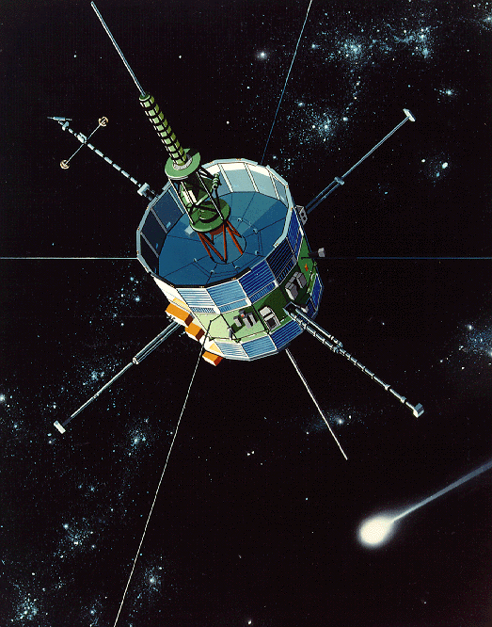
ICE (formerly ISEE3), 1985
Comet 21P/Giacobini-Zinner
Previously solar monitor ISEE3; went on to observe Halley's Comet

Slide 72
Comet 21P/Giacobini-Zinner

Slide 73
Discovery Photo

Slide 74
Comet 21P/Giacobini-Zinner in Monoceros on April, 24 2019
Live Illustration
Video

Slide 75
Vega 1, 1985
Comet 1P/Halley
Previously visited Venus
Minimum distance 8,890 km;

Slide 76
1P/Halley’s Comet
Recorded in ancient Greece and China between 468 and 466 BC
Recorded on cuneiform clay tablet between 22 and 28 164 BC, Babylon

Slide 77
Chinese chronicle Records of the Grand Historian or Shiji, which describes a comet that appeared in the east and moved north in 240 BC

Slide 78
1006 BC
Battle of Hastings
Bad omen for Harold II of England
Good omen for William the Conqueror of Normandy
Bayeux Tapestry

Slide 80
Edmond Halley
The comet appeared in 1531, 1607 and 1682. Halley predicted that the same comet could return to Earth in 1758. Halley did not live long enough to see its return – he died in 1742 – but his discovery inspired others to name the comet after him
HALLEY’S COMET 1985-86 VIDEO
76 YEAR PERIOD
NEXT TIME 2061-62

Slide 81
Giotto, 1986
1P/Halley
Minimum distance 596 km; went on to visit comet 26P/Grigg-Skjellerup

Slide 82
Giotto’s Journey
VIDEO
NEWS BRIEF
ANIMATION

Slide 83
Deep Space 1, 2001
Comet 19P/Borrelly
Previously visited asteroid 9969 Braille

Slide 84
Comet 19P/Borrelly
TRAJECTORIES

Slide 86
Live tracker for 19P Borrelly
TRACKER
3D SIMULATOR
Comet 19P/Borrelly in Ophiucus on April, 24 2019

Slide 87
Stardust, 2004 (write it down!)
81P/Wild
Flyby, sample, return
sample returned January 2006; also visited asteroid 5535 Annefrank

Slide 89
Orbiter and Lander with sampler

Slide 90
81P/Wild
TRAJECTORY

Slide 92
Rosetta-Philae, 2014-2016
Comet 67P/Churyumov– Gerasimenko
Flybys of asteroids 2867 Šteins and 21 Lutetia completed; intentionally impacted into Comet 67P/Churymov-Gerasimenko at end of mission
VIDEO

Slide 93
Rosetta

Slide 95
Philae

Slide 102
Space Probes to the Kuiper Belt
New Horizons, 2019
Flyby success
Extended mission after Pluto encounter, currently sending back data from flyby; may flyby other Kuiper Belt object in 2020s

Slide 103
New Horizons, 2007 to 2019
Flyby of Jupiter
gravity assist en route to Pluto
Then to Kuiper Belt
Then to Outer Space

Slide 105
I
Space Probes 2.
Discuss with a friend:
What Is a comet?
How does it differ from a planet or asteroid?
What Comet probes took and returned samples to earth??
I will get an A on my exams and quizzes.

Slide 106
Kuiper Belt Formation
VIDEO
Origin
Definition
May have formed closer to the sun, near where Neptune now orbits. In this model, the planets engaged in an elaborate dance, with Neptune and Uranus changing places and moving outward, away from the sun. They may have carried the Kuiper Belt objects with them, shepherding them ahead as they migrated.
The Kuiper Belt (also known as the Edgeworth–Kuiper belt) is a region of the Solar System that exists beyond the eight major planets, extending from the orbit of Neptune (at 30 AU) to approximately 50 AU from the Sun. It is similar to the asteroid belt, in that it contains many small bodies, all remnants from the Solar System’s formation

Slide 107
Space Probes leaving the Solar System
Pioneer 10, 1973 to 2003
Pioneer 11, 1979 to 1995
Voyager 1, 1980 to present
Voyager 2, 1989 to present
New Horizons, 2015 to present

Slide 108
PIONEER 10, 1973 to 2003
first probe to cross the asteroid belt
first Jupiter probe
first man-made object on an interstellar trajectory;
now in the outer regions of the Solar System but no longer contactable

Slide 111
Pioneer 10 and 11 Plaques
Hyperfine transition of neutral hydrogen
Relative position of Sun to the center of Milky Way Galexy and 14 pulsars
Solar System and diagrammatic flight path.
Man and Woman

Slide 112
Pioneer 11, 1974 to 1995
Flyby of Jupiter
Went on to visit Saturn
Then went outside the Solar System

Slide 114
Voyager 1, March of 1979 to present
Flyby of Jupiter
Went on to visit Saturn
Then to Outer Space

Slide 115
Voyager Message: Golden Record
VIDEO
Carl Sagan (CS Video)
115 Images
Spoken greetings Akkadian to Wu (modern Chinese)
music

Slide 117
VOYAGER 2, JULY of 1979 to present
Flyby of Jupiter
went on to visit Saturn, Uranus and Neptune
Identical to Voyager 1

Slide 120
VIDEO

Slide 121
New Horizons, 2007 to 2019
VIDIO OF FLIGHTPATH
Flyby of Jupiter
gravity assist en route to Pluto
Then to Kuiper Belt
Then to Outer Space
VIDEO

Slide 122
New Horizons Message Initiative
You can submit ideas
Message will be uploaded to the spacecraft

Slide 123
I
Space Probes 2.
Discuss with a friend:
If an alien civilization encounters Pioneer, Voyager or New Horizons, what will they learn about us and our planet?
I will get an A on my exams and quizzes.

