Slide 1
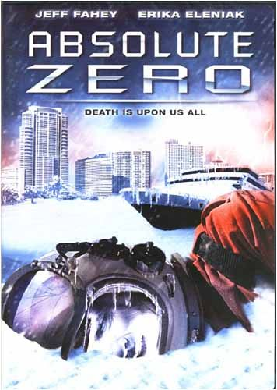
Absolute Zero (2006)
Dr. gregg wilkerson

Slide 2
Director
(Pompeii, Alone in the Dark, House of the Dead, Shoot ‘Em Up”, Viper, )

Slide 3
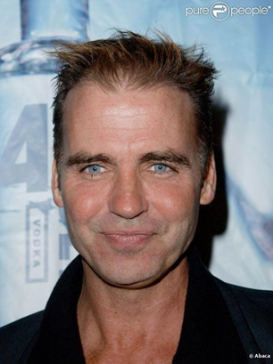
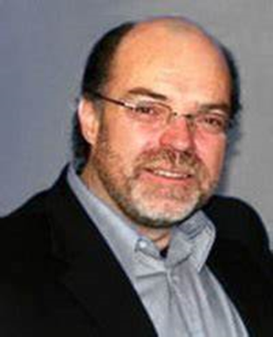
Jeff Fahey, (Lost, The Marshal, One Life to Live, Psyco III, Body Parts, The Lawnmower Man).
Erika Eleniak, (E.T., The Blob, Beverly Hillbillies (1993), Under Seiege, Chasers)
Bill Dow, (Legends of the Fall, The Big Year, Cool Runnings, The X Files, Stargate Universe: Atlantis:SG-1)

Slide 4
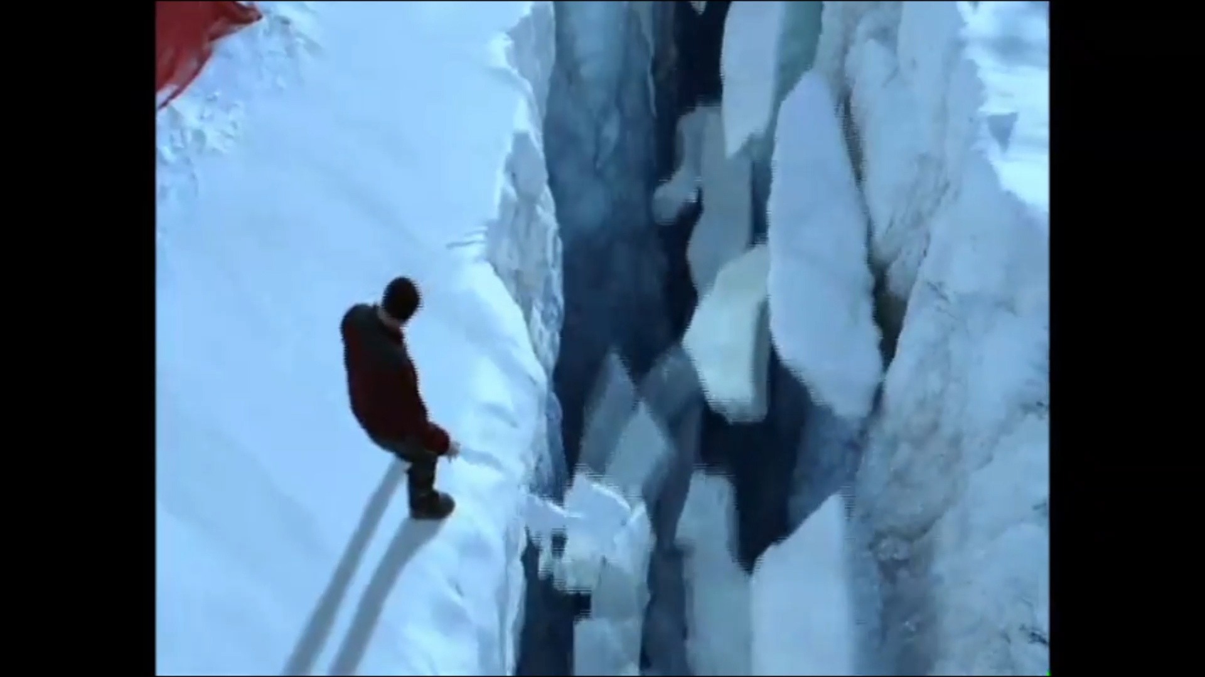
Researcher falls into Antarctic Ice Cap
I guess this is due to global warming
WATCH IT!

Slide 5
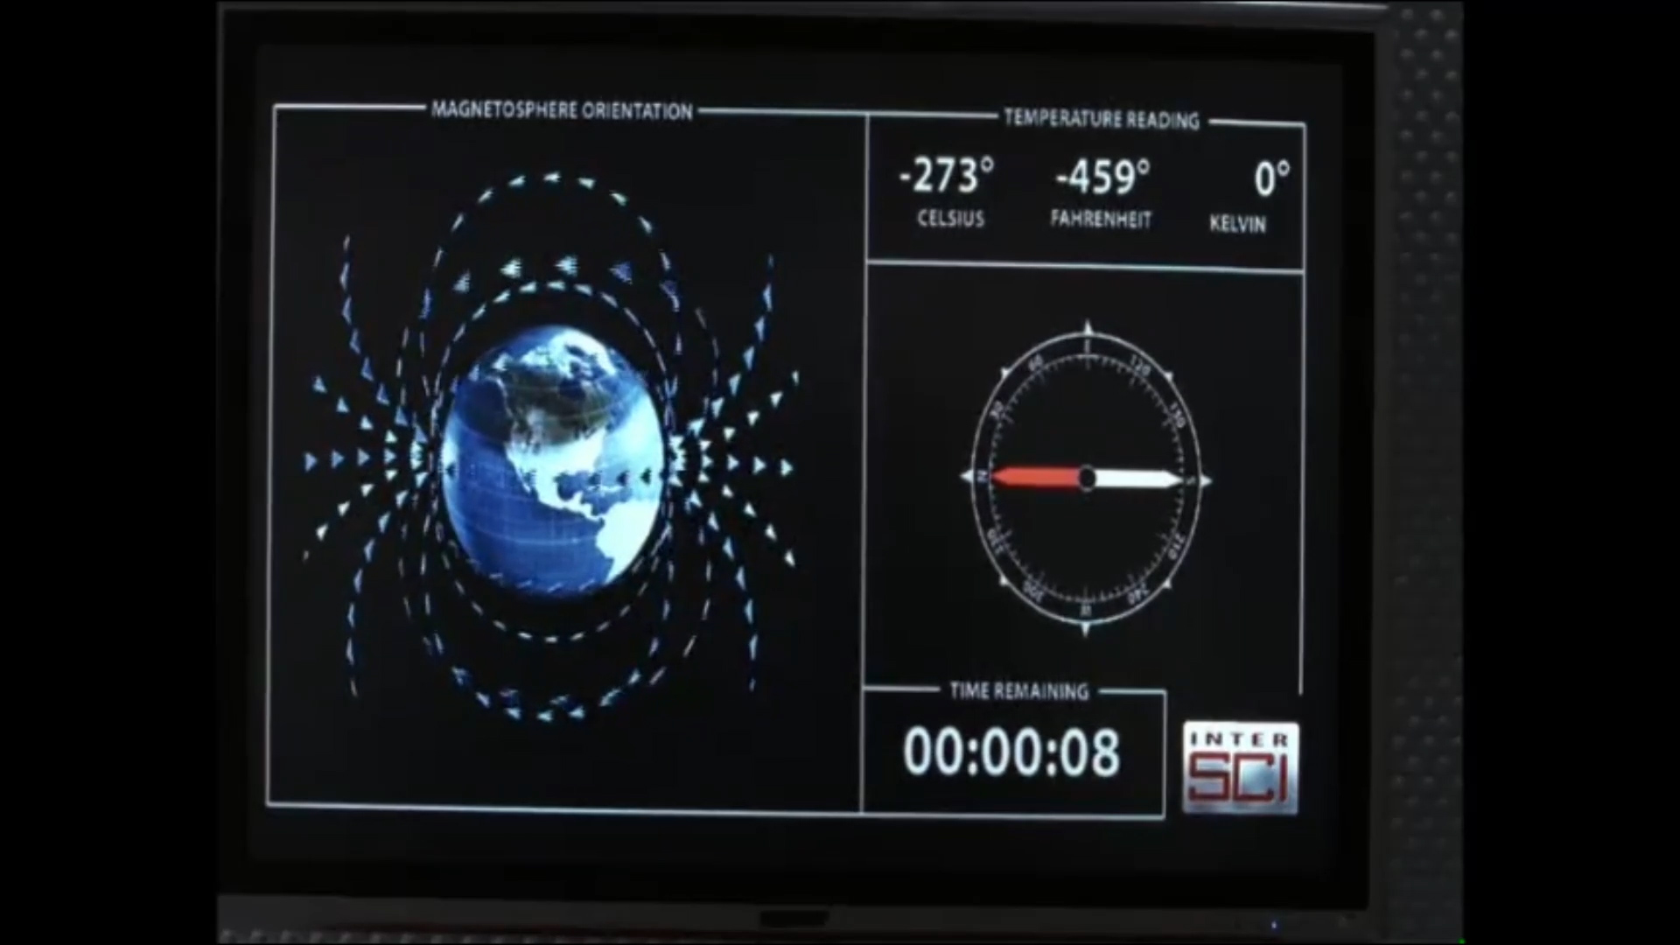
Magnetic Field Reversal Causes -273 degrees Celsius!
“Through out everything ever written about the Ice Age”
Instant Ice Age
“Because Science is never wrong!”
WATCH IT

Slide 6
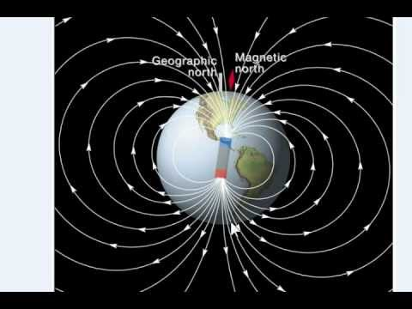
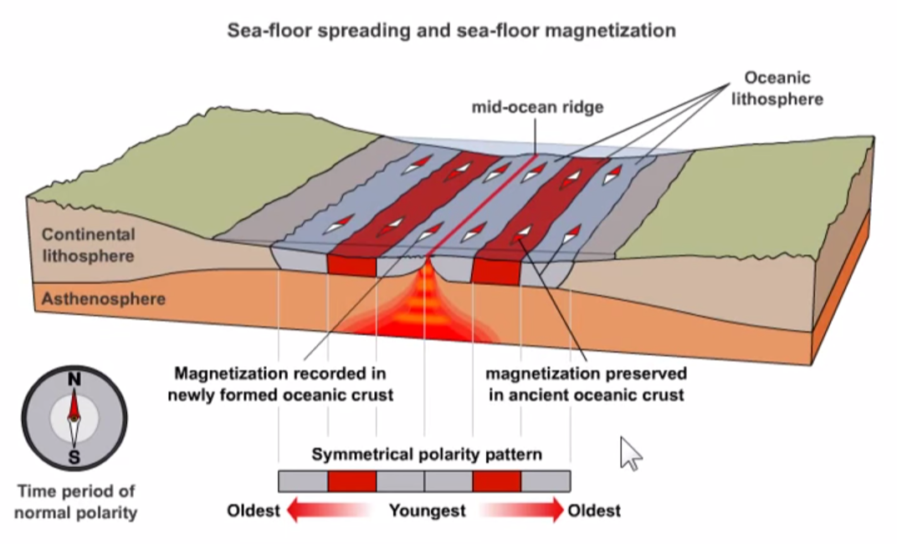
Magnetic Reversals
Are not instantaneous
Reversal occurrences are statistically random
83 reversals over the last 83 million years.
The latest, the Brunhes–Matuyama reversal, occurred 780,000 years ago

Slide 7
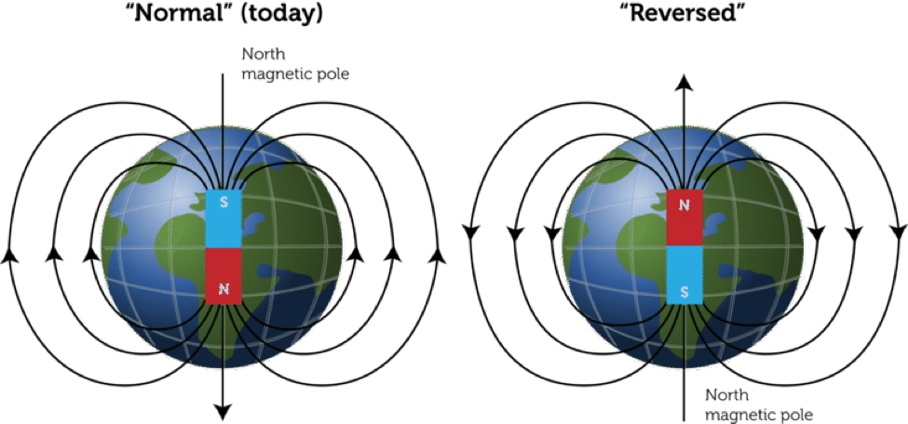

Slide 8
Magnetic Reversals

Slide 9
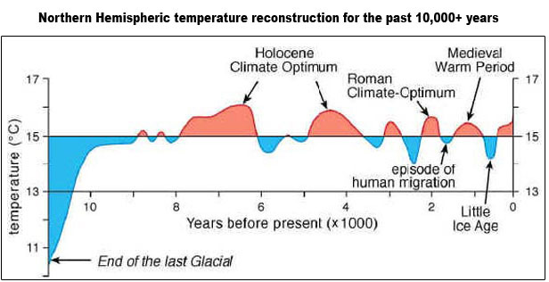
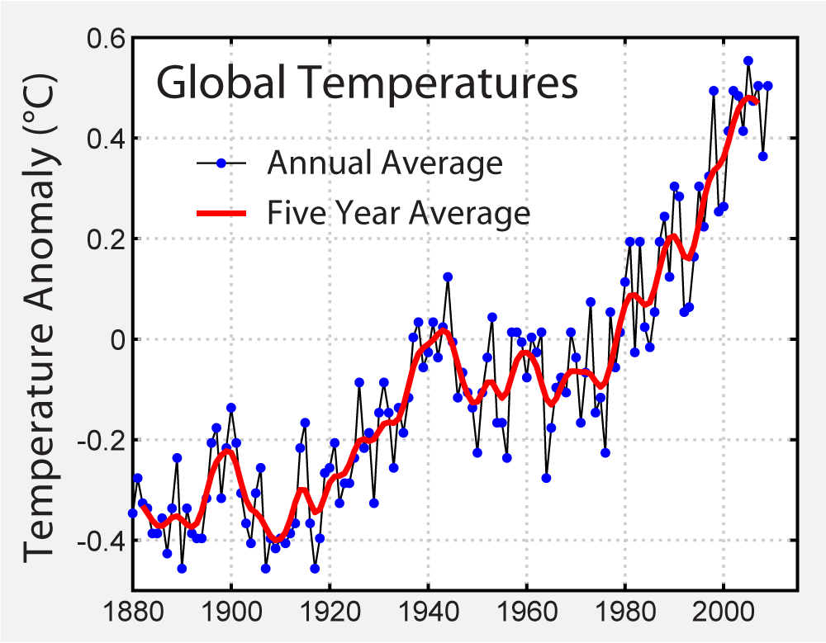
Magnetic Field and Climate
No direct connection
Some affect on upper atmosphere

Slide 10
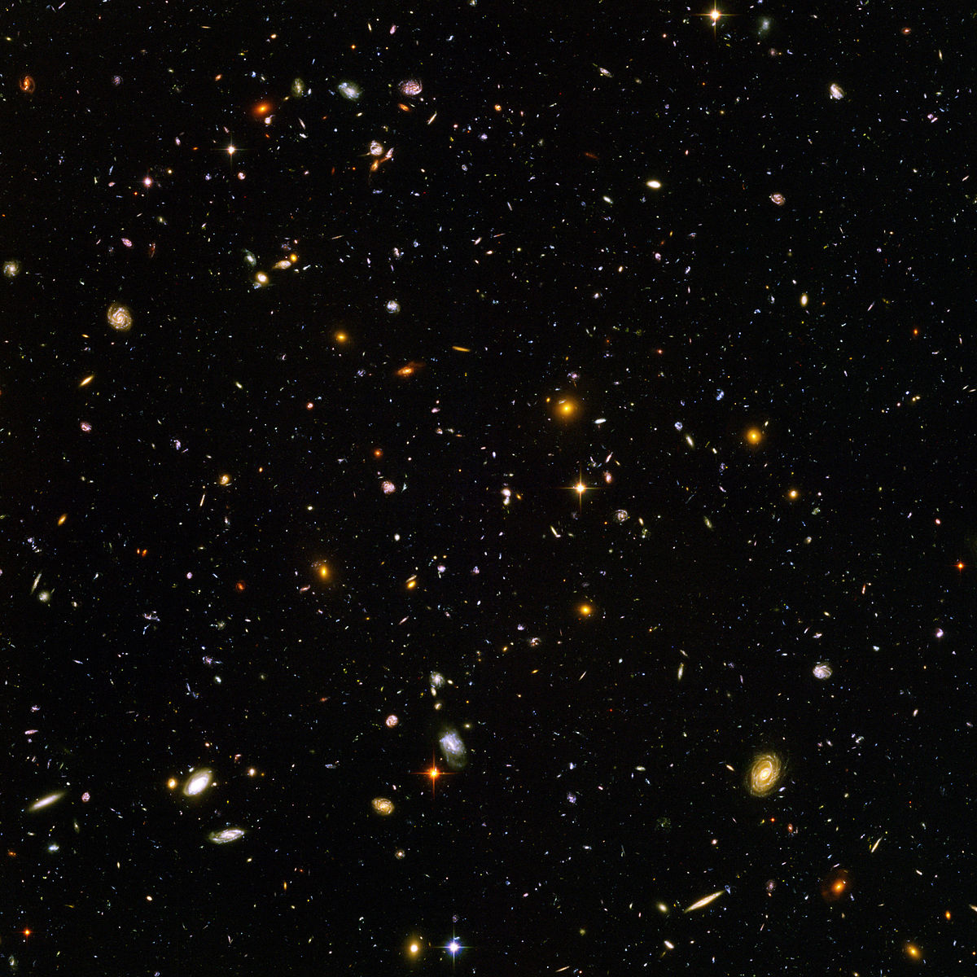
-273 degrees Celsius
0 degrees Kelvin
the lowest limit of the thermodynamic temperature scale, a state at which the enthalpy and entropy of a cooled ideal gas reach their minimum value, taken as 0
Deep space has a temperature of 0 degrees Kelvin

Slide 11
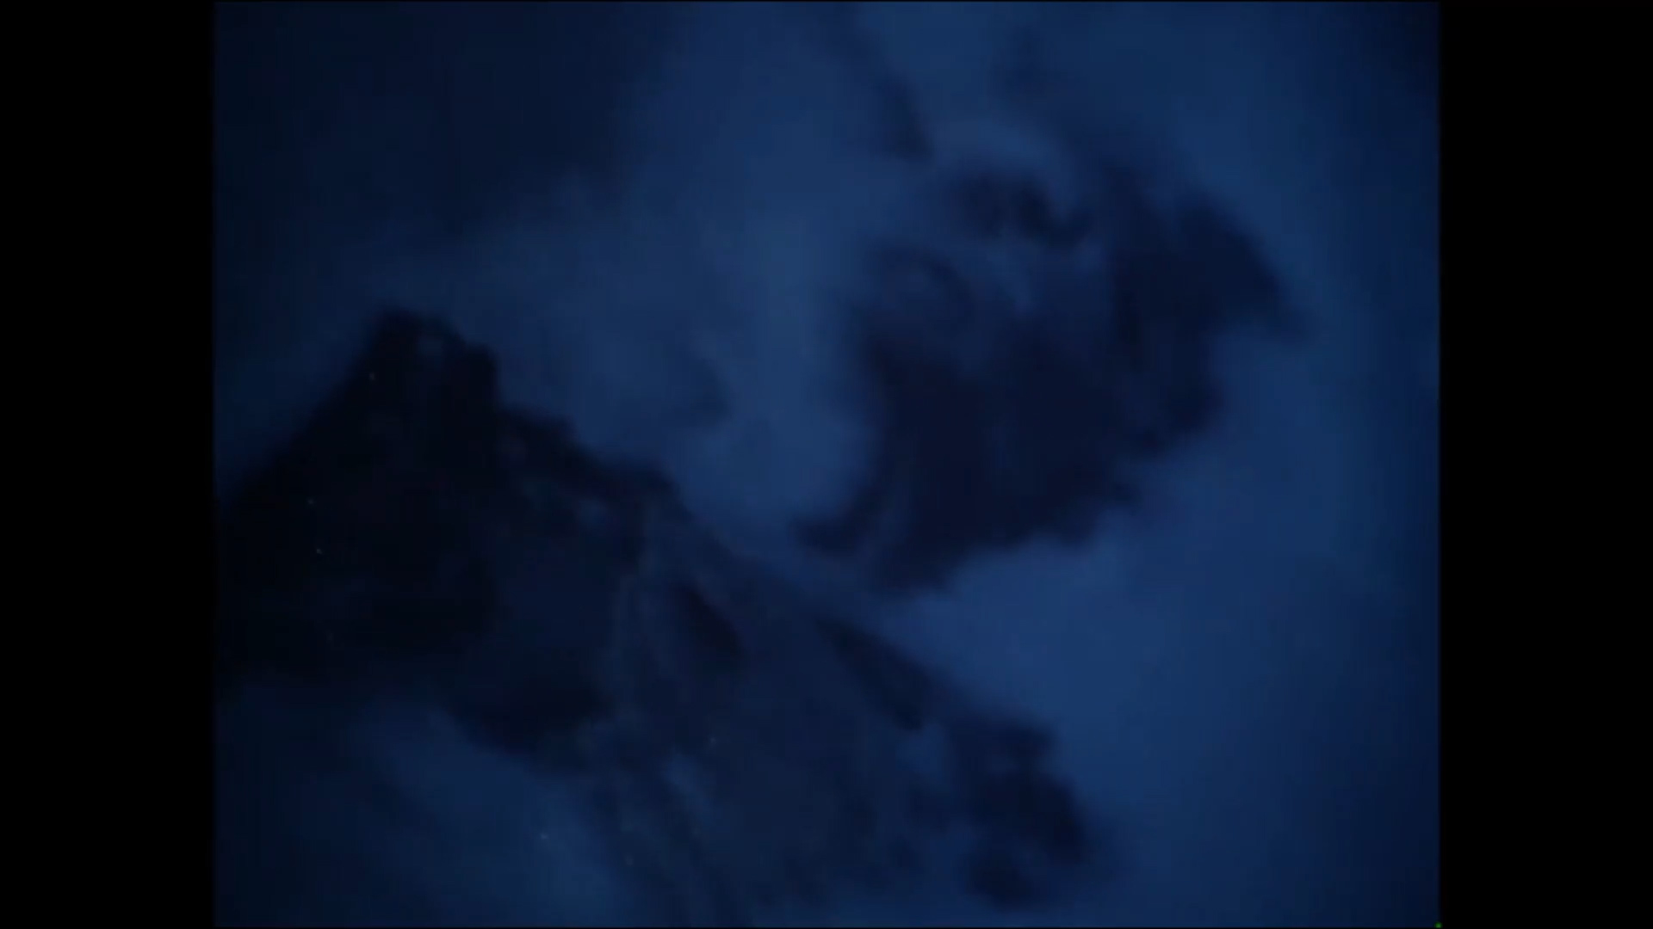
Check out a warm spot in Antarctica
The ice man commeth
A nice little cave and probe.
WATCH IT!

Slide 12
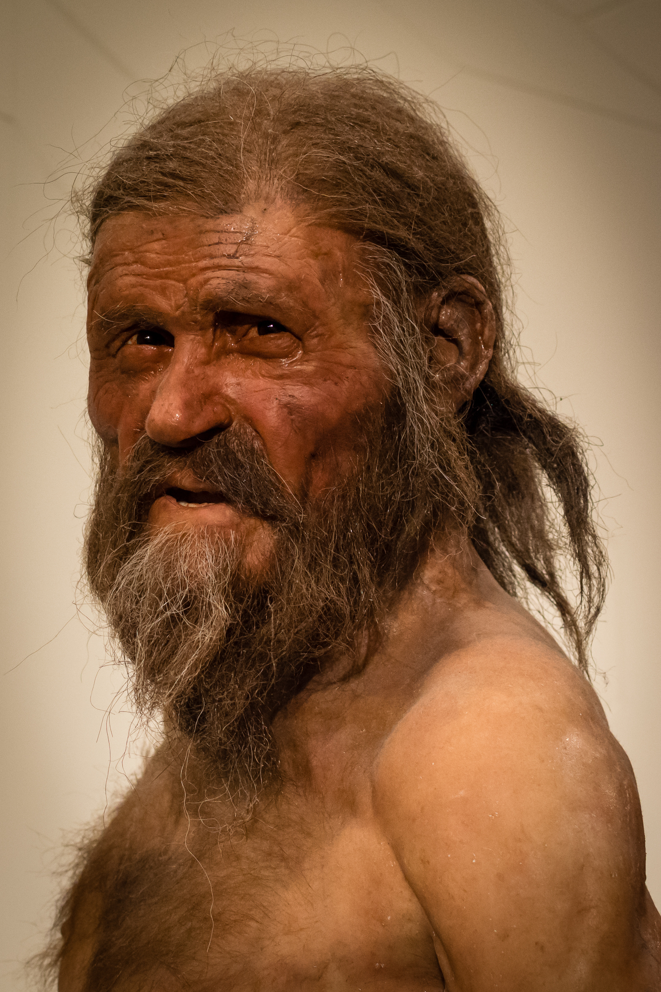
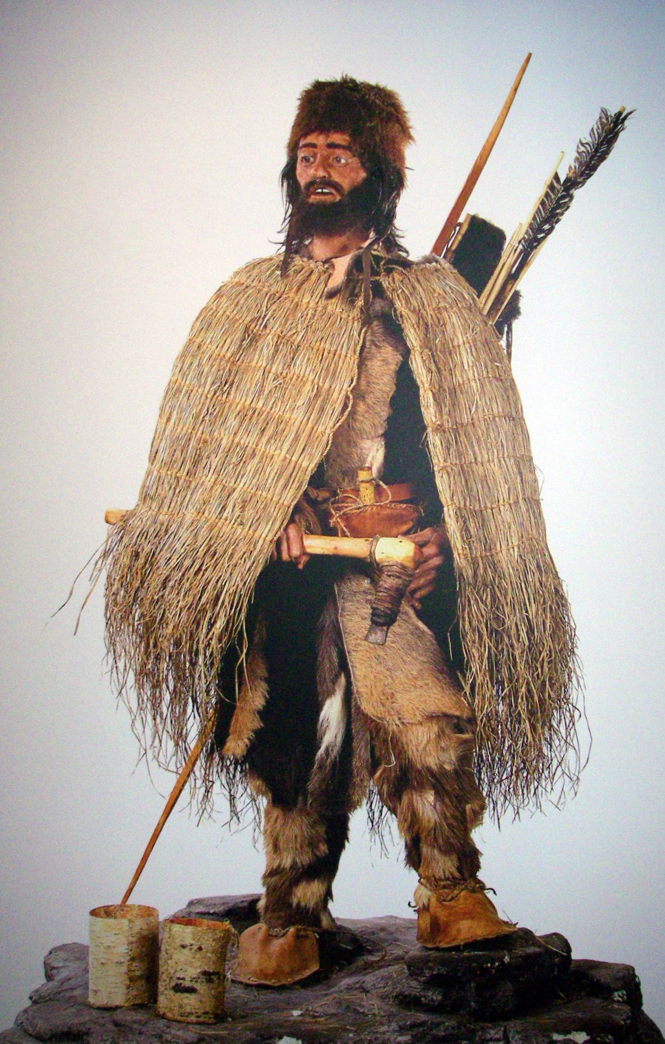
Otzi
1991:
3210 m above sea level near Tisenjoch/Giogo di Tisa
Schnalstal/Val Senales Valley, Austria.
Excavated without archaeologist
A forensic scientist from Innsbruck oversaw the transport of the mummy in a body bag.
During the recovery, numerous leather fragments, string, pieces of hide and clumps of hay came to light.
Adjacent to the body was a dagger and nearby a long stick that was later identified as a bow.
The dead man was flown by helicopter to Vent in the Ötztal Valley, Austria. He was placed in a wooden coffin and driven in a hearse to the Institute of Forensic Medicine in Innsbruck.

Slide 13
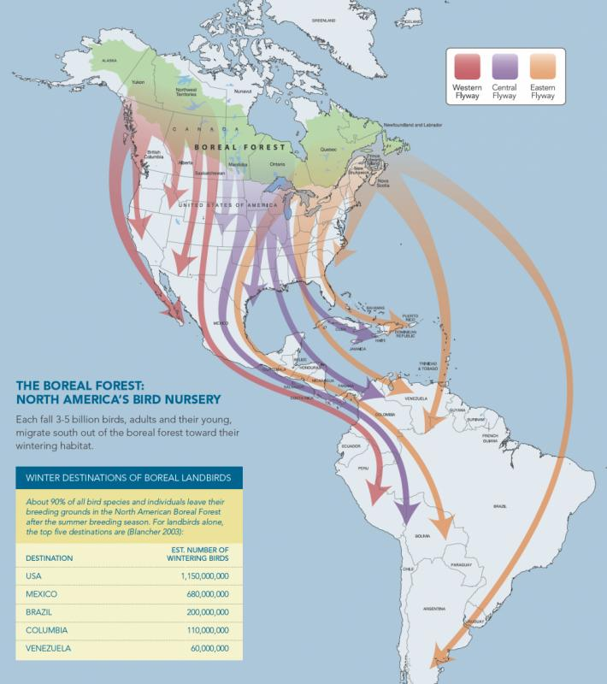
Accelerated travel plans for birds
Birds go north ahead of schedule
WATCH IT!

Slide 14
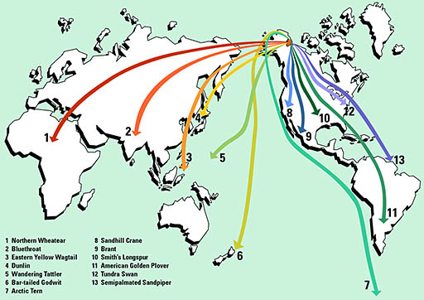
Why do birds migrate?
They know the Sun!
Sensitive to length of the day and angle of sunlight

Slide 15
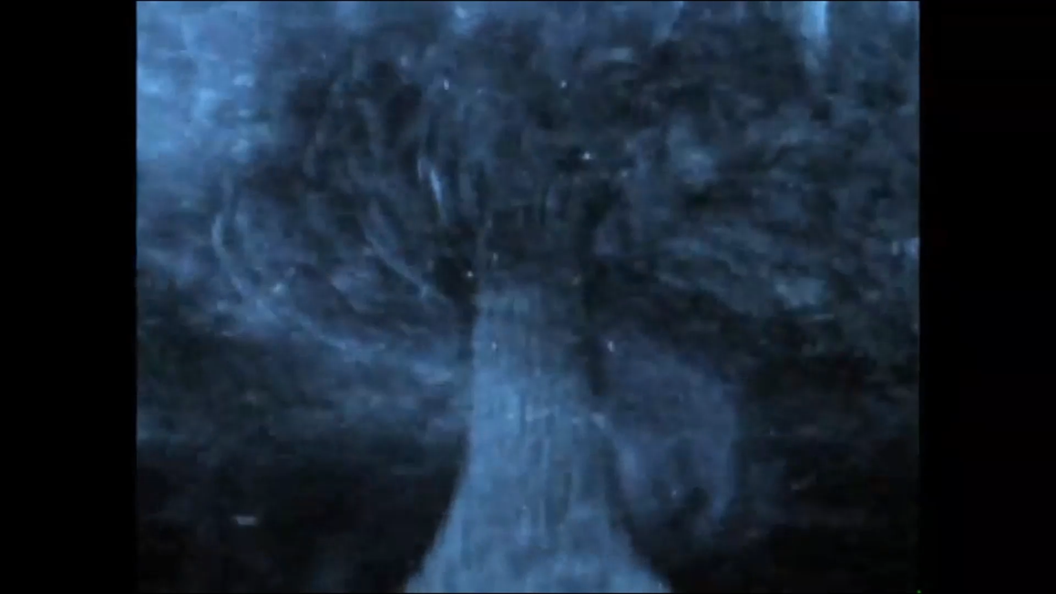
Snow Hurricane and the ice man
Instant snow somethings
Saved by the cave!
Cave paintings on ice!
Dying climatologist!
WATCH IT!

Slide 16
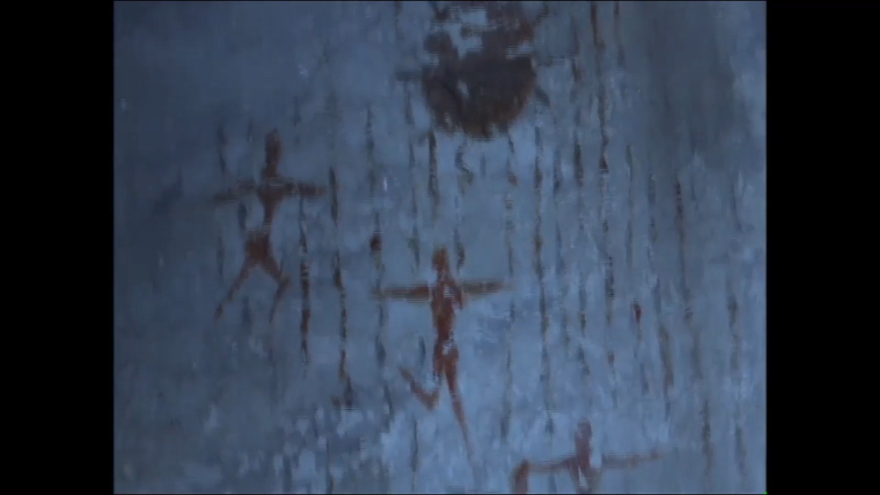
Storms don’t dump snow like that!
Blizzards, not show hurricanes
Cave paintings don’t last on ice for 10,000 years!
Old climatologists never die..they just….melt…away!

Slide 17
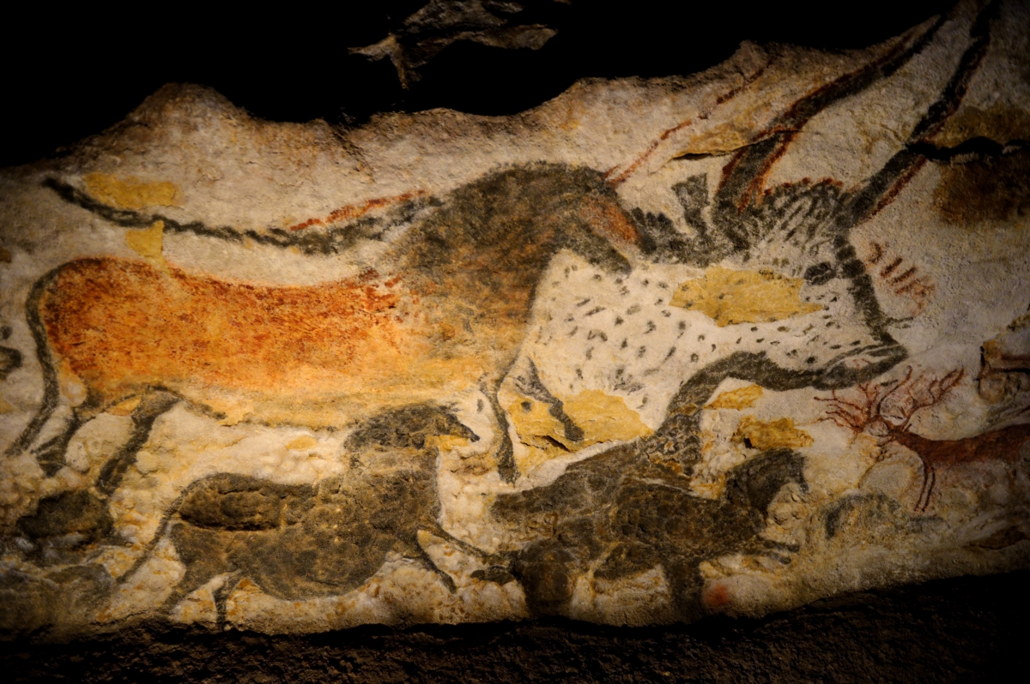
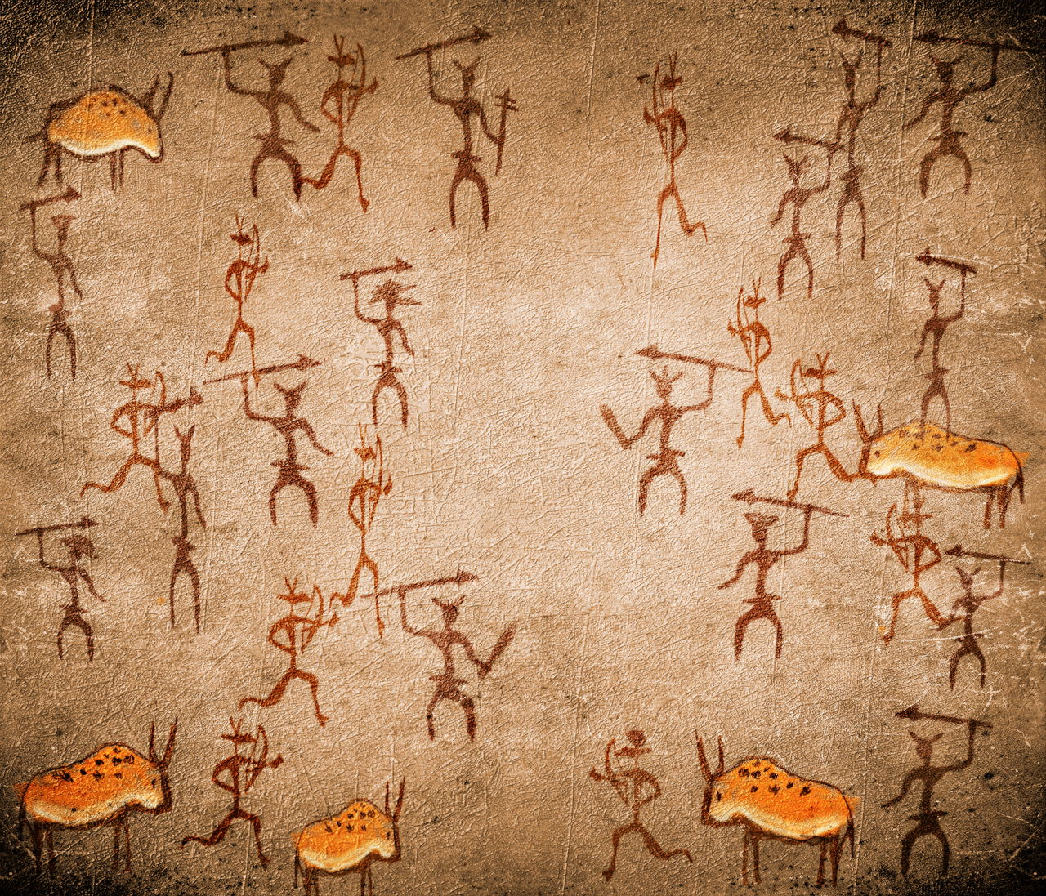
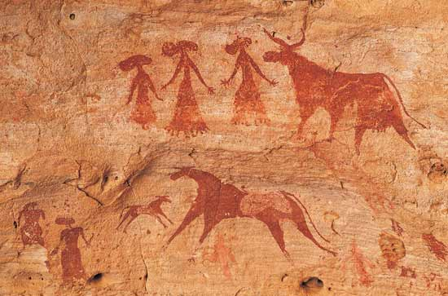
Real Cave Paintings
On stone!

Slide 18
Science is never wrong!
Science is a series of educated risks
A Ph.D praying for grants
WATCH IT!
Science and Truth

Slide 19
Naturally, frozen crab cakes!
WATCH IT!
Do the crabs freeze, but not the water?

Slide 20
Glacier under Miami, silly birds
Underground glacier Scarisoara, Romania
1000 year old animals in ice!
Silly birds!
WATCH IT

Slide 21
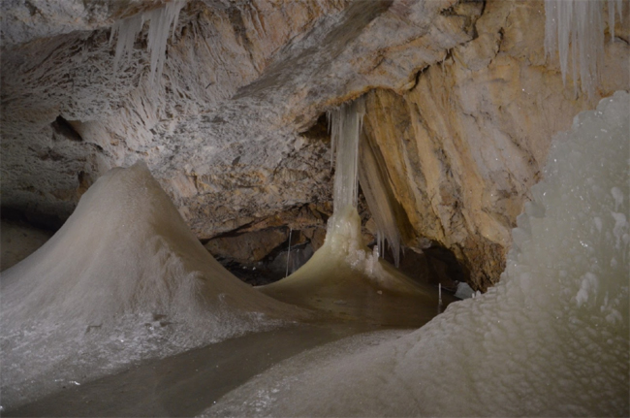
Scărișoara Cave, Romana
First mentioned in 1863 by the Austrian geographer Arnold Schmidl
Speleologist Emil Racoviță between 1921 and 1923
Formed 3500 years ago, during the glaciations.
120 m (390 ft) deep and 720 m (2,360 ft) long
Great Hall, which is approximately 108 m (354 ft) long and 78 m (256 ft) wide includes an ice cliff nearly 18 m (59 ft) tall, which overlooks a pool called the Pool of Ice

Slide 22
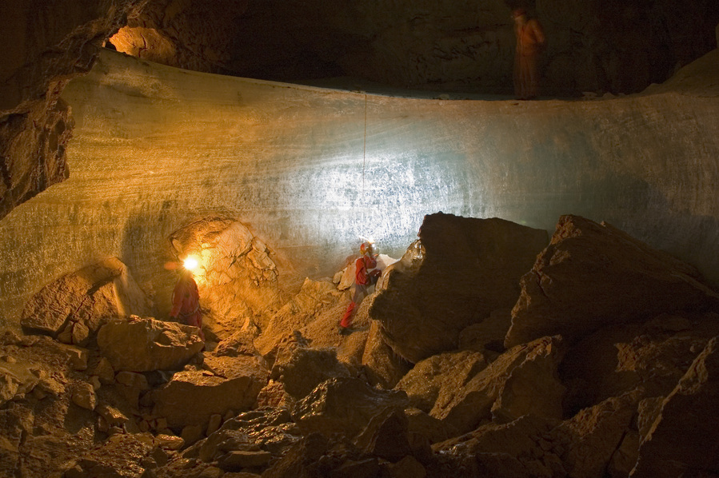
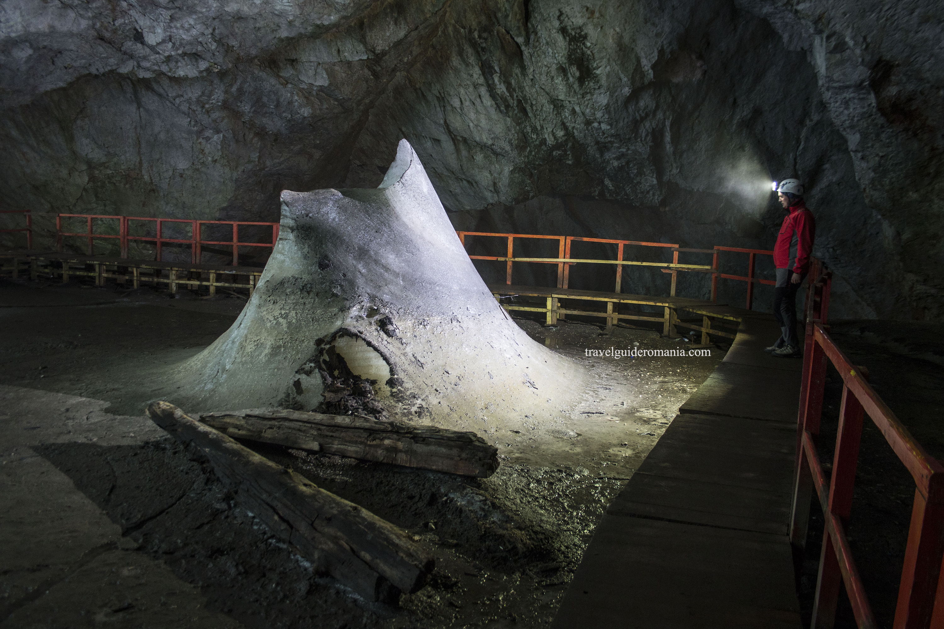
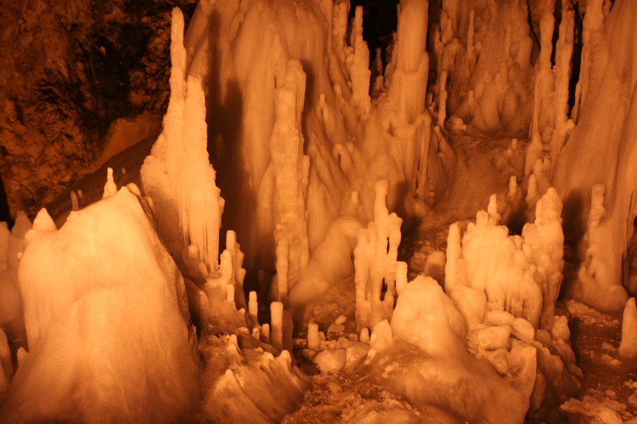
The temperature is up to +1 °C in the summer and down to -7 °C in the winter.
NO FROZEN CRABS!

Slide 23
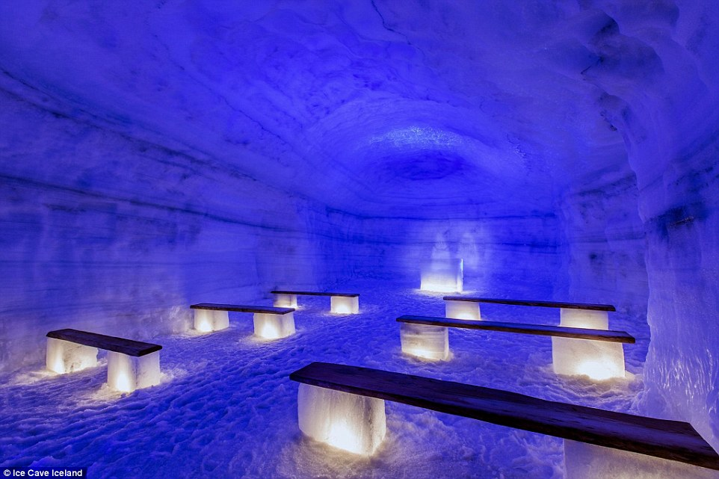
Iceland underground glaciers

Slide 24
Argentinian cave paintings, 10,000 B.P.
All painted on same day
Sun turned black at noon
1000 years of darkness
What if ice ages can on in just one day?
Wow! Interdisciplinary Science!
WATCH IT!

Slide 25
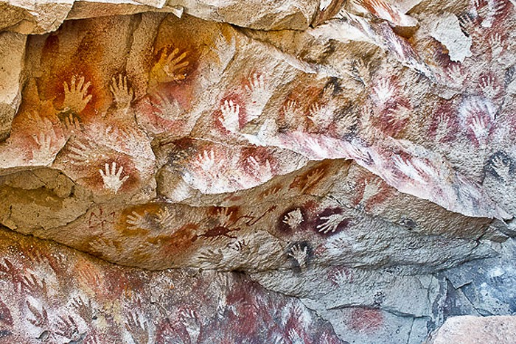
Cueva de las Manos, Argentina
13,000 to 9,000 B.P.
bone-made pipes used for spraying the paint on the wall of the cave to create silhouettes of hands.
(No end of world stories found)

Slide 26
Magnetic studies of ice cave paintings
No magnetic field when paint dried (on the ice)!
Magnetic field shift changes SHAPE of the earth, and off its axis!
Instant iceberg in harbor entrance!
WATCH IT!

Slide 27
Magnetic Reversals
Are not instantaneous
Reversal occurrences are statistically random
83 reversals over the last 83 million years.
The latest, the Brunhes–Matuyama reversal, occurred 780,000 years ago

Slide 28
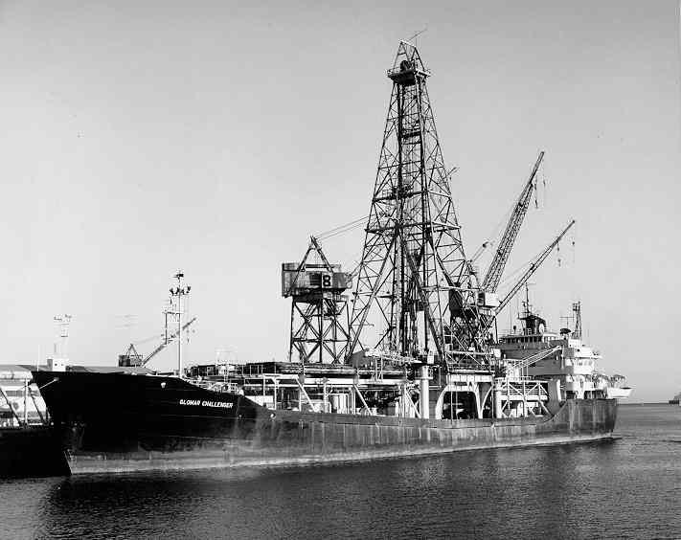
Magnetic Reversals: how long does it take?
7,000 years
Glomar Challenger, 1967
Deep Sea Drilling Project
During reversals decreases to 10% of full polarity value

Slide 29
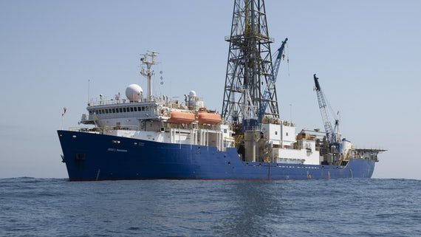
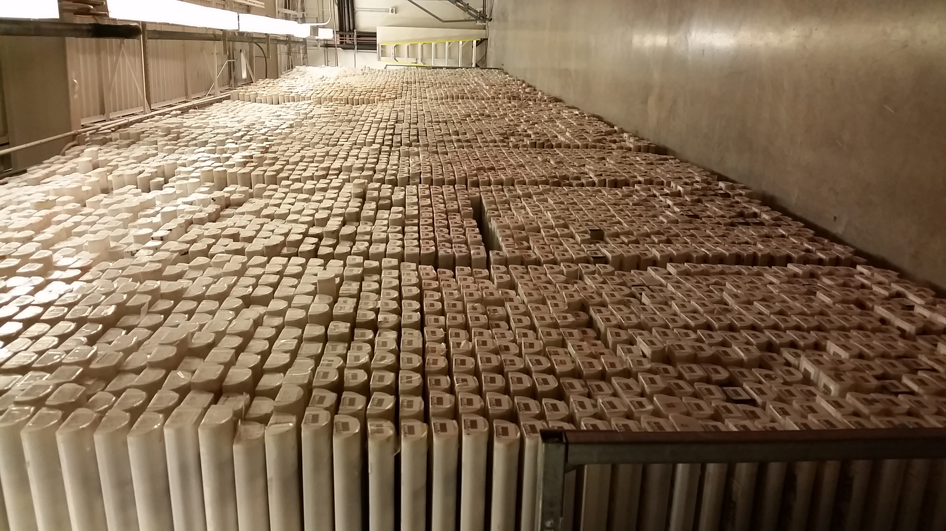
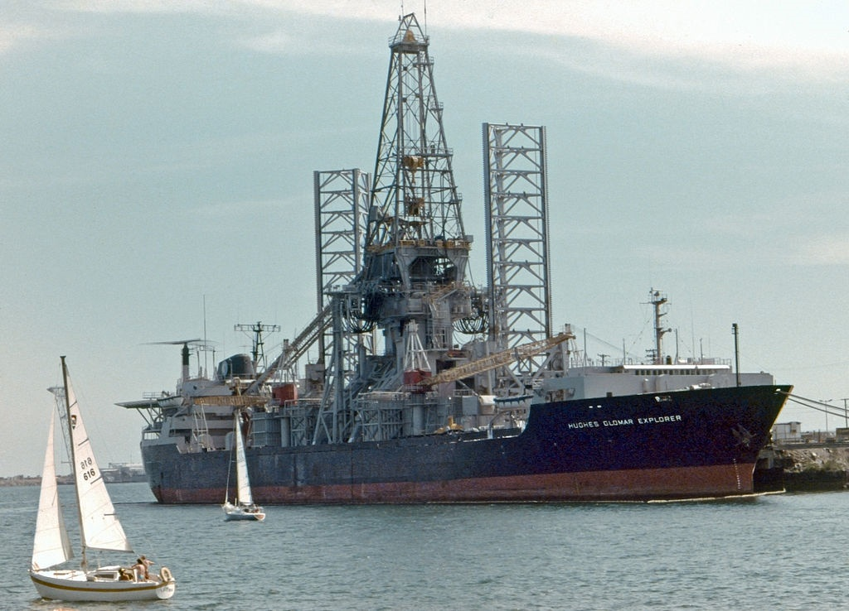
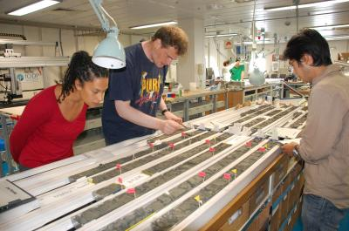
Deep Sea Drilling
Scientific
Oil/Gas exploration
Glomar Explorer

Slide 30
Deep Sea Drilling

Slide 31
Icebergs in Miami?
Tracking Iceberg B-15
The B15 Antarctic iceberg was the world's largest recorded iceberg, with an area of over 11,000 km² it was larger than the island of Jamaica. It calved from the Ross Ice Shelf in March 2000, breaking up into several pieces in 2002 and 2003. The largest of these, B-15A, was the world's largest free-floating object
WATCH IT

Slide 32
Evil Administrators!
The poles are shifting!
We can legally bind you from publishing!
At least a 200 year long process!
Value of holding back information!
Manipulating government funding!
WATCH IT!

Slide 33
Earth’s polarity is going to shift, right now!
None of our climate models can explain it!
“Slight shifts”
We at InterSci will STOP it! 200 years to fix
Government contractors! Yea, a 200-year contract!
WATCH IT!

Slide 34
Computing Glacial Timeline!
Love those computers!
4 hours, 23 minutes!
Call for evacuation!
Drop to Absolute Zero
“Nothing will survive, nothing”
WATCH IT!

Slide 35
From bikini’s to snowsuits!
30 degrees north and south of the equator
Icebergs continuing to form in Miami bay!
WATCH IT!

Slide 36
Icebergs take centuries to form, not hours!

Slide 37
There goes Dad!
More snowstorm hurricane bombs!
WATCH IT!

Slide 38
No more electricity!
Evil administrator stuck in elevator
WATCH IT!

Slide 39
No where to run to
“Science is never wrong”
WATCH IT!
Is “science” ever wrong?

Slide 40
Astronaut suits!
“The vortex could crush you like a bug”
WATCH IT!

Slide 41
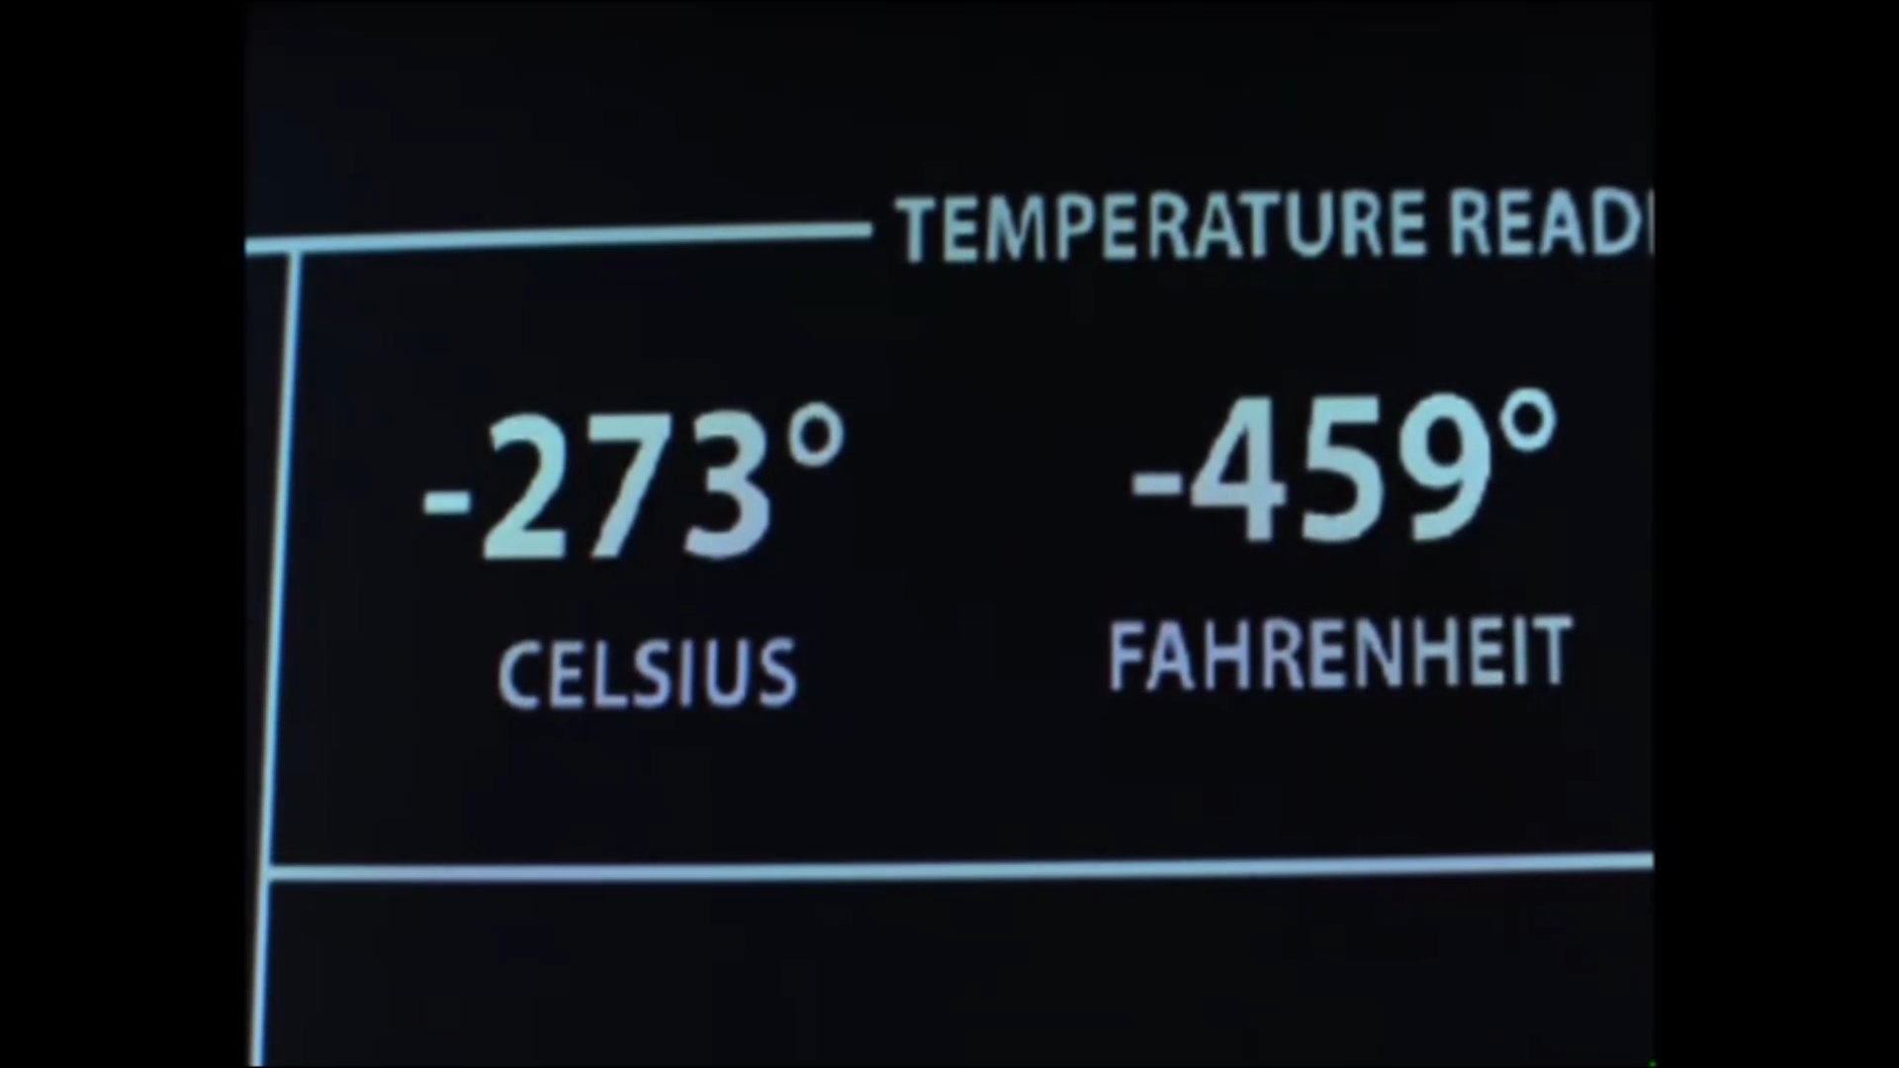
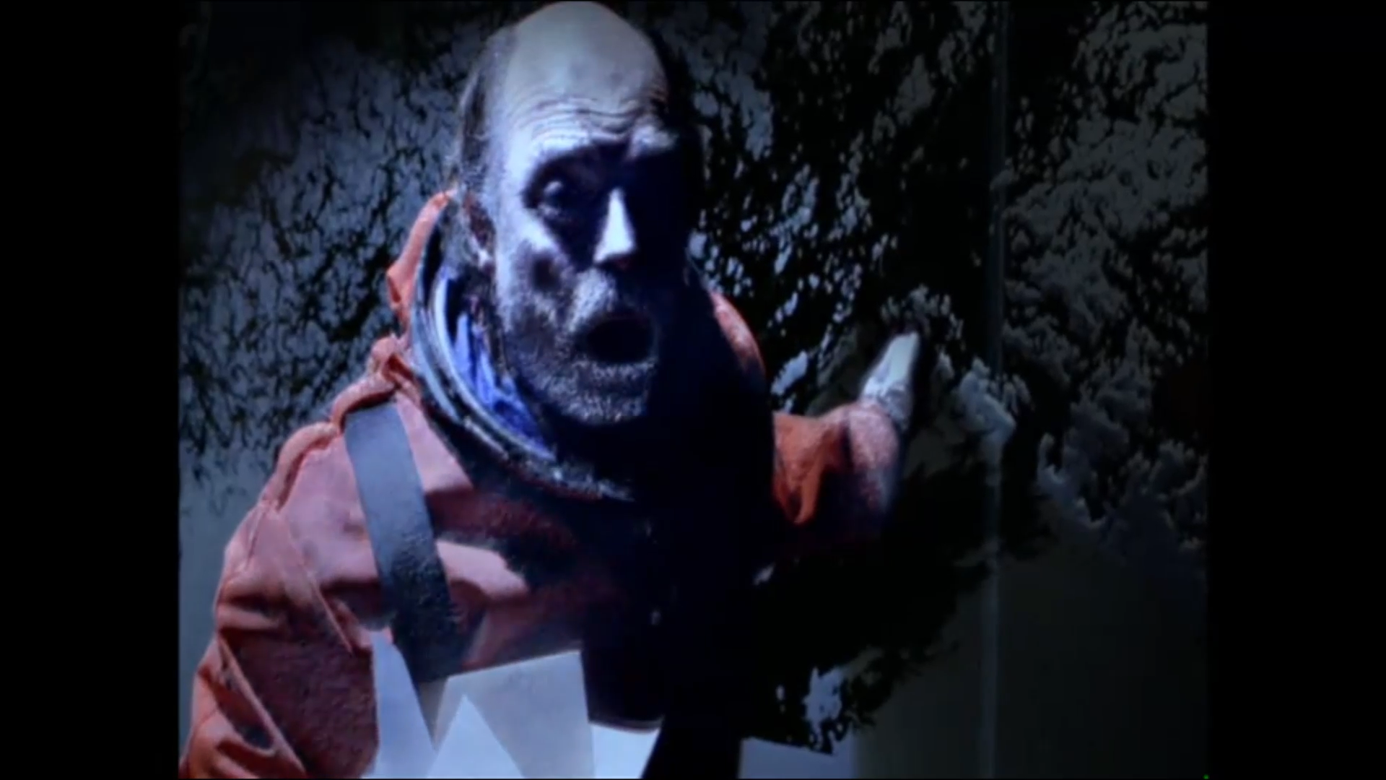
Instant Absolute Zero
Hibernation chamber
Evil Administrator dies for his contract
Frozen cities -- poorly drawn paintings
“Science is never wrong” +/- 33 degree latitude
WATCH IT!

Slide 42
Rescue: Brave New World
Billions frozen alive
“Science is never wrong”
Equatorial Alaska/Antarctica
Life continues
“From the Tropics of New York”
WATCH IT!
New world does not match newscaster description

