Slide 1
Archaeology and the Old Testament Chapter 1: Introduction
Dr. Gregg Wilkerson

Slide 2
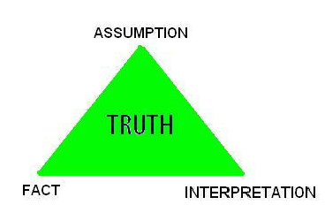
The Truth Triangle

Slide 3
Uniqueness of the Historical Sciences
No repeat
No experimentation
Requires assumptions
Possibilities
Probabilities

Slide 4
Truth Spectrum
Conservative
Maximalist
Liberal
Minimalist

Slide 5
Conservative Maximalists vs Liberal Minimalists
Conservative Liberal
-Bible mostly historical -Bible mostly mythical
-Early date for Exodus (1450 BC) -Late date for Exodus (1250 BC)
-Young Earth / Creationism -Old Earth / Evolutionism
FUNDAMENTALISTS HUMANISTS
-Dinosaurs and Men lived together -Biostratigraphy
-Noah’s Flood responsible for most -Uniformitarianism
Geologic strata
-Literal Interpretation -Symbolic Interpretation

Slide 6
Archaeological Methods
Stratigraphy

Slide 7
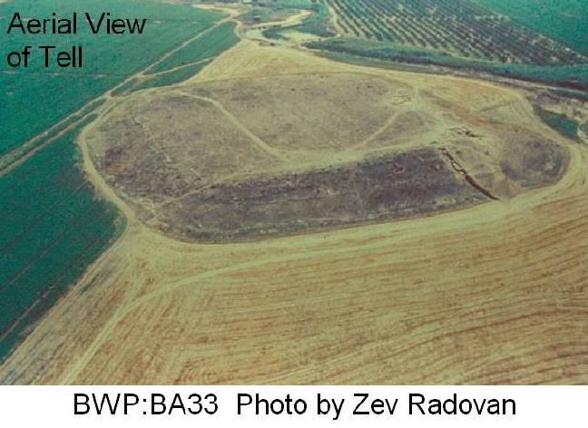
IRON AGE, TELL BATASH

Slide 8
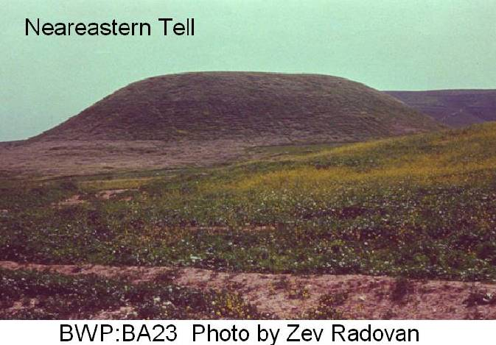

Slide 9
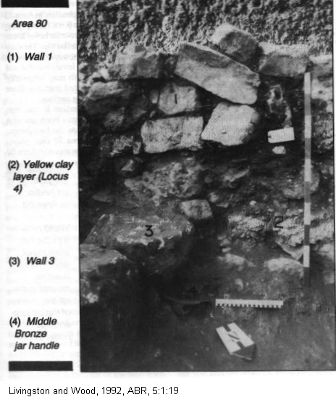
JERICHO

Slide 10
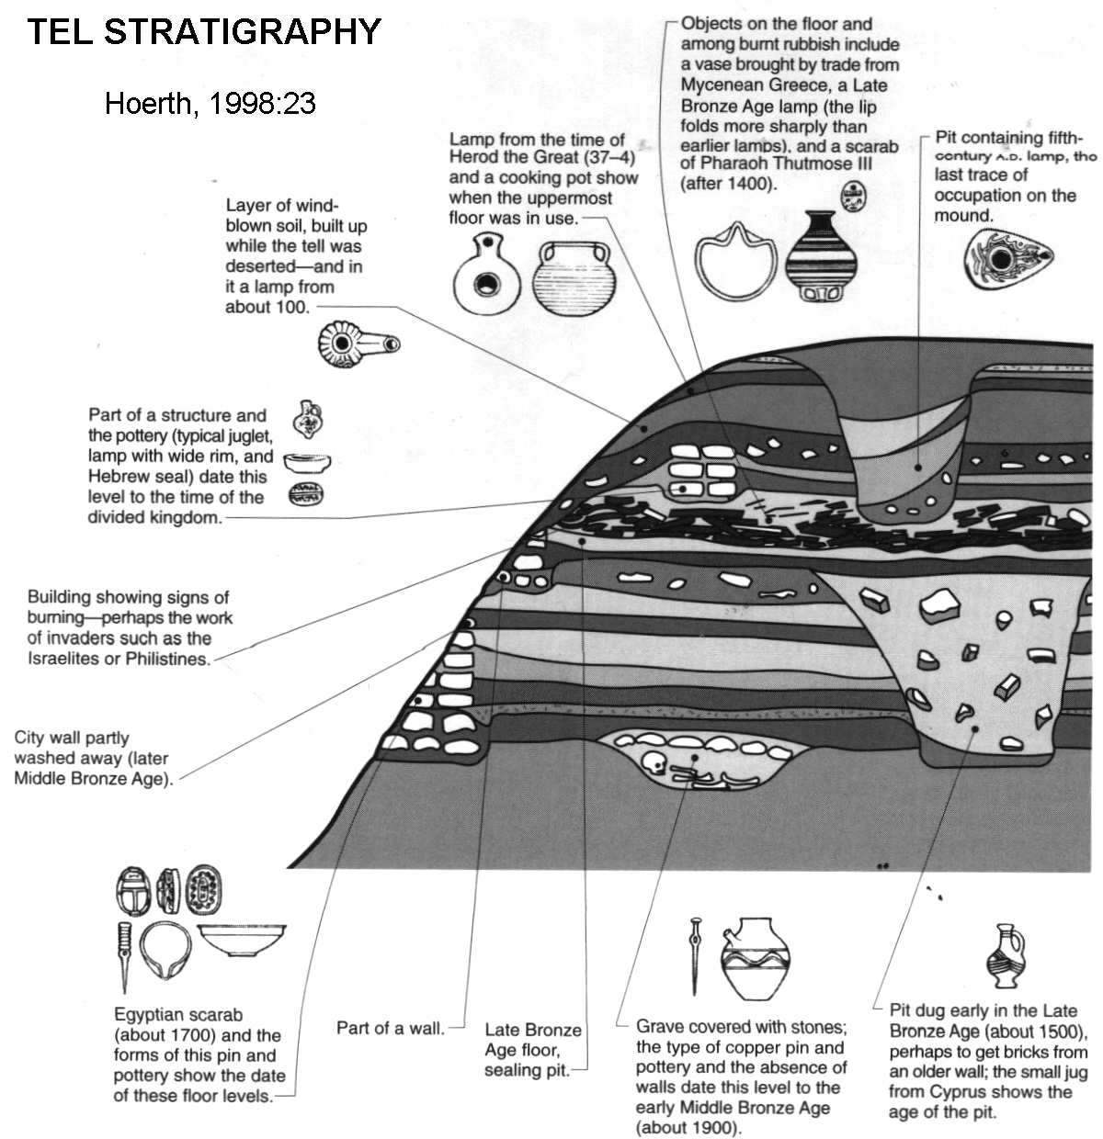

Slide 11
Archaeological Methods
Excavations

Slide 12
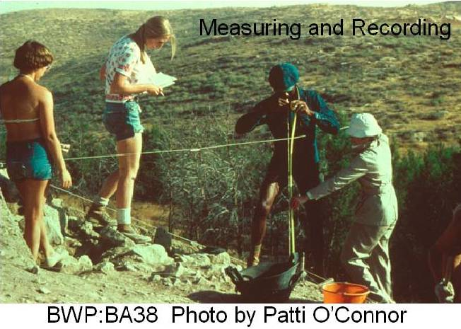

Slide 13
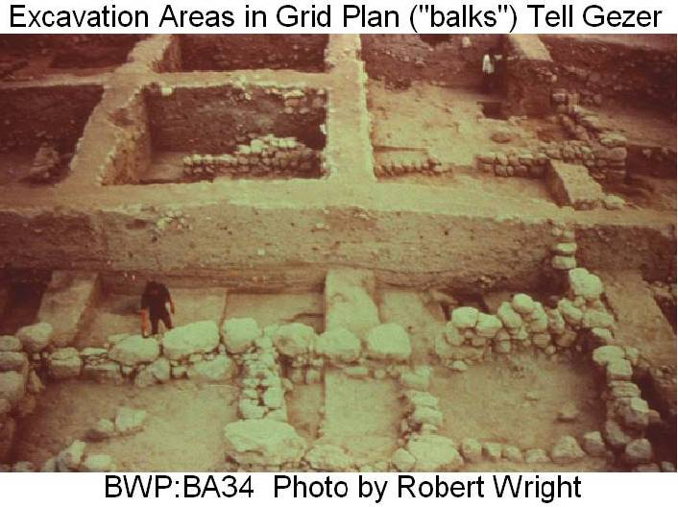

Slide 14
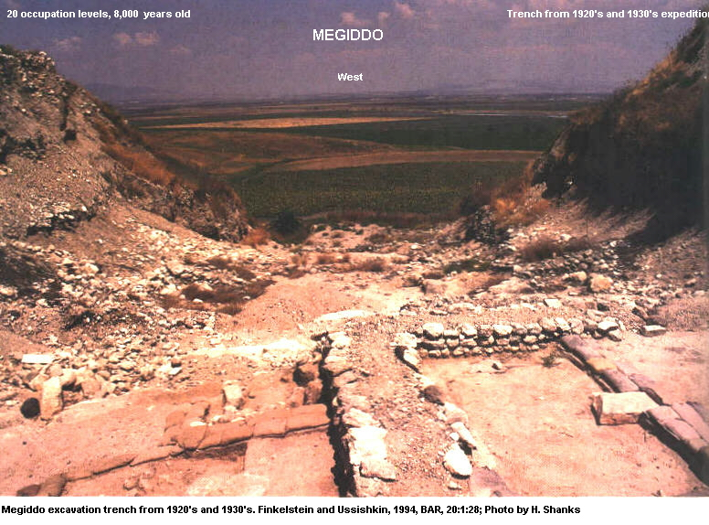

Slide 15
Archaeological Methods
Pottery

Slide 16
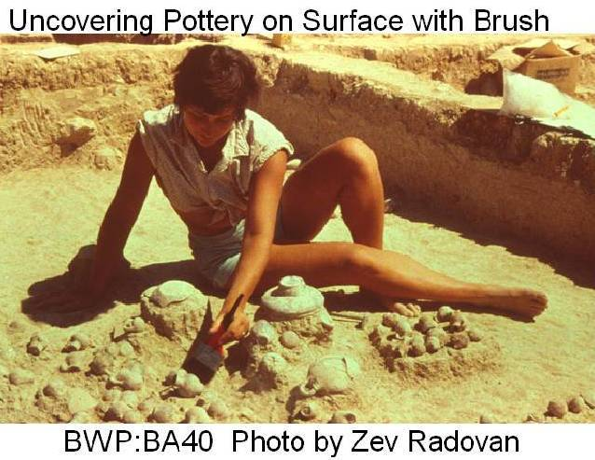

Slide 19
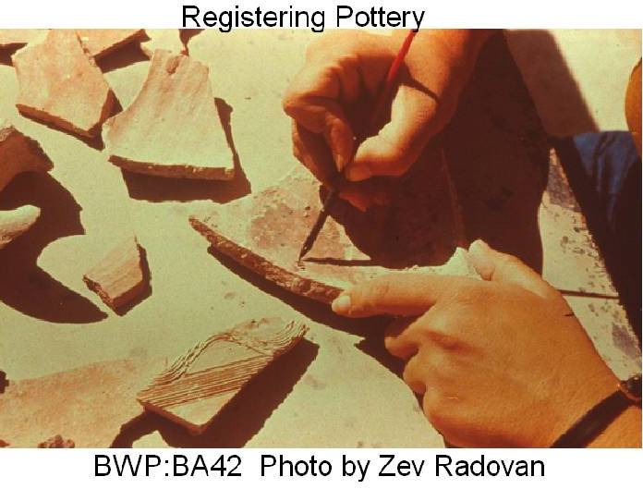

Slide 20
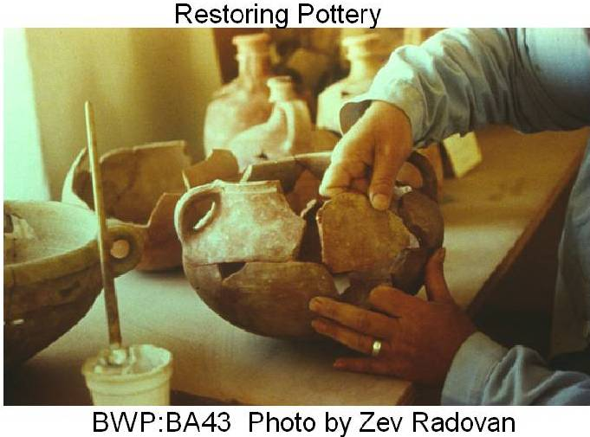

Slide 22
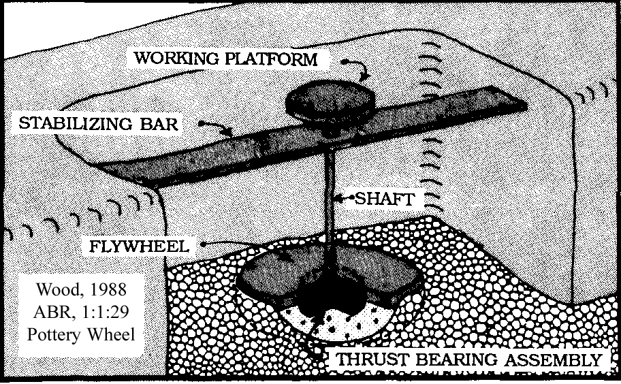

Slide 23
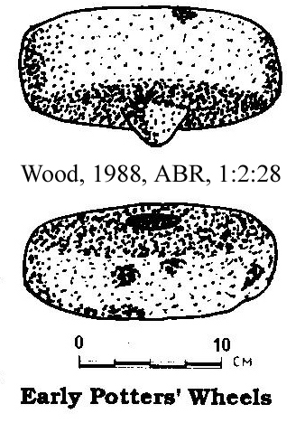

Slide 24
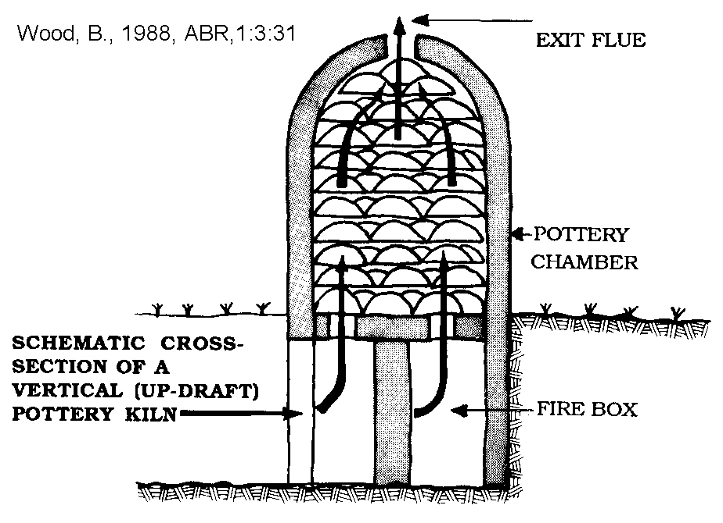

Slide 25
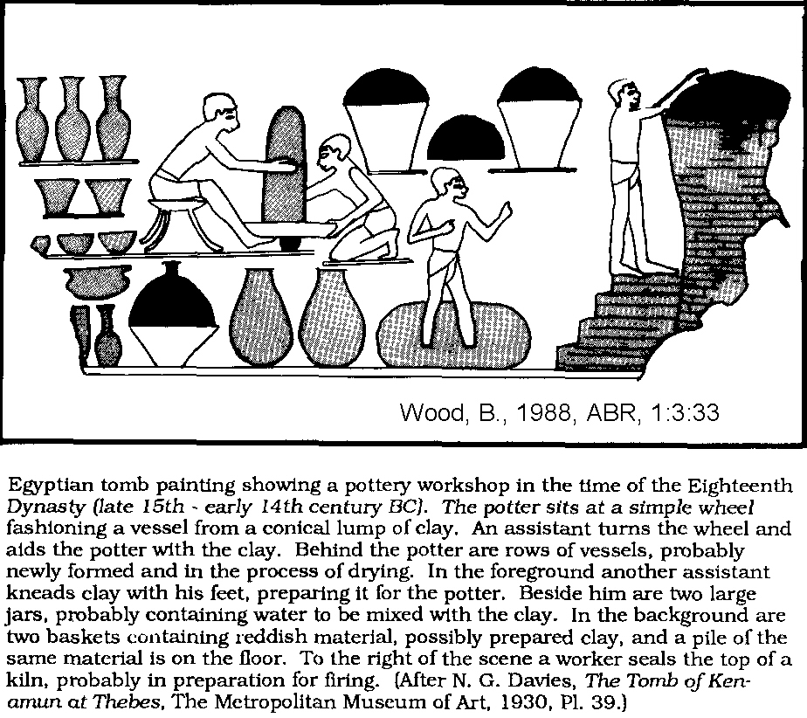

Slide 27
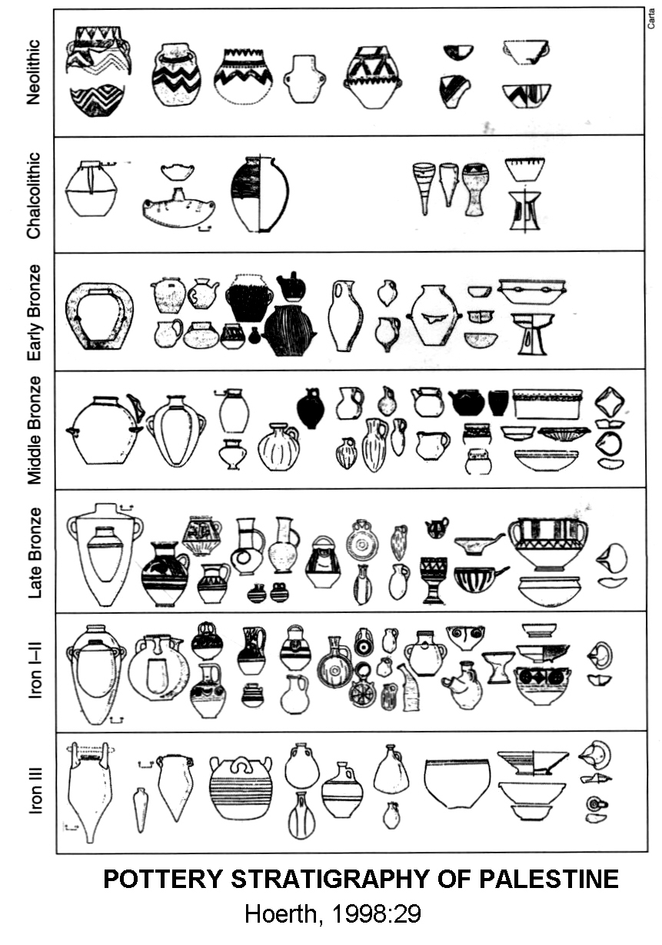

Slide 28
Pottery Stratigraphy
Neolithic

Slide 29
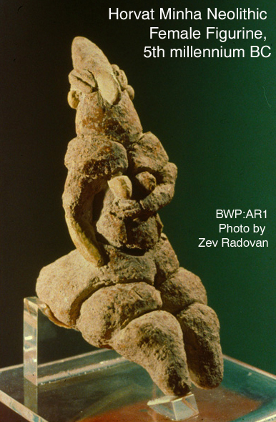

Slide 30
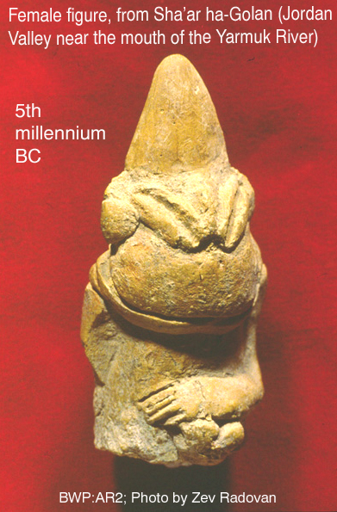

Slide 31
Pottery Stratigraphy
Chalcolithic

Slide 32
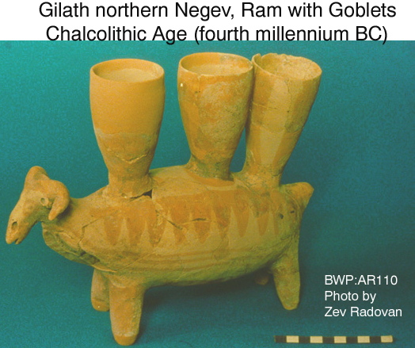

Slide 33
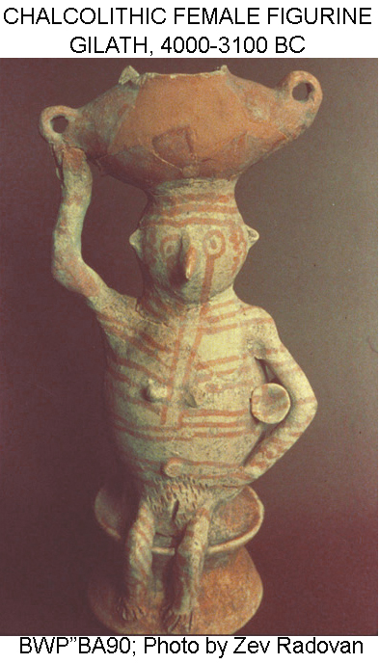

Slide 34
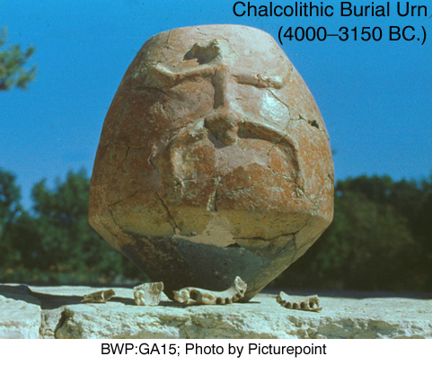

Slide 35
Pottery Stratigraphy
Early Bronze Age

Slide 36
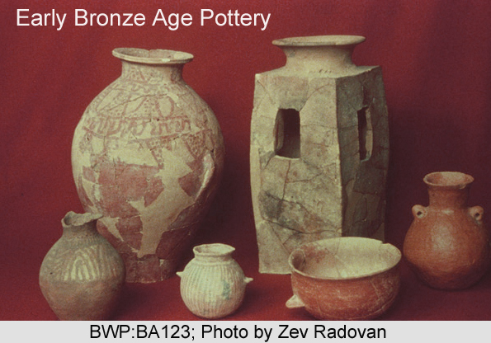

Slide 37
Pottery Stratigraphy
Middle Bronze Age

Slide 38
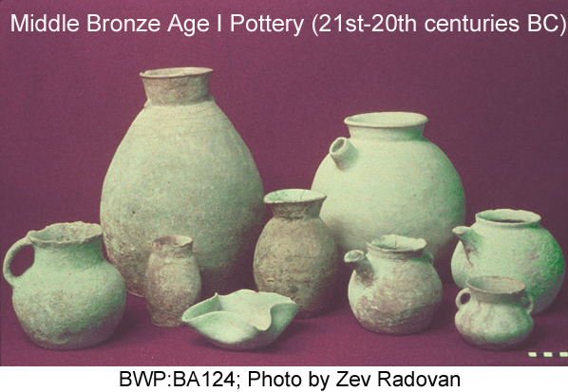

Slide 39
Pottery Stratigraphy
Late Bronze Age

Slide 40
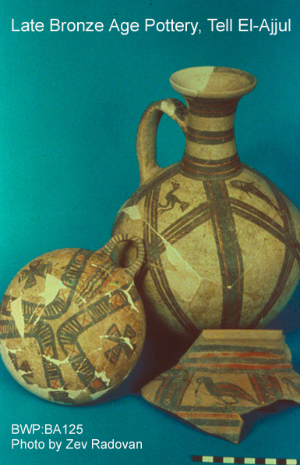

Slide 41
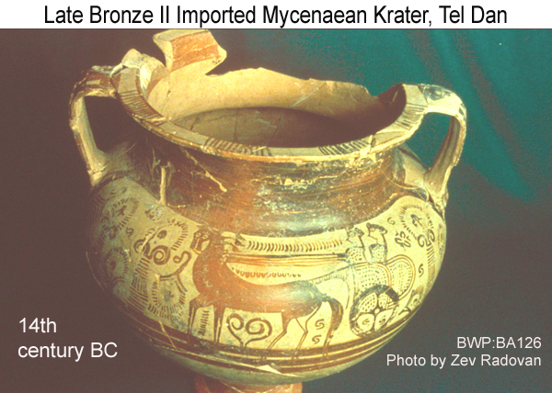

Slide 43
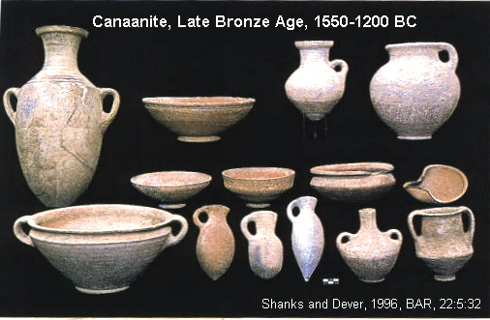

Slide 44
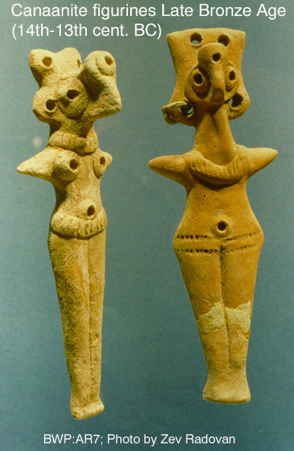

Slide 45
Pottery Stratigraphy
Iron Age I

Slide 46
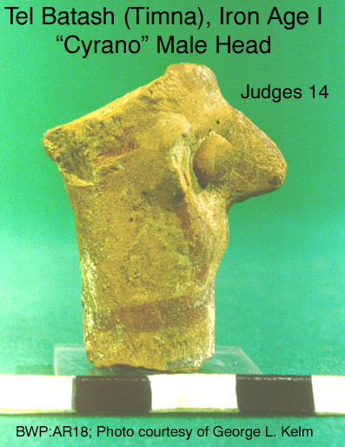

Slide 47
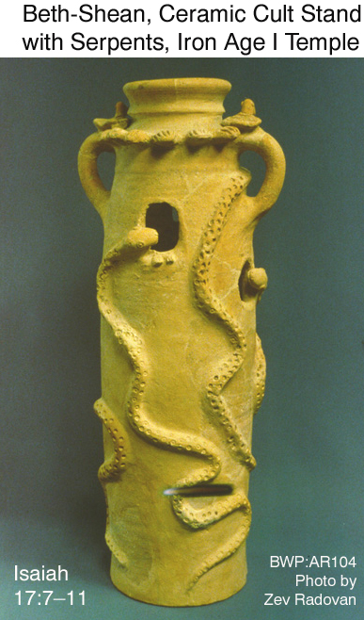

Slide 48
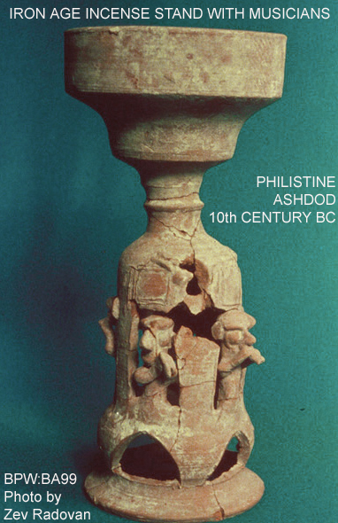

Slide 49
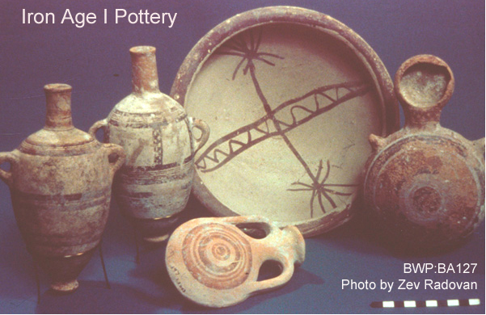

Slide 50
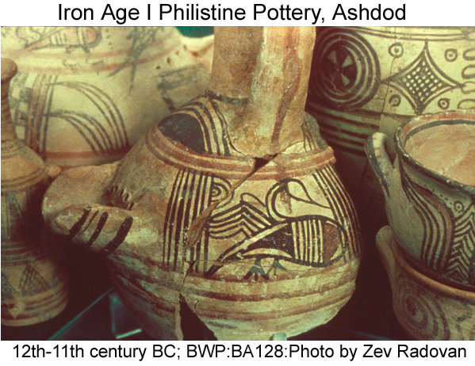

Slide 51
Pottery Stratigraphy
Iron Age II

Slide 52
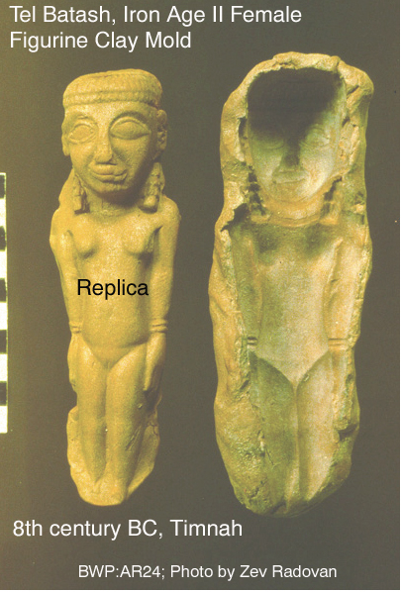

Slide 53
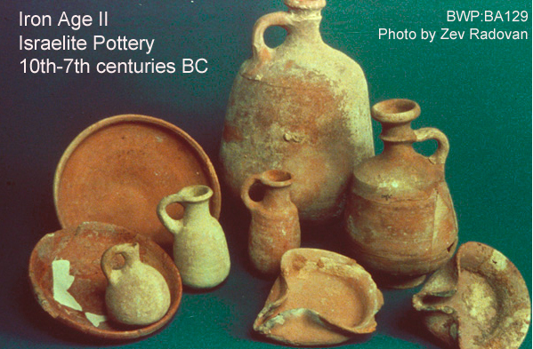

Slide 54
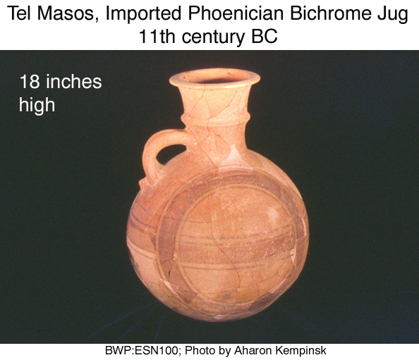

Slide 56
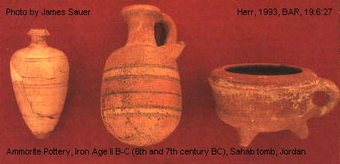

Slide 57
Pottery Stratigraphy
Persian Period

Slide 58
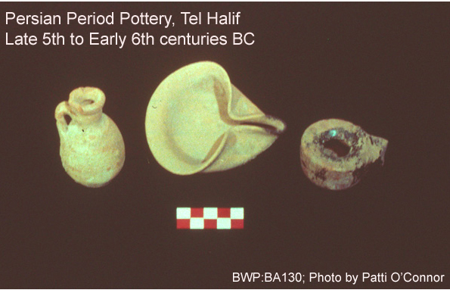

Slide 59
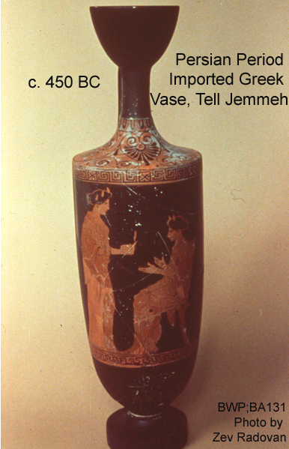

Slide 60
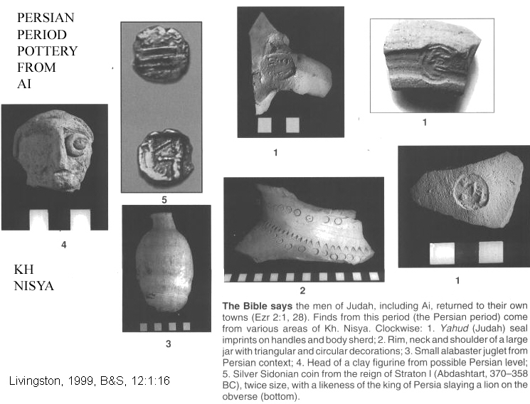

Slide 61
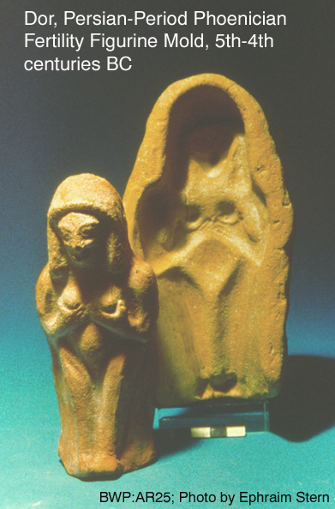

Slide 63
Seals and Bullae
Bullae

Slide 64
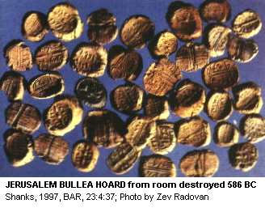

Slide 65
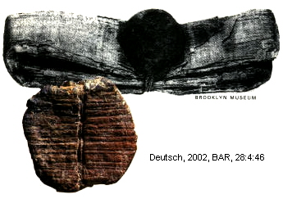
BULLAE FROM ELEPHANTINE

Slide 66
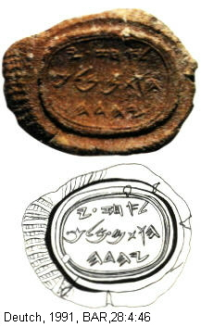
Bullea of Ahaz

Slide 67
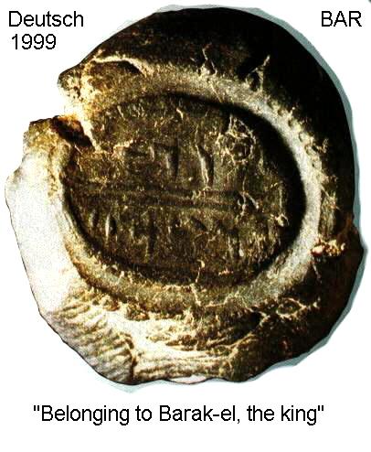

Slide 68
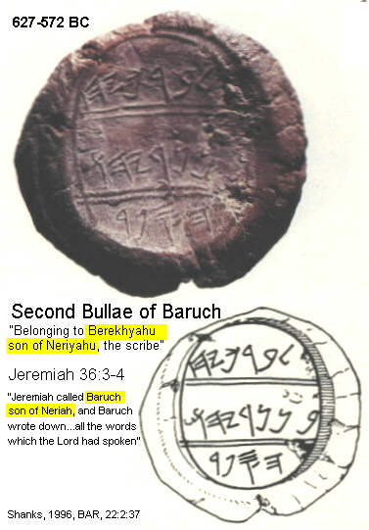

Slide 69
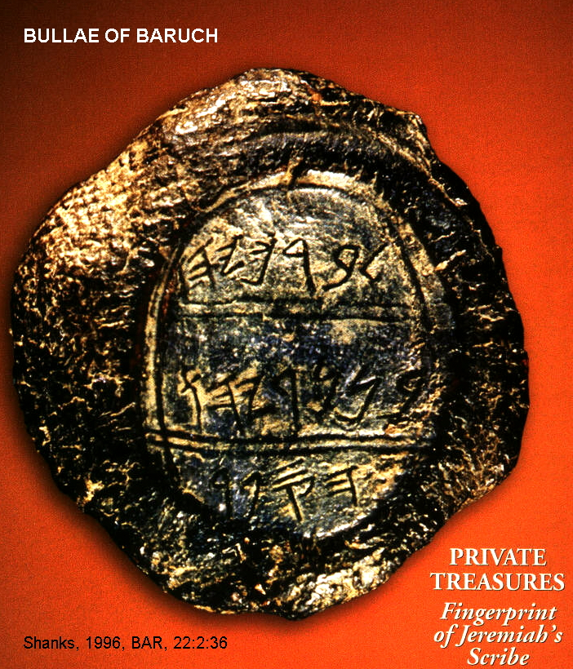

Slide 70
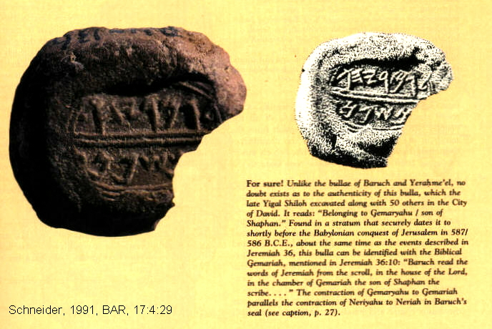
BULLAE OF GEMARYAHU OF JER. 36:10

Slide 71
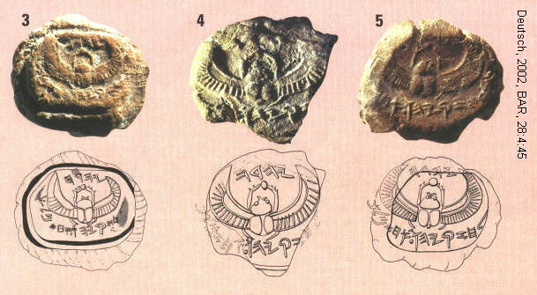
BULLAE OF HEZEKIAH

Slide 72
Seals
Ring Seals
Cylinder Seals
Stamp Seals

Slide 73
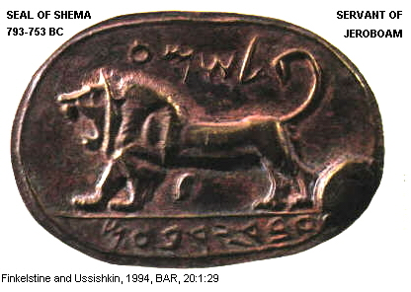

Slide 74
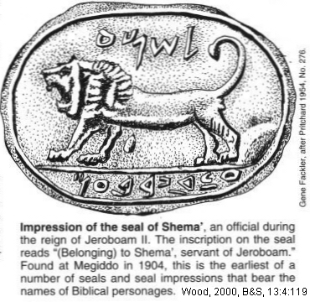

Slide 77
2 Kings 25:23

Slide 78
Natural vs Man-Caused Destruction Levels
Neat rows of fallen columns
Collapsed walls
Fallen keystones
Patched walls
Crushed skeletons
Patterns of destruction

Slide 88
PATTERNS
OF
DESTRUCTION

Slide 89
Geophysical Methods
Ground Penetrating Radar
Geophysical diffraction tomology (GDT)
Computer graphics programs (GIS)

Slide 91
GROUND
PENETRATING
RADAR

Slide 93
ROGEM
HARI
NEOLITHIC

Slide 94
GROUND PENETRATING RADAR TARGETS AT ROGEM HARI

Slide 99
RELATIVE DATING AND COMPARATIVE STRATIGRAPHY
Stone Age (Paleolithic)
Copper Age (Chalcolithic)
Bronze Age
Iron Age

Slide 100
Early Bronze Age
EB I; 3250-2900 BC
EB II; 2900-2650 BC
EB III; 2650-2250 BC
EB IV Early Bronze Age IV or
MBI; Middle Bronze Age I; 2300-1950 BC

Slide 101
Middle Bronze Age
MBI; 2300-1950 BC
MB IIA; 1950-1720 BC
MB IIB; 1720-1600 BC
MB IIC; 1600-1480 BC

Slide 102
Late Bronze Age
LB IA; 1480-1440 BC
LB IB; 1400-1390 BC
LB IIA; 1390-1295 BC
LB IIB; 1295-1175 BC
Iron Age; 1175-587 BC

Slide 103
ABSOLUTE DATING
Literary
Geophysical and Geochemical

Slide 104
Literary Methods of Dating

Slide 106
EBLA
LIBRARY

Slide 107
DEAD SEA SCOLL

Slide 108
Literary Methods Israel’s Festival Calendar
Lunar calendar
Passover is first new moon after the Autumn Equinox
Months 29 or 30 days long
11 days shorter than solar year
Every other year, a 13th month added
Leap-year days in a 19-year cycle

Slide 109
Spring Harvest Festival (Exodus 23:15)
Pre-Exile: Month of Abib (First month of the religious calendar)
Post-Exile: Month of Nisan

Slide 110
Summer Wheat Harvest Festival (Feast of Weeks, Ex. 34:22)
Month of Silvan

Slide 111
Autumn General Harvest (Feast of Ingathering, Feast of Booths)
Month of Ethanim

Slide 112
First Months
Passover held on the 14th day of Abib (later Nisan, March-April)
Northern Kingdom marked kingships from the month of Abib (March-April)
Southern Kingdom marked kingships from month of Ethanim (Sept.-Oct)
Near East cultures counted years from spring to spring (Nisan to Adar)
Hebrews counted years from autumn to autumn (Tishri to Elul)

Slide 113
First Years Traditional “inauguration” month
Northern Kingdom: month of Abib
Southern Kingdom: month of Ethanim
Dating of year of taking power: non-ascension year dating (most Israelite kings)
Dating by year following inauguration: ascension-year dating (most Judean kings)

Slide 114
Royal Dating Systems For First Years
Dating of year of taking power: non-ascension year dating (most Israelite kings)
Dating by year following inauguration: ascension-year dating (most Judean kings)
King’s choice
No consistency

Slide 117
Overlapping Reigns Co-Regencies

Slide 118
Comparison to Assyrian and Babylonian Records
Archaeoastronomy
Solar eclipse, month of Simanu during governorship of Assyrian ruler Bur-Sagale (June 15-16, 763 BC)
Canon of Ptolemy gives list of all governorships

Slide 119
Annular eclipse of May 24, 1994
http://www.mreclipse.com/Totality/TotalityCh12-1.html

Slide 123
SUMERIAN KING LIST
Klein, 2001, Archaeological Odyssey, 4:1:19

Slide 124
Astroarchaeological Dates and Assyrian Records
Death of King Ahab at the Battle of Qarqar in 853 BC in “6th year of Shalmaneser III”
Tribute of King Jehu to Assyrian King Shalmaneser III in 841 BC

Slide 125
Astroarchaeological Dates and Egyptian Records
Pharaoh Tirhakah (Taharqa) begins his reign in 690 BC
Invasion of Shishak (Shoshenq I) of Palestine in 926/925 BC in the “5th year of Rehoboam”
Death of Solomon in 931/930 BC

Slide 127
Chronologies of Israelite Kings Before the Exile
Solomon Dies 931/930 BC
Ahab dies at the Battle of Qarqar in 853 BC
Jehu pays tribute to Shalmaneser III in 841 BC
Fall of Samaria 723 BC to the Assyrians
Josiah discovers the “Book of the Law” in 623 BC
Fall of Jerusalem in 586 BC to the Babylonians

Slide 130
JUDGES
Dates are dependent on date selected for the Exodus
Cycles of Freedom, Apostasy and Oppression
Joshua, “book of victories”, while Judges is a “book of defeats”

Slide 132
Moses, Exodus and Conquest
Late Chronologies: Exodus @1240 BC
Early Chronologies: Exodus @1440 BC

Slide 133
Geochemical and Geophysical Methods for Age Dating
Carbon 14
Thermoluminescence
Uranium disequilibrium

Slide 134
C-14 dating
Organic materials
Formed in upper atmosphere from cosmic ray bombardment of N-14
Absorbed by plants, then eaten by animals
C-14 equilibrium in living systems
Half life is 5,730 years
Mass spectrometers extend technique back to 50,000 years

Slide 137
http:/www.sonic.net/bristlecone/dendro.html, 2004

Slide 138
http://www.c14dating.com/int.html, Thomas Higham, 2004

Slide 140
ACCELERATED MASS SPECTOMETER

Slide 142
Calibration
Cosmic Ray Flux
Changes in Earth’s Magnetic Field
Dendrochronology (Tree Ring Dating)
Bristlecone Pines. California

Slide 143
TREE RING DATING

Slide 144
http://www.sonic.net/bristlecone/dendro.html

Slide 145
Leonard Millar, 2004
http://www.sonic.net/bristlecone/Images.html

Slide 146
Thermoluminescence Dating
Artifact exposure to ionizing radiation
Light emissions a function of age

Slide 148
Biblical History
Adam and Eve Paleolithic (32,000- 8,000)
Noah Early Bronze Age I (3000 BC)
Abraham Early Bronze Age IV or Middle Bronze Age II (2165 BC)

Slide 149
Biblical History
Job Early Bronze Age IV or Middle Bronze Age I (circa 2100 BC)
Abraham Early Bronze Age IV or enters Canaan Middle Bronze Age I (2090 BC)
Issac Early Bronze Age IV or Middle Bronze Age I (2065 BC)

Slide 150
Biblical History
Jacob and Esau Early Bronze Age IV or Middle Bronze Age I (2005 BC)
Joseph Middle Bronze Age II (1914 BC)
Moses leads Late Bronze Age IA the Exodus (1445 or 1250 BC)
Conquest Late Bronze Age IB (1406-1309 BC)

Slide 151
Biblical History
Deborah and Barak Late Bronze Age (1237-1198 BC)
Widespread Near Late Bronze Age Destruction (c 1200 BC)
Gideon Late Bronze Age
Samuel Late Bronze Age (1105 BC)
Samson Late Bronze Age (1069 BC)

Slide 152
Biblical History
David Iron Age IA (1001 BC)
Solomon Iron Age IA or Iron Age II (971 BC)
Temple started Iron Age IA or Iron Age II (966 BC)
Divided Kingdoms Iron Age II (931 BC)

Slide 153
Biblical History
Destructions of Beginning of Iron Age Shishak IIA (925 BC)
Jehu’s Revolt End of Iron Age IIA (830 BC)
War with Hazael End of Iron Age IIA of Damascus (830 BC)
Fall of Samaria Iron Age II (722 BC)
End of Northern Kingdom

Slide 154
Biblical History
Fall of Jerusalem Iron Age II End of the Southern (586 BC) Kingdom
Daniel and the Exile Iron Age III (605-536 BC)
2nd Temple Iron Age III constructed (536-516 BC)
Ezra-Nehemiah 458-445 BC
Apocrapha and 160-50 BC Pseudepigrapha

