Slide 1
Archaeology and the Old Testament
Chapter 4, Part 1 and 2
Scripts of the Old Testament
Dr. Gregg Wilkerson

Slide 2
Extent of writing Moses, c. 1500 BC
at least eight languages recorded.
Five completely different systems of writing.
Writing was not the exclusively domain of the upper classes in these cultures, or of the scribes.

Slide 3
ORIGIN OF WRITING
Clay counting objects
4th millennium BC

Slide 4
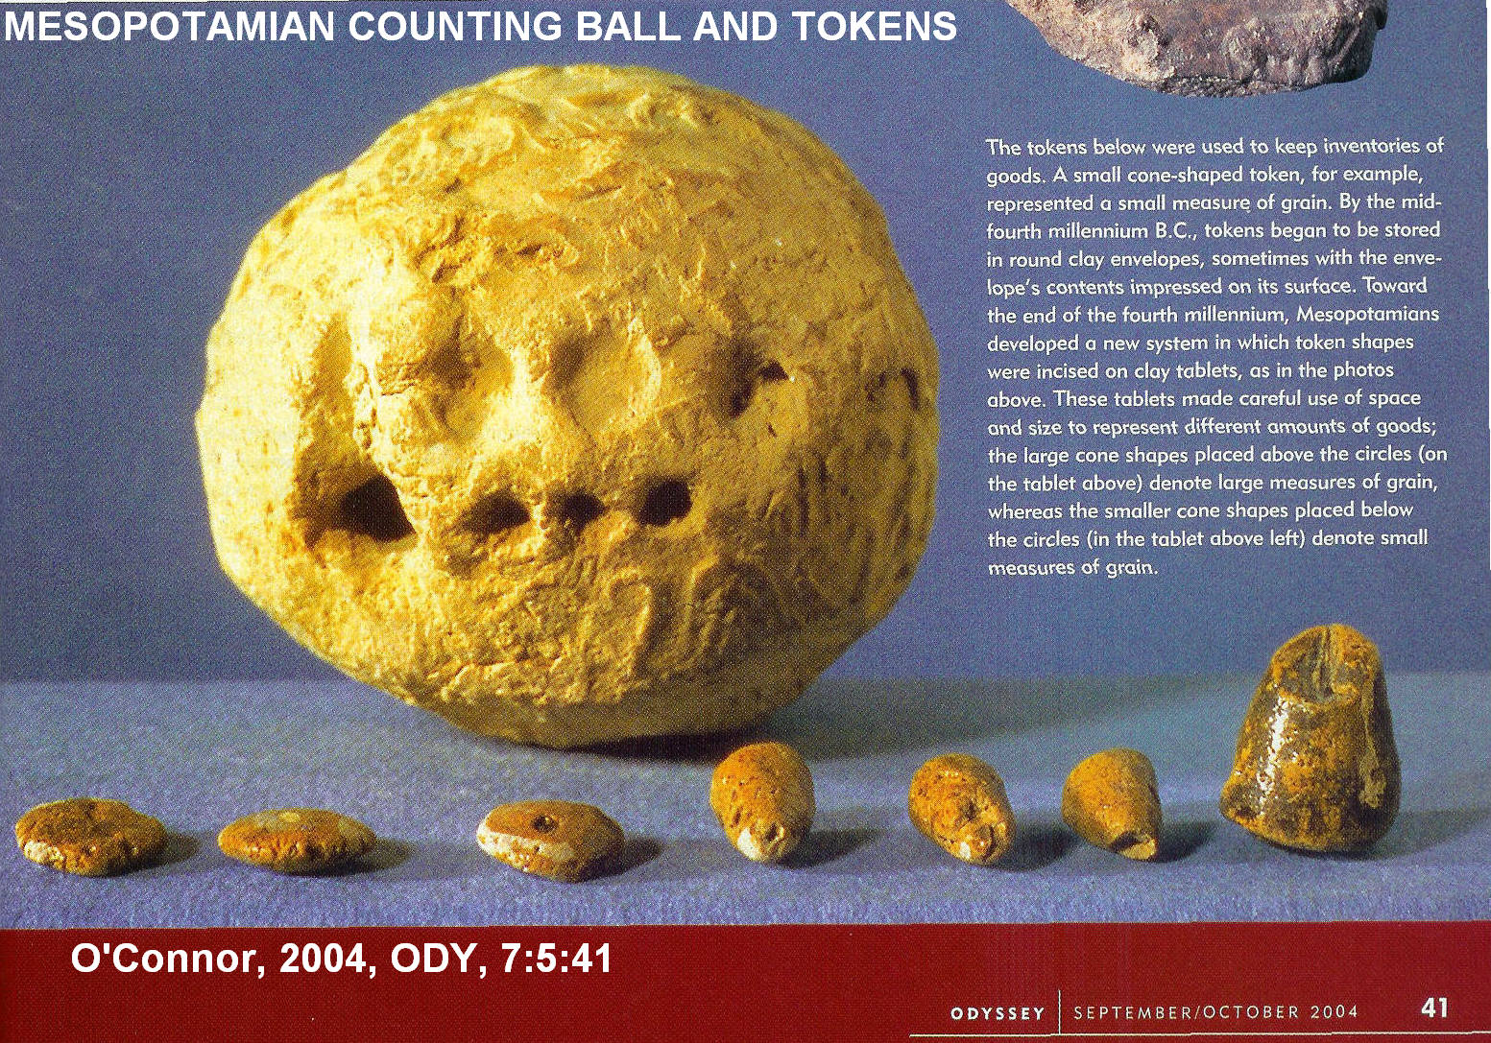

Slide 5
Clay Counting Objects
Seller would place these counting objects (sometimes made in facsimile of the object sold) inside clay balls
When the shipment was received, the clay ball was “opened” and the number of items to be delivered verified.
Later, markings indicating the were number of objects inside were inscribed on outside of the clay ball.

Slide 6
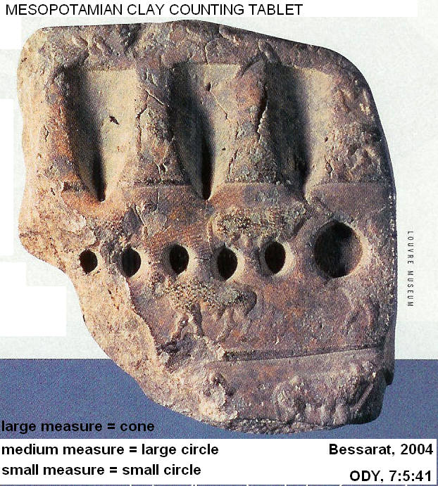
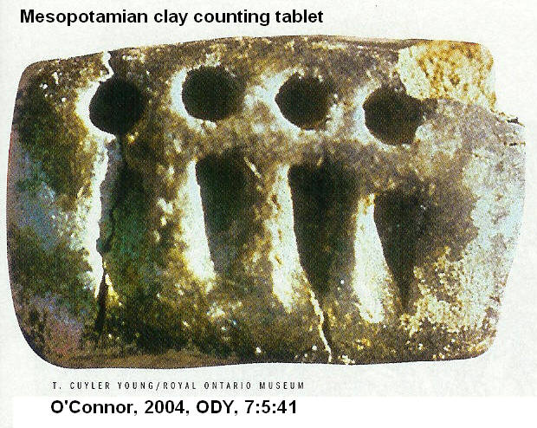
Clay counting tablets

Slide 7
Replacement of counting objects by counting signs
counting objects were replaced with counting symbols.
Miniature replicas of cargo in the clay balls were replaced by pictographs of the cargo.
Pictographs were the earliest form of writing

Slide 8
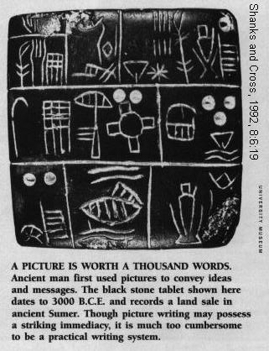
SUMARIAN PICTOGRAPH, 3000 BC

Slide 9
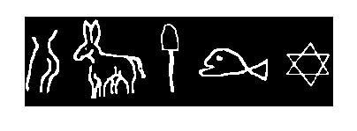
'Holy Mackerel, Dig The Ass On That -----'

Slide 10
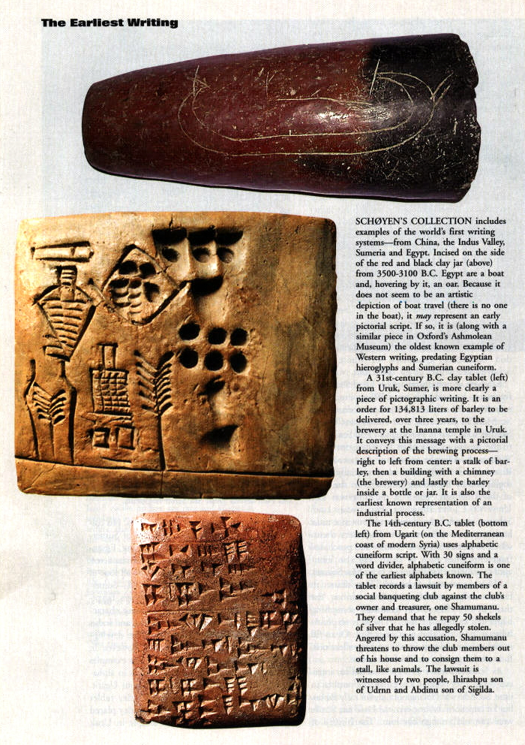
Pictograph
Pictographs with counting markers
Cuneiform symbols

Slide 11
Acrophobic Principle
The early Canaanite pictorial scripts used the Acrophonic principle
A symbol represented the first sound in the object depicted by the symbol
Pictographs of a cat, apple and ball would mean “CAB”

Slide 12
Art and Writing
Art before writing tended to be geometric, stylized and static.
Art, after writing was invented, became flowing and told a narrative story

Slide 13
Pre-writing, geometric

Slide 14
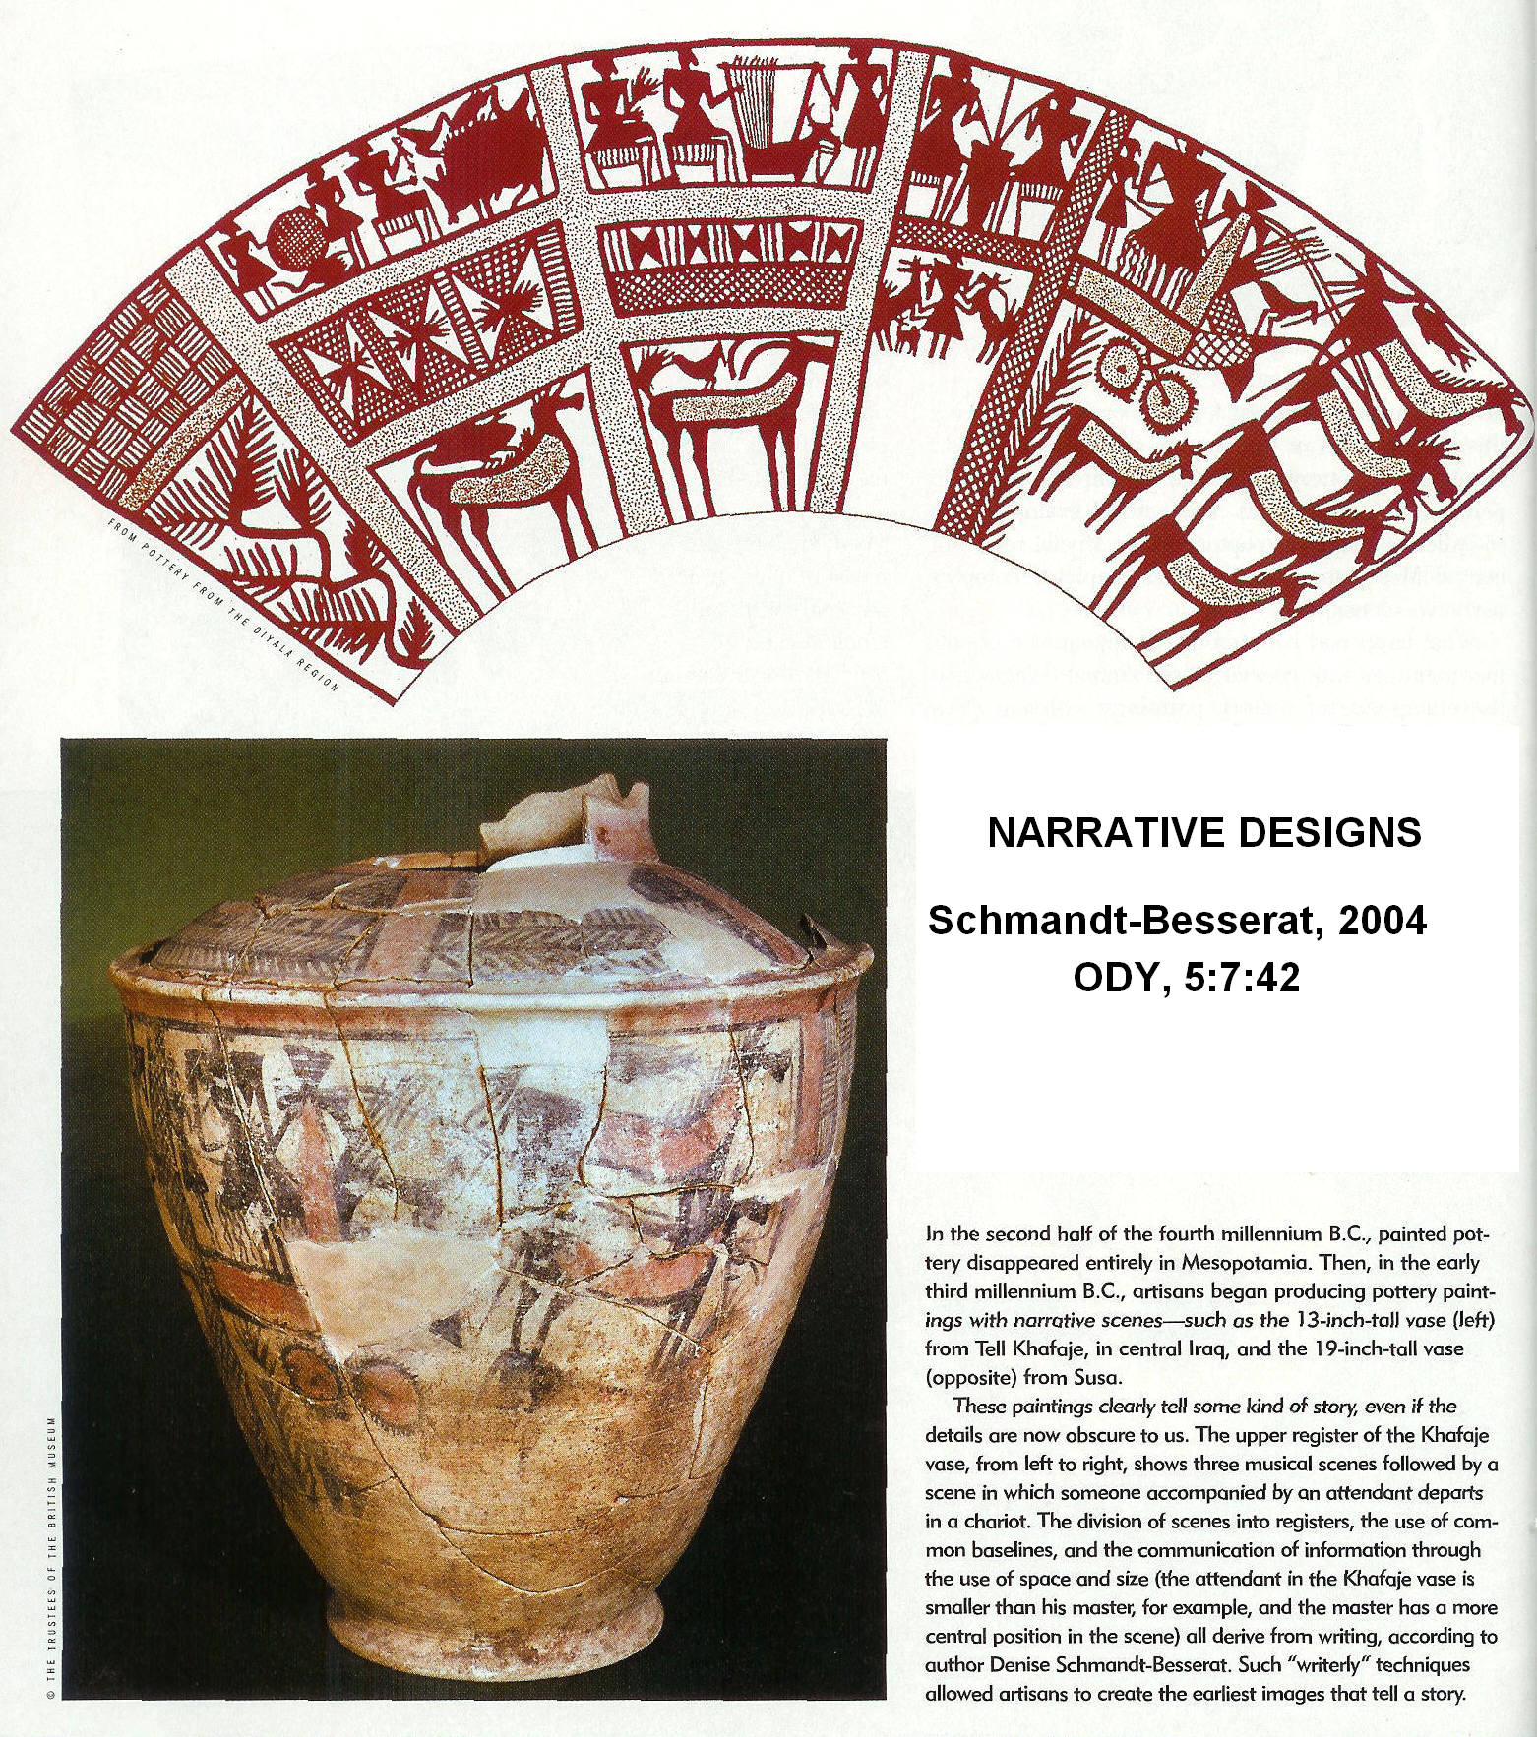
Post-writing
Flowing, with narrative design

Slide 15
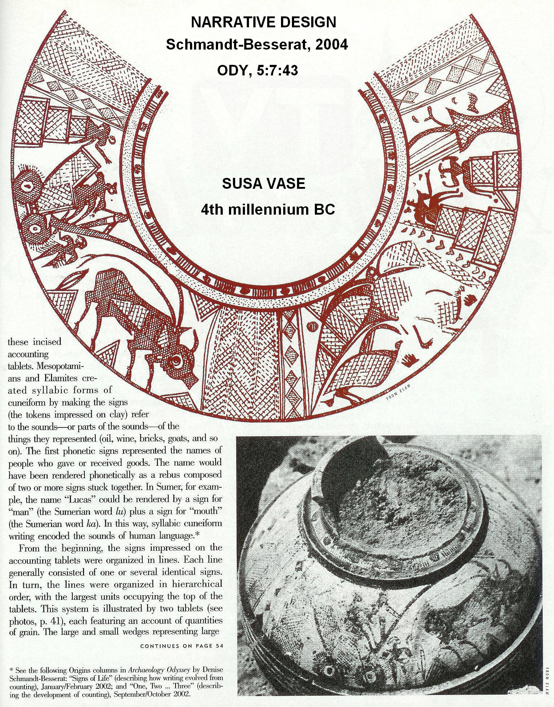
Post-writing
Narrative Design

Slide 16
Origin of Alphabet
The Alphabet was only invented once
originated in an area between two great civilizations which had two different writing systems: Levant (Palestine)
Mesopotamian cuneiform
Egyptian hieroglyphics
Each of these civilizations had developed non-alphabetic writing systems about 3,000 BC

Slide 17
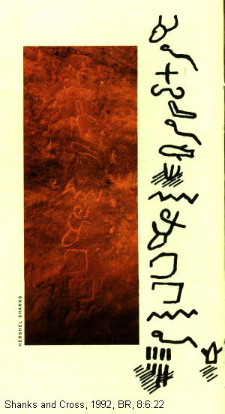
Proto—Sinaitic Inscriptions
Serabet-el Kahdem
Turquoise Mine
Temple of Hathor
1500 BC

Slide 18
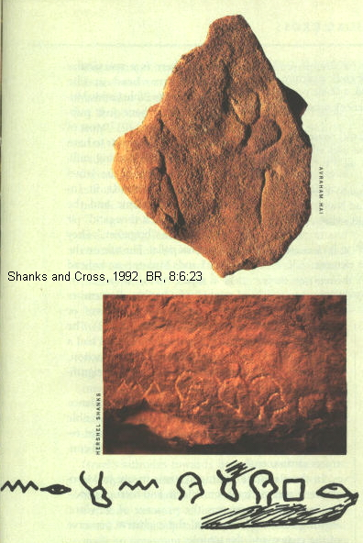
Proto—Sinaitic Inscriptions Serabet-el Kahdem Turquoise Mine Temple of Hathor 1500 BC

Slide 19
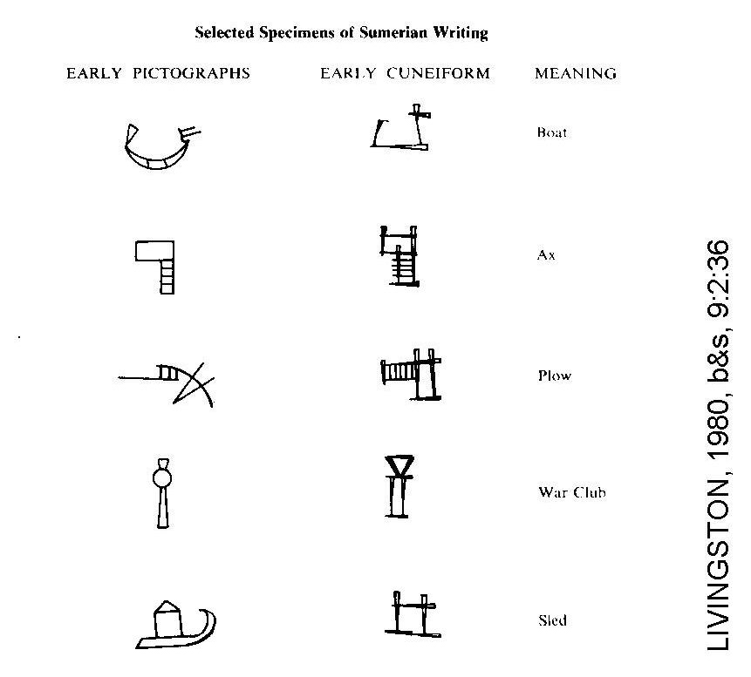

Slide 20
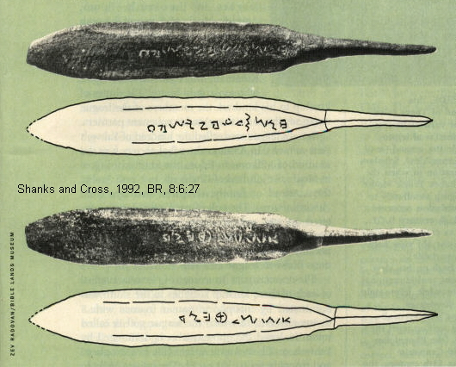
Next Phase in alphabet development: Inscribed Arrowheads

Slide 21
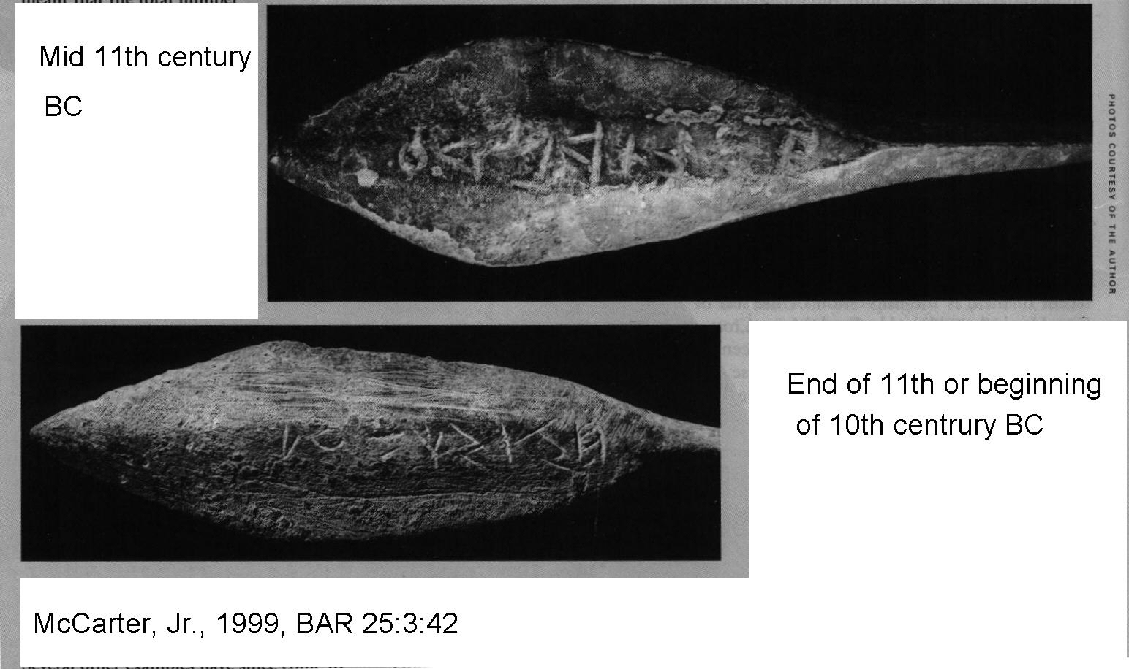

Slide 22
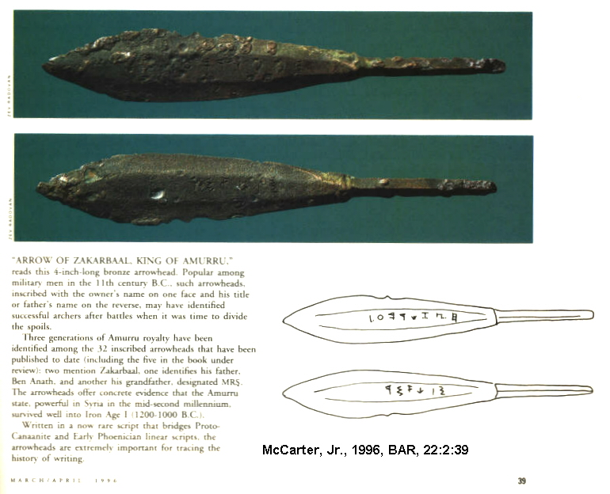

Slide 23
Next phase in alphabet development: ABCDeciaries
Ugarit abecedaries and syllabic cuneiform
14th century BC.
Canaanite alphabet was modified to be written with cuneiform wedges

Slide 24
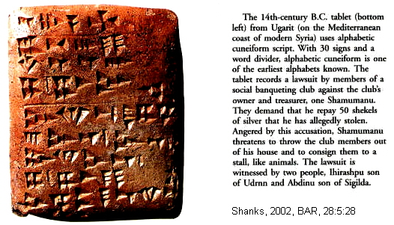

Slide 25
Evolution of writing
Proto-Sianitic–>
Ugaritic arrowheads –>
Early Phoenician linear–>
Old Hebrew –>
Old Aramean –>
Early Greek

Slide 26
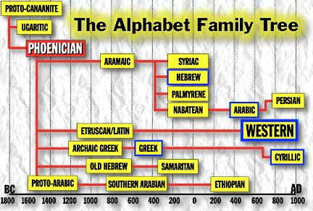

Slide 27
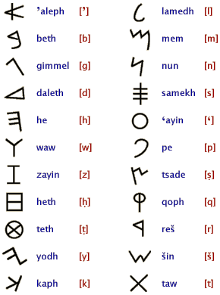
Phoenician Linear B
22 Characters
One sound for each character

Slide 28
Writing Materials
baked clay
unbaked clay
inscribed stones (stelae)
pottery fragments (ostraca)
Parchment (animal hides)
Papyrus (scrolls)

Slide 29
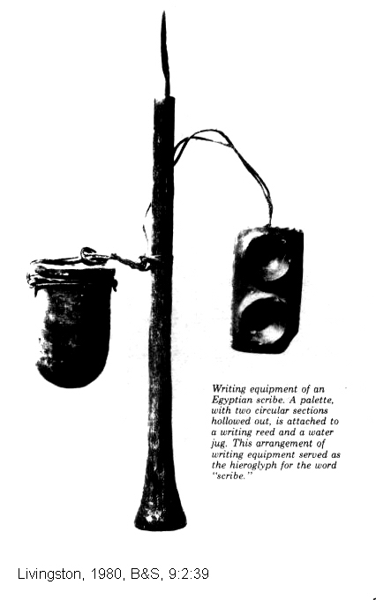

Slide 30
EPIGRAPHY AND PALEOGRAPHY
Epigraphy: the study of the meaning of ancient inscriptions
Paleography: is the science of analyzing the shape and changes in the scripts (“letters”) that make up the inscriptions

Slide 31
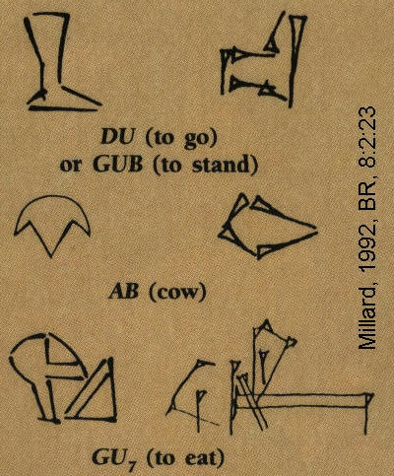
EPIGRAPHY: STUDY OF MEANING OF SYMBOLES
PICTOGRAPH
TO
CUNEIFORM
IDEAGRAMS

Slide 32
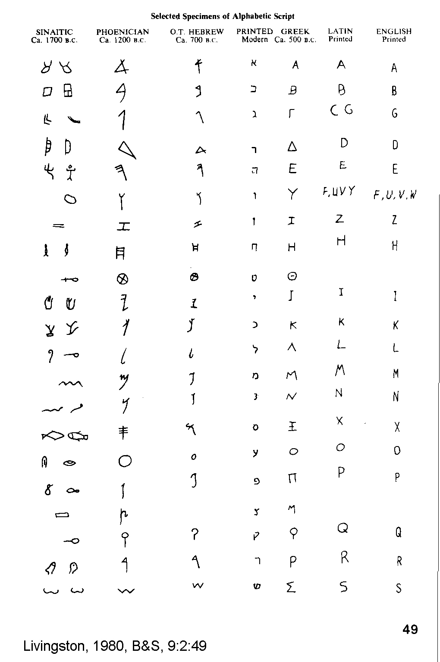
EVOLUTION OF LETTERS OF THE ALPHABET

Slide 34
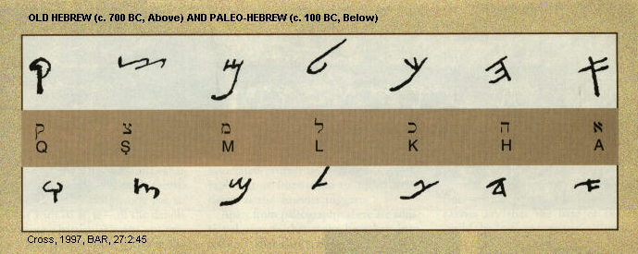
PALEOGRAPHY: Study of the change in the script with time

Slide 35
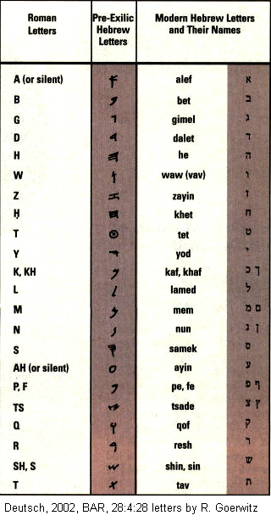
PALEOGRAPHY
Shape of letters changed through time

Slide 37
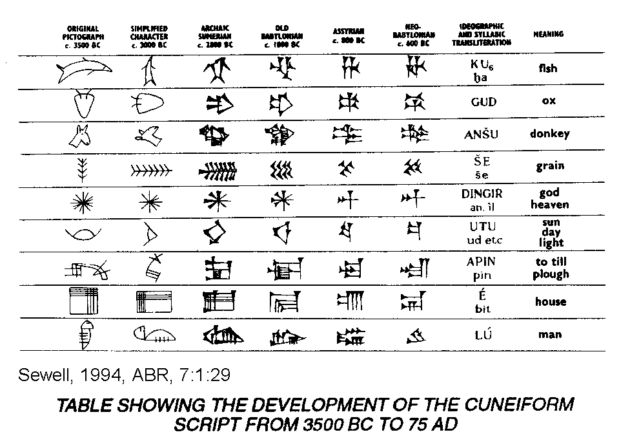

Slide 38
MODERN IDEAGRAMS
No left turn
Chinese: Child under house = “to care for”
School Crosswalk

Slide 39
Types of Writing
Monumental Inscriptions
Example, Siloam Inscription

Slide 40
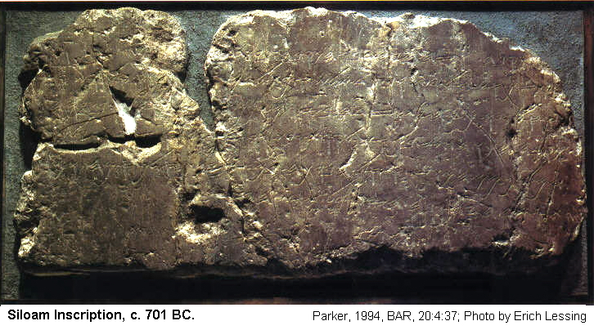

Slide 41
Types of Writing
Professional Writings
Example: Gezer calendar

Slide 42
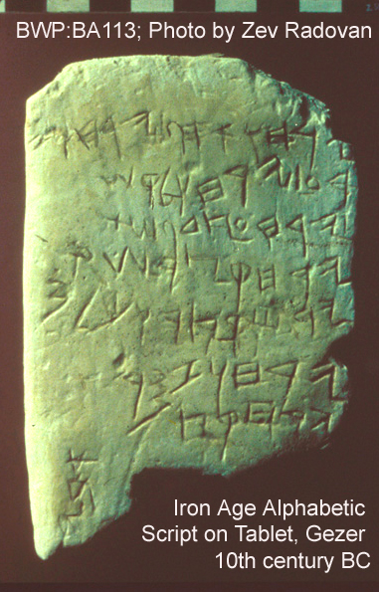
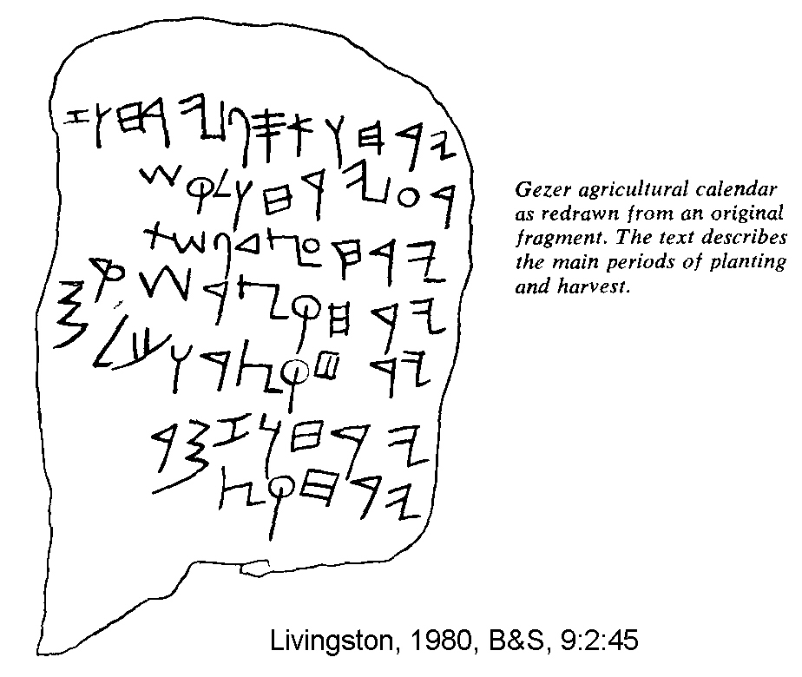

Slide 43
Types of Writing
Occasional Writings
Example: ostracon

Slide 44
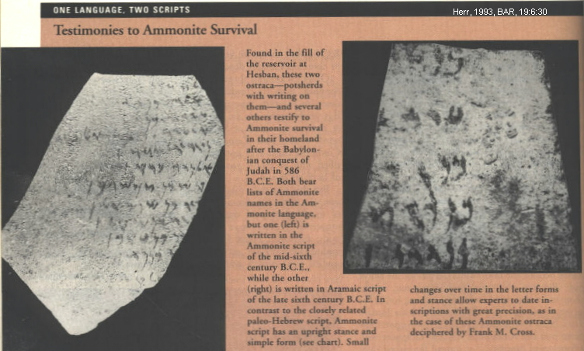

Slide 45
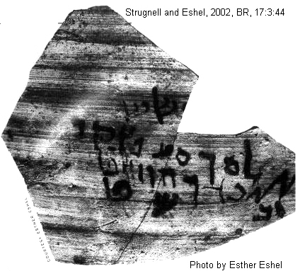
Ostracon from Qumran

Slide 46
SCRIPTS OF MESOPOTAMIA
Cunieform ideagrams, then alphabet
“Cunieform”: Latin for “wedge shaped”

Slide 47
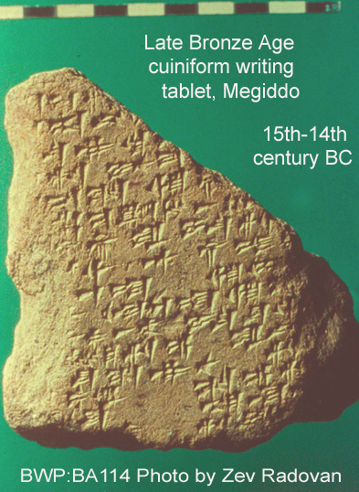

Slide 48
Sumerian Language (cir. 3500-2050 BC)
Not a Semitic language
Dead in 2050 BC it was studied by scribes of later cultures (Babylonian, Assyrian, Elamite, Hurrian, Hittite, Canaanite) for several centuries.
Law Codes

Slide 49
Sumerian Law Codes
Ur-Nammu code of law (c. 2150 BC)
Lipit-Ishtar code of law (c. 1900 BC) Hammurabi)
Hammurabi Law Code 1792-1730 BC

Slide 50
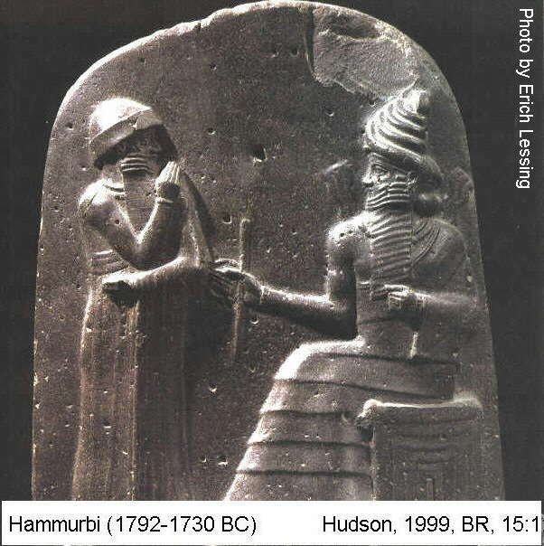

Slide 51
Sumerian Cunieform Script
agglutinative (running together)
250,000 tablets and fragments

Slide 52
Sumerian Pictographs and Cuneiform
Pictoraphs,
Erech, 3000 BC

Slide 53
Pictographs to Cunieform
pictographs were replaced by stylized wedge-shaped marks (cuneiform)
the signs became more phonetic.
Signs represented a consonant AND a vowel (i.e. ba, bi, bu, ub, ib, ab)
Hundreds of signs (900 are known at Erech alone!)

Slide 55
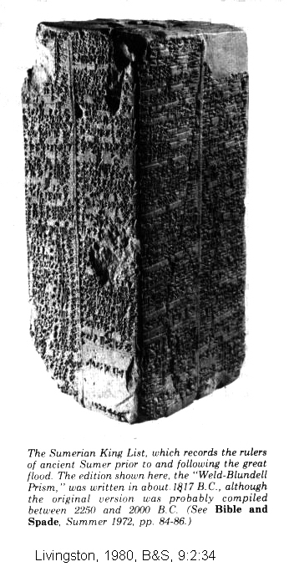
SUMERIAN KING LIST
ON
CUNIEFORM PRISM

Slide 56
Sumerian Cunieform
Established as a writing method by the time of Semitic Empire of Sargon I (end of 3rd millennium BC)
Originally arranged (like Chinese/Japanese) in columns written left to right
Later, for reasons unknown, columns were turned on their sides creating horizontal patterns of writing.
To keep the original writing orientation, the signs were turned on their sides as well

Slide 58
Akkadian Language
Eastern Semitic language.
It was spread throughout the Assyrian Empire by Sargon I (third millennium BC).

Slide 59
Two Akkadian Dialects
The oldest Akkadian dialect is Babylonian.
The Babylonian dialect was the language of the Code of Hammurabi at Susa (circa 1728 BC) and most of the Tell el-Amarna letters (Middle Babylonian, 14th century).
Neo Babylonian was the language that king Nebuchadnezzar (605-562 BC) used for his royal inscriptions which were written in the ancient Babylonian language style

Slide 60
Two Akkadian Dialects
The second dialect of Akkadian is Assyrian.
It was the main language of Anatolia and faded out of usage with the Assyrian empire's disruption in 612 BC.
It is the parent of Hebrew

Slide 61
Akkadian Cunieform Script
Lasted as a writing medium for 1,800 years
Semitic Akkadians, lead by Sargon I, adapted Sumerian cuneiform to make the Akkadian script.
This in turn was adapted by the Old Babylonian Empire of Hammurabi (late 18th, early 17 centuries BC).
By the 14th century BC Akkadian was used in international communication by the Hurrians, Hittites, Assyrian, Canaanites.

Slide 62
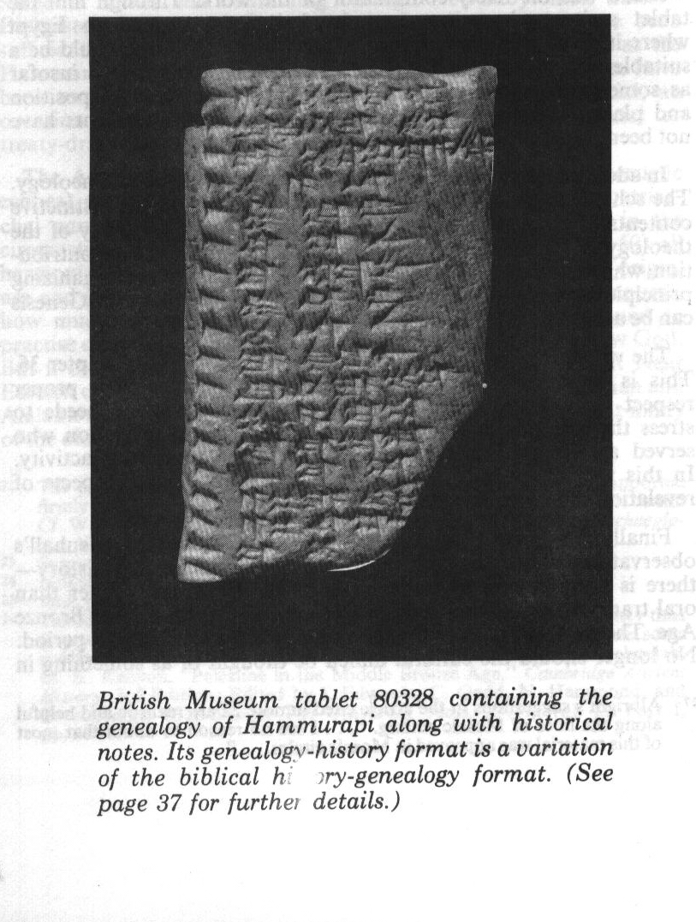

Slide 64
Akkadian Cunieform Script
Akkadian cuneiform is the script for the Tell el-Armana letters.
It was a language and script used by Assyrians, neo-Babylonians and Persians.
It declined in popularity during the Greek Empire and disappeared by 75 AD

Slide 65
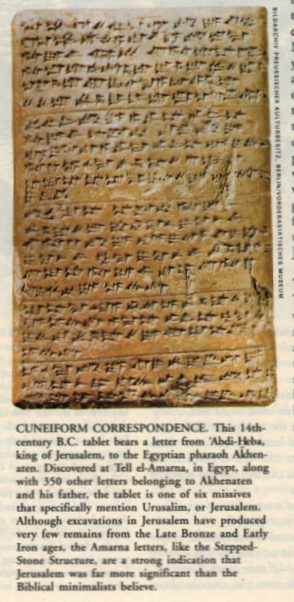
TELL EL-ARMANA LETTERS
14th CENTURY BC

Slide 66
Babylonian Scribal Practices The Colophon
The colophon, a marginal notation at the beginning and end of cuneiform tablets, was a scribal tool in use by Babylonian scribes from 3,000 to 1 BC.
It gave the name of the scribe and sometimes gave the name of scribe's colleague, senior, inspector or collator.
It sometimes gave details of exemplar such as "copied from a tablet from Babylon."

Slide 67
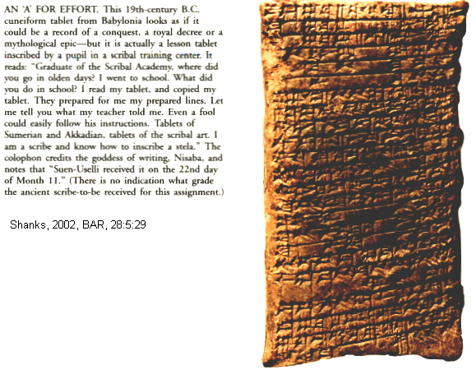
Colophon at end

Slide 68
The Colophon
Contained notes about the total number of lines on the tablet.
If the scribe was preparing a long text, every 10th line is marked and subtotals entered at the base of each cuneiform column.
A check was made after the tablets were copied. Sometimes corrections were made in the text, and if a line was found to have been omitted, it was written on the edge of the tablet with a horizontal line marking it's correct position in the text

Slide 69
The Colophon
Insured accuracy of copying

Slide 70
Copying Accuracy
A Sumerian hymn of praise is nearly identical to its Old Babylonian version. This is so despite age difference of 7 or 8 centuries.
Hammurabi Law Code as depicted in early 2nd millennium (Hammurabi) and 1st millennium (Nebuchadnezzar) versions are nearly same, except for spelling modernizations.

Slide 71
Copying Accuracy
The poem "Return of Ninurta to Nippur" is known from 54 different Old and Middle Babylonian, Middle Assyrian, Neo-Assyrian and Neo-Babylonian texts. These collectively show only 64 variants in 207 lines of manuscript. Of these only 12 variants have real alteration of meaning of the text.

Slide 72
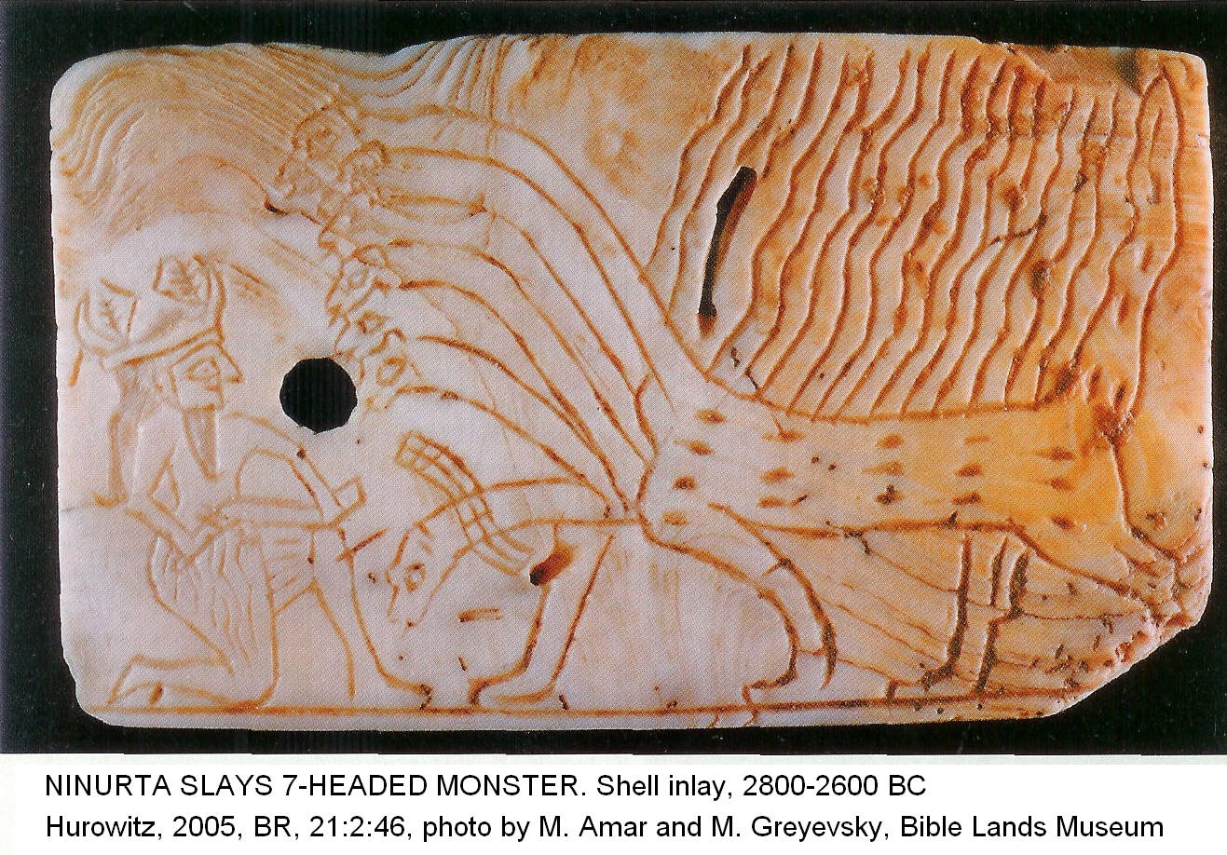

Slide 73
Hurrian Language
The Hurrian language was discovered in some Tell el-Armana letters.
It is also known from the Nuzi tablets (15th, 14th centuries BC).
It is unrelated to Sumerian, Akkadian, or any Indo-European language.
It may have some affinity to ancient Armenian

Slide 74
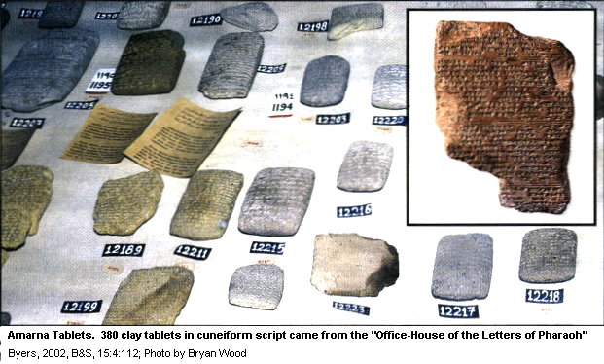
TELL EL-AMARNA LETTERS

Slide 75
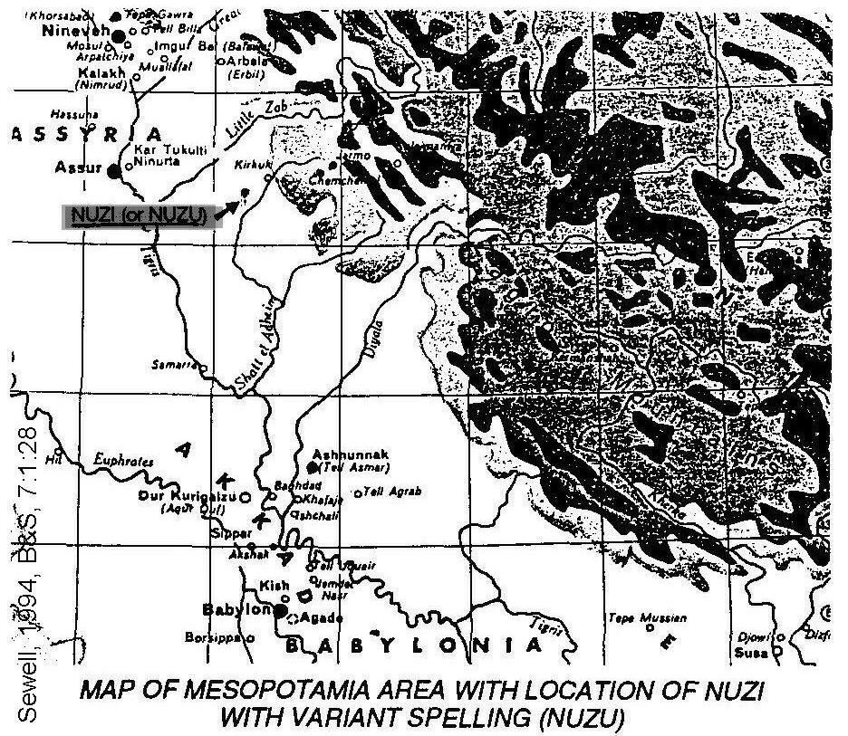

Slide 76
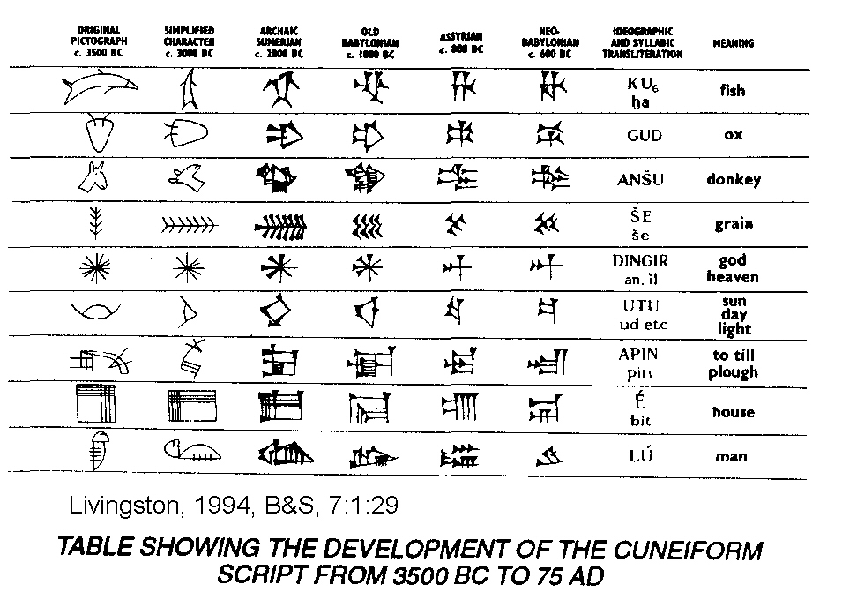

Slide 77
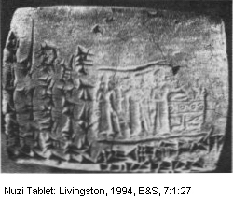

Slide 78
NEXT TIME
Scripts of Egypt

Slide 79
Egyptian Language
Hieroglyphic scripts began to fade with Akenaton's (d.1358 BC) phonetic revolution (Late Egyptian, Hieratic Script)
Simplification lead to Demotic script.
When Egypt was ruled by Greeks, the Coptic script (Hellenistic Ptolmies) was adopted with a Greek style alphabet

Slide 80
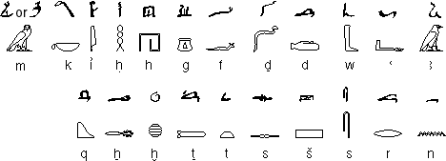
Hieratic Script and the Hieroglyphs they evolved from

Slide 81
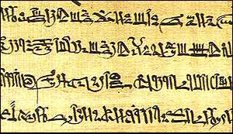
HIERATIC SCRIPT

Slide 82
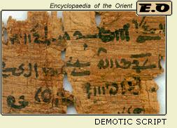

Slide 83
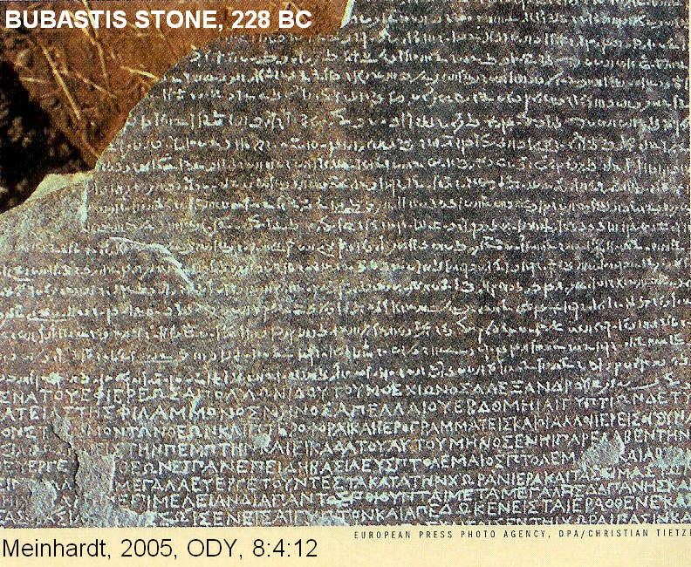
DEMOTIC SCRIPT

Slide 84
Demotic Script
pre-700 BC
The Egyptian script used by Greek and Roman empires.
They were used for commerce and government records.
Writing mediums for this script were papyrus, wood and pottery.
The last known Demotic inscription, from 476 AD

Slide 85
SCRIPTS OF THE LEVANT
Aramaic Language
Aramaic Alphabetic Script
Canaanite Language
Proto-Sinaitic (Canaanite) Alphabetic Script
Early Canaanite script
Canaanite and North Semitic Alphabetic Script

Slide 86
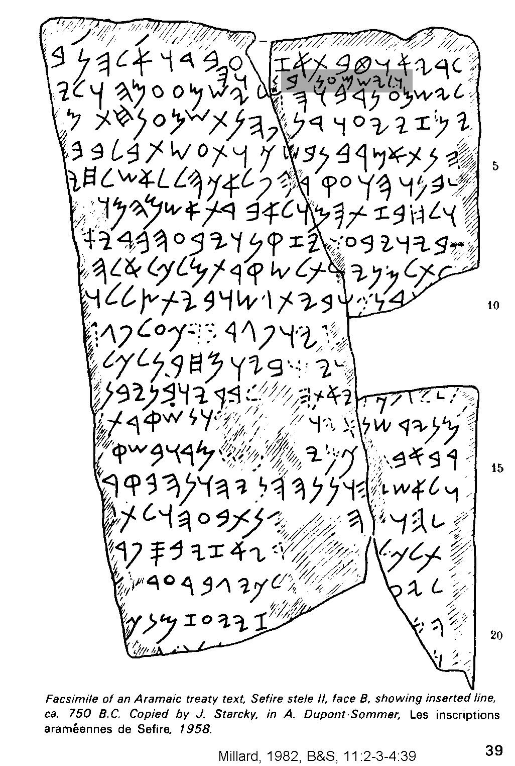
Aramaic Treaty with inserted line 750 BC

Slide 87
Aramaic
Aramaic inscriptions appear at 1000 BC.
This language had several variations.
Old Aramaic :North Syrian inscriptions (10th-8th centuries BC).
Aramaic is found in official Assyrian tablets from the 8th and 7th centuries.
Aramaic is found in Neo-Babylonian (Persian) tablets of 605-538 BC.
Levantine Aramaic is known from Syria and Palestine after 721 BC.

Slide 88
Aramaic
Aramaic replaced Akkadian as the lingua franca of international diplomacy during Assyrian Empire.
It became the language of common people in the Mesopotamian valley so Hebrews adopted it while in exile there.
Palestinian Jewish Aramaic became the common language of the people from 420 BC to 100 AD following the return of the exiles from Babylon

Slide 89
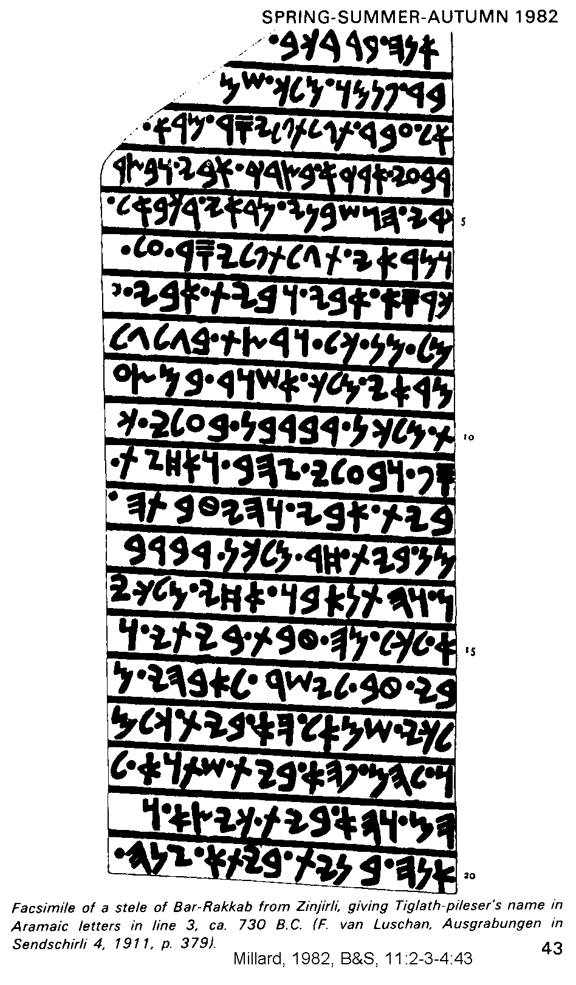
TIGLATH-PILESER’S NAME IN ARAMAIC LETTERS, IN THIRD LINE, 750 BC
<

Slide 90
Aramaic Alphabetic Script
This script is the father of some eastern scripts (Phoenician was father of Western scripts).
The Hebrews abandoned the Phoenician style of scripts and transliterated Old Testament scriptures into a derivative of Aramaic form of writing

Slide 91
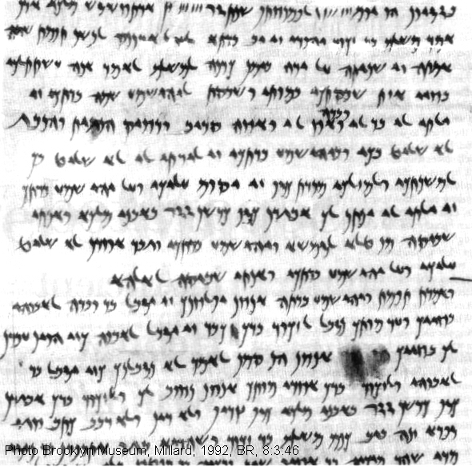

Slide 92
Aramaic in the Old Testament
Genesis 31:47 (the only Aramaic phrase from the Pentateuch), Ezra 4:8-6:18; 7:12-26 and Daniel 2:4b-7:28 and Jeremiah 10:11

Slide 93
Early Aramaic Script
looked much like the paleo-Hebrew (which was borrowed from Phoenician) but which developed differently.

Slide 94
Canaanite Language
Canaanite is a northwest branch of Semitic tongues.
It was called "Phoenician" by Greeks.
Examples are known from the Ugarit (Ras Shamrah) tablets (pre-1200 BC) at the northeastern tip of Mediterranean Sea.
Canaanite employed vowels.
The Canaanite language gives insight to the meaning of many Old Testament words and phrases, especially in Psalms and Wisdom literature

Slide 95
Proto-Sinaitic (Canaanite) Alphabetic Script
This script is known from Serabit el-Kahdem in the southwest Sinai peninsula
Dates to 1,500 BC (about time of the Exodus [early date]).
The site is associated with a Turquoise mining operation.
Inscriptions come from artifacts from a temple to the cow goddess Hathor (Baalat).

Slide 96
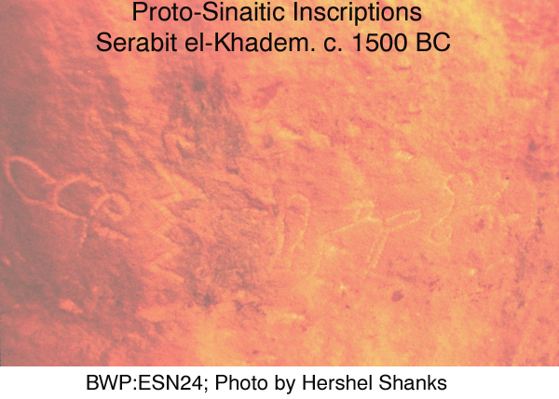

Slide 97
Serabit el-Kahdem
Semitic miners (who were slaves or supervised by Egyptians) borrowed hieroglyphic symbols and invented an alphabet.
Another possibility is that this alphabet was an earlier invention of Semites in Canaan of which the Sinaitic script is a later variety

Slide 99
PROTO-SINAIC INSCRIPTIONSERABIT EL-KAHDEM

Slide 100
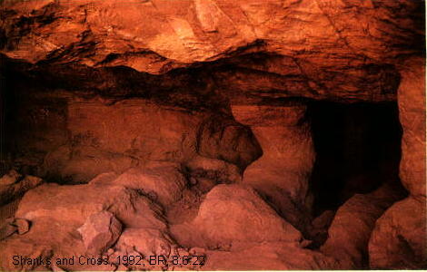
Mines of Serabit el-Kahdem

Slide 101
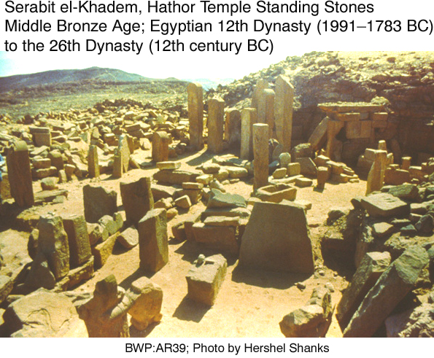

Slide 102
Early Canaanite script
18th-17th centuries BC (Patriarchal Period)
15th to early 14th centuries BC (Conquest Period)
13th century BC (Judges Period)

Slide 103
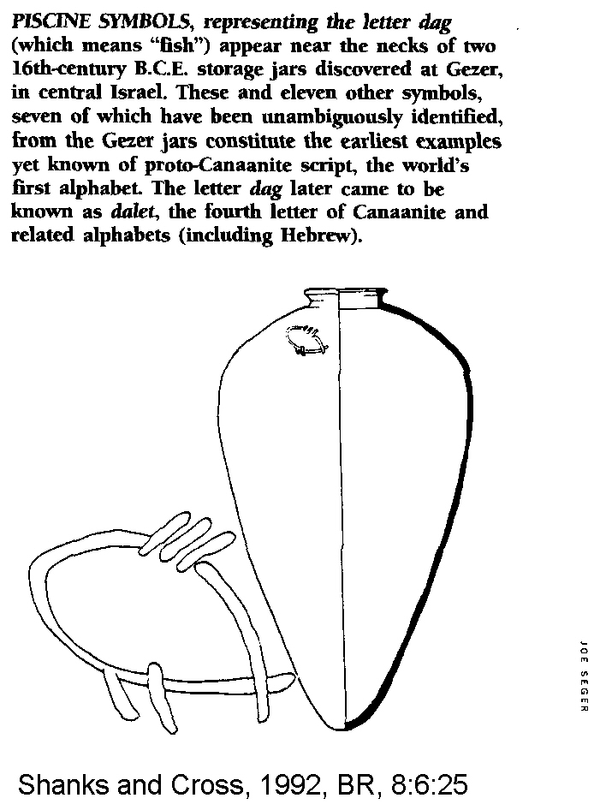
PROTO-CANANITE SCRIPT
ON STORAGE JAR

Slide 104
Canaanite and North Semitic Alphabetic Script
The first Canaanite alphabetic script was invented by Semites in Levant between 2000-1700 BC, probably in 18th century when Hyksos invaders ruled lower Nile Delta.
This Canaanite script employed a one sign-one sound principle and with it the acrophonic principle was well established

Slide 106
Alphabetic writing was invented in Canaan
A bilingual Canaanite scribe (or school), being familiar with both the Egyptian and Mesopotamian systems
They were in a position to see the possibility of a simpler writing system (one sound-one sign).
That system used some hieroglyphs for some of its phonetic signs

Slide 108
Northwest Semitic Sources, 2000 to 550 BC
North Semitic Script
Neo-Philistine Script
Ugaritic Alphabetic Script
Hebrew
-Old Hebrew Script
-Paleo Hebrew script
Ammonite script
Phoenician Script
Square Hebrew Aramaic Script

Slide 109
North Semitic Script
The North Semitic script had 22 letters, all consonants.
It was written right to left.
This script was used by Syrians, and was essentially same as the script used in Palestine
This script was adopted by Greeks about 1100-1000 BC (but Classicists say 9th century)

Slide 110
MOABITE STONE (MESHA STELA), North Semitic Script, 850 BC

Slide 111
Neo-Philistine Script
More akin to Hebrew than to Phoenician.
This is surprising and may be due to political domination of Philistine cities by Israel during the period of the United Monarchy

Slide 113
Ugaritic Alphabetic Script
Known from excavations at Ugarit (Ras Shamrah).
Tablets date from 1500 to 1200 BC.
Ugaritic used a Canaanite alphabet in Akkadian cuneiform.
It had 32 signs with 27 consonants, 3 vowels and 2 others of signs of minor value

Slide 114
Ugaritic Alphabetic Script
The only similarity with Akkadian cuneiform is wedge-shaped markings.
The language was very different. It was written left to right.
In the oldest tablet with an A-B-C-D list (“abecediary”), there are 30 letters, 22 of which are equivalent to 22 of the North Semitic alphabet and are listed in the same order.

Slide 115
Ugaritic Alphabetic Script
Use of cuneiform with the Ugarit alphabet apparently ceased with destruction of that city

Slide 116
Hebrew Language
Never called "Hebrew" in the Old Testament.
Termed “the Jew's language” (2 King 13:26 and Neh 13:24) or "the language of Canaan" (Isaiah 19:18).
Hebrew is a highly mixed tongue, containing elements of Akkadian, Canaanite, Aramaic and Arabic

Slide 117
Hebrew Language
Abraham spoke Akkadian, later, as he moved into what we now call the “Promised Land”, he learned and spoke Canaanite.
Jacob learned Aramaic while with Laban.
Hebrew language further evolved from Aramaic in land of Goshen while the Israelites were captives there.

Slide 118
Hebrew Language
After the Exile, Aramaic became common in everyday speech and Hebrew was used in only in religious activities.
Hebrew became a dead language after 2nd Jewish Revolt in 135 AD.
Revived as the national language of Israel after World War II

Slide 119
Hebrew Language
Semitic language.
It has root words of 3 consonants and highly variable vowels modify meanings of these roots.
Hebrew thinking and language was optical with prodigious use of similes and metaphors.
The language has few particles, adjectives and adverbs.
It is not at all like Greek with logical syllogisms.
With time, Hebrew lost most of its case endings (a form of simplification). It uses short, blunt sentences

Slide 120
Old-Hebrew Script
Only slightly different then that used by older Canaanites.
The early signs were more conventional, angular and prong-like.
The consonants and right to left writing were the same as old Canaanite.
There were no vowels

Slide 121
OLD HEBREW SCRIPT
SILVER SCROLL AMULET
7TH CENTURY BC

Slide 124
GEZER CANANDER, OLD HEBREW SCRIPT

Slide 126
ORIGINAL INSCRIPTION IN OLD HEBREW SCRIPT

Slide 127
OLD HEBREW WITH WORD DIVIDER (Dot)

Slide 128
Paleo-Hebrew script
The Old-Hebrew script was discarded during the Exile.
After the Exile, the Hebrews used the square Aramaic Script.
But some post-Exilic writings were made using an archaizing script called Paleo-Hebrew.

Slide 129
Paleo-Hebrew script
There was a limited revival of a form of the Old-Hebrew script just before New Testament times.
There are subtle differences between Old Hebrew and Paleo-Hebrew scripts that make them distinguishable

Slide 133
Ammonite script
The neighboring Moabites, Ammonites, and Edomites employed a similar script as Hebrews.
The evolution of Ammonite script is known from the many decades of ostraca deposited in the Pool of Heshbon from the 4th through 5th centuries BC

Slide 134
AMMONITE OSTRACON

Slide 135
Phoenician Script
The Phoenician script was common among Phoenicians of Tyre, Sidon and other communities on islands and along coast of Mediterranean Sea.
Most surviving examples are from Persian Period

Slide 136
Phoenician Script
The Phoenician script is the father of all Western scripts, and came to us mainly through the Greeks.
They borrowed the alphabet from Phoenicians as early as 11th century BC (but Classicists argue 9th century BC).

Slide 138
Greek adaptions to Phoenician
Added vowels and 2 new characters (Phoenician had 22 while Greek had 24 letters).
There were various directions of writing. Some was left to right (LXX, 3rd century BC). In others one line was read one way and next line the opposite way. Others were read right to left

Slide 140
Square Hebrew Aramaic Script
This classic script developed during Exile (6th to 5th cents. BC).
At this time the Hebrews decided to transliterate their Scripture into the common language of the time, Aramaic
They borrowed the Aramaic script.
Parts of Daniel and Ezra written in Aramaic

Slide 141
Square Hebrew Aramaic Script
The square Hebrew script has 22 letters in its alphabet.
All letters are consonants. Two letters lost their sound value.
Four letters were used as signs for long vowels as spoken Hebrew died out (except in synagogue and school applications).

Slide 142
Hebrew vowel development
In the Middle Ages, vowel development occurred in 3 schools.
Babylonian
Tiberian
Palestinian

Slide 143
Modern Hebrew Script
Cursive styles of Square Hebrew script developed in Enlightenment and Industrial Revolution periods.

Slide 144
Early West Semitic Scribal Practices
Hebrew scribes would break words between lines of text if space ran out, and they divided each word from its neighbor by a space or a point (dot)

Slide 145
WORDS SEPARATED BY SPACES

Slide 146
WORDS SEPARATED BY DOTS, PALEO HEBREW

Slide 147
Early West Semitic Scribal Practices
An important scribal practice was error correction.

Slide 149
TEXT WITH INSERTED LINE

Slide 150
AEGEAN SCRIPTS
Hieroglyphic Creten
Linear A
Linear B

Slide 151
Hieroglyphic Cretan
Writing was developed in the Aegean around 1800 BC under the influence of Mesopotamian writing traditions.
The oldest is a hieroglyphic Cretan script represented by some seals and seal impressions dating from 1800-1600 BC

Slide 154
Linear A
Enigmatic
Not Deciphered

Slide 156
Linear B
Deciphered
Syllabic

Slide 157
DEMOCRATIZATION OF CULTURE THROUGH WRITING
Once invented, the alphabet spread throughout world in only about 1,000 years.
A result of this intellectual revolution was that learning and culture were no longer under control of tiny elite.
Religious lore (myth, ritual, magic, medicine) was no longer exclusive property of professional interpreters of sacred knowledge, it made it possible for ideas of all types to enjoy a wider audience.
This made for better and faster accumulation, preservation and transmission of knowledge.

Slide 158
DEMOCRATIZATION OF CULTURE THROUGH WRITING
The early writing system was completely phonetic with 22 characters after 1200 BC.
This simple system (which we have complicated by dialects and changes in vocalization) made for easier analysis, criticism and logical perusal of ideas.
Pre-alphabetic societies (Mesopotamia, Egypt) became decadent, moribund, static, hierarchical and oppressive compared to the innovative, prospering and more democratic societies (e.g. Greeks and Romans) that used alphabets.

Slide 159
Alphabet: Hebrew vs Greek

Slide 160
NEXT TIME
Early Judaism Part 1

