Slide 1
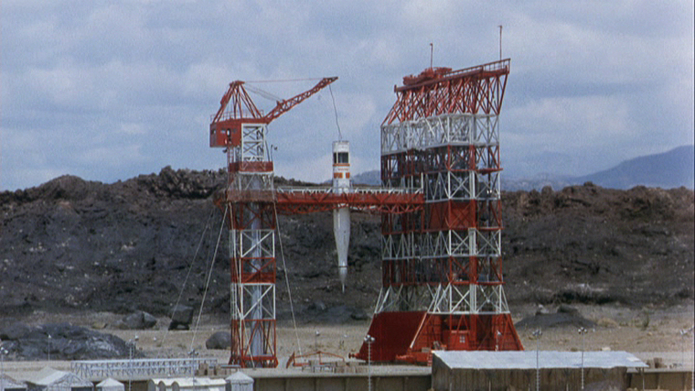
Crack in the Earth (1965)
Dr. Gregg wilkerson

Slide 3
Dana Andrews, Janette Scott, Kieron Moore Alexander Knox

Slide 4
Director
Andrew Marton

Slide 5
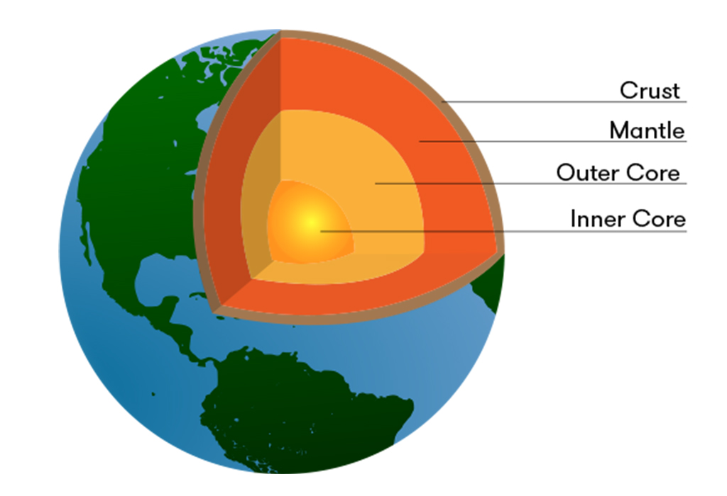
The Mission: Geothermal Energy
Drill down to core-mantle interface
Thin layer barrier holds them back
10 megaton thermonuclear device
WATCH IT!

Slide 6
Let’s Not Do This!
Bureaucracy in action
Contrary scientific interpretations
Violate the chain of command
WATCH IT

Slide 7
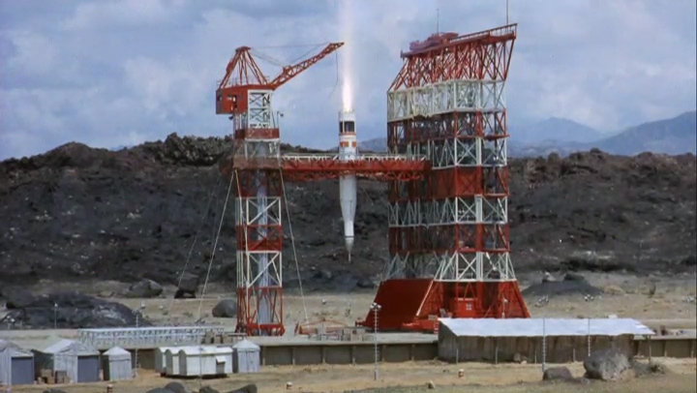
Blast Down
We hit magma!
Metals in molten form
Energy!
WATCH IT

Slide 8
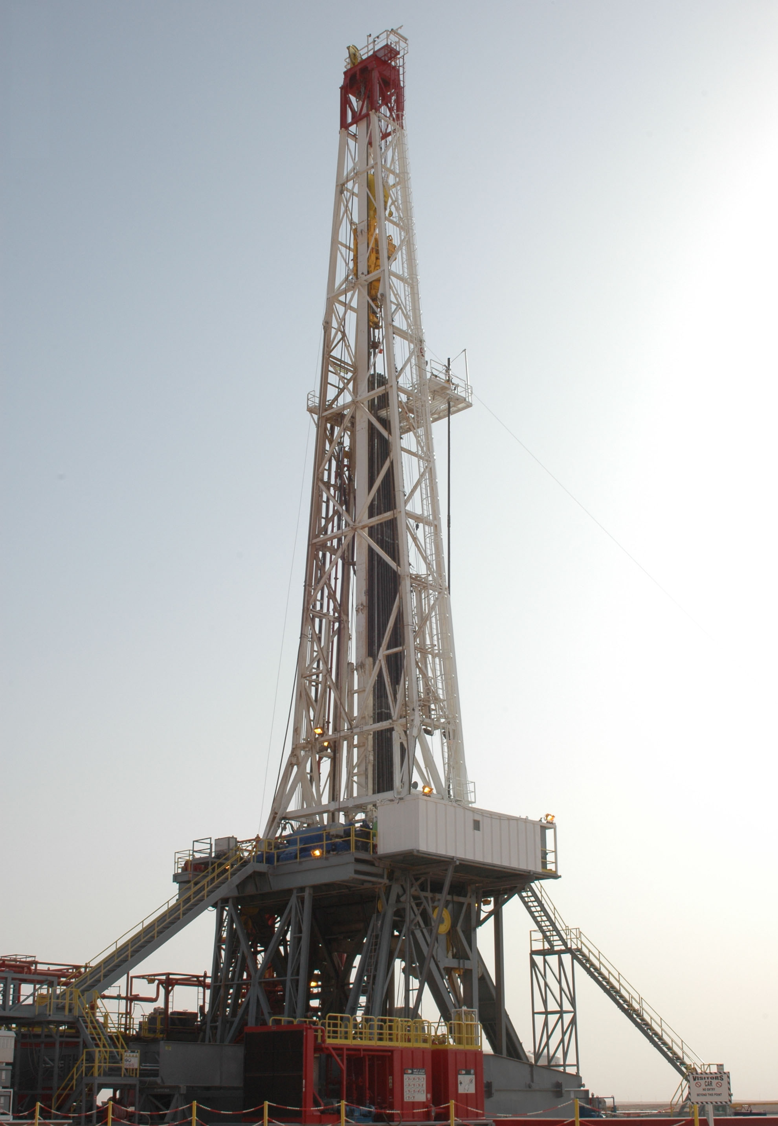
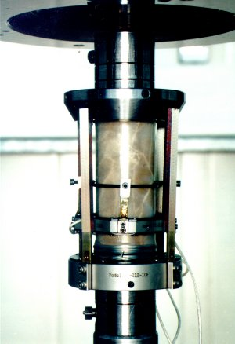
Deep Drilling
There is a limit to how far down you can go
Lithostatic plus Geostatic Pressure
No open hole possible
Plus way to hot
Rocks behave plastically
40,000 ft (12 mi) maximum

Slide 9
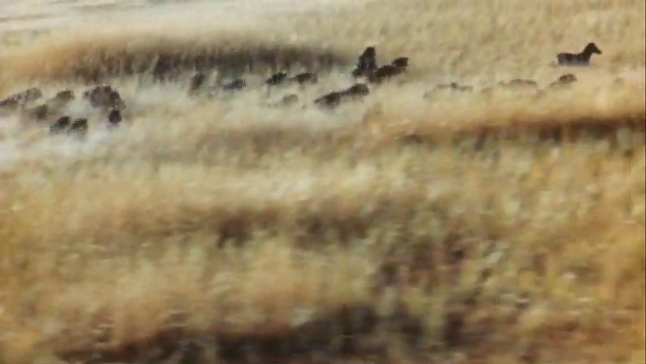
Animals Know Better
They are running scared
WATCH IT

Slide 10
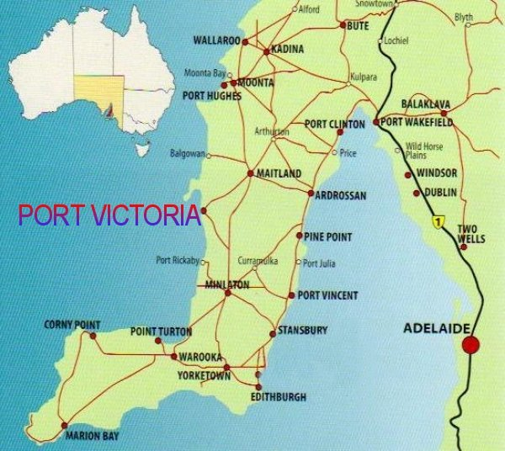
Port Victoria Earthquake
Photos from Alaska, 1964
Prediction: next quake on Quinamanukan Island Island
On Line of Masedo Fault
Prediction: next quake on Shearwater Island.

Slide 11
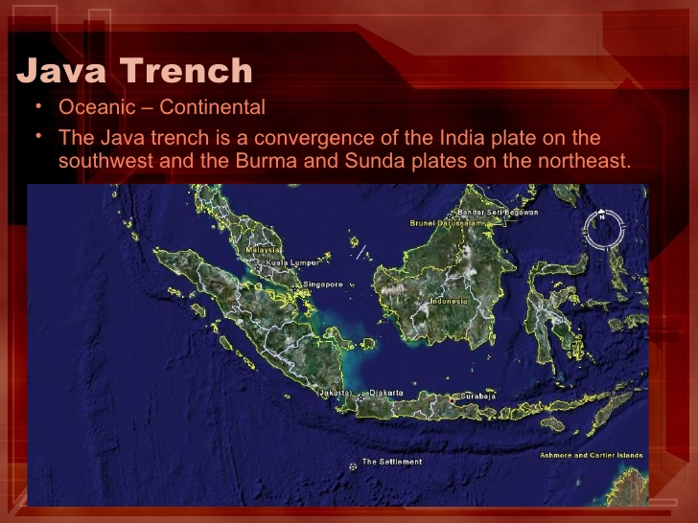
Macedo Trench vs Java Trench
Dr. Ted Rampion: Along the Macedo Trench. It's following a geological flaw in the Earth's crust, known as the Macedo Fault. That runs from here, to the tip of India, veers off towards Indonesia, and terminates off the Australian continental shelf.
Made up
Similar to the Java Trench

Slide 12
Mariana Trench
The Mariana Trench is the deepest of all ocean trenches. Formed by the same plates that created the Philippine Trench, the Mariana Trench is just northeast of that slightly shallower one, to the east of the Mariana Island chain and just south of Japan. The deepest part, known as the Challenger Deep, is 10,911 meters (35,797 feet) below sea level.

Slide 13
Mariana Trench

Slide 14
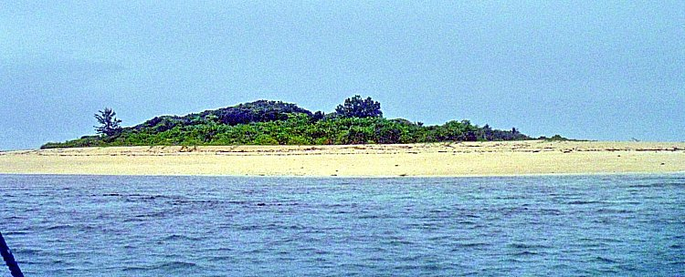
Quinamanukan Island
Camarines North Province
6 hours drive from Manila

Slide 15
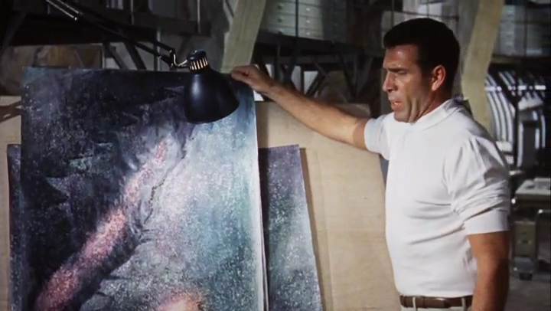
Undersea Exploration: Deep Fissure
Submersible
Undersea Lava
Crack in the Earth!
WATCH IT

Slide 16
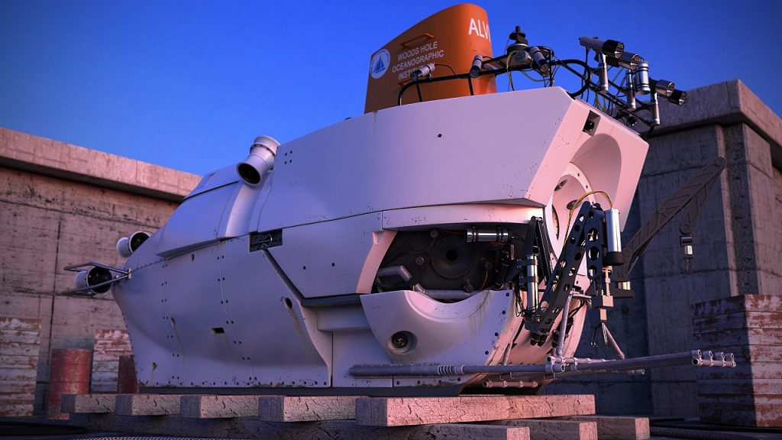
Submersibles and Pillow Lavas
Submersibles good to 14,800 Ft (Alvin)
PILLOW LAVA VIDEO

Slide 17
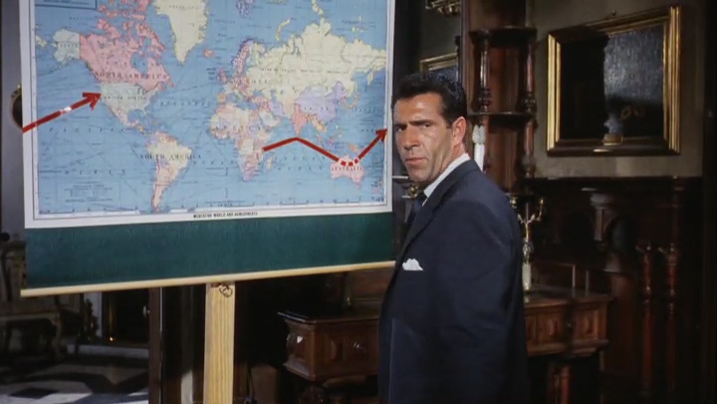
Crack in the World
Imaginary Macedo Trench not quite like real tectonic plates
Imaginary trench will go around the world
Closest real analogue would be the Pacific Plate
WATCH IT!

Slide 18
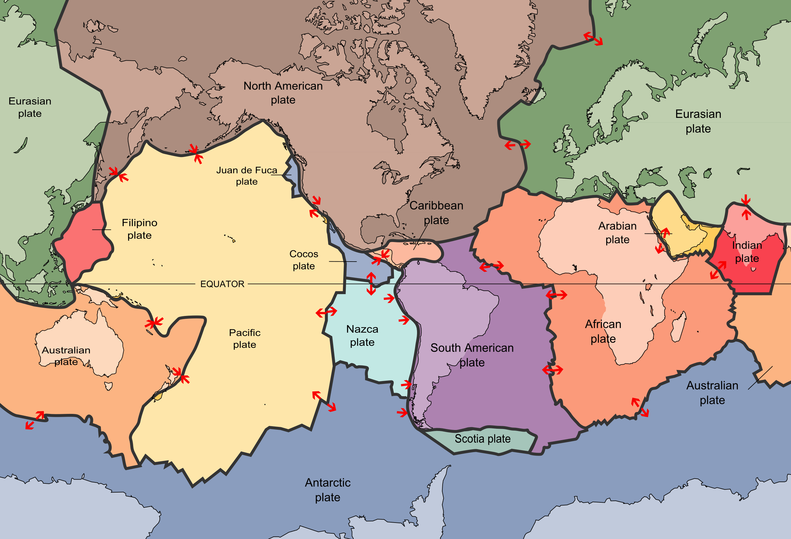
Tectonic Plates
7 large
Several small

Slide 19
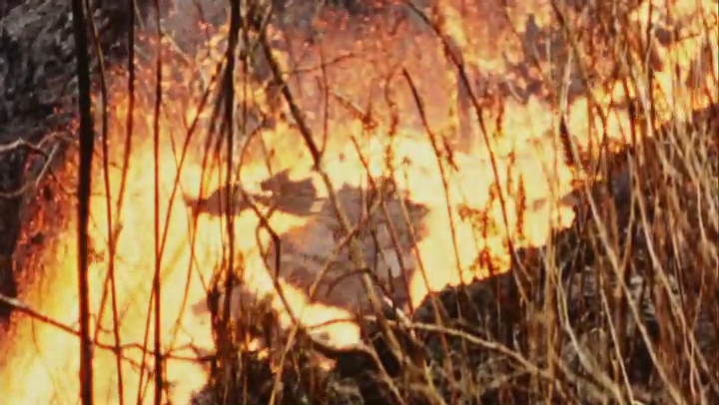
Destruction and more destruction
Oh the poor little animals!
WATCH IT

Slide 20
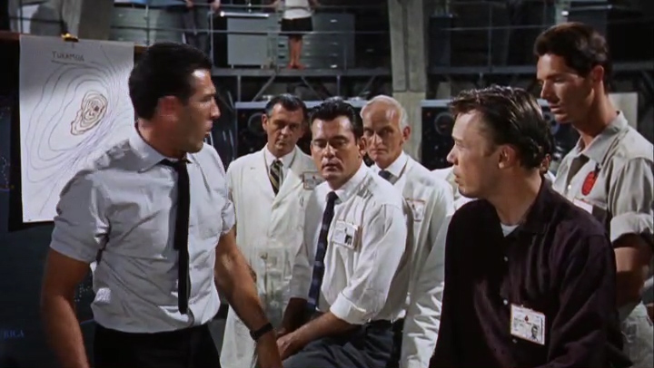
Hydrogen Bomb Solution
Comparison of spectrographs
Interior Hydrogen!
Kakamora Island
WATCH IT!

Slide 21
Kakamora
There is no such island
There are mythical being named “Kakamora” in the legends of the Solomon Islands
"Kakamora [...] are not quite human. They vary in height, from six inches [approx. 15 cm - WB] to three or four feet [approx. 95 to 125 cm - WB] [...]. Most of them are considered to be quite harmless, but sometimes they have been known to attack men.”

Slide 22
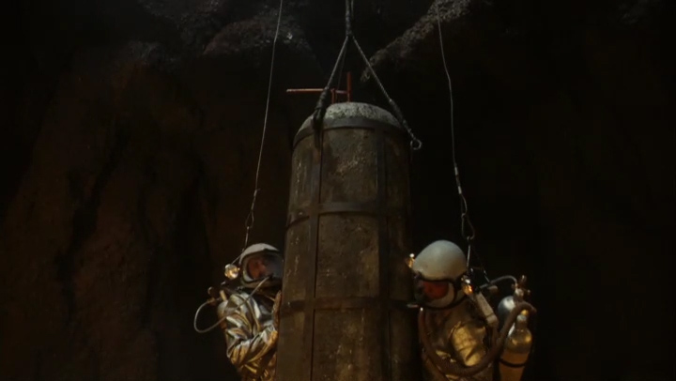
Drop the Bomp
Into a volcanic neck
Geometry unrealistic
WATCH IT

Slide 23
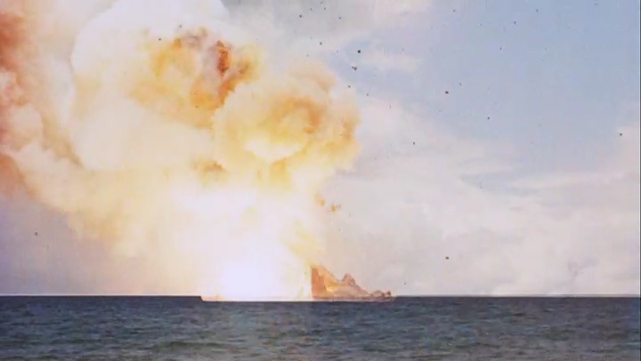
Blow up the Volcano
I love a good explosion
Proximity of observers too close to avoid radiation damage
Clipped footage of nuclear test
WATCH IT!

Slide 24
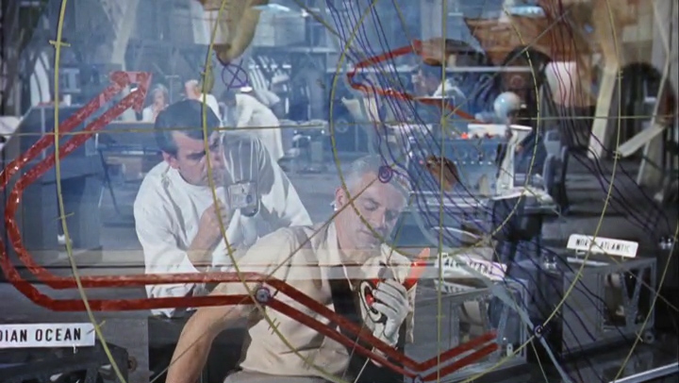
We just made things worse!
Crack not stopped
Changed direction
WATCH IT!

Slide 25
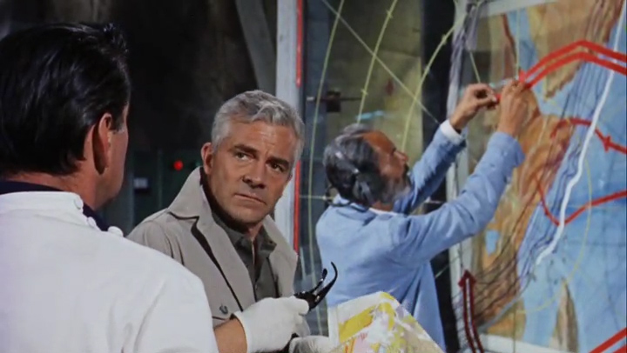
Two Fissures
Crack Returns to where it started
20,000 square miles
Birth of a moon predicted!
WATCH IT!

Slide 26
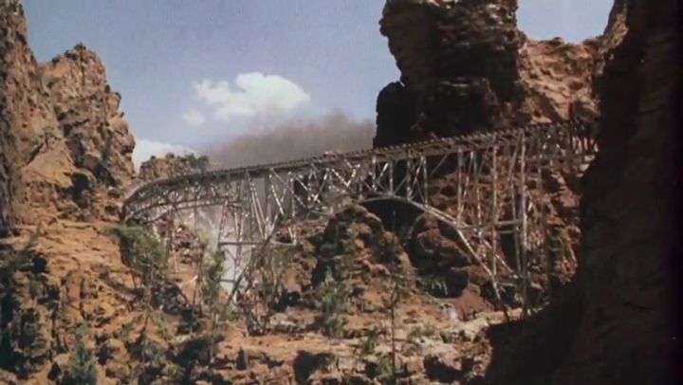
Now that’s a crack!
Train wreck
Fissure formation
WATCH IT!

Slide 27
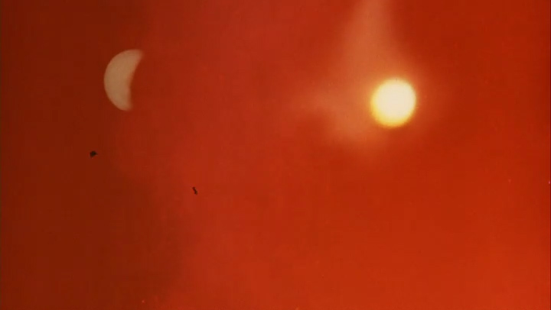
Escape just in time to see birth of new moon
The villain stays behind but dies heroically
Wrecked a beautiful old car
Two moons!
WATCH IT!

Slide 28
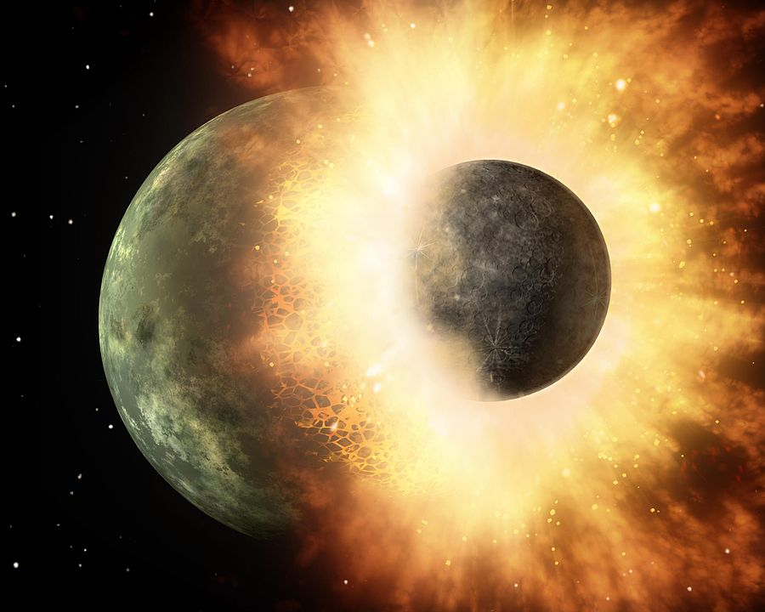
Physics and moon creation
Our moon is the result of a collision, 4.5 billion years ago

Slide 29
Evidence for collision hypothesis
Earth's spin and the Moon's orbit have similar orientations.[5]
Moon samples indicate that the Moon's surface was once molten.
The Moon has a relatively small iron core.
The Moon has a lower density than Earth.
There is evidence in other star systems of similar collisions, resulting in debris disks.
Giant collisions are consistent with the leading theories of the formation of the Solar System.
The stable-isotope ratios of lunar and terrestrial rock are identical, implying a common origin

Slide 30
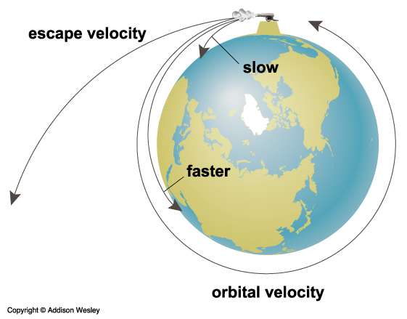
Crack in world theory: does not hold water
F = ma
Escape velocity 11.186 km/s (6.951 mi/s)

