Slide 1
Mining history of the lake isabella region
Dr. Gregg Wilkerson
U.S. Bureau of Land Management

Slide 2
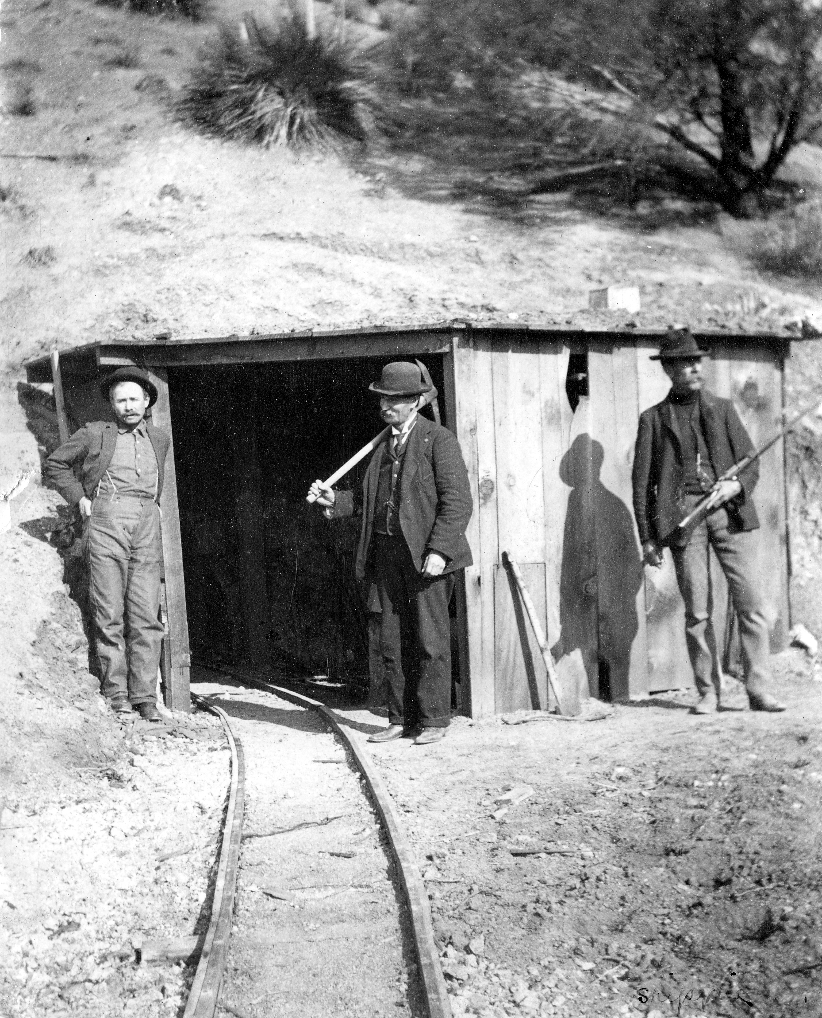
Acknowledgements
Photos courtasy of Bob Powers Collection
Charles L. Barbee

Slide 3
Greenhorn Mountain District

Slide 4
Petersburg-Greenhorn Creek
Discovered 1851
Party sent out by John C. Fremont
$50 per pan placer; several lodes
Petersburg: supply center established 1858
Two 6-stamp mills in 1858 and three arastras
20-stamp mill in 1866
Declined by 1890

Slide 5
Keyesville District

Slide 6
Keyesville District

Slide 7
Keyesville Mining District

Slide 8
Keyesville
1853: Richard Keys, half-Cherokee discovered lode gold
1952/53: Captain Maltby discovered Mammoth Mine
1858: five water driven mills with 22 stamps
1861 - 1862 : floods destroyed them all.
50 to 60 people and boasted eight houses, a saloon and crude hotel
1865-66: 20 stamp mill, ineffective

Slide 9
Keyesville Arastra

Slide 10
Mammoth Mill

Slide 11
Keyesville Revival
1897
5-stamp mill was erected at the Keyes mine and a 10-stamp mill at the Mammoth
1897 to 1943: Intermittent mining
The Keyes mine produced a total of $450,000, the Mammoth about $500,000.

Slide 12
Keyesville, 1914

Slide 13
Keyes Stamp Mill
Hauled though Visalia from San Francisco and erected on the river in 1856.
1865-1897: idle
1897: 5 stamp mill

Slide 14
Keyes Mine

Slide 16
Stravert Keyes Mine

Slide 18
Stravert Arrastra, Keyes Mine

Slide 19
Al Coe at the Mammoth Mine

Slide 20
Big Blue Mine – Cove District

Slide 21
Big Blue Mine- Cove District

Slide 22
Big Blue Mine – Cove District
1861: Placer gold discovered by Lovel Rogers when he picked up a rock and found it full of gold.
Rogers traces float and finds the Big Blue Vein
1863: Camp of Quartzburg laid out
1864: Residents rename the camp Kernville
1868: Judge J. Warner Sumner consolidation of claims

Slide 23
Lovel Rodgers at Big Blue Mine

Slide 24
Big Blue Mine – Cove District
1875-1876: Senator John P. Jones of Nevada: consolidated all mining and water rights.
New Mills, Cornish water pumps dewater the Sumner Shaft.
November 1883: Fire destroys pumps and timbers.
1834: New Mill
1834-1943: Continuous Operation
Cove district yielded as much as $8 million in gold.
2010: New drilling planned

Slide 27
Jim Jorgensen Big Blue Mine

Slide 28
Mine Superintendent House

Slide 29
Claraville – Piute Mnt District

Slide 30
Claraville – Piute Mnt District

Slide 31
CLARAVILLE (aka THE MT. SINAI DISTRICT, TICKNOR BASIN, EAST PIUTE MTS
June 1861: Discovered in Ticknor Basin, high in the Piute Mountains, by a party of prospectors
Easily worked lodes paying as much as $300 per ton
1864: Camp of Kelsoe began to take shape. Later the camp's name was changed to Claraville in honor of the first white girl born in the camp: Clara Munckton

Slide 32
CLARAVILLE
1867 : Claraville consisted of about twelve houses, a store, blacksmith shop and hotel
June 1869: the community was deserted.

Slide 33
SAGELAND
1860: St. Johns Mine discovered
Sageland 4 miles north of St. Johns Mine
Also served:
- the Burning Moscow situated 5 miles west of Sageland,
- the Gold Hill situated on Gold Peak 4 miles south
- the Esperanza about 3 miles southwest of the St. John

Slide 34
St. John Mine
October 1867: 12-stamp mill was erected at Tunnel Springs
May 1886: The Gold Hill mining Company moved a 10-stamp mill from Havilah to the same location, beginning operation.
June 1869: the community was deserted

Slide 35
Lorain Mining District

Slide 36
Lorain – Amalie
1890’s : Discovery of Amalie Mine by C. Moore
March 1894: W.E. Rodgers purchases Mine
Mill, new shafts drifts, 20 tons per day mill
Silver Chloride and Free Gold
Sulfides and Smelting
1895: Amalie only mine, but followed quickly by others
Boarding house, store, blacksmith shop, and barn had been erected. A Post Office had opened, and a stage to Caliente ran three times a week

Slide 38
Lorain – Amalie
1896-1900: Idle due to litigation
1900-1906: Continuous operation with 12-40 men mining 10-15 tons per day.
June 1906: New mill, but inefficient
Total production $600,000 in gold and silver

Slide 39
Barbarosa Mine
1903-1904: 2.000 tons mined
Ore processed at Amalie Mill
$60,000 total production

Slide 41
Golden Cowboy
Golden Cowboy mine discovered in “early days” by W Hampton (“Hamp”) Williams, half Piute Indian.
Produced about $100,000 prior to 1905, and $200,000 prior to 1913.

Slide 42
Zenda Mine
March 1906: Mill erected
March 1909: New Mill
1910: Cyanide circuit
1922: New owners, 150 tons per day mill
In 4 years produced $650,000 in gold and silver

Slide 43
Weldon Tungsten District

Slide 44
Weldon Tungsten District

