Slide 1
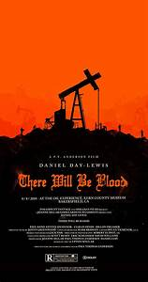
There Will be Blood (2007)
Dr. gregg wilkerson

Slide 2
TRAILER
WATCH IT!
Nominated for 8 Oscars
Best Actor
Best Cinematography

Slide 3
Location
It was filmed in the same area of Texas used by “No Country for Old Men”
3 Academy Awards

Slide 4
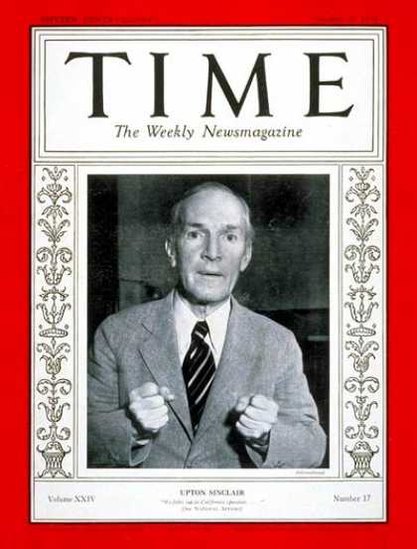
Novel
Loosely based on the novel Oil! by Upton Sinclair

Slide 5
Director and Writer
Paul Thomas Anderson
(Punch Drunk Love, Boggie Nights, Inherent Vice)

Slide 6
Daniel Day-Lewis, (Last of the Mohicans, Lincoln, Gangs of New York)
Paul Dano, (Little Miss Sunshine, 12 Years a Slave, Love and Mercy)
Ciarán Hinds (Women in Black, Harry Potter and the Death Hallows: Part 2, Tinker Tailor Soldier Spy, Rome)

Slide 7
The Miner, 1898
Pick work
Black Powder and fuse
Hint: Remove tools first, then get tools!
Don't mine by yourself
“There she is”
WATCH IT!

Slide 8
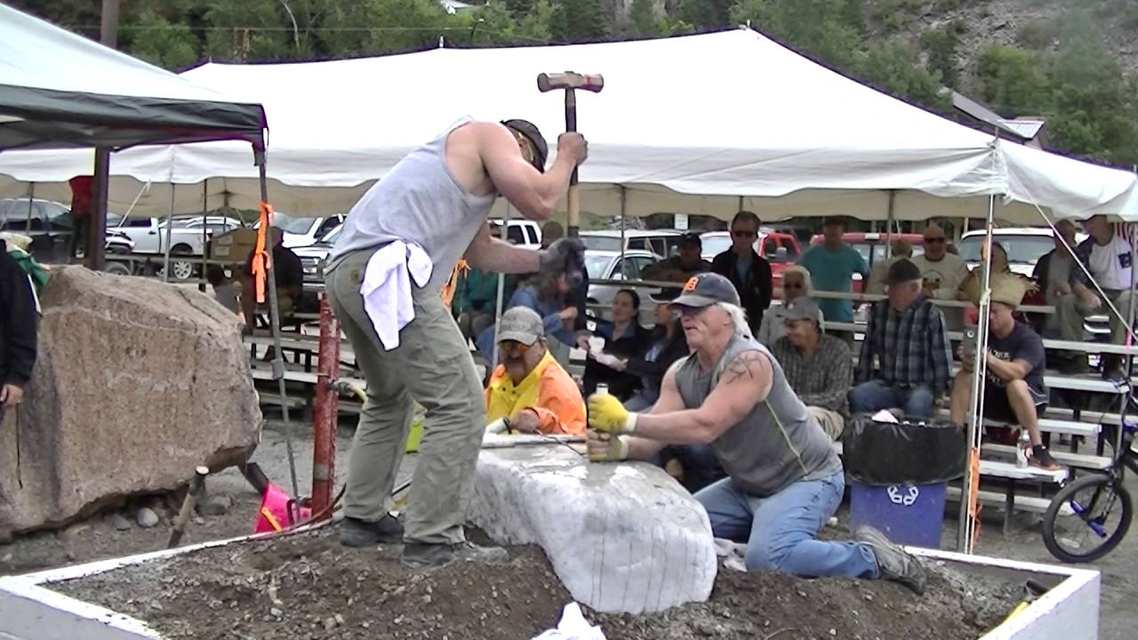
Not the way you blast
Make hole
Single or Double “Jack”
Rotate bit
WATCH IT!

Slide 9
Melting the Ore
3 oz per ton at $1.14 per ounce
Crush
Put in furnace
WATCH IT!

Slide 10
The Oilman, 1902
Crude Cable Tool
Mine Shaft
Drop a heavy iron spear
Baby on board
Hand buckets to oil sump
WATCH IT!

Slide 11
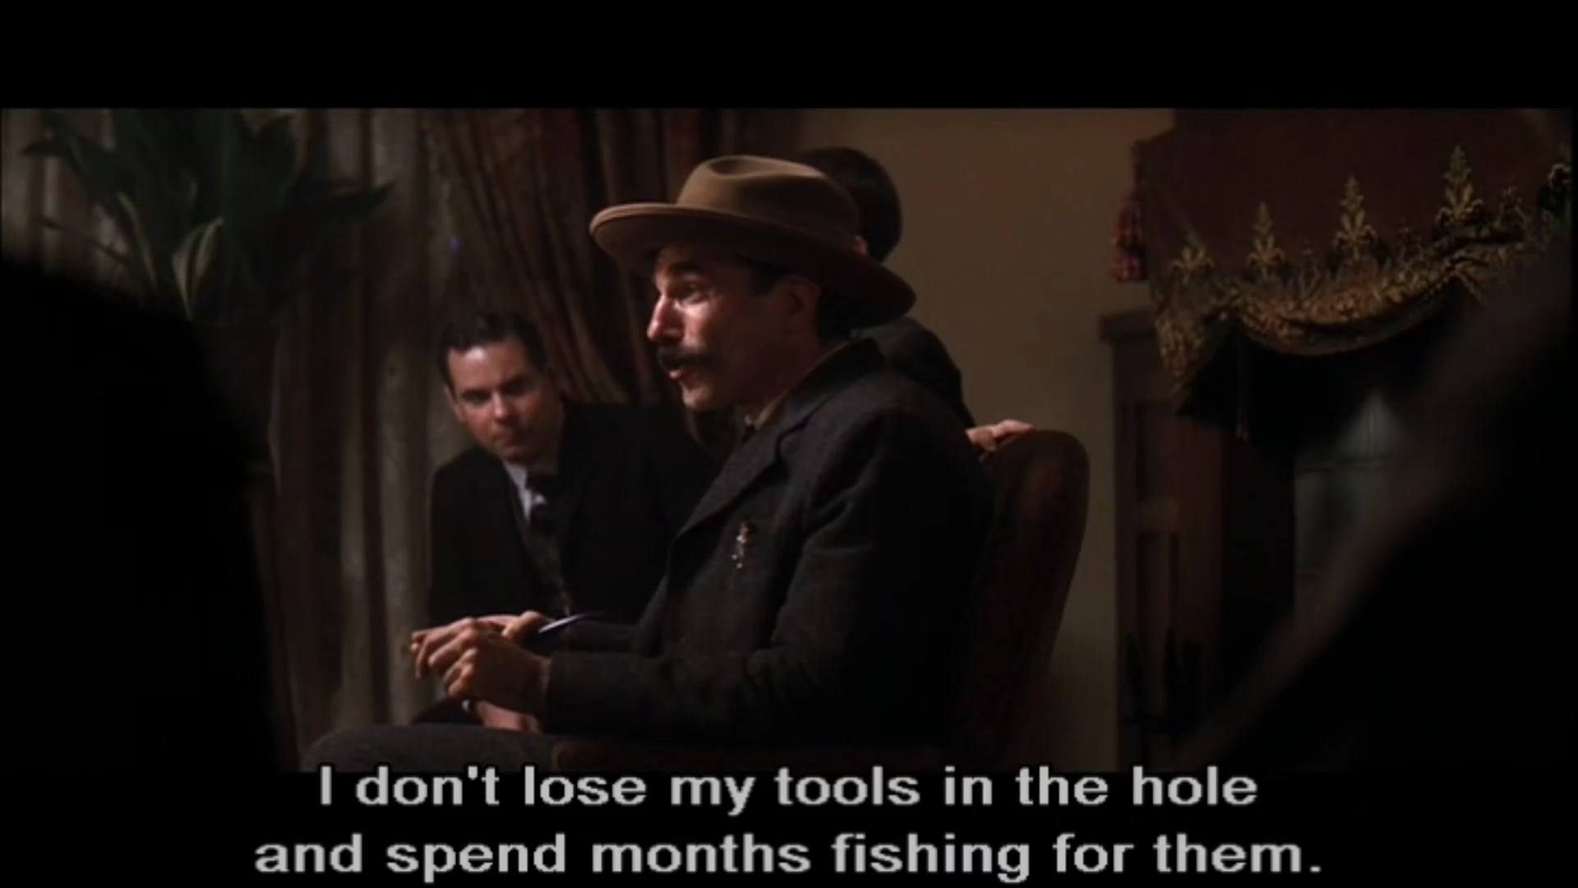
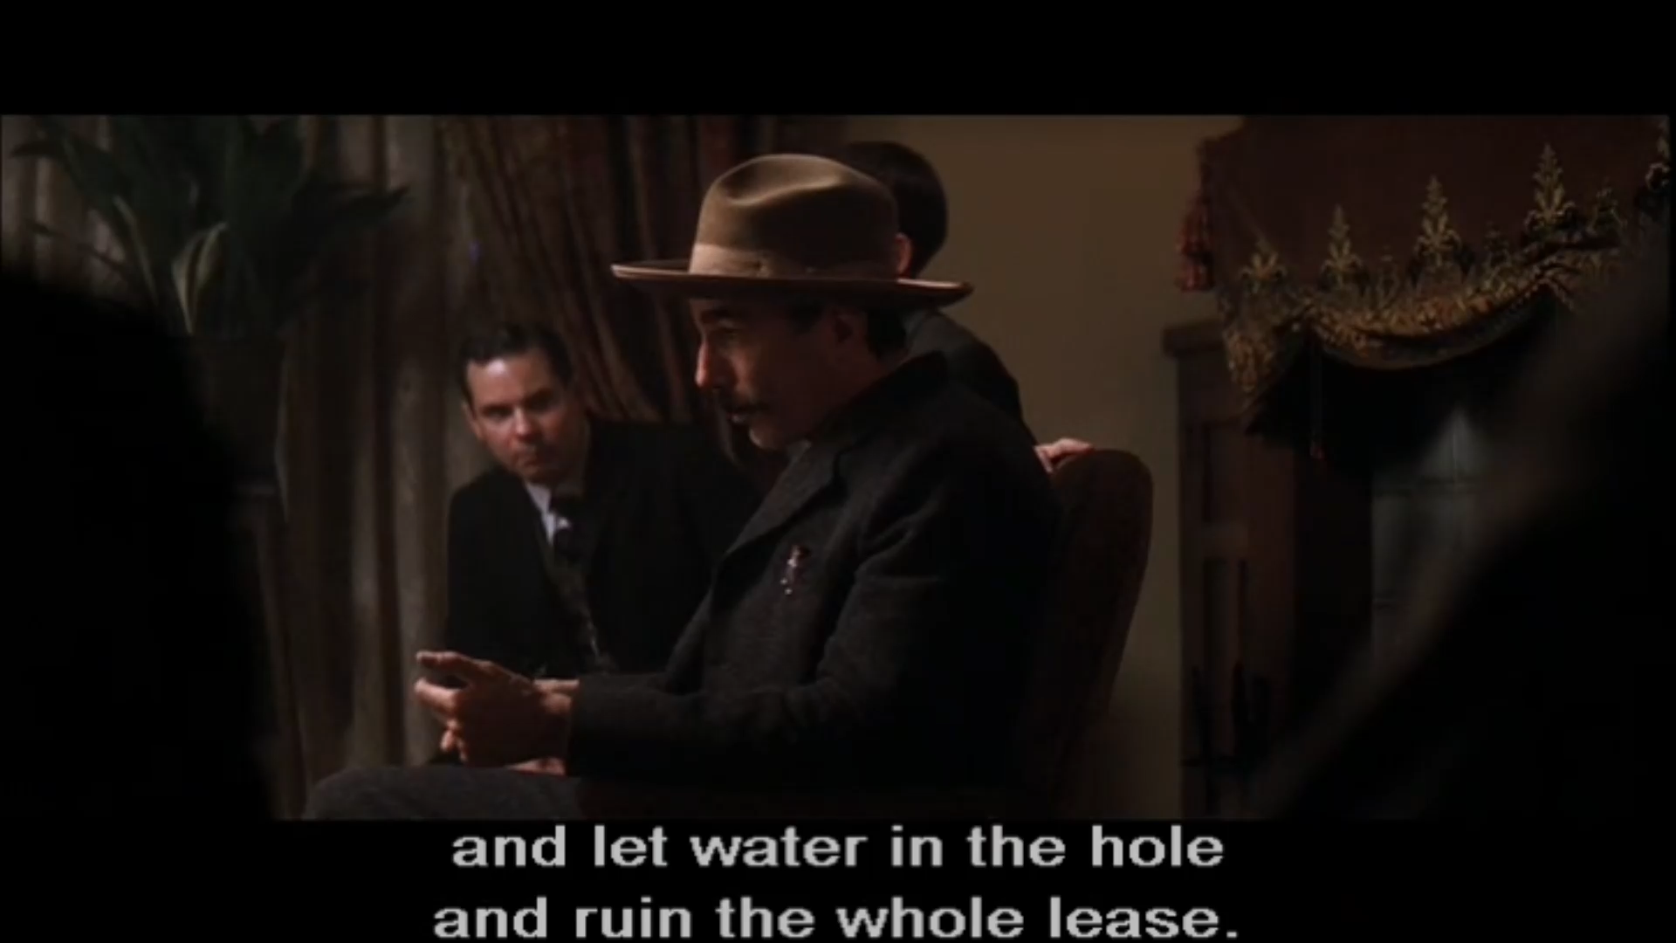
The Oil Business, 1911
Oilmen vs Speculators
Coyote Hills, California
Fishing for tools
Botched cement job to keep water out
Lumber for derricks
WATCH IT!

Slide 12
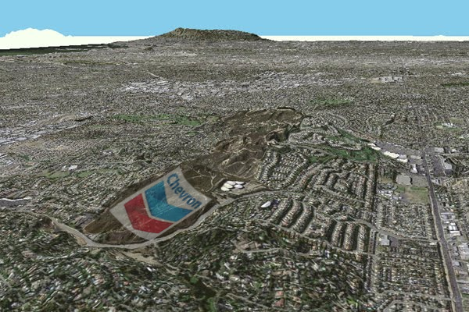
West Coyote Hills
Orange County, California
1870’s discovery
1890’s a major oil field

Slide 13
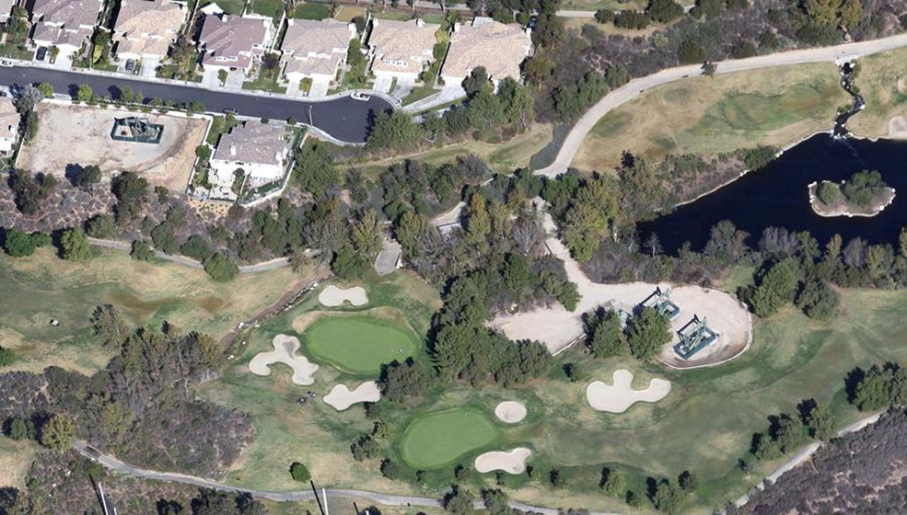

Slide 14
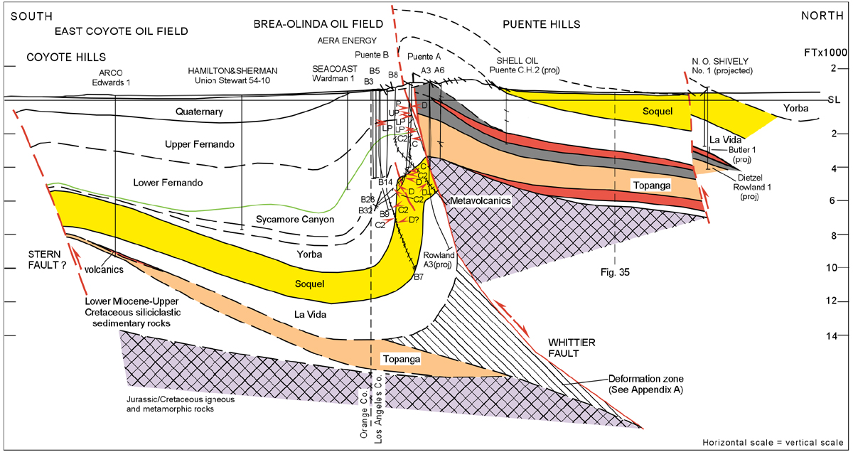

Slide 15
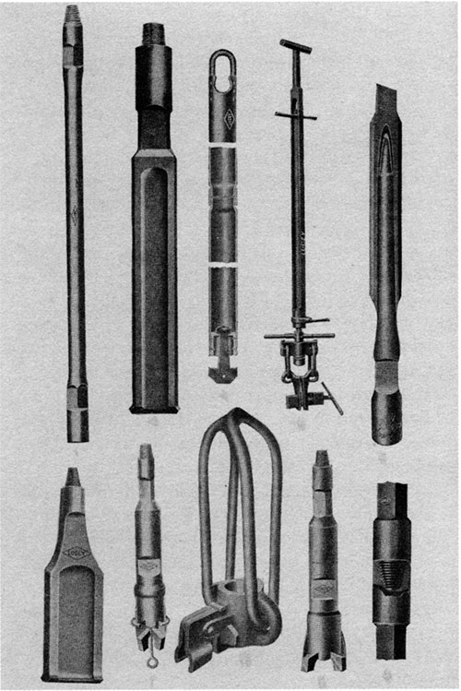
Fishing tools

Slide 16
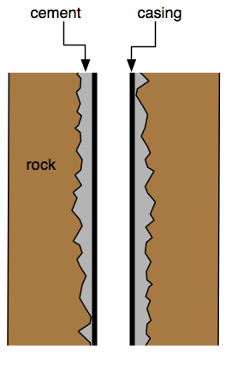
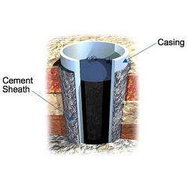
Cementing oil wells
VIDEO

Slide 17
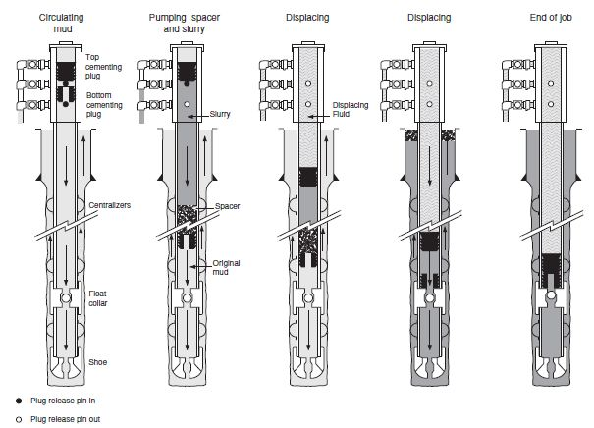
Cementing: Deepwater Horizon Blowout

Slide 18
First Cement Job in California
Lompoc Oil Field

Slide 19
Distance and Money
Further from discovery
Deeper, harder to reach
1/6th royalty
“We have to act quickly because very soon these fields will be dry”
WATCH IT!

Slide 20
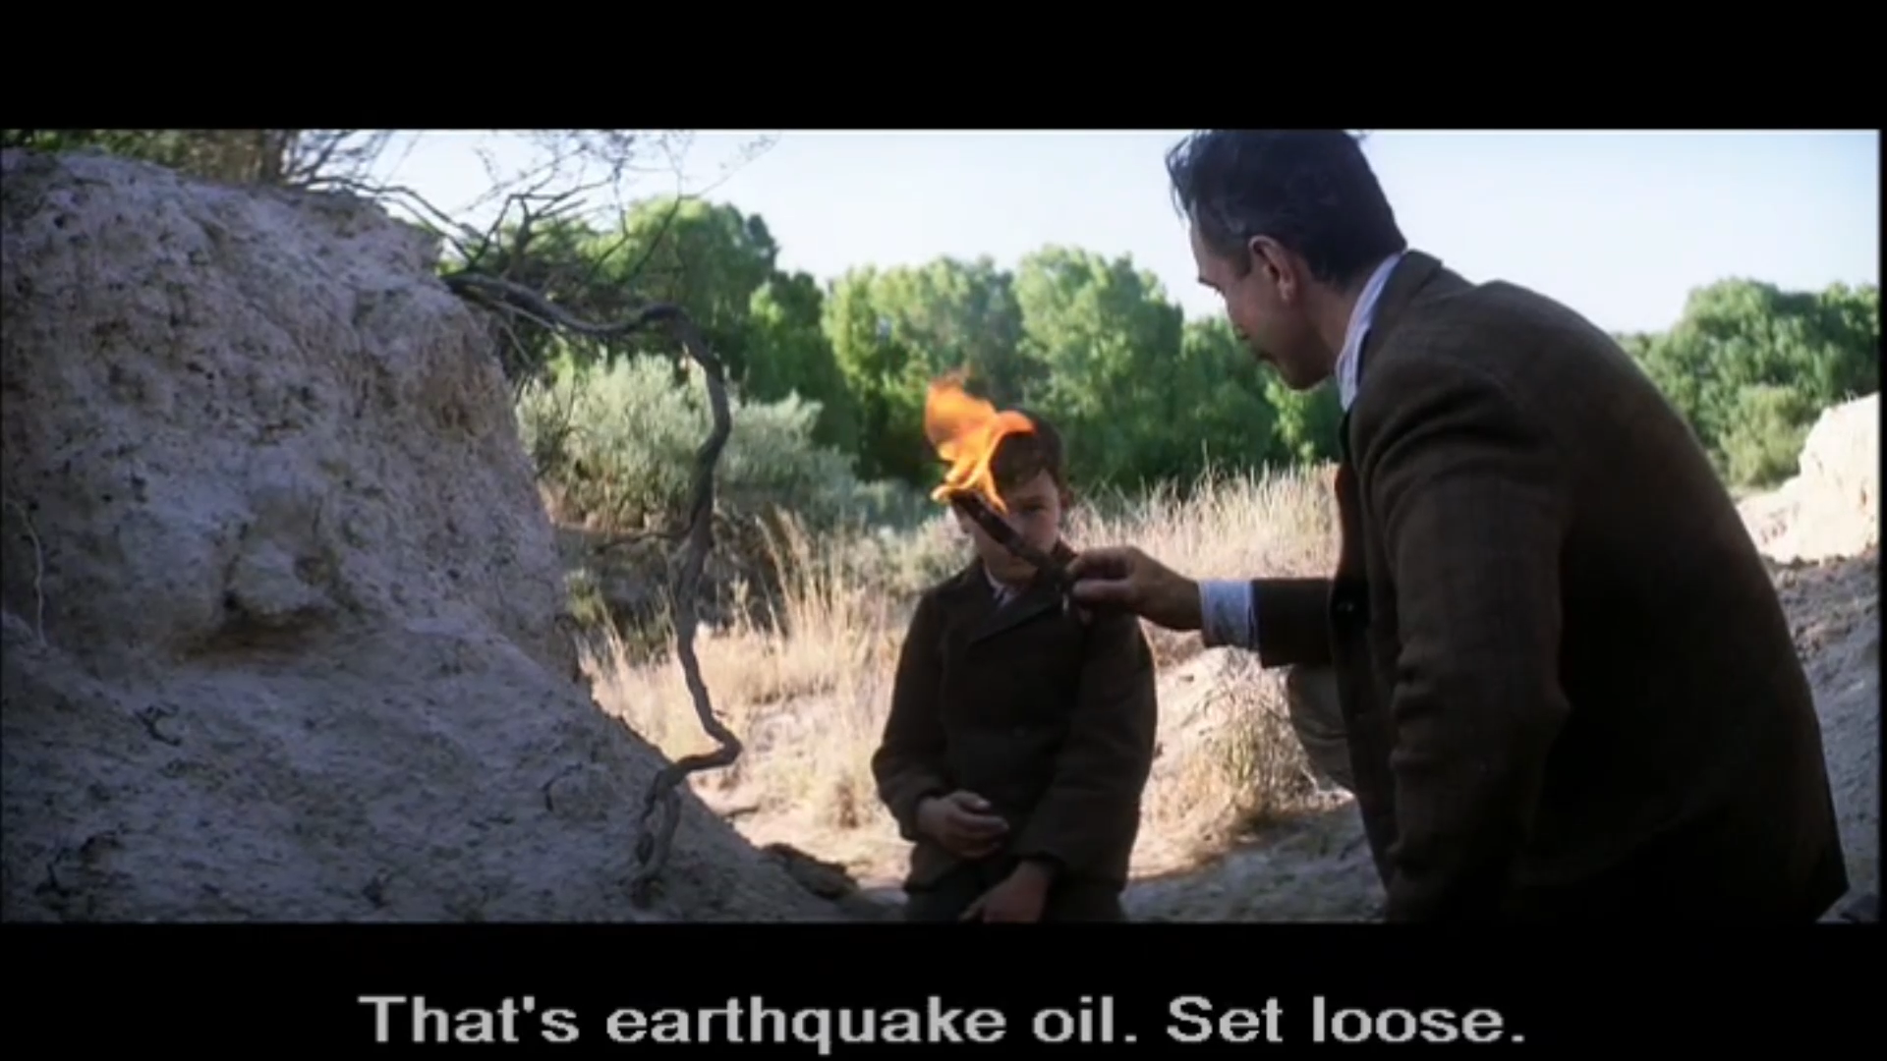
Seeps clue to oil fields
Look a my shoe!
Oil Seeps
Test with match
Earthquake oil, set loose
Shipping costs
Oil Prices vs Quail Prices
WATCH IT!

Slide 21
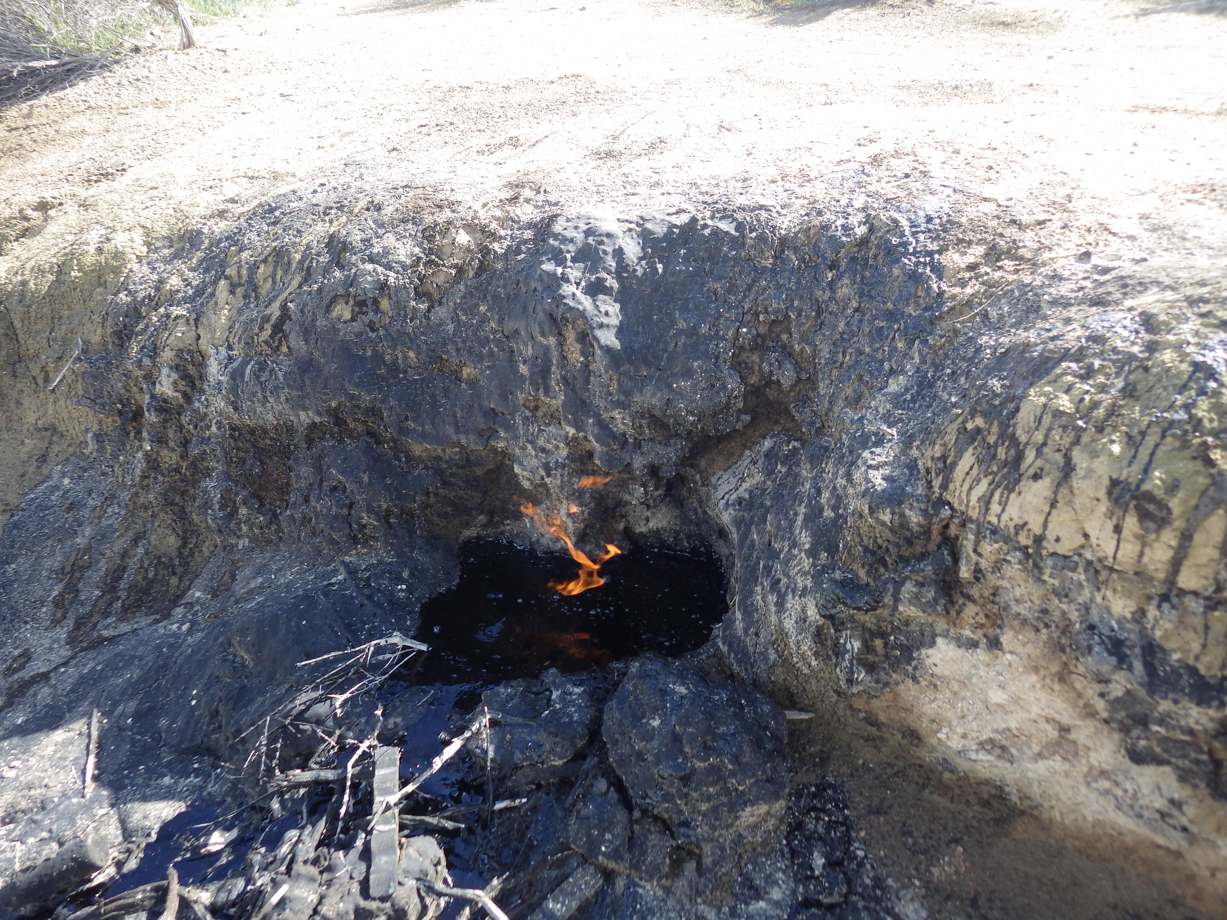
Oil Seeps

Slide 22
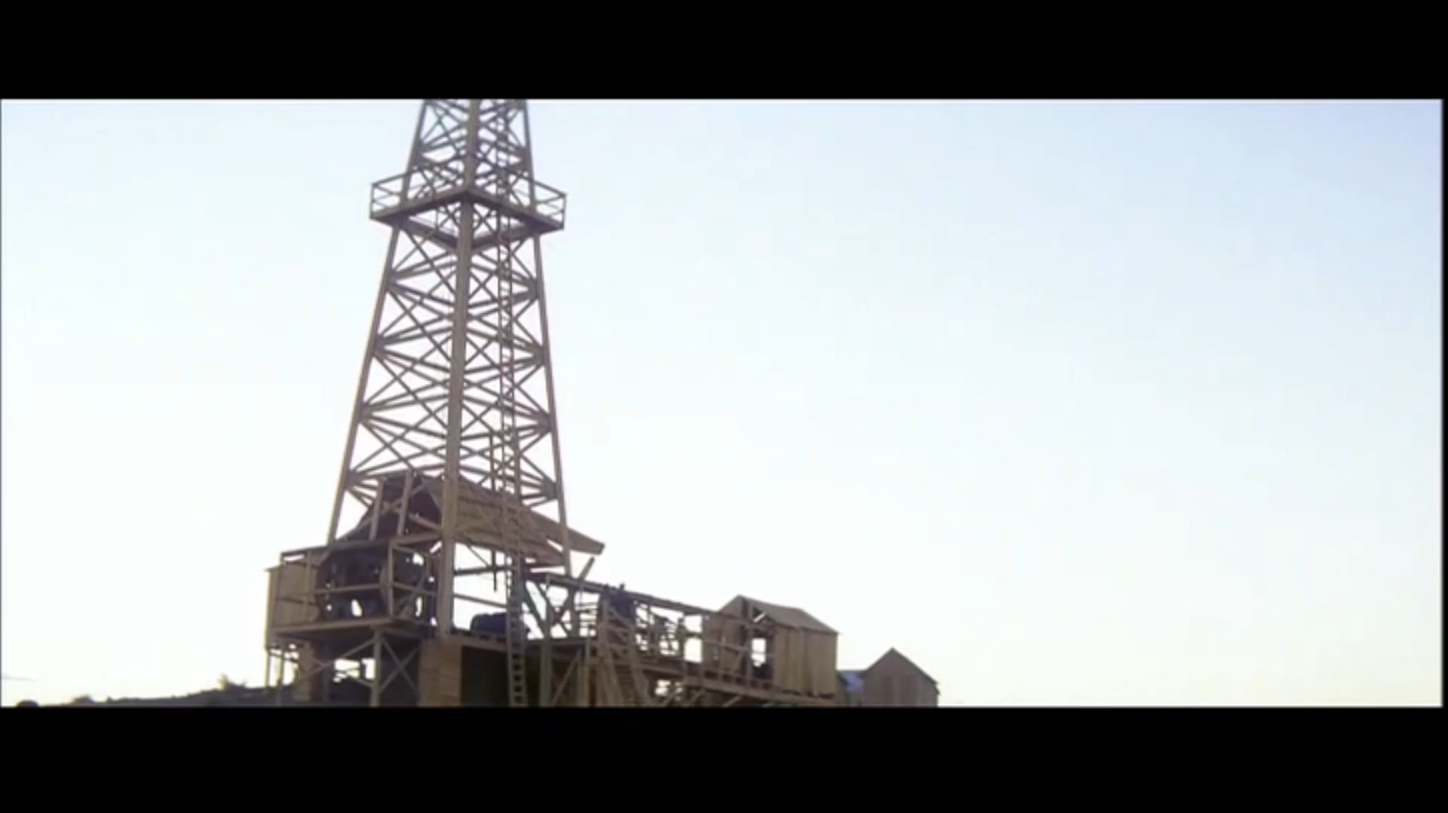
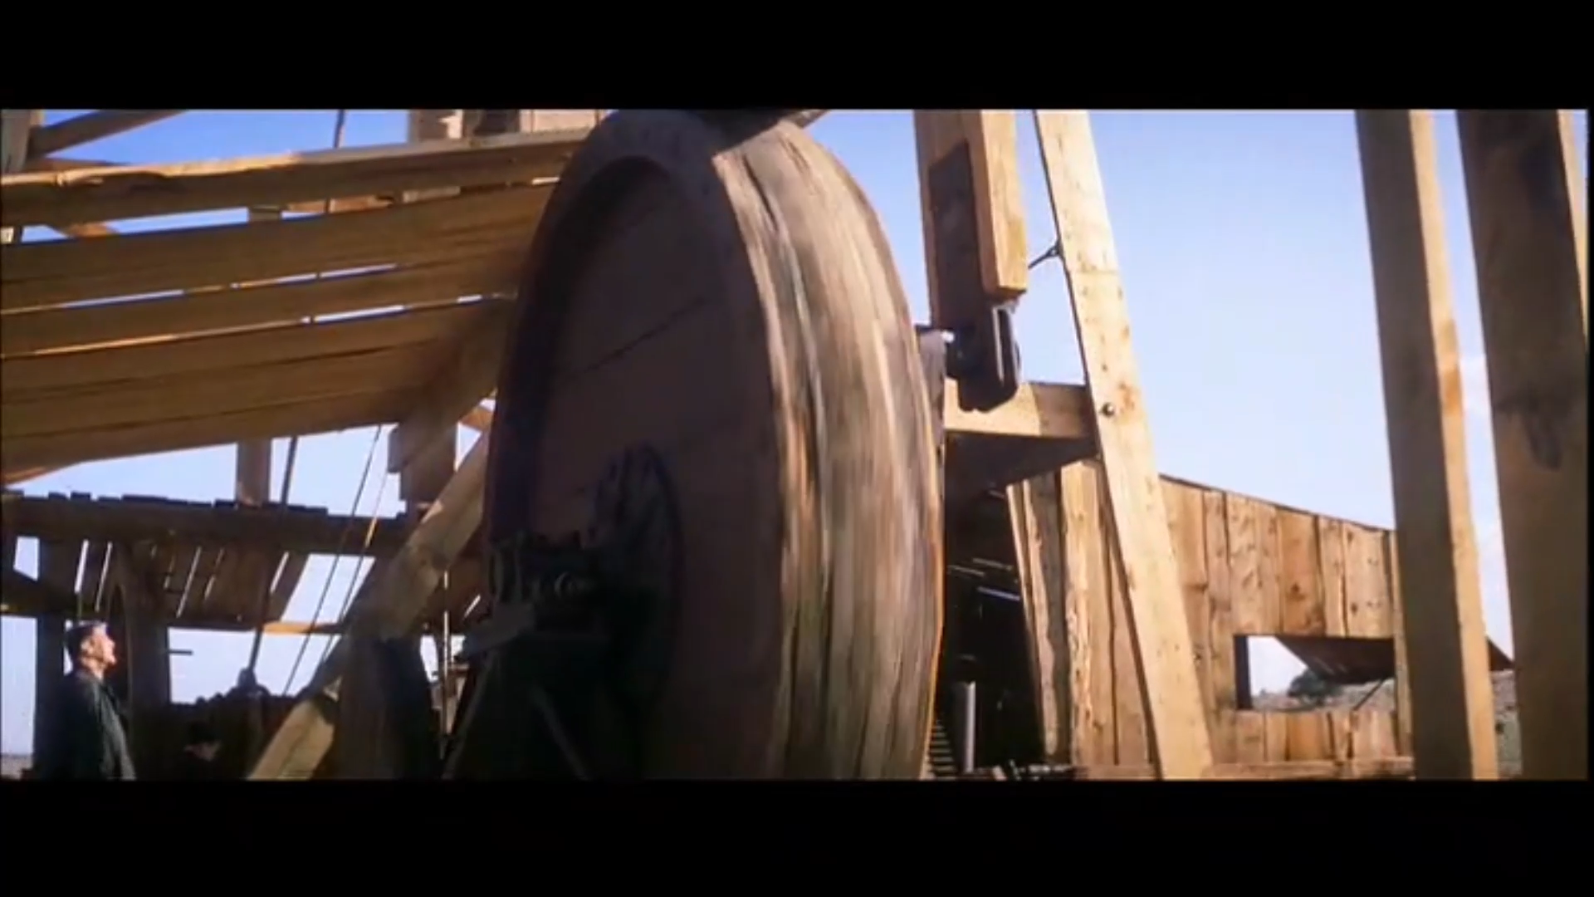
Oil Well Drilling
Wooden derrick
Cable tool
WATCH IT!

Slide 23
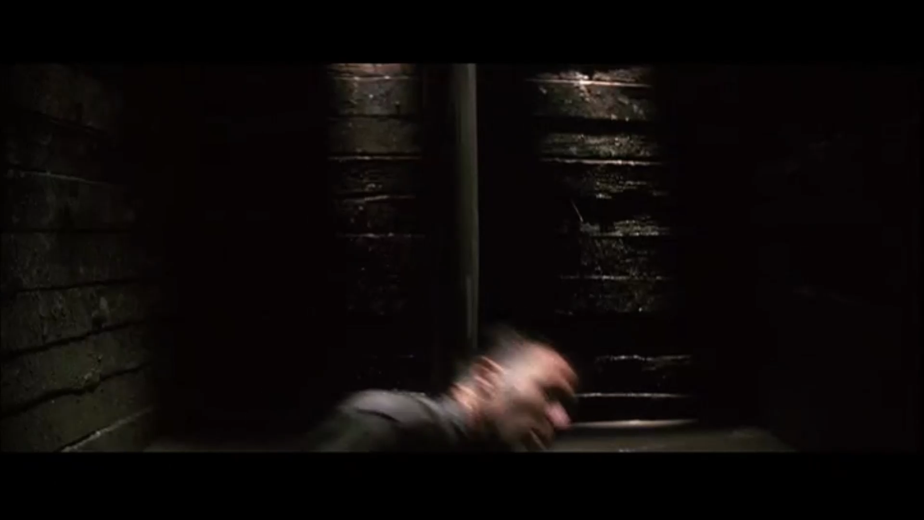
Lost a Man down the well
No OSHA
No Hard Hat
WATCH IT!

Slide 24
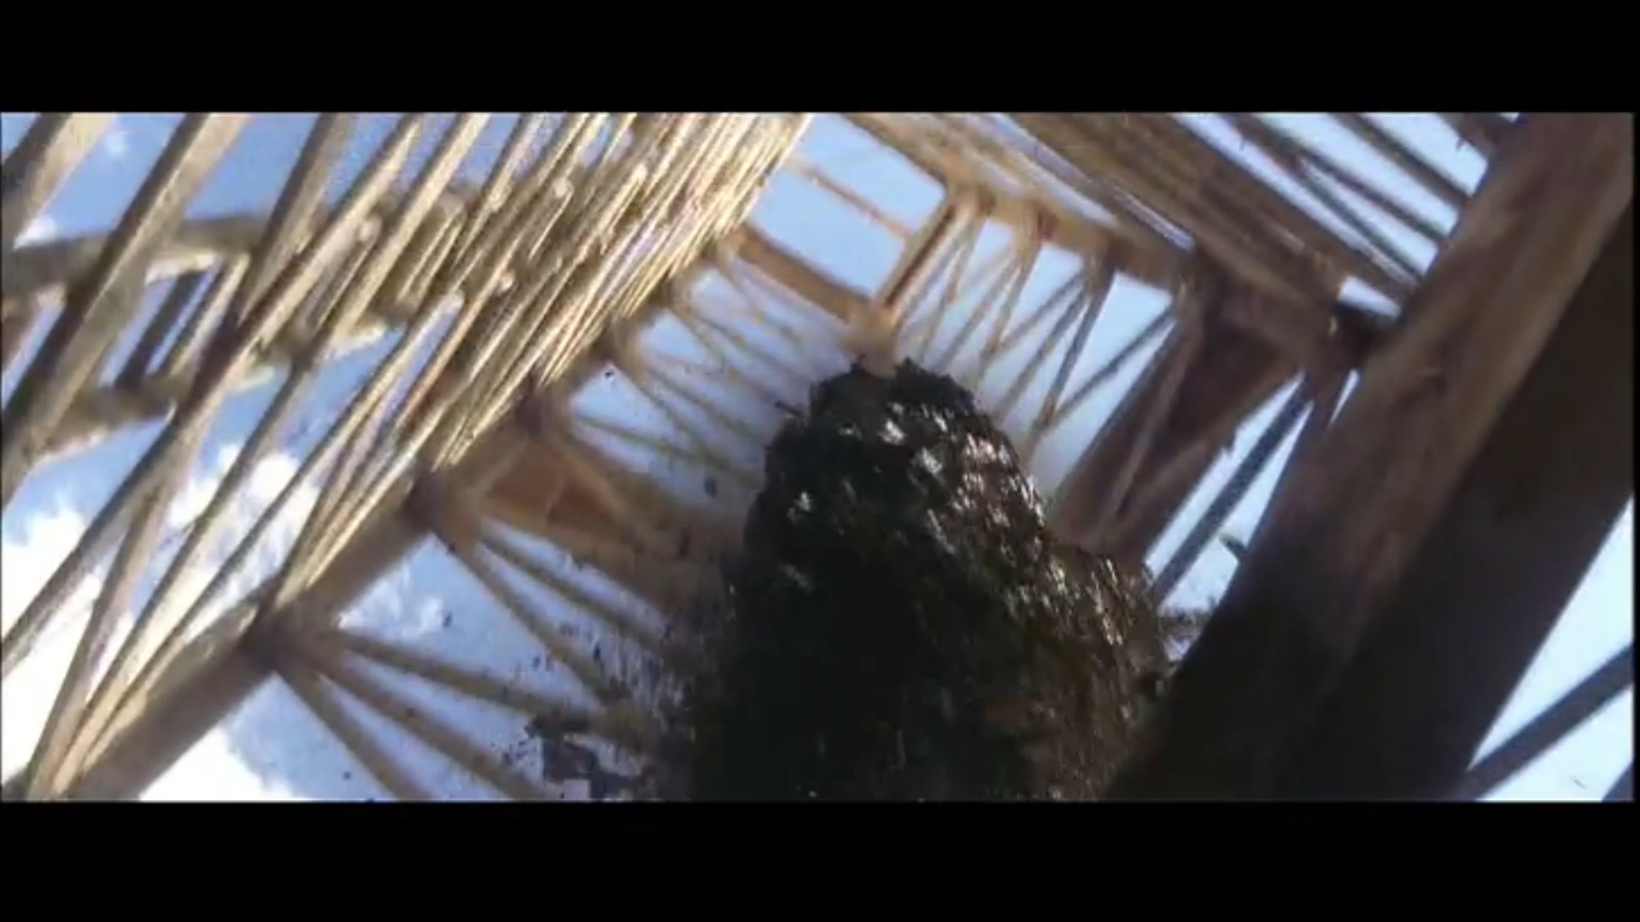
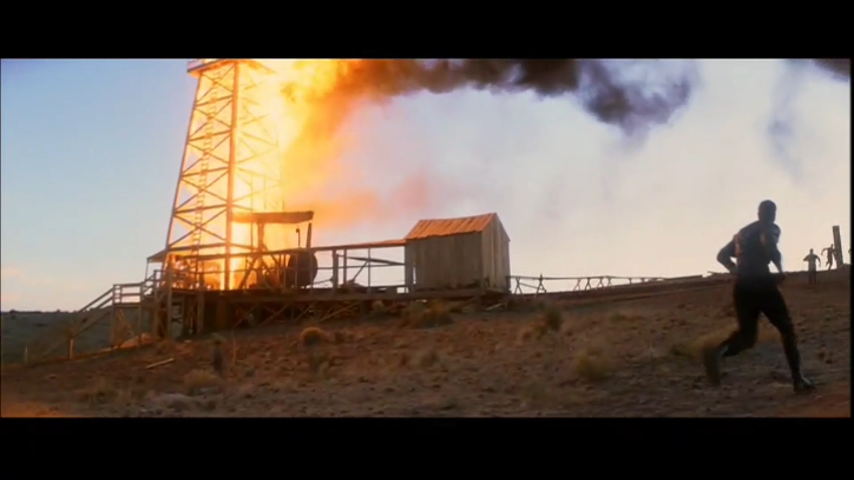
Gas, Oil, Fire
Lights Out!
Gas, then oil
No blow out preventers!
WATCH IT!

Slide 25
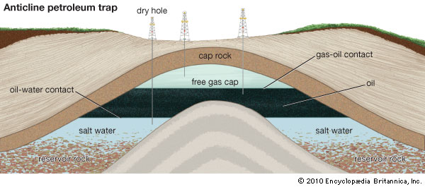
Anticlines and Oil
Gas on top of
Oil on top of
Water

Slide 26
Kill Fire with Dynamite
Load barrels with dynamite
Push into well
Run like hell!
WATCH IT!
(residual fire would probably have re-ignited it)

Slide 27
Pipeline Construction, 1927
Save on railroad shipping costs
Join the Church of the 3rd Revelation
Deal with Union Oil
WATCH IT

Slide 29
California Pipelines

Slide 30
Bandy Oil Prospect
Little Boston Oil Field (fictional)
Conditions
$100,000 signing bonus
Confessions
WATCH IT!

Slide 31
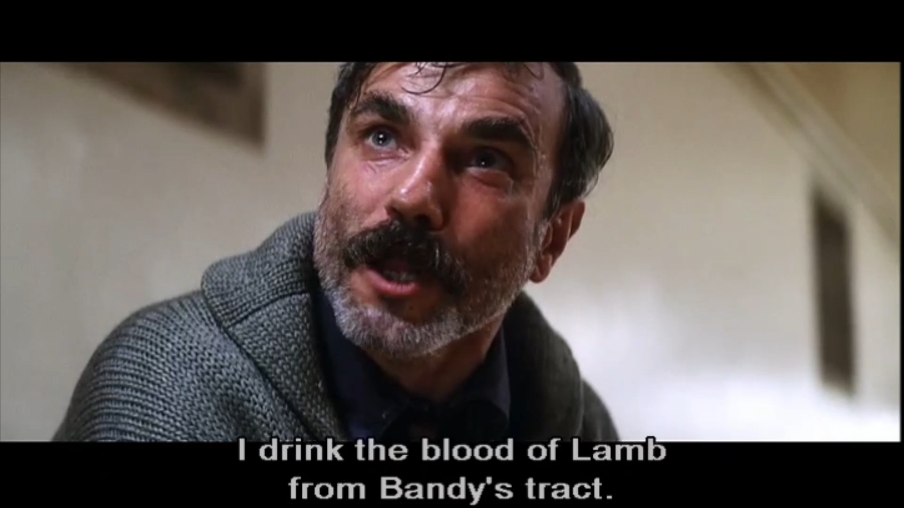
Drainage
“Those areas have been drilled”
WATCH IT!

Slide 33
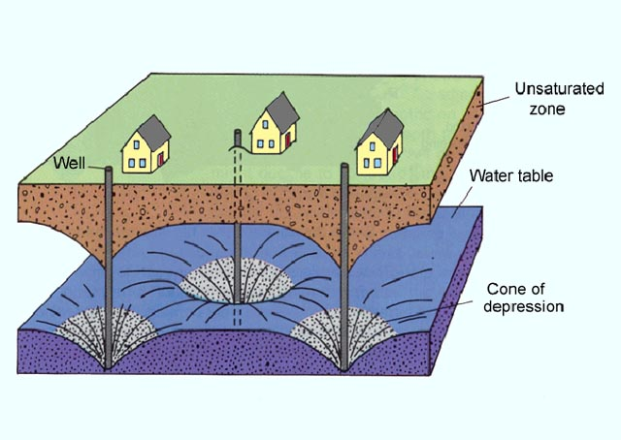

Slide 34
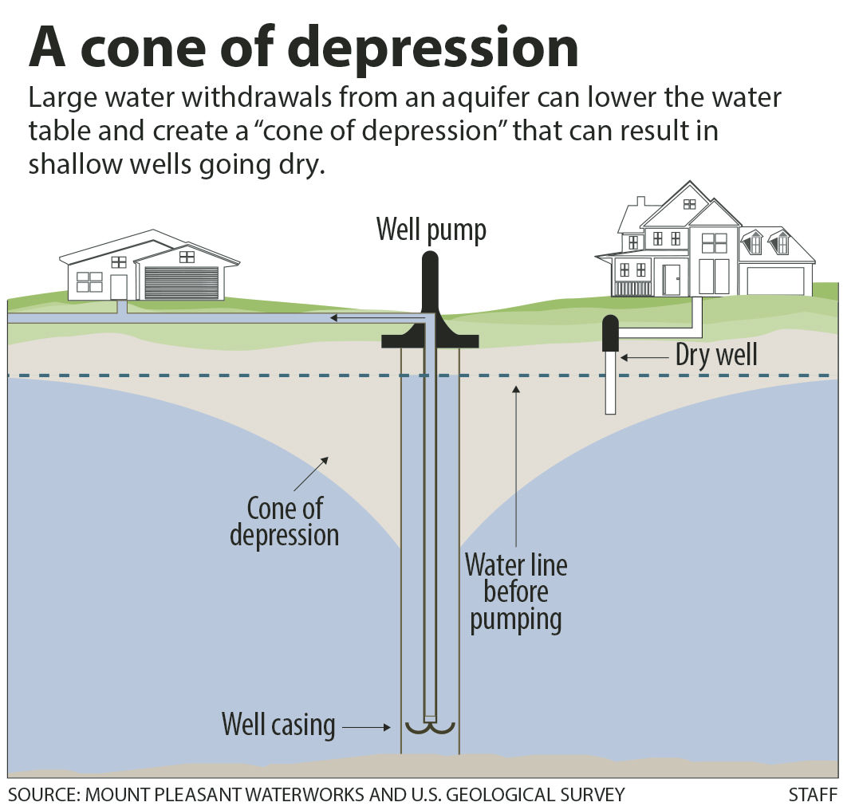

Slide 35
